Slide 1

Designing Distributed Systems
Chapter 12
焦 媛
2019年6月

Slide 2
Result Aggregation
The previous chapter described a number of patterns for splitting and chaining queues together to achieve more complex batch processing.
But it is equally important to pull multiple outputs back together to generate the aggregate output。

Slide 3
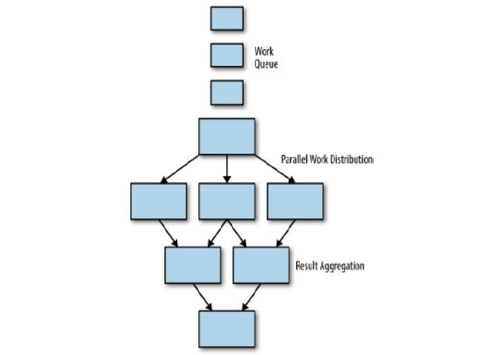

Slide 4
Join(or Barrier Synchronization)
Barrier synchronization:
In parallel computing, a barrier is a type of synchronization method. A barrier for a group
of threads or processes in the source code means any thread/process must stop at this point
and cannot proceed until all other threads/processes reach this barrier.
Join :
Join is similar to joining a thread. The basic idea is that all of the work is happening in parallel,
but work items aren’t released out of the join until all of the work items that are processed.

Slide 5
Join(or Barrier Synchronization)
// 主线程
public class Father extends Thread {
public void run() {
Son s = new Son();
s.start();
s.join();
...
}
}
// 子线程
public class Son extends Thread {
public void run() {
…
}
}

Slide 6
Join(or Barrier Synchronization)
特点：
The value of the join is that it ensures all of the data in the set is present.
This reduces the parallelism that is possible in the batch workflow, and thus increases the overall latency of running the workflow.

Slide 7
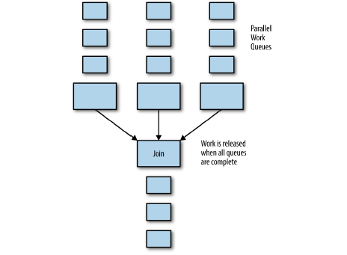

Slide 8
Reduce
If sharding a work queue is an example of the map phase of map/reduce algorithm, then what remains is the reduce phase .
It is similar to join; that is, to group together the parallel output of a number of different batch operations on different pieces of data
However, reduce does not wait until all data has been processed.
It reduces the total number of outputs ,and it reduces the data from a complete data item .
The reduce phase can be repeated as many times as necessary to successfully reduce the output down to a single output.

Slide 9
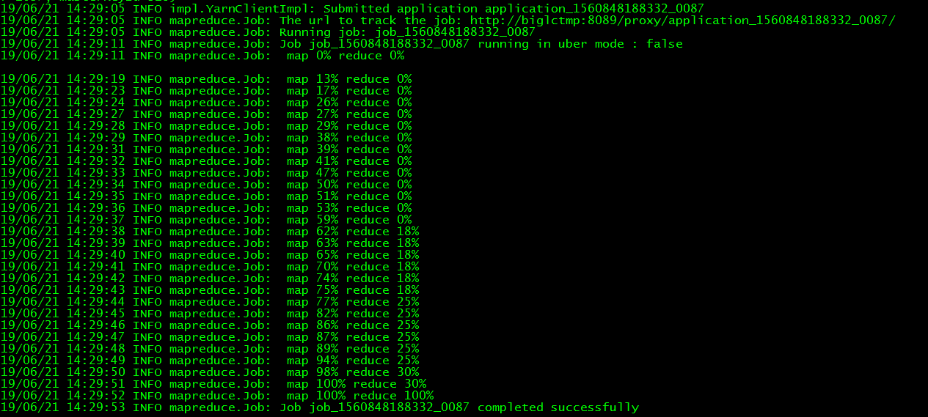
Reduce

Slide 10
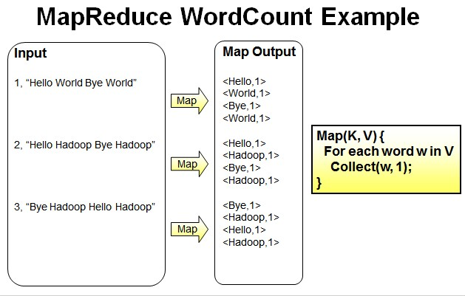
Hands On: word count

Slide 11
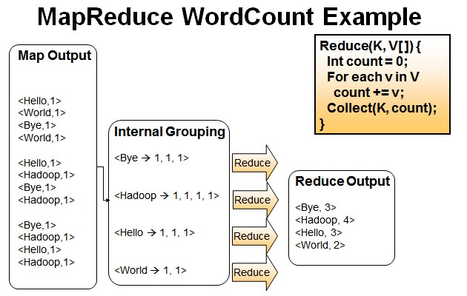

Slide 12
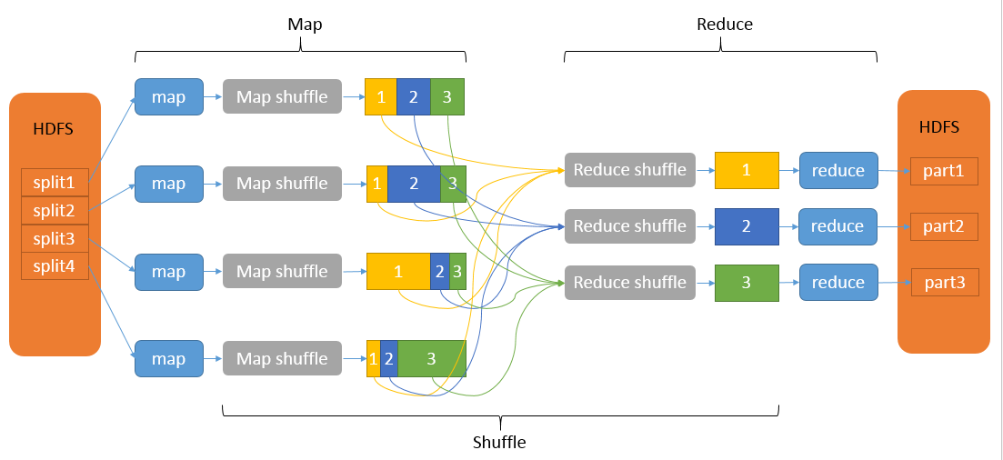

Slide 13
Hands On: Sum
For example, you want to sum the total population of the United States. Assume that you will do this by measuring the population in every town and then summing them all together.
But it’s clear that even when distributed in parallel, it would take a single person a long time to count the number of people in every town. Consequently, we perform a second sharding to another set of work queues, this time by county.

Slide 14

Hands On: Histogram
Consider that while we are counting the population of the United States via parallel sharding/mapping and reducing, we also want to build a model of the average American family. To do this, we want to develop a histogram of family size; that is, a model that estimates the total number of families
with zero to 10 children.

Slide 15
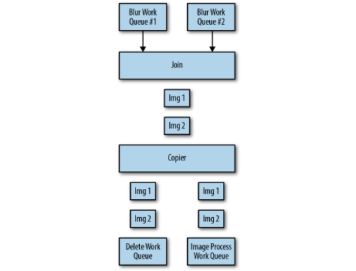
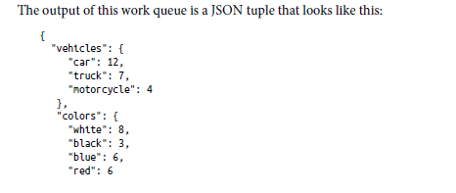
Hands On: An Image Tagging and Processing Pipeline

Slide 16





THANKS!

