Slide 1

Designing Distributed Systems
Chapter 7
焦 媛
2019年5月

Slide 2
Scatter/Gather 分散收集模式
该模式特点：
Scatter/gather requests are farmed out to all the replicas in the system
Each replica does a small amount of processing and then returns a fraction of the result to the root
The root server then combines the various partial results together to form a complete response
将请求分发到不同的服务器上分布式处理，最后将各个服务器的处理结果汇总到根节点，最后返回给客户。是一个分布式计算的过程。

Slide 3
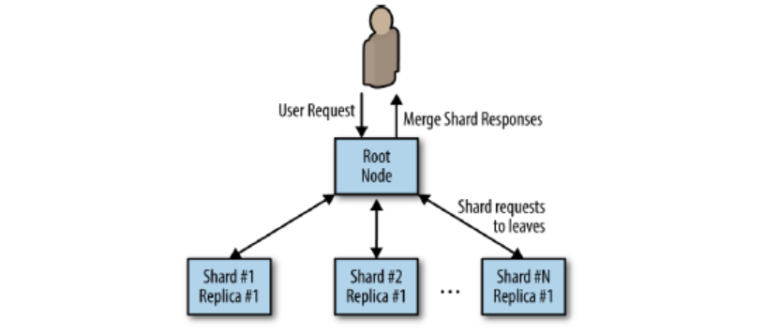

Slide 4
Scatter/Gather 实现（1）-- 请求分片分发
描述：
Each leaf is entirely homogenous
But work is distributed to a number of different leaves in order to improve performance
The problem can be broken up into different pieces and each piece can be put back together with all of the other pieces to form a complete answer
特点：
Improve overall latency requests
If a leaf node responds slowly，root can dynamically redistribute load to assure a fast response
Can not scale beyond an amount of data that can be held in the memory or disk of a single machine

Slide 5
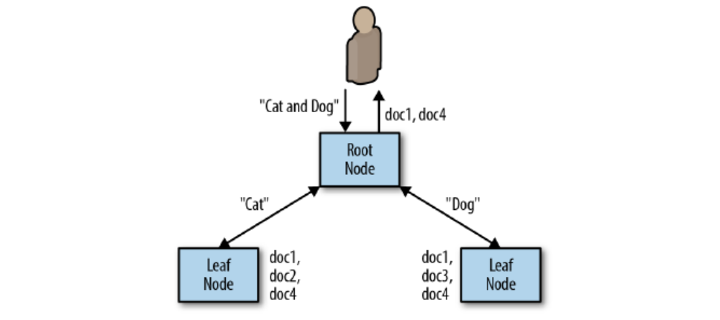

Slide 6
Scatter/Gather 实现（2）-- 数据分片存储
描述：
The request is sent to all of the leaf nodes(or shards)
Each leaf node processes the request using the data loaded in its shard
This partial response then returned to the root node , and the root node merges all the responses together.
数据存储：
The data is too large to fit in the memory of a single machine
Use some items such as the document id to modulo the total number of the shards to determine the data location.
ES中：
shard = hash(routing) % number_of_primary_shards （ ES中 routing默认是文档的_id，可以自定义 ）
Notes:
数据分布式存储在所有的节点上，每个节点计算结果，根节点对结果进行合并。
数据根据一定的hash算法分布式存储，例如特定的值对shard数进行取模

Slide 7
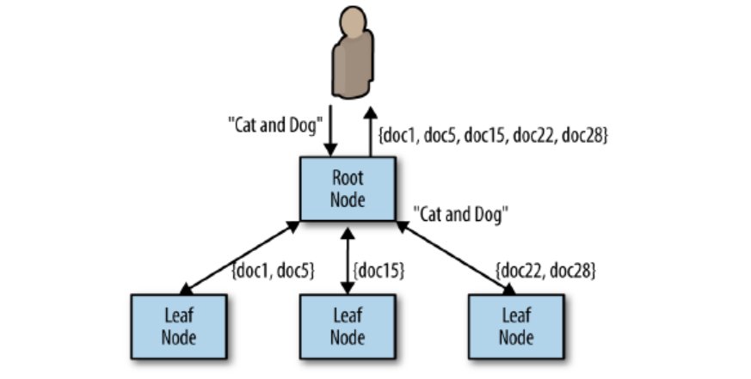

Slide 8
Choosing the Right Number of Leaves
Increased parallelism dos not always speed things up, choosing the right number of leaf nodes is critical to designing a distributed system.
Processing any particular request has a certain amount of overhead , such as the time spent parsing requests , sending HTTP across the wire ,merging various of responses .
As parallelization continues, the overhead eventually dominates the compute cost of the business logic.
The “straggler” problem (短板效应）
The performance of 99th percentile is more important than in other systems because each request actually becomes numerous requests to the service
0.99*0.99*0.99*0.99*0.99 == 0.95
ES中默认一个索引5个主分片
Notes:
虽然跨分片查询是并行的，但是
1）请求分发、结果合并都是需要消耗性能和时间的
2）某些落后的节点会拖慢整个作业的性能，算法：
3）%99的性能可靠性在本架构下十分重要

Slide 9
Scaling Scatter/Gather for Reliability and Scale
A single replica of a sharded scatter/gather system：
If one replica fails, all requests will fail because all requests are required to be processed by all
leaf nodes
Upgrade while under user-facing load is no longer possible
总结：
Given these challenges of reliability and scale, the correct approach is to replicate each of the
individual shards .
ES 中默认一个主shard，一个副本shard
Notes:
1）访问该副本数据的作业就会失败
2）滚动升级过程中，会选择部分数据分片，使得部分数据分片不可用

Slide 10
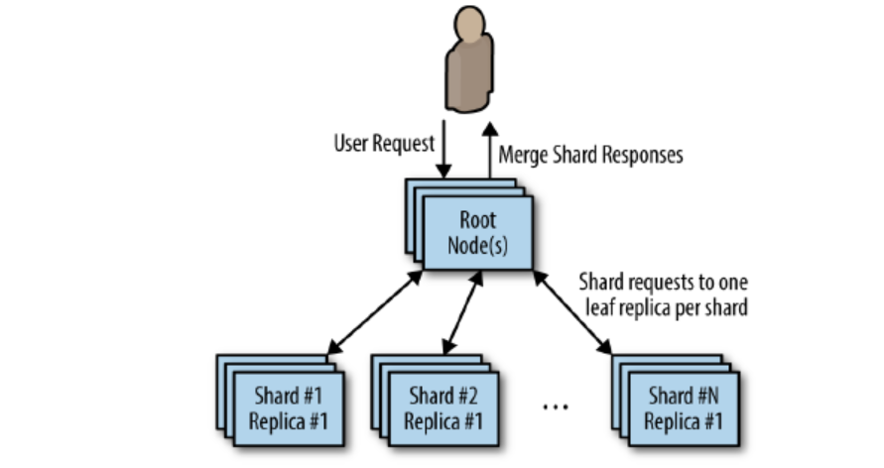
Replicated , sharded scatter/gather pattern

Slide 11





THANKS!

