Slide 1
Chapter 11. Event-Driven Batch Processing
武文齐
2019-6-14

Slide 2
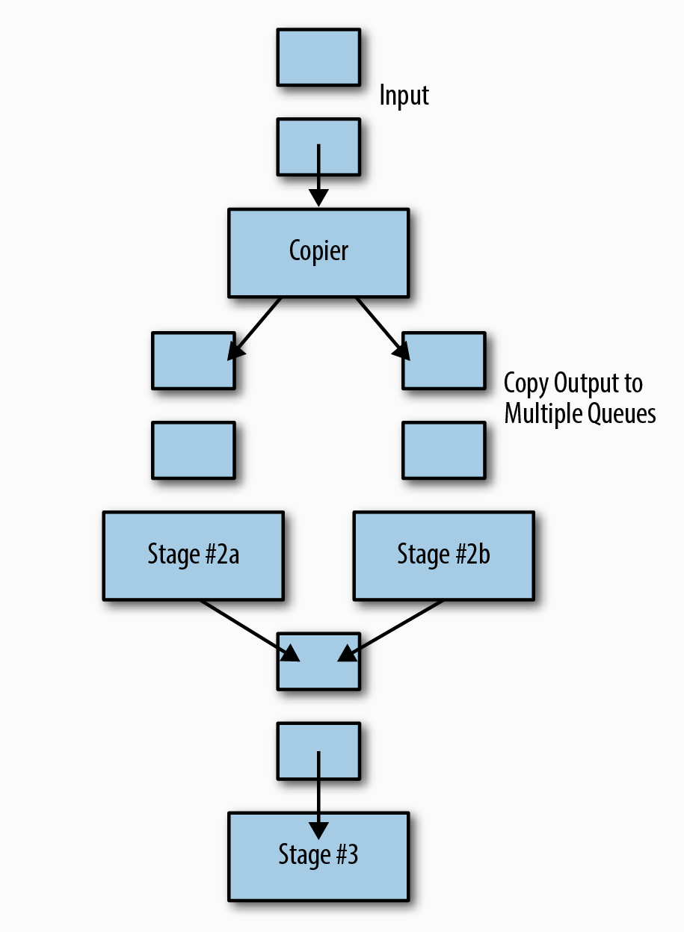
Workflow
Simplest Workflow
one input to one output
Actual WorkFlow
multiple different outputs from a single data input
perform more than a single action

Slide 3
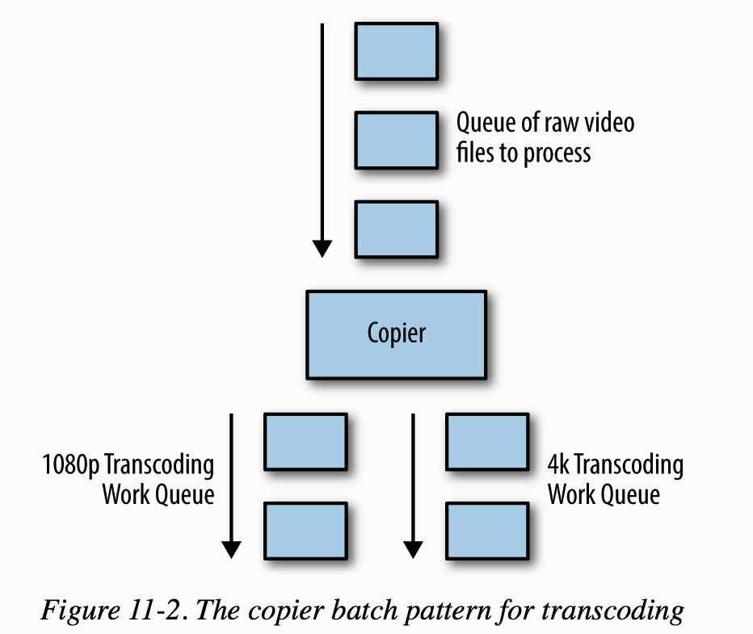
Patterns of Event-Driven Processing
Copier
Filter
Splitter
Sharder
Merger

Slide 4
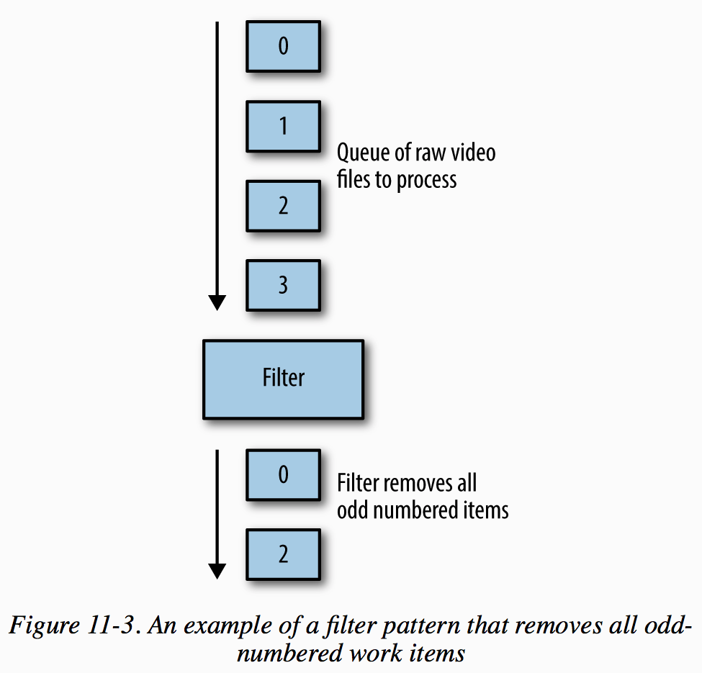
Patterns of Event-Driven Processing
Copier
Filter
Splitter
Sharder
Merger

Slide 5
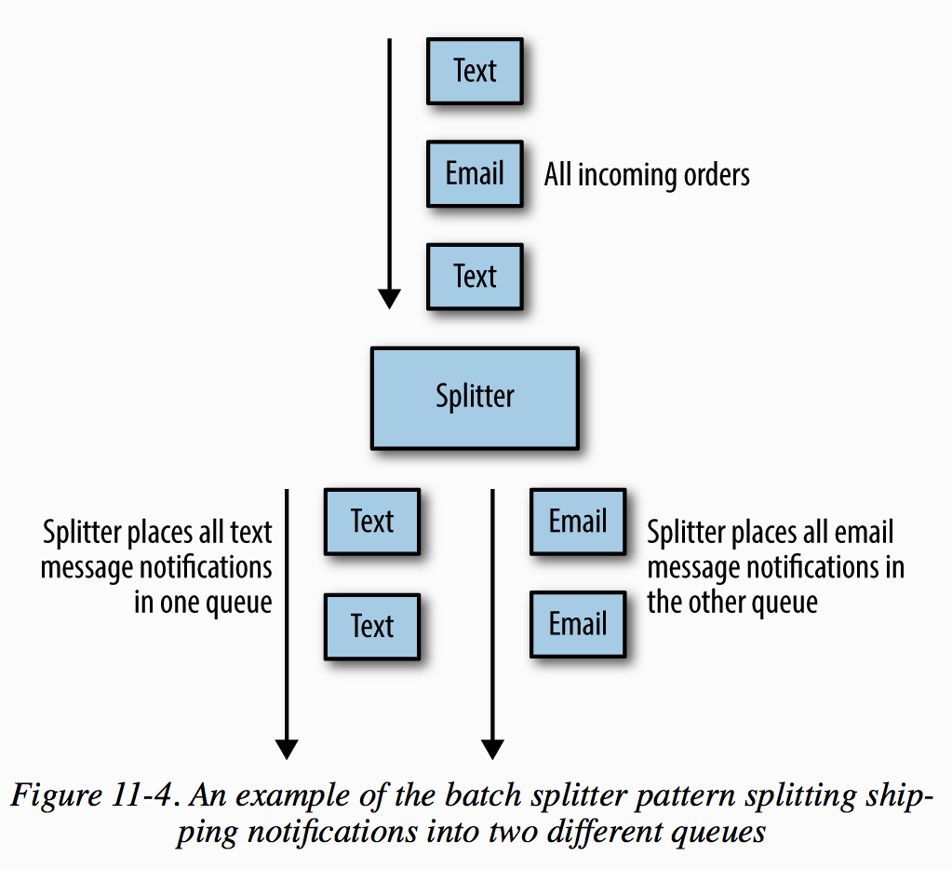
Patterns of Event-Driven Processing
Copier
Filter
Splitter
Sharder
Merger

Slide 6
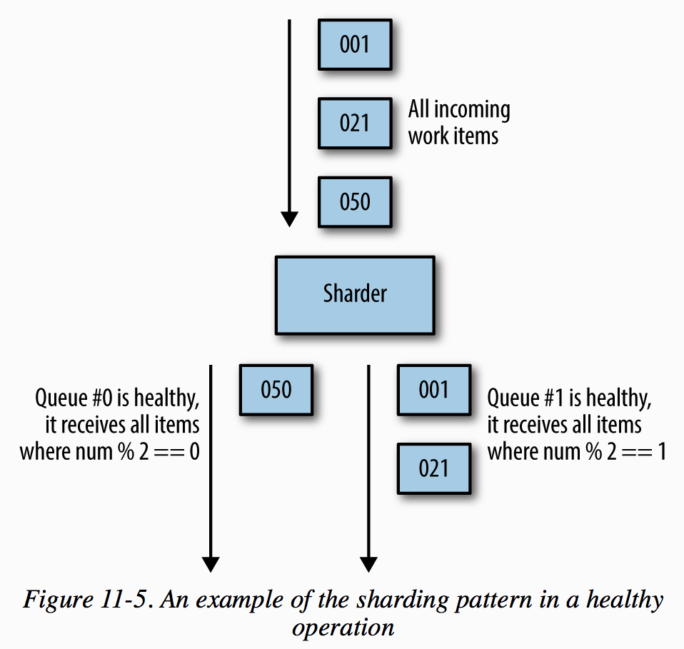
Patterns of Event-Driven Processing
Copier
Filter
Splitter
Sharder
Merger

Slide 7
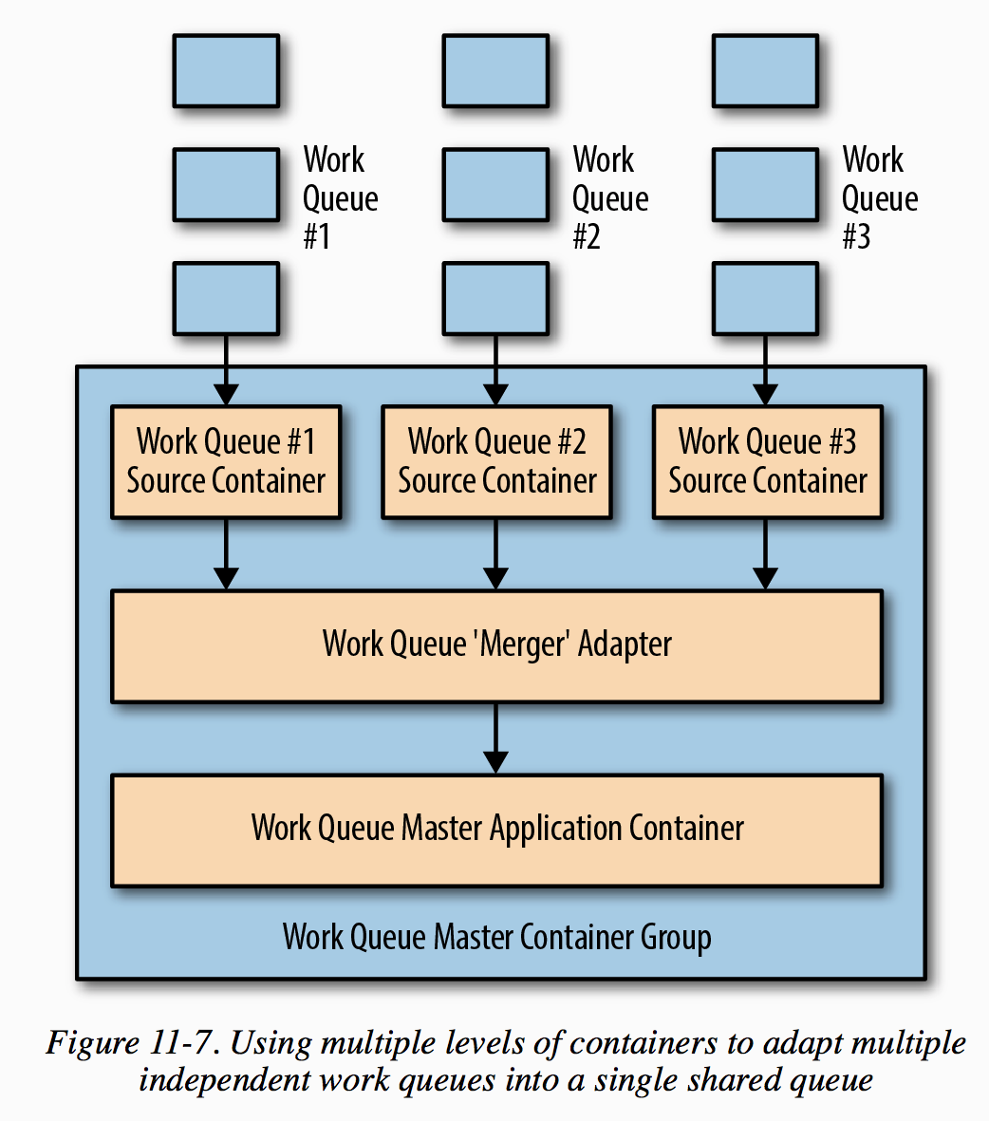
Patterns of Event-Driven Processing
Copier
Filter
Splitter
Sharder
Merger

Slide 8
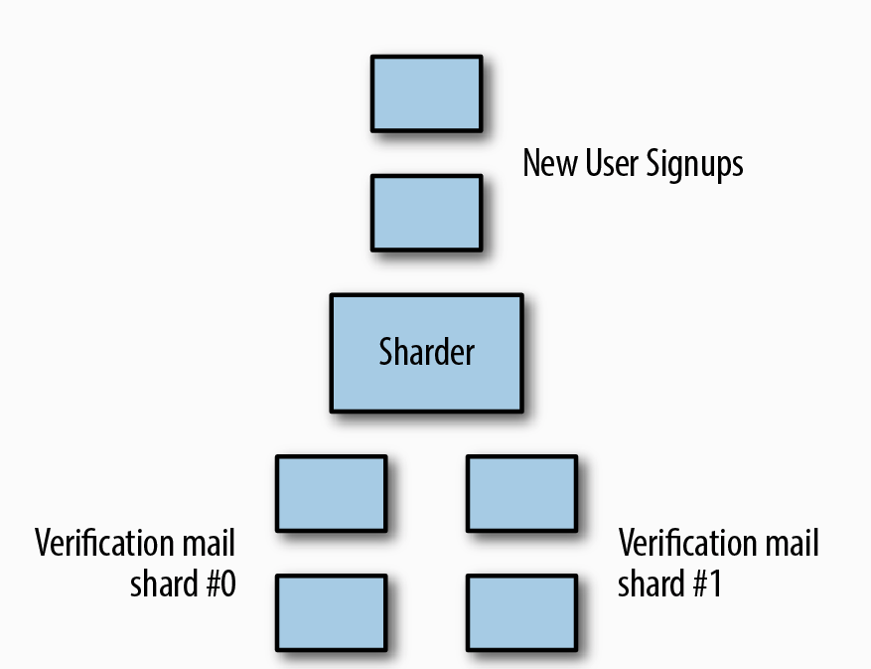
Hands On: Building an Event-Driven Flow for New User Sign-Up
The first step in the event-driven workflow is the generation of the verification email
The second step is to send welcome emails and sets up notifications

Slide 9
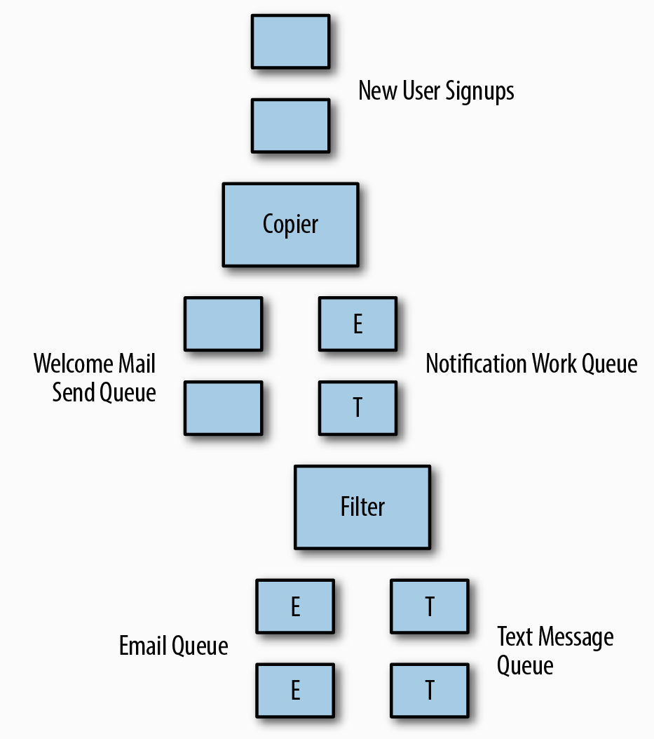
Hands On: Building an Event-Driven Flow for New User Sign-Up
The first step in the event-driven workflow is the generation of the verification email
The second step is to send welcome emails and sets up notifications

Slide 10
How to make event-driven workflow work?
Publisher/Subscriber Infrastructure:
Kafka
RabbitMQ
Patterns
Copier
Filter
Splitter
Sharder
Merger

Slide 11
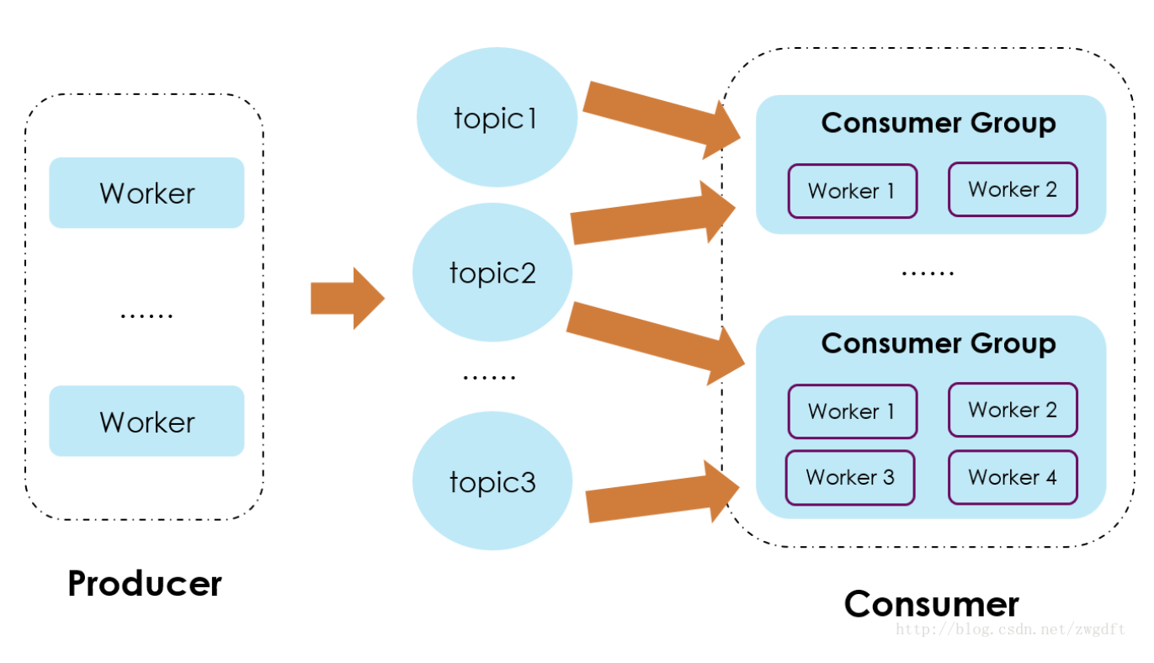
Kafka implements（1）
每个事件的数据推送到不同的topic中，即以事件名称来作为topic分类
Consumer端，建立自己的group来消费自己感兴趣的一组topic
Kafka的每个Topic、每个分区都会对应一个物理文件，当Topic数量增加时，消息分散的落盘策略会导致磁盘IO竞争激烈成为瓶颈

Slide 12
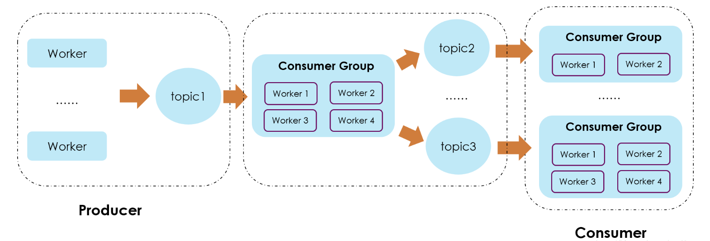
Kafka implements（2）
中间数据流处理，将数据按照订阅规则进行归类，然后写入不同的topic中
这种方式适用于数据量较大、但是Consumer端的消费group有限的情况
否则也会使Topic数量增加，进而导致磁盘IO竞争激烈，成为瓶颈

Slide 13
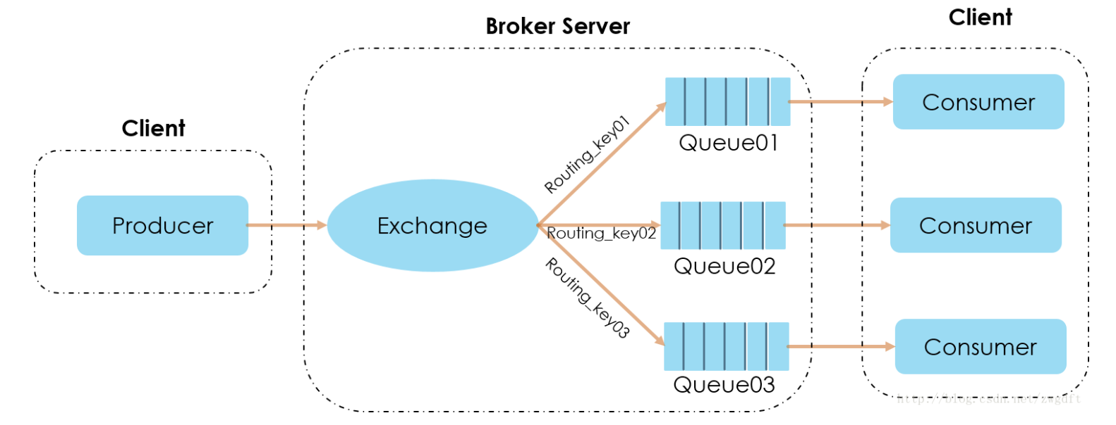
RabbitMQ implements（1）
API 接口创建Exchange，queue，以及Exchange与queue的绑定/路由规则
Exchange 与 queue是多对多关系，由Exchange的规则制定
由Exchange按照routing_key投递到对应的Queue中

Slide 14
RabbitMQ implements（2）
Exchange Type：
Direct： 消息体中的routing key == binding key, 单路或多路
Topic：支持通配符
Fanout（广播式交换器）广播
Headers： AMQP （Advanced Message Queuing Protocol）消息头中的键值对 == Exchange与queue的绑定

