Slide 1

Designing Distributed Systems
Chapter 8
黄鹏程
2019年5月

Slide 2
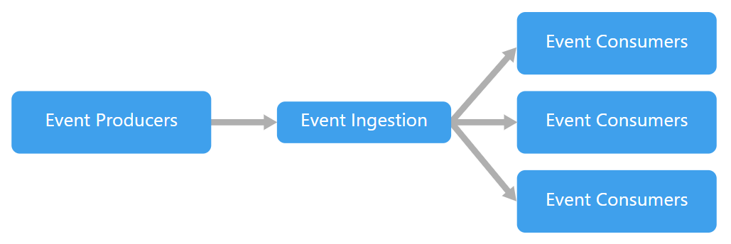
Functions and Event-Driven Processing 函数和事件驱动处理
适用场景：
Functions are executed in response to discrete events that occur and trigger the execution of the functions.
几个流行的名词：
Event-Driven：
Notes:
和request driven的比较：
The differentiation, in
my mind at least, between a request and an event have to do with the notion of ses‐
sion. Requests are part of a larger series of interactions or sessions; generally each user
request is part of a larger interaction with a complete web application or API. Events,
as I see them, instead tend to be single-instance and asynchronous in nature. Events
are important and need to be properly handled, but they are fired off from a main
interaction and responded to some time later.

Slide 3
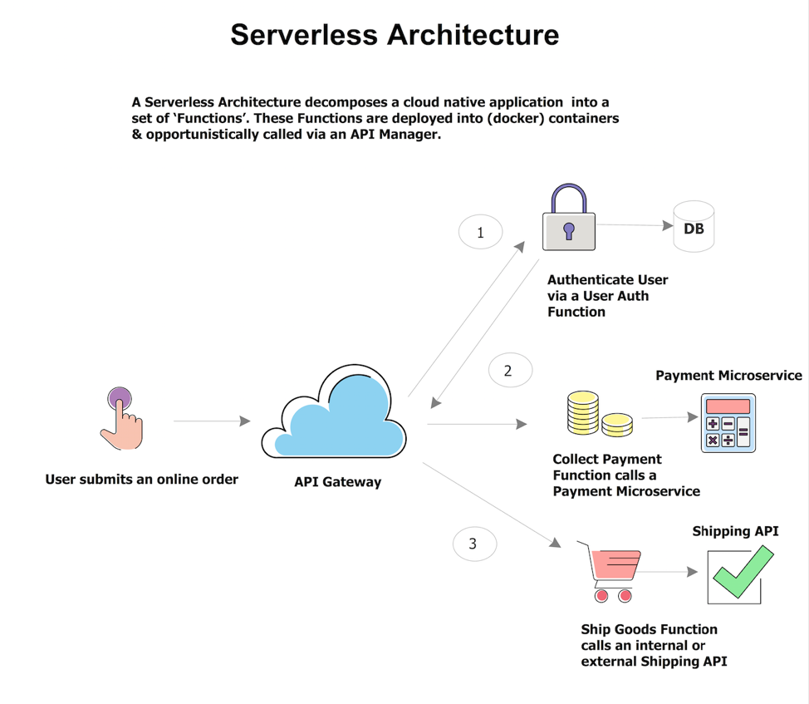
Functions and Event-Driven Processing 函数和事件驱动处理
几个流行的名词：
Serverless：服务器架构是基于互联网的系统，其中应用开发不使用常规的服务进程。相反，它们仅依赖于第三方服务（例如AWS Lambda服务），客户端逻辑和服务托管远程过程调用的组合。
Notes:
Serverless Computing is a new paradigm in software development where the application developer is focused on coding the application functions and is freed from having to invest time and effort in configuring and managing the resources required to deploy and run these applications.
In this paradigm, the cloud or infrastructure provider needs to do all the required plumbing for the application to be instantiated once a request has been received for it. The developer focuses on the code of the application, and it is the responsibility of the underlying data center provider to manage all associated resources required to run it, reliably.

Slide 4
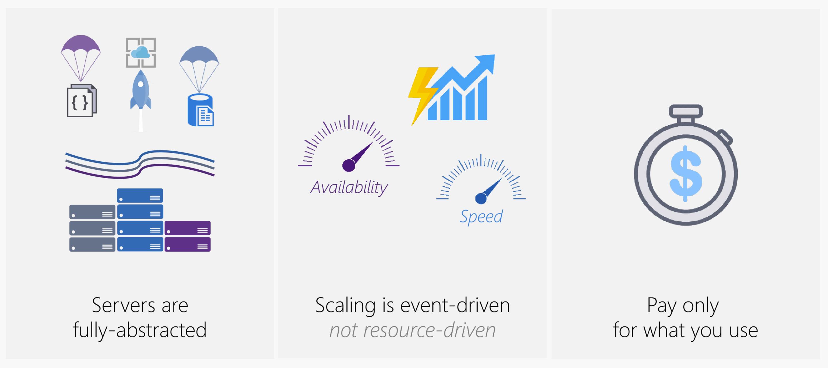
Functions and Event-Driven Processing 函数和事件驱动处理
几个流行的名词：
Functions as a Service (FaaS) ：Serverless架构可以提供一种更加“代码碎片化”的软件架构范式，我们称之为Function as a Services（FaaS）。而所谓的“函数”（Function）提供的是相比微服务更加细小的程序单元。例如，可以通过微服务代表为某个客户执行所有CRUD操作所需的代码，而FaaS中的“函数”可以代表客户所要执行的每个操作：创建、读取、更新，以及删除。当触发“创建账户”事件后，将通过云厂商提供的Lambda函数的方式执行相应的“函数”。
Notes:
the overall flow of a FaaS architecture is fairly straightforward:
An event (e.g. an online order at a retailer) is received by an API Manager.
The Manager creates an http request that results in a function being launched
The function is first instantiated in a container. The container has all the configuration the function needs to run, including its dependencies
The function processes the request
The container is then automatically destroyed
The user only pays for the resources consumed (RAM, CPU, Disk etc.) during the time the function ran.

Slide 5
FaaS和Serverless
FaaS严格来说应该算Serverless的一个子集，现在以k8s为引擎的PaaS也可以算作Serverless的一种形式，Serverless这个概念存在已经很久了，最早指不需要服务器端的软件，比如纯客户端软件以及 P2P软件，在云时代，这个概念才表示不需要关心服务器端的相关技术。
Serverless通常包含两个领域：
BaaS：比PaaS更上层，不仅提供应用中间件、数据中间件，还能提供已经实现好的程序逻辑供应用调用
FaaS：通过订阅事件源，由消息触发程序函数执行。传统应用不管是部署在物理机、虚机还是容器中，都需要长时间运行监听访问请求，而FaaS是将程序的函数直接部署到平台，通过事件来触发

Slide 6
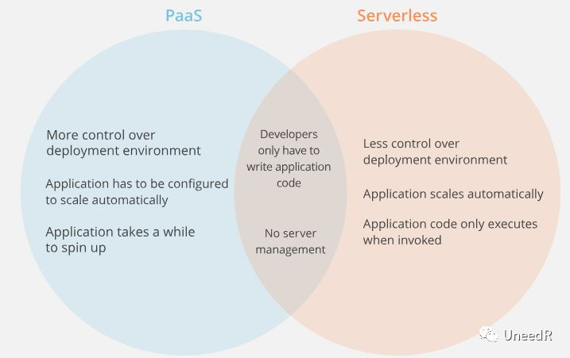
PaaS和Serverless
Notes:
相较于PaaS服务，SC架构的自动化程度更高，对于开发环境的依赖度更低，且应用只在被调用时唤醒因此收费更加合理。

Slide 7
开源FaaS项目与Kubeless
对众多开源FaaS项目概览后，我们会发现因为FaaS的事件触发机制，底层首选都是跑在容器平台，用虚拟机运行对资源利用率太不友好了，而现在k8s作为容器平台的事实标准，FaaS的部署也是首选k8s平台，其中Kubeless因为完全采用k8s的框架进行开发，与k8s集成性最好。
Kubeless有三个核心概念
Functions：Functions代表了被执行的代码，Functions包含有关代码运行时依赖关系的元数据、构建指令等，
Triggers：Triggers代表了与其关联函数的事件，当事件发生时，Kubeless将会保证关联函数至多被唤醒一次，根据事件的类型，一个Trigger能够和一个或多个函数相关联
Runtime：Runtime表示执行函数的语言和运行时特定环境。

Slide 8
Kubeless与K8S
Kubeless为了将函数部署在k8s上引用了很多k8s的概念：
用CRD表示Functions
每个事件源被建模成一个独立的Trigger CRD对象
独立的CRD控制器负责有关于CRD对象的CRUD操作
Deployment/Pod来运行相关的Runtime
Configmap用来注入函数代码到Runtime Pod中
Init-container用来加载函数可能需要的依赖
Service用来暴露函数
Ingress用来对外暴露函数

Slide 9
Kubeless 函数部署步骤 （注意：书中kubeless版本较老且没有详细步骤）
编写函数：city-bikes.py -- search through the list of Capital City Bikeshare stations and return a list of matches.
部署函数
查看状态
部署代理
调用函数
调试函数
Notes:
Notice that this find() function has a required parameter named request. When Kubeless calls the function, it will pass in a LocalRequest object from the Bottle Web Framework. The LocalRequest object has a handy property called json which returns all of the POST request parameters as a JSON object. By parsing the JSON, it’s easy to extract the search term from the posted data.
Registering the function with Kubeless involves telling Kubeless these bits of information:
The name you will use to access the function over the Web
The protocol you will access the function (here, HTTP)
The runtime to be executed to run the code (here, Python)
The name of the file containing the function code
The name of the function inside the file

Slide 10
FAAS 模式1： The Decorator Pattern
描述：augment or decorate HTTP requests to or from a different service
适合场景：
Stateless
often added after the fact to existing code as the service evolves experiment with a variety of different decorators before finally adopting one and pulling it more completely into the implementation of the service.
Example： adding defaults to the input to an HTTP RESTFul API
Notes:
当然你也可以使用Adapter模式创建一个adapter container，但是这样的cost很大，并且把default 服务和原来的api服务绑定了

Slide 11
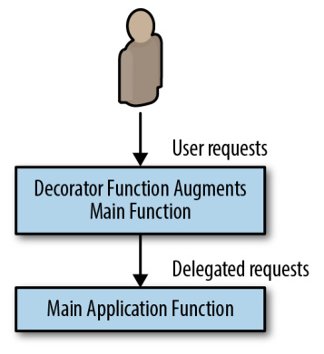

Slide 12
FAAS 模式2： Handling Events
描述：Events tend to be single-instance and asynchronous in nature. Events
are important and need to be properly handled, but they are fired off from a main
interaction and responded to some time later.
适合场景：
events tend to be largely independent and stateless in nature, and
because the rate of events can be highly variable, they are ideal candidates for event-
driven and FaaS architectures.
Example： Two-factor authentication

Slide 13
FAAS 模式3： Event-Based Pipelines
描述：event pipeline
适合场景：
event pipelines often resemble the flowcharts of
old. They can be represented as a directed graph of connected event syncs. In the
event pipeline pattern, each node is a different function or webhook, and the edges
linking the graph together are HTTP or other network calls to the function/webhook.
Example： the task of implementing a new-user signup flow.

Slide 14





THANKS!
参考文献：
https://martinfowler.com/articles/201701-event-driven.html
https://aws.amazon.com/cn/blogs/china/iaas-faas-serverless/
https://www.confluent.io/blog/journey-to-event-driven-part-1-why-event-first-thinking-changes-everything
https://yq.aliyun.com/articles/674294
http://blog.nsfocus.net/kubeless/
https://kubeless.io/

