Slide 1

Chapter 6
Sharded Services
武文齐
2019年5月

Slide 2
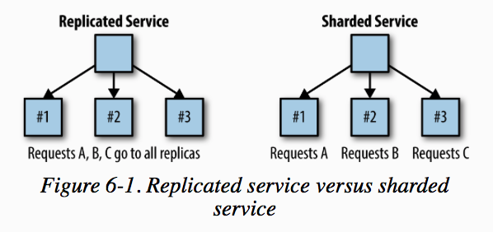
Replicated service versus sharded service
This chapter will discuss one example of sharded service – sharded cache

Slide 3
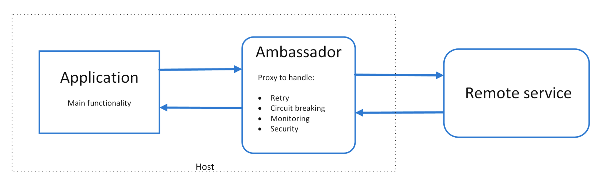
Ambassador pattern
Use this pattern when you:
Need to build a common set of client connectivity features for multiple languages or frameworks.
Need to offload cross-cutting client connectivity concerns to infrastructure developers or other more specialized teams.
Need to support cloud or cluster connectivity requirements in a legacy application or an application that is difficult to modify.
This pattern may not be suitable:
When network request latency is critical. A proxy will introduce some overhead, although minimal, and in some cases this may affect the application.
When client connectivity features are consumed by a single language. In that case, a better option might be a client library that is distributed to the development teams as a package.
When connectivity features cannot be generalized and require deeper integration with the client application.

Slide 4
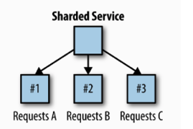
Non-consistent hash
算法：
Shard = hash(key) % 3 0 1 2 0 1 2 0 1 2 0 1 2
移除一台主机：
Shard = hash(key) % 2 0 1 0 1 0 1 0 1 0 1 0 1 命中率为33%
添加一台主机：
Shard = hash(key) % 4 0 1 2 3 0 1 2 3 0 1 2 3 命中率为16%
使用非一致哈希进行路由，增加或删除机器导致命中率显著下降

Slide 5
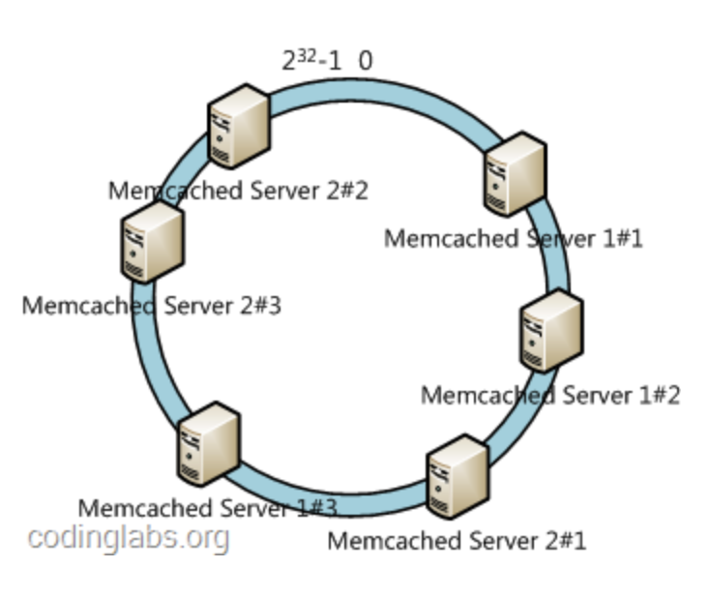
consistent hash -----ketama（一致性哈希算法库）
Ketama solves this problem in the following way:
Take your list of servers (eg: Memcached Server 1, Memcached Server 2)
Hash each server string to several (100-200) unsigned ints(32bit)
Conceptually, these numbers are placed on a circle called the continuum.
Each number links to the server it was hashed from, so servers appear at several points on the continuum, by each of the numbers they hashed to.
To map a key->server, hash your key to a single unsigned int, and find the next biggest number on the continuum. The server linked to that number is the correct server for that key.
If you hash your key to a value near 2^32 and there are no points on the continuum greater than your hash, return the first server in the continuum.

Slide 6
twenproxy
参考：
https://github.com/twitter/twemproxy
twemproxy (pronounced "two-em-proxy"),
aka nutcracker, is a fast and lightweight proxy for memcached and redis protocol.
It was built primarily to reduce the number of connections to the caching servers on the backend.
This, together with protocol pipelining and sharding(routing) enables you to horizontally scale your distributed caching architecture.
Supportted distribution mode: ketama、modula、random

Slide 7
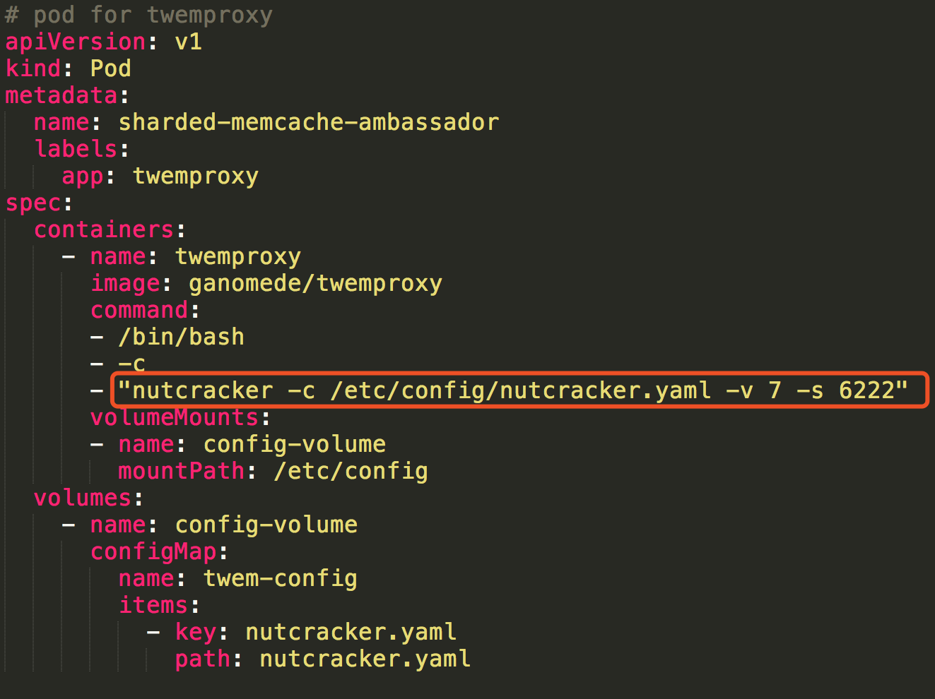
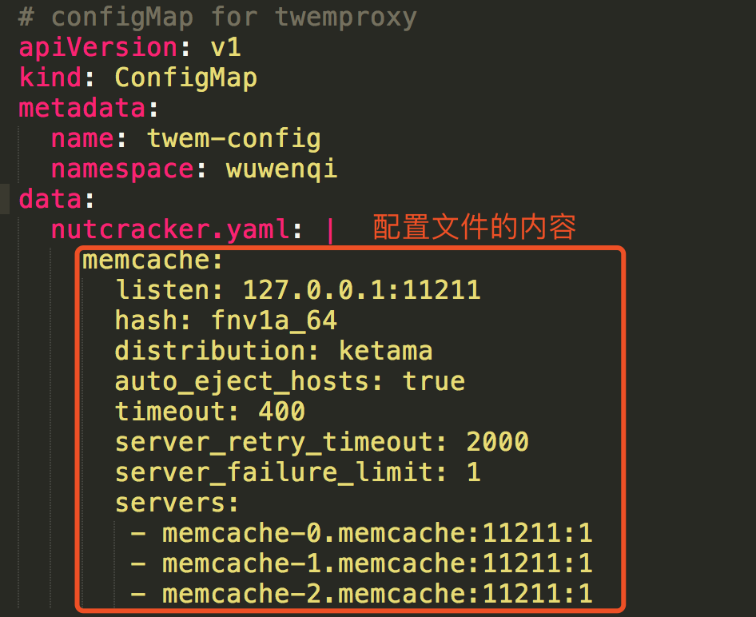
twenproxy-启动
2个端口：
数据端口11211
状态端口 6222

Slide 8
Hands On：Deploying an Ambassador and Memcache for a Sharded Cache
pod
name: sharded-memcache-ambassador
nc localhost 11211
configMap
data:
nutcracker.yaml: | …
nutcracker -c /etc/config/nutcracker.yaml -v 7 -s 6222
pod
memcache-0.memcache
lable: app=memcache
pod
memcache-1.memcache
lable:app=memcache
pod
memcache-2.memcache
lable:app=memcache
StatefulSet
repliacs: 3
name: memcache
service
name: memcache
lable:app=memcache
Notes:
service负载分发策略
service 负载分发策略有两种：
RoundRobin：轮询模式，即轮询将请求转发到后端的各个pod上（默认模式）；
SessionAffinity：基于客户端IP地址进行会话保持的模式，第一次客户端访问后端某个pod，之后的请求都转发到这个pod上。

Slide 9
Hands on
映射：键 => 主机
first => memcache-0.memcache
a => memcache-1.memcache
fourth => memcache-2.memcache
与Memcached建立 4 个连接
nc localhost 11211 连接代理
nc memcache-0.memcache 11211 与真实的memcache连接
nc memcache-1.memcache 11211 与真实的memcache连接
nc memcache-2.memcache 11211 与真实的memcache连接
Memcached命令
set key 0 9999 3
get key
nutcracker 状态查看
nc localhost 6222

Slide 10
An alternative: Deploy a replicated shard router service
service
type: LoadBalancer
lable:app=memcache
Deployment
repliacs: 3
name: shared-twemproxy
pod
label:app: shared-twemproxy
nutcracker
pod
label:app: shared-twemproxy
nutcracker
pod
label:app: shared-twemproxy
nutcracker
pod
memcache-0.memcache
lable: app=memcache
pod
memcache-1.memcache
lable:app=memcache
pod
memcache-2.memcache
lable:app=memcache
StatefulSet
repliacs: 3
name: memcache
service
name: memcache
lable:app=memcache
Notes:
service负载分发策略
service 负载分发策略有两种：
RoundRobin：轮询模式，即轮询将请求转发到后端的各个pod上（默认模式）；
SessionAffinity：基于客户端IP地址进行会话保持的模式，第一次客户端访问后端某个pod，之后的请求都转发到这个pod上。

Slide 11
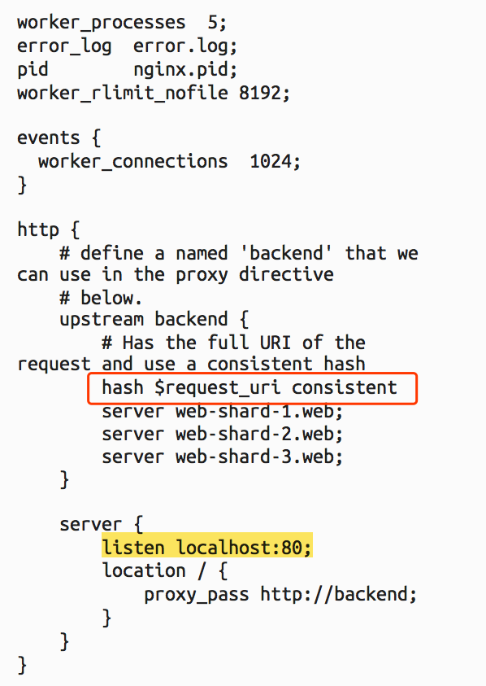
Nginx 也可实现一致性哈希
该例子中对路径做哈希
第三方模块ngx_http_upstream_consistent_hash（https://github.com/replay/ngx_http_consistent_hash/blob/master/ngx_http_upstream_consistent_hash_module.c）
Notes:
service负载分发策略
service 负载分发策略有两种：
RoundRobin：轮询模式，即轮询将请求转发到后端的各个pod上（默认模式）；
SessionAffinity：基于客户端IP地址进行会话保持的模式，第一次客户端访问后端某个pod，之后的请求都转发到这个pod上。

Slide 12





!
THANKS!

