Slide 1

HACKNWA // 2026
HOLIDAY IN
SCAMBODIA
[ SPEAKER / TOPIC IMAGE ]
AI For Ethical Hackers
Christopher Williams | CISSP, GCFA, CISM
SOURCE: LEAKED_CAM_01
HACKNWA
APRIL 17, 2026

Slide 2

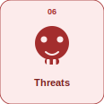
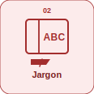
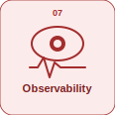
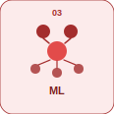
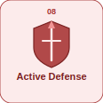
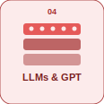



// OPERATIONS HMI
01 INTRODUCTION
06 THREATS
02 JARGON
07 OBSERVABILITY
03 MACHINE LEARNING
08 ACTIVE DEFENSE
04 LLMs, GPTs, and MoE's
09 EXERCISE
05 AGENTs and Super AGENTs
10 QUESTIONS
HACKNWA
AGENDA
APRIL 17, 2026

Slide 3
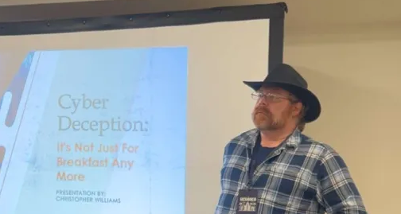


01 Introduction – Christoper Williams
Principal Incident Response Engineer for a top retailer
B.S. in Cyber Security from Bellevue University
Graduate Student for M.S. in Cyber
Active CISSP, GCFA, CISM
Ethical Hacker, DevOps Practitioner, UNIX/Linux & FOSS
Programming for 46 years, 30+ Years in IT
Married father of 4 kiddos and 2 pets
CTF Competitor Shifted to Challenge Designer
Reading, kayaking, hiking, music, travelling
My presentation, comments and opinions are provided in my personal capacity and not as a representative of my employer. They do not reflect the views of my employer and are not endorsed by my employer.
[ STAT / IMAGE ]
“It's the questions we can't answer that teach us the most. They teach us how to think. If you give a man an answer, all he gains is a little fact.
But give him a question and he'll look for his own answers.”
― Patrick Rothfuss, The Wise Man's Fear
HACKNWA
AI For Ethical Hackers
APRIL 17, 2026

Slide 4
terminal — bash
$ JARGON
[+] Dataset: a collection of examples used for training or evaluation
[+] Feature: an input used by the model to make a prediction
[+] Label: the correct class or category for an example
[+] Classification: predicting one class from a set of potential classes
[+] Supervised learning: training with examples using correct labels
[+] Unsupervised Learning: using pattern recognition and predictive modelling on unlabeled data
[+] Self-supervised learning: the model uses algorithms to predict what labels should be
[+] Reinforcement Learning: the model receives positive or negative feedback on decisions
[+] Semi-supervised Learning: the model applies labels to a large unlabeled dataset based on a smaller labelled dataset
[+] Hybrid Learning: this method uses a combination of techniques
$ ▌
HACKNWA
AI For Ethical Hackers
APRIL 17, 2026

Slide 5
terminal — bash
$ JARGON [2]
[+] Descriptive Analysis: to help understand what happened in the past
[+] Prescriptive Analysis: to automate business decisions and processes based on data
[+] Predictive Analysis: to predict future business scenarios
[+] Training set: the data used to teach the model
[+] Test set: held-out data used to measure final performance
[+] Model: a system that learns patterns from data
[+] Epoch: one full pass through the training data
[+] Batch: a small group of examples processed together
[+] Loss: a value showing how wrong the model is during training
[+] Optimizer: the algorithm that updates model weights
[+] Class: a pre-defined category that a value may be assigned to during classification
$ ▌
HACKNWA
AI For Ethical Hackers
APRIL 17, 2026

Slide 6
terminal — bash
$ JARGON [3]
[+] Hyperparameter: a config variable set before training to tune the process
[+] Inference: using a trained model to make predictions
[+] Parameters: numeric adjustable variables used internally during training
[+] Weights: tunable numeric variables used internally during training to control the strength of the connection between neural nodes
[+] NLP: Natural Language Processing
[+] Token: a word or word-piece used as model input
[+] Tokenization: splitting text into tokens
[+] Embedding: a numeric representation of meaning
[+] Transformer: a neural network architecture built around attention
[+] Baseline model: a simple model used to evaluate the performance of more complex algorithms
[+] Pretrained model: a model trained earlier on a large set of general text
[+] Fine-tuning: adapting a pretrained model to a specific task
$ ▌
HACKNWA
AI For Ethical Hackers
APRIL 17, 2026

Slide 7
Machine Learning
01
02
03
Supervised
Unsupervised
Reinforcement
Trained using properly labeled data
A human has applied labels
The model learns the patterns and tries to apply them
Example: credit risk scoring
Trained with unlabeled data
Applies pattern recognition to discover new relationships
Example: market segmentation clustering
Reward signals are used
Classic: Training through playing games with humans or other models
Example: Adaptive navigation systems find efficient routes and monitor progress
HACKNWA
AI For Ethical Hackers
APRIL 17, 2026

Slide 8
Machine Learning
04
05
06
Semi-Supervised
Self-Supervised
Transfer
Uses a small representative data set to pre-train
Applies the labels to a much larger dataset
Example: Radiology model trained on a small sample applied to a large dataset
Relies on predictive algorithms
Applies the algorithms to new data to predict future, missing, or masked values
The patterns are applied in downstream tasks
Example: models trained on token prediction used for code generation
A general-purpose model is trained for a specialized task
Reduces the cost of developing the specialized model
Example: a model trained on image recognition is fine-tuned to detect assembly line defects
HACKNWA
AI For Ethical Hackers
APRIL 17, 2026

Slide 9

LLMs, GPTs and MoE's
Manual features and shallow algorithms
Neural networks with greater compute and storage
Deep learning with automated hierarchical layer representations
Transformers with attention and parallelism
Increased scale and self-supervision
Generative Pre-Trained Transformers
Mixture of Experts activates multiple Feed Forward Networks
HACKNWA
AI For Ethical Hackers
APRIL 17, 2026

Slide 10
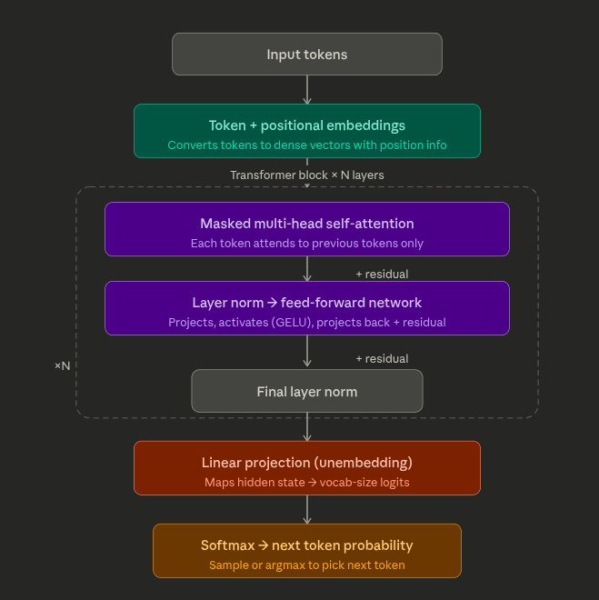
GPT Workflow
HACKNWA
AI For Ethical Hackers
APRIL 17, 2026

Slide 11
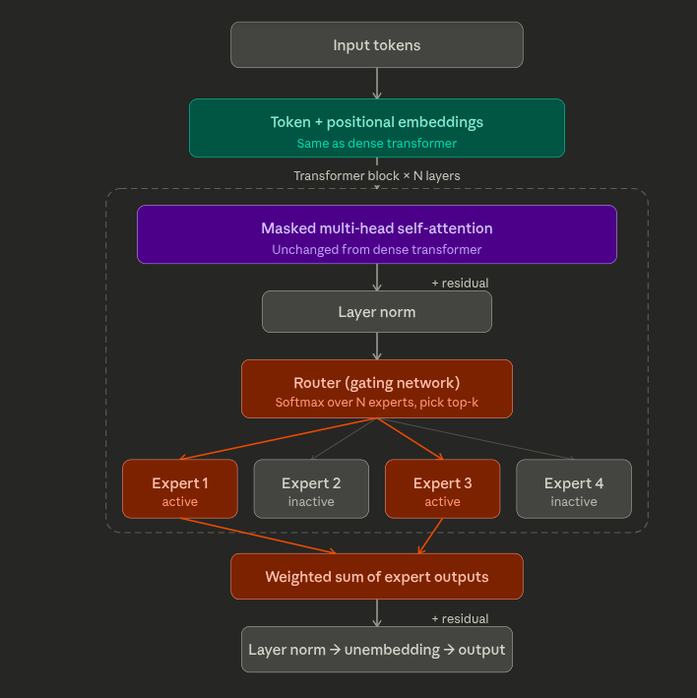
MoE Workflow
HACKNWA
AI For Ethical Hackers
APRIL 17, 2026

Slide 12

Agents and Super-Agents
AI agents use LLMs to perform specific tasks using tools often exposed using Model Context Protocol in multi-step reasoning loops
Super agents orchestrate multiple agents, chain workflows, and are often granted greater autonomy
Key risks
Over-privileged agents
Lack of segmentation
Vulnerabilities (Prompt Injections)
Governance gaps
Lack of auditing/observability
Errors can propagate rapidly with no HITL
Examples (Demo #1)
HACKNWA
AI For Ethical Hackers
APRIL 17, 2026

Slide 13
“
The experiences of the atomic scientists clearly show the need to take personal responsibility, the danger that things will move too fast, and the way in which a process can take on a life of its own. We can, as they did, create insurmountable problems in almost no time flat. We must do more thinking up front if we are not to be similarly surprised and shocked by the consequences of our inventions.
— Bill Joy, "Why The Future Doesn't Need Us", Wired Magazine, 2000
HACKNWA
APRIL 17, 2026

Slide 14
terminal — bash
$ # THREAT CATEGORIES
[+] Prompt Injection
[+] Jailbreaking
[+] Data Exfiltration
[+] Agent Exploitation
[+] Malicious Agents
[+] Sandbox Escape
[+] Output Manipulation
[+] Retrieval Attacks
[+] Model Poisoning
[+] Model inversion
[+] Denial of Service
[+] Social Engineering by LLM
[+] Context Window Manipulation
[+] Multi-Modal Attacks
[+] Supply Chain Attacks
$ ▌
HACKNWA
AI For Ethical Hackers
APRIL 17, 2026

Slide 15
LLM THREAT MATRIX
CATEGORY
ATTACK TYPE
WHAT IT TARGETS
IMPACT
NOTES / EXAMPLES
PROMPT ATTACKS
Prompt injection (direct/indirect)
Instructions / reasoning
Behavior override
Hidden instructions in input or RAG docs
Prompt persistence / chaining
Memory, summaries, agents
Delayed execution
Payload survives compression and re-triggers
JAILBREAKING
Roleplay / DAN / multi-turn
Safety controls
Policy bypass
Gradual weakening vs persistent payloads
DATA EXFILTRATION
Context leakage
System prompt, memory
Secret exposure
API keys, hidden prompts
Training data extraction
Model memory
Data leakage
General memorization attacks
MODEL INFERENCE
Membership inference
Training dataset presence
Privacy violation
"Was this record in training?"
Model inversion
Learned representations
Sensitive reconstruction
Rebuild features from outputs
TOOL / AGENT
Tool injection
Tool inputs
Execution abuse
Manipulated arguments
MCP manifest poisoning
Tool descriptions
Control-plane compromise
Poisoned tool schemas / routes
Agent-to-agent injection
Inter-agent communication
Cascading compromise
Sub-agent poisons orchestrator
SANDBOX ESCAPE
Code interpreter escape
Execution environment
System access
File system / network breakout
OUTPUT ATTACKS
HTML / Markdown injection
Rendering layer
XSS / UI compromise
Script injection in output
Insecure output handling
Downstream systems
Command / SQL injection
LLM → shell / API without sanitization
RAG ATTACKS
Embedding / chunk poisoning
Vector DB
Retrieval manipulation
Hidden instructions in documents
Search ranking manipulation
Retrieval logic
Biased outputs
Adversarial indexing
DOS
Token flooding
Context window
Resource exhaustion
Large prompts
Sponge attacks
Model compute
Cost amplification
Maximize compute per token
ATTENTION ATTACKS
Context manipulation
Model attention
Instruction loss
Bury or overshadow critical text
SUPPLY CHAIN
Training data poisoning
Model training
Behavior corruption
Malicious datasets
LoRA / adapter poisoning
Fine-tuning artifacts
Backdoored models
Malicious HF adapters
MULTI-MODAL
Image prompt injection
Vision models
Hidden instructions
Text embedded in images
SOCIAL ENGINEERING
LLM persuasion
Human user
Trust exploitation
Phishing, authority spoofing
LLM Security Threat Matrix · MITRE ATT&CK–inspired taxonomy · 2025–2026

Slide 16
LLM THREAT MATRIX BY TACTIC
MITRE ATT&CK–INSPIRED
TACTIC
TECHNIQUE
EXAMPLES / NOTES
INITIAL ACCESS
Prompt injection
Direct, indirect, RAG doc injection
RAG poisoning
Embedding / chunk manipulation
MCP manifest poisoning
Malicious tool descriptions
EXECUTION
Tool / agent abuse
Function call manipulation, tool injection
Sandbox escape
Code interpreter breakout
Agent-to-agent injection
Sub-agent poisons orchestrator
PERSISTENCE
Prompt persistence
Payload survives memory / summarization
Backdoor triggers
Hidden phrases in RAG or adapters
PRIVILEGE ESCALATION
Role hijacking
"You are now system / admin"
Jailbreaking
DAN, roleplay, multi-turn
DEFENSE EVASION
Encoding / obfuscation
Base64, Unicode tricks
Attention manipulation
Burying instructions in context
CREDENTIAL ACCESS
Context leakage
System prompt, API keys, secrets
DISCOVERY
Model probing
Capability and boundary discovery
COLLECTION
Model inversion
Reconstruct sensitive attributes
Membership inference
Detect training data presence
EXFILTRATION
Data extraction
RAG scraping, memory leakage
IMPACT
Output injection
LLM output → shell / SQL / API
DoS / sponge attacks
Cost and compute exhaustion
SUPPLY CHAIN
Training data poisoning
Dataset manipulation
LoRA / adapter poisoning
Malicious fine-tune artifacts
LLM Security Threat Matrix · MITRE ATT&CK inspired taxonomy · 2025

Slide 17

Observability
Log inputs, outputs, and tool calls, not just errors
Trace across agent boundaries, not per agent or tool
Alert on behavioral anomalies like unexpected tools, token spikes, and off-scope calls
Immutable audit logs are essential
HACKNWA
AI For Ethical Hackers
APRIL 17, 2026

Slide 18

Observability - Examples
A ReAct agent loops a web search tool 40 times on a single query: a token flood caught by volume threshold alert
An MCP-connected file agent reads outside its approved directory is caught by tool call path auditing
A sub-agent passes a modified goal to its orchestrator after processing a poisoned RAG document is caught by cross-boundary trace comparison
An LLM customer service bot is prompted to impersonate a supervisor is caught by behavioral anomaly on role-change instruction pattern
An Ollama-hosted coding agent executes a shell command not present in its approved tool manifest is caught by tool call allowlist enforcement
HACKNWA
AI For Ethical Hackers
APRIL 17, 2026

Slide 19

Active Defense
Deploy canary tokens in system prompts and tool configs
Seed honey documents into RAG vector stores and training data
Monitor for canary triggers as prompt injection signals
Alert on any agent accessing decoy resources or endpoints as you would a human
HACKNWA
AI For Ethical Hackers
APRIL 17, 2026

Slide 20

Exercise
Demo #2
We will look at an attack against an AI agent.
What was the attacker's objective?
What tactics did you observe?
Was the attack successful?
HACKNWA
AI For Ethical Hackers
APRIL 17, 2026

Slide 21

HACKNWA
QUESTIONS?
Christopher Williams
Principal Incident Response Engineer, Ethical Hacker, DevOps practitioner
signal: cybersquirrel.73
discord: cybersquirrelfl
email: gnulinuxadmin@gmail.com
HACKNWA
AI For Ethical Hackers
APRIL 17, 2026

