Slide 1
DPDK

Slide 2
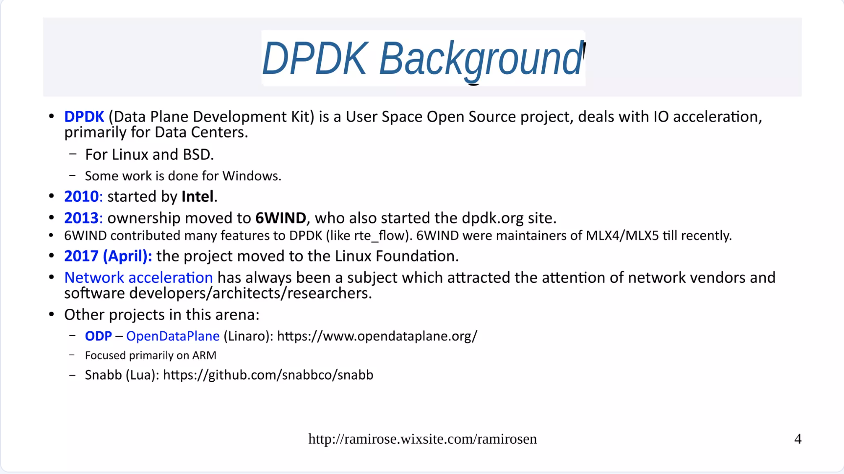

Slide 3
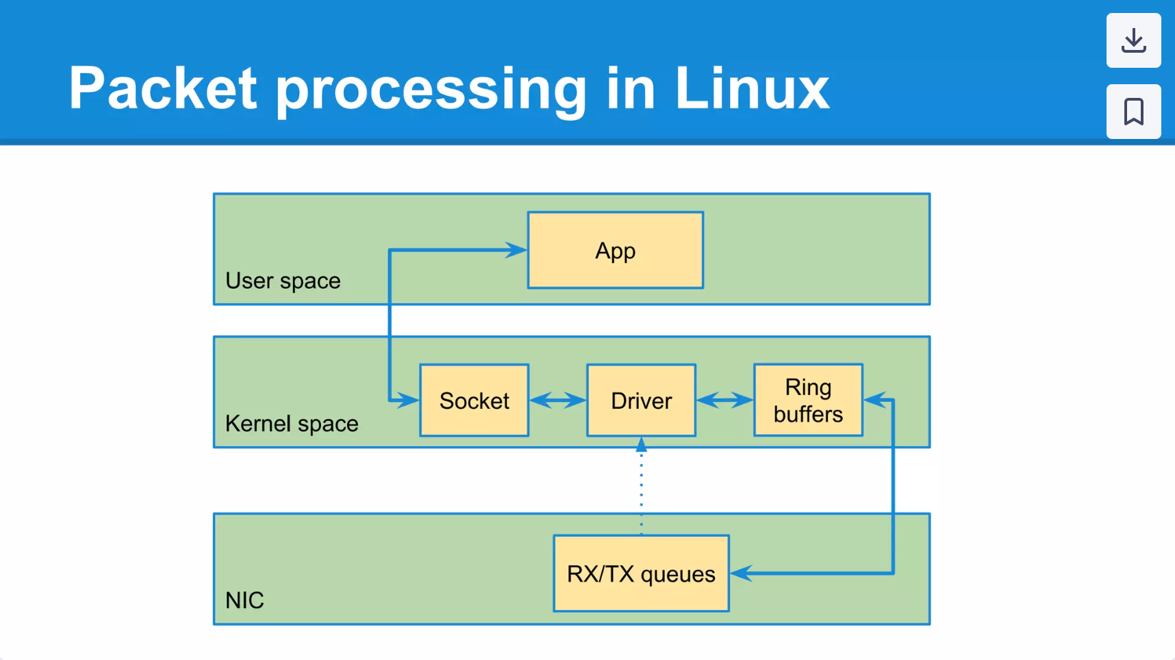
Notes:
https://www.slideshare.net/slideshow/dpdk-44585840/44585840

Slide 4
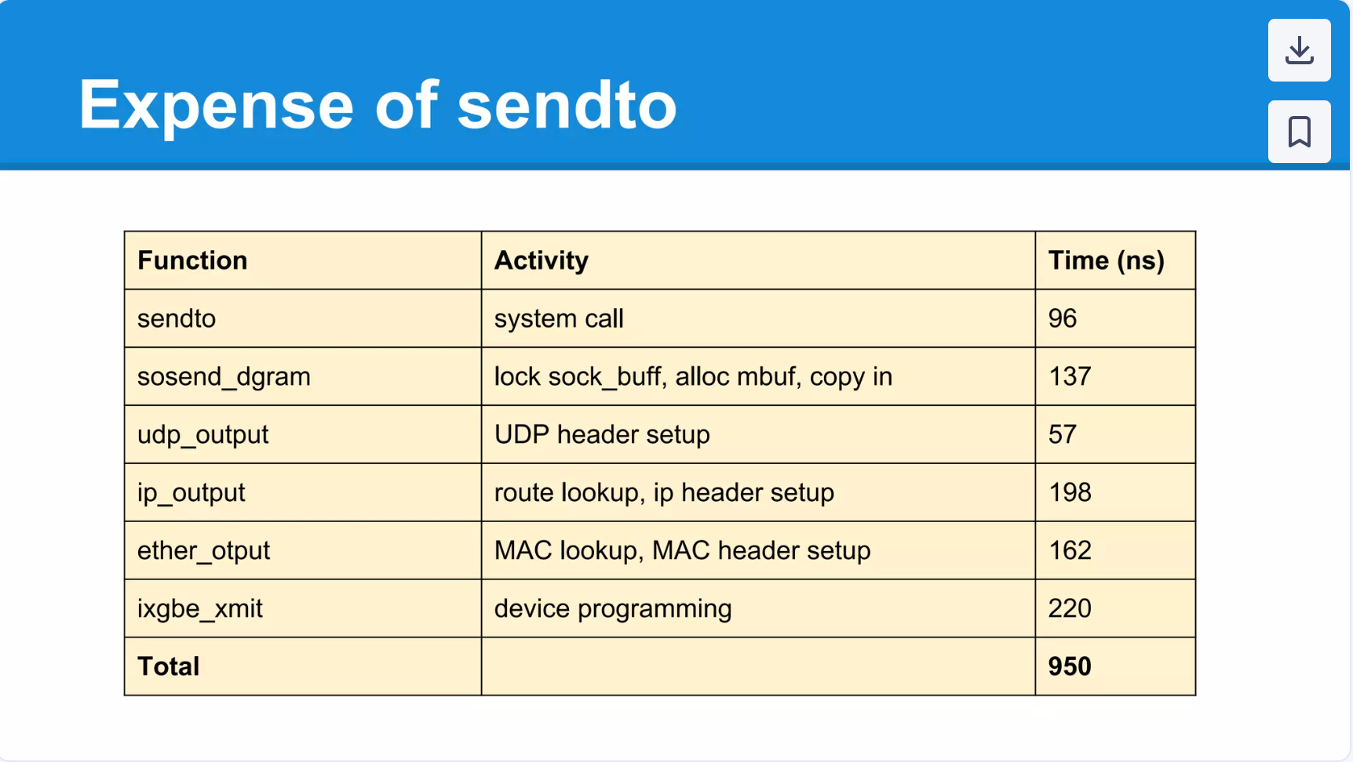

Slide 5
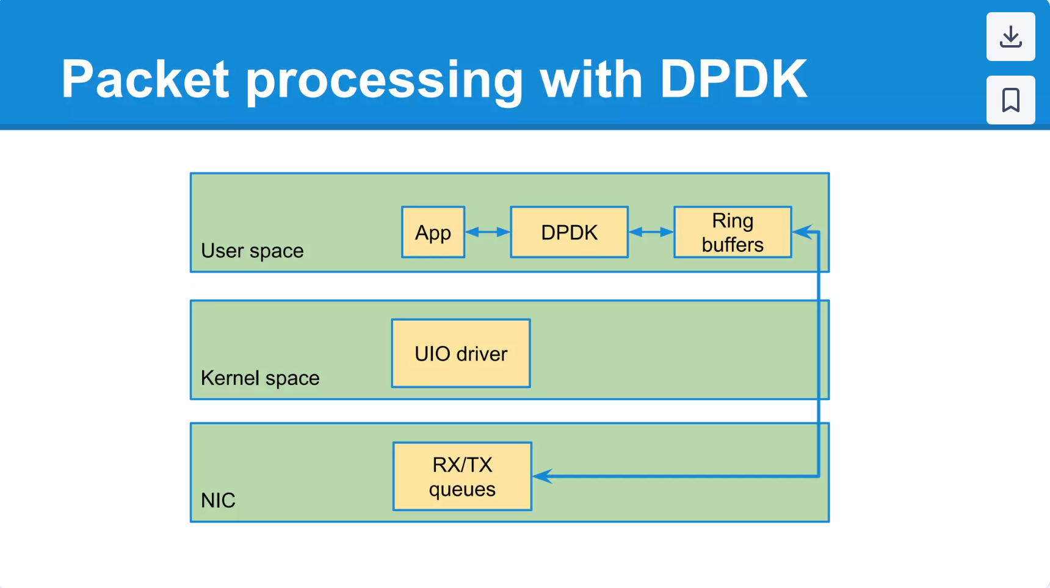

Slide 6

PcapPlusPlus
https://pcapplusplus.github.io/

Slide 7
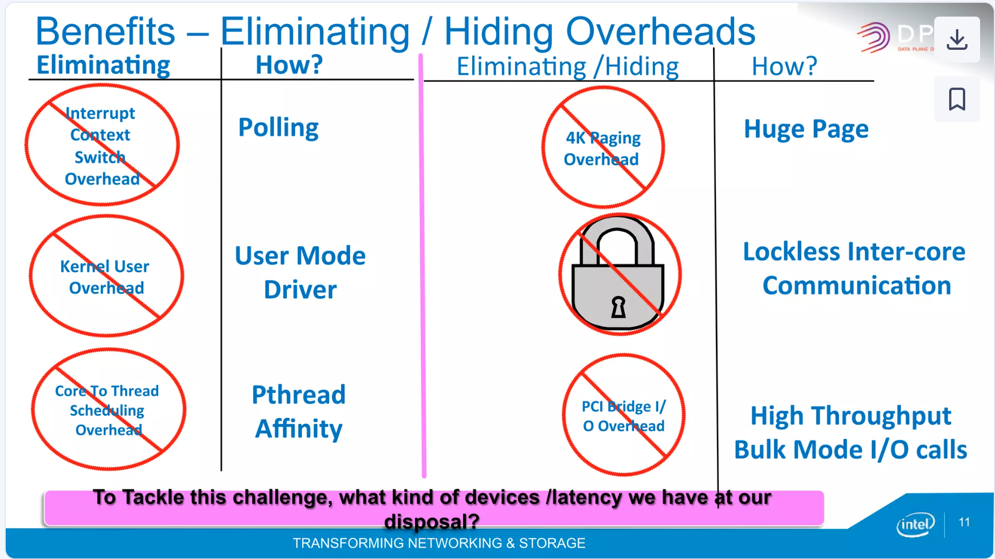
Notes:
https://www.slideshare.net/slideshow/dpdk-multi-architecture-high-performance-packet-processing-72911726/72911726

Slide 8
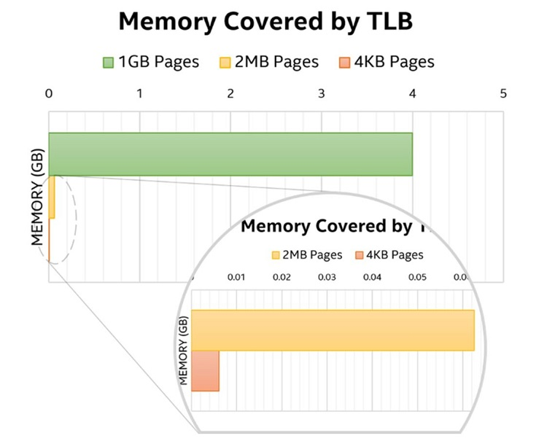
Notes:
https://www.intel.com/content/www/us/en/developer/articles/technical/memory-in-dpdk-part-1-general-concepts.html

Slide 9
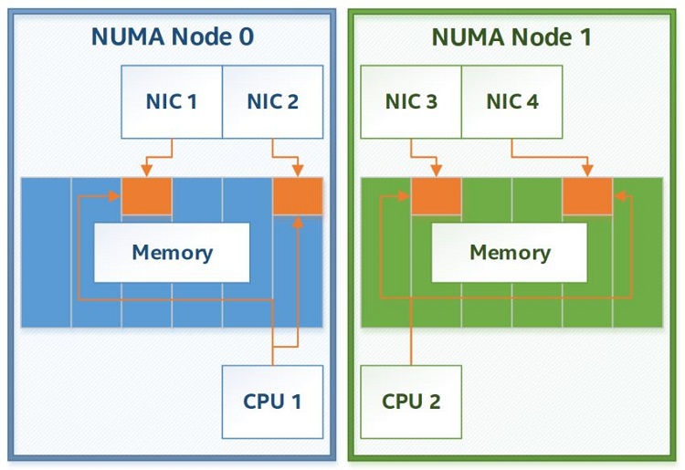
Notes:
https://www.intel.com/content/www/us/en/developer/articles/technical/memory-in-dpdk-part-1-general-concepts.html

Slide 10
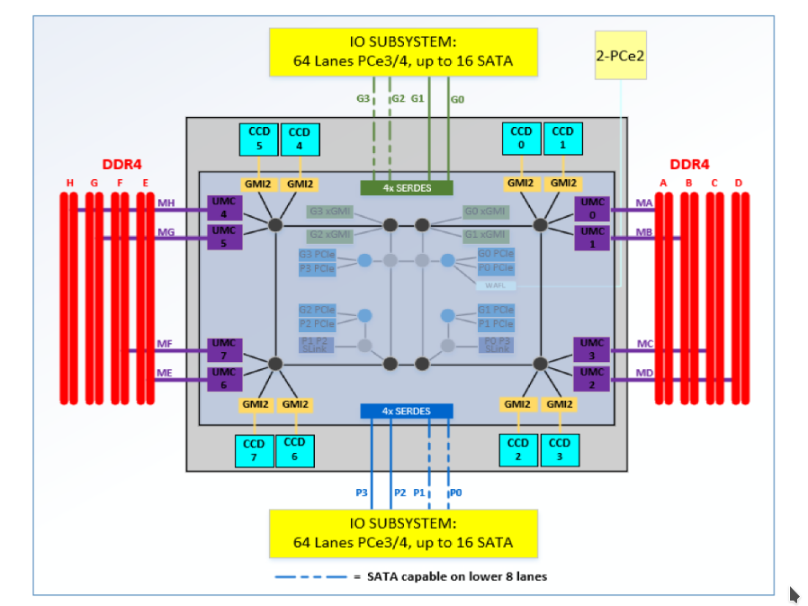
Notes:
https://www.intel.com/content/www/us/en/developer/articles/technical/memory-in-dpdk-part-1-general-concepts.html
GMI - Global Memory Interface
UMC - Unified Memory Controller
Infinity Fabric
Cache Snooping
Memory prefetching

Slide 11
Hardware, Physical Addresses, and DMA
DPDK was conceived as a set of user space packet I/O libraries, and to this day it largely stays true to its original mission statement. However, hardware does not work with user space virtual addresses—it is unaware of any user space processes, and thus lacks the context required to understand where user space virtual addresses point to. Instead, it works using real physical addresses; that is, the addresses that the CPU, RAM, and all other parts of the system use to communicate to each other.
Modern hardware almost always uses direct memory access (DMA) transactions for efficiency reasons. Normally, in order to perform a DMA transaction, the kernel would need to be involved to create a DMA-enabled memory area, translate the in-process virtual address to a real physical address that can be understood by the hardware, and to initiate the DMA transaction. This is how I/O works in most modern operating systems; however, this is a time-consuming process that requires context switching and translation and lookup operations that are not conducive to high-performance I/O.
DPDK’s memory management addresses this problem in a simple way. Whenever a memory area is made available for DPDK to use, DPDK figures out its physical address by asking the kernel at that time. Since DPDK uses pinned memory, generally in the form of huge pages, the physical address of the underlying memory area is not expected to change, so the hardware can rely on those physical addresses to be valid at all times, even if the memory itself is not used for some time. DPDK then uses these physical addresses when preparing I/O transactions to be done by the hardware, and configures the hardware in such a way that the hardware is allowed to initiate DMA transactions itself. This allows DPDK to avoid needless overhead and to perform I/O entirely from user space.

Slide 12
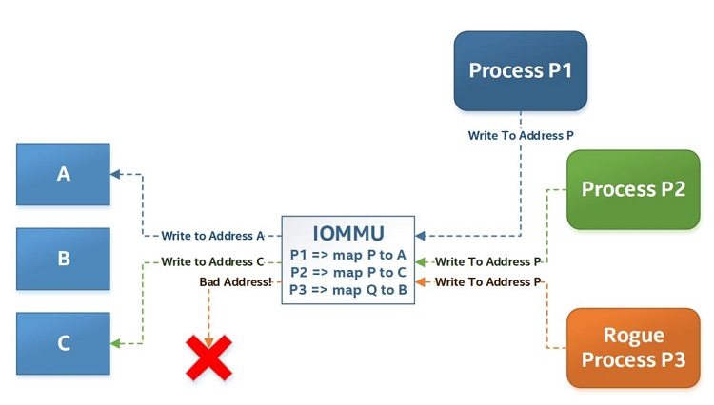
Notes:
https://www.intel.com/content/www/us/en/developer/articles/technical/memory-in-dpdk-part-1-general-concepts.html
IOMMU - Intel
GMI - AMD

Slide 13


Slide 14
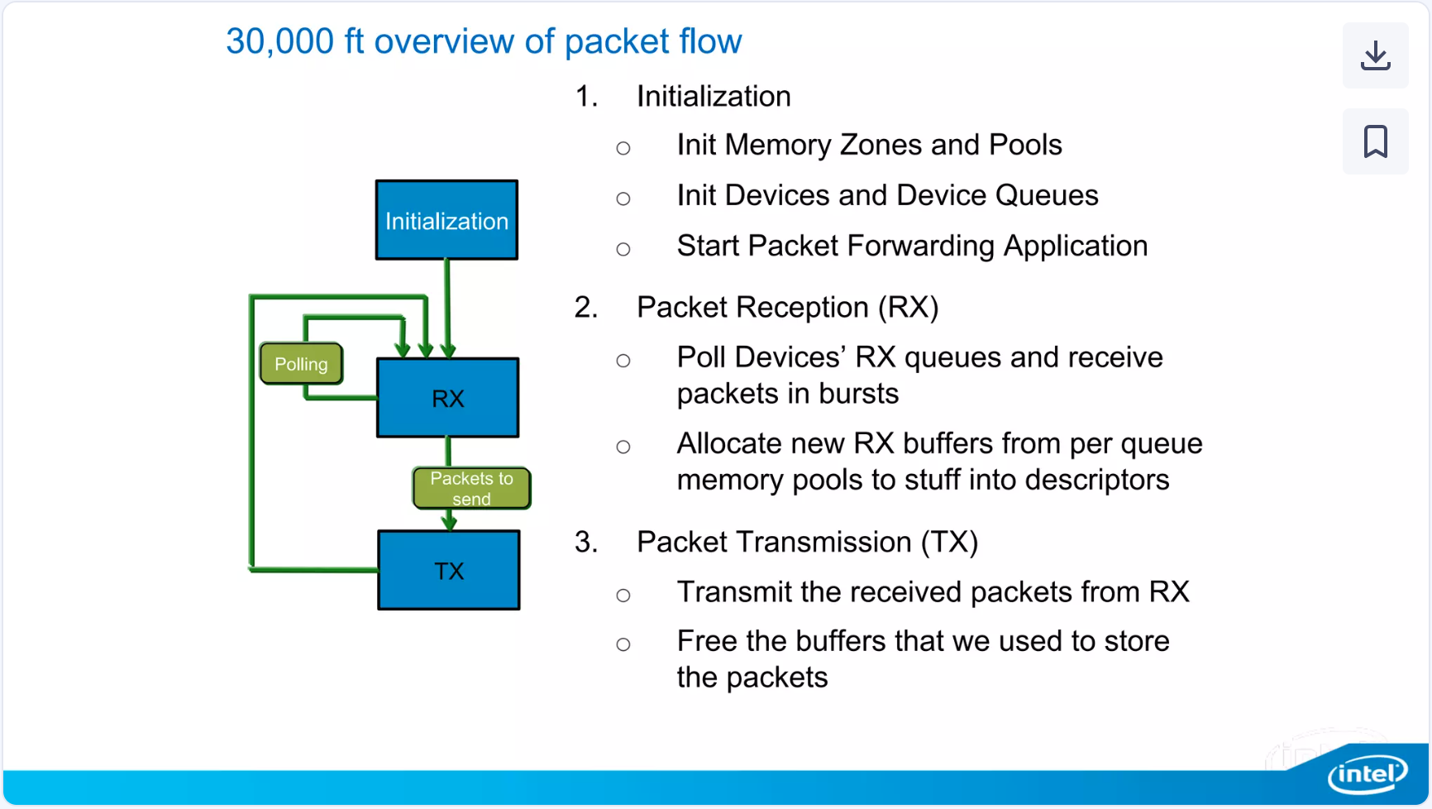

Slide 15
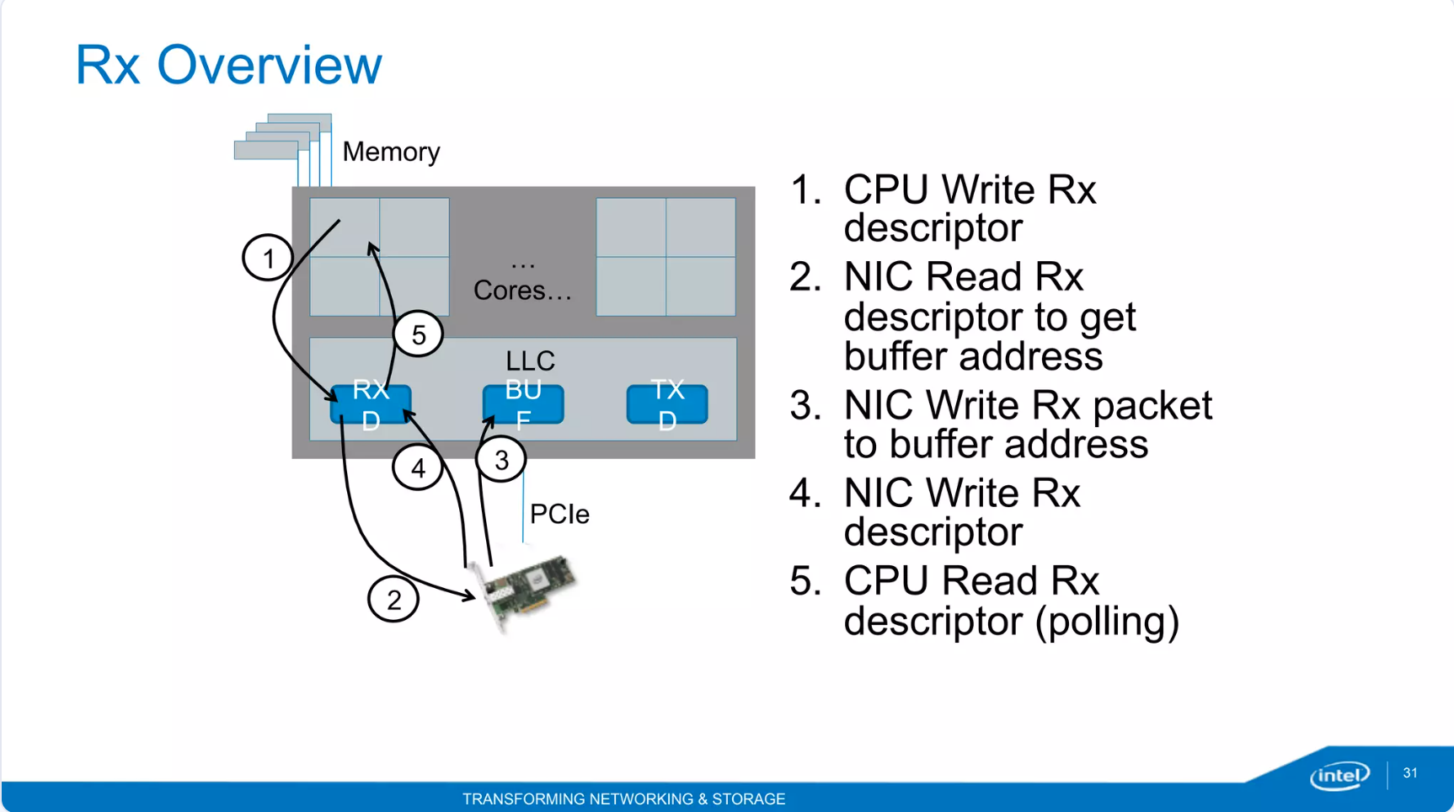
Notes:
https://www.slideshare.net/slideshow/dpdk-multi-architecture-high-performance-packet-processing-72911726/72911726#32
Demo - 128000 packets in L3 cache, larger buffer swaps in and out of memory

Slide 16
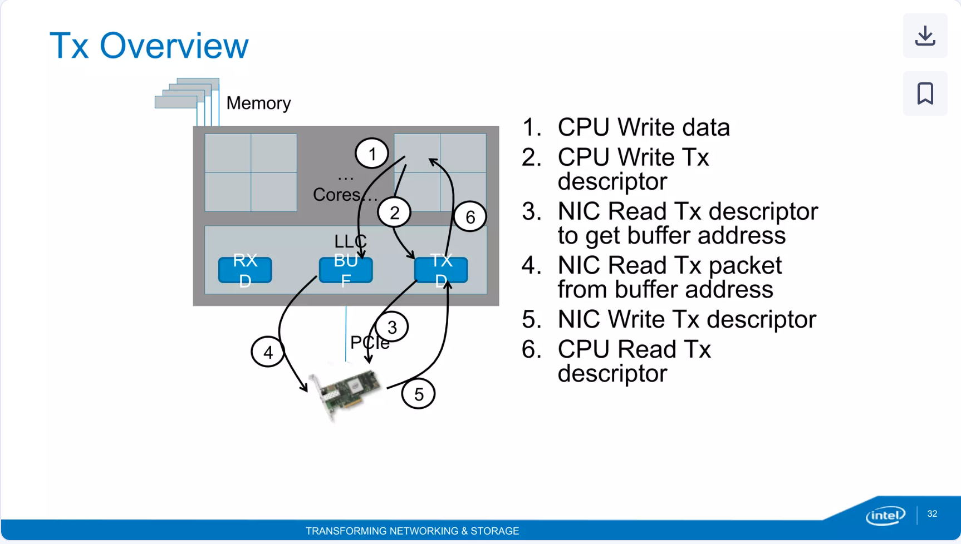
Notes:
https://www.slideshare.net/slideshow/dpdk-multi-architecture-high-performance-packet-processing-72911726/72911726#32

Slide 17
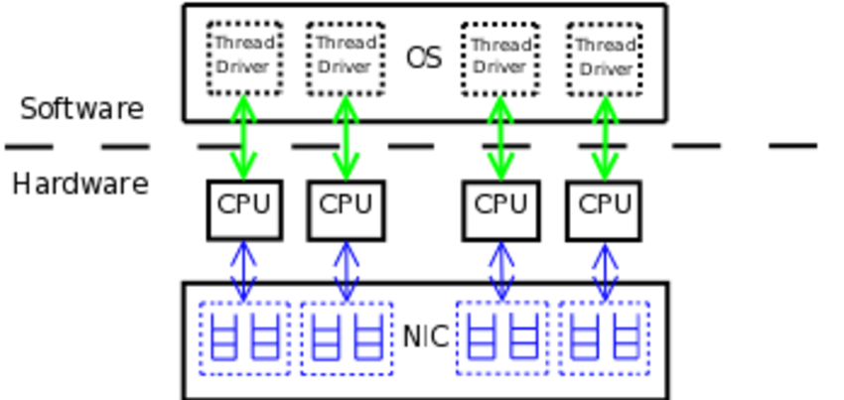

Slide 18
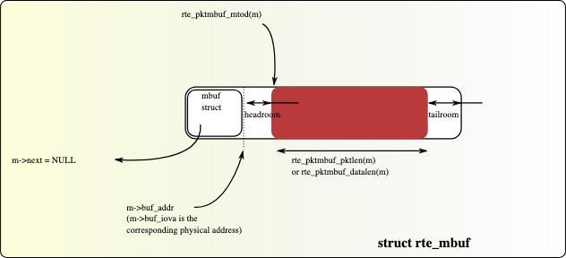
Fig. 2.2 An mbuf with One Segment

Slide 19
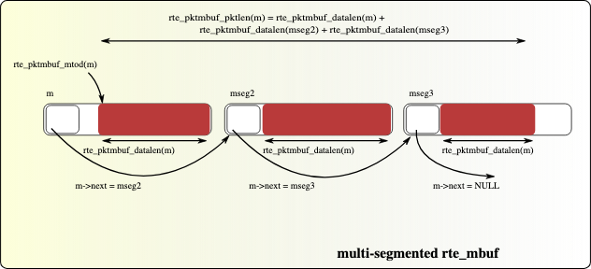
Notes:
Fig. 2.3 An mbuf with Three Segments

