Slide 1
Zeroconf
Evan Widloski - 2023-04-05
Notes:
things to add
- arrays
- backticks
- wget text vs del file example script

Slide 2

What is Zeroconf
Zeroconf
  Dictionary term: set of technologies allowing a network to configure itself
  Host discovery and service discovery
  Examples: NetBIOS, UPnP, DNS-SD + mDNS, Alljoyn
DNS-SD + mDNS
  Bonjour - Apple's implementation, partially open-source
  Avahi - Linux implementation (started in 2004 by Poettering)
Amazing Avahi Logo

Slide 3
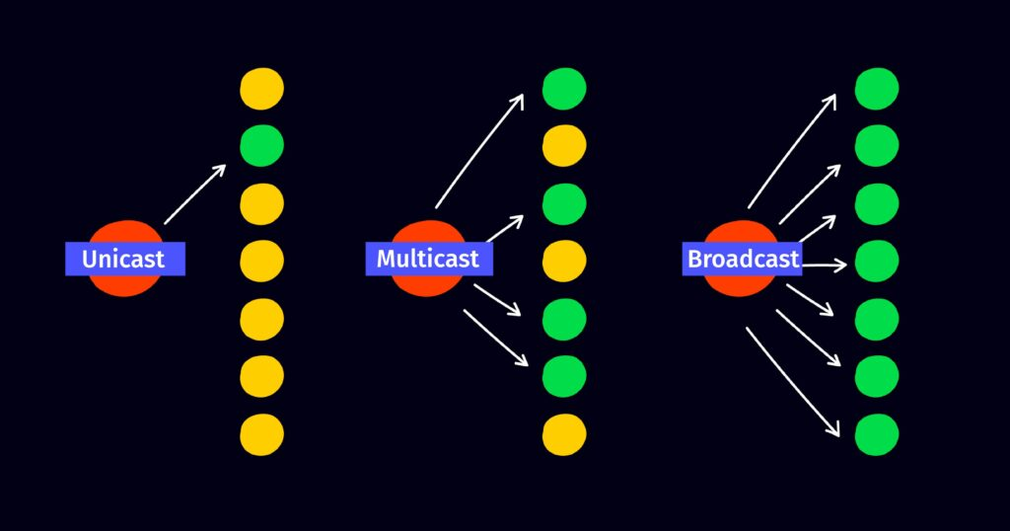
IP Multicast Overview
mDNS uses IP multicast for communication
Clients must subscribe to multicast group
mDNS uses .251 address, but there are many others
# subscribe to multicast group (mDNS uses .251 address)
sudo ip addr add 224.0.0.251/32 dev eth0 autojoin
ip maddress show
# listen on mDNS port
nc -u -l -p 5353
# send a multicast packet
nc -u 224.0.0.251 5353 <<< helloworld
No authentication. Assumes trusted network
  Attackers can publish any hostname they want during mDNS resolution

Slide 4
mDNS Overview
Requests/Responses nearly the same as regular DNS protocol
Send request to mDNS multicast group/port (udp:224.0.0.251:5353)
Responses usually are
  A/AAAA records - resolve hostnames such as foobar.local to IPv4/IPv6 addresses
  PTR records - list of available services of a particular type
    Example types
    _printer._tcp (printer), _raop._tcp (iTunes),
    _smb._tcp (Samba), _airplay._tcp (AppleTV),
    _googlecast._tcp (Chromecast), etc
  SRV/TXT records - service port, connection configuration, other details
  # query for printers on the network
  avahi-browse -rt _printer._tcp
  # query for any devices/services
  mdns-scan

Slide 5
Create your own services with Avahi (permanent)
User-defined Avahi services go in /etc/avahi/services
Example fake printer service
<?xml version="1.0" standalone='no'?>
<!DOCTYPE service-group SYSTEM "avahi-service.dtd">
<service-group>
<name>fakeprinter</name>
<service>
<type>_printer._tcp</type>
<port>9001</port>
</service>
</service-group>

Slide 6
Create your own services with Avahi (temporary)
Temporarily publish service (blocking)
avahi-publish-service fakeprinter2 _printer._tcp 9001

Slide 7
The Shitty Bits
Sometimes 'mdns' needs to be added to /etc/nssswitch.conf
hosts: files mdns4_minimal [NOTFOUND=return] dns mdns4 mdns
Sometimes firewalld blocks mDNS from working
systemctl disable --now firewalld

