Slide 1
Distributed Storage (Ceph)
Krishnan

Slide 2
Motivation

Slide 3
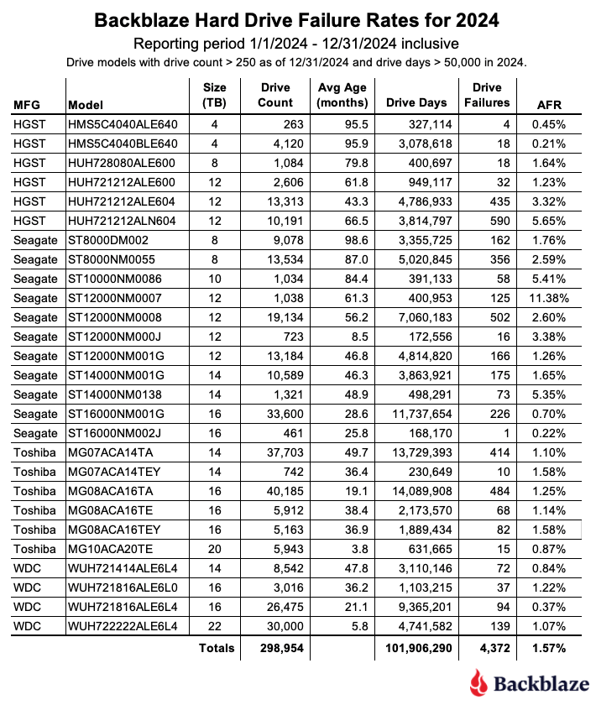
Redundancy / Backups
What if a drive fails?

Slide 4
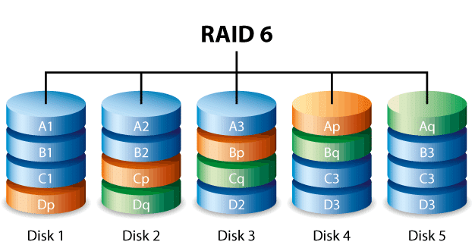
2. High-Availability
What if a drive fails, AND you don’t want stuff to break until it’s replaced?
We want the backups to immediately fill the role of the primaries when needed.

Slide 5
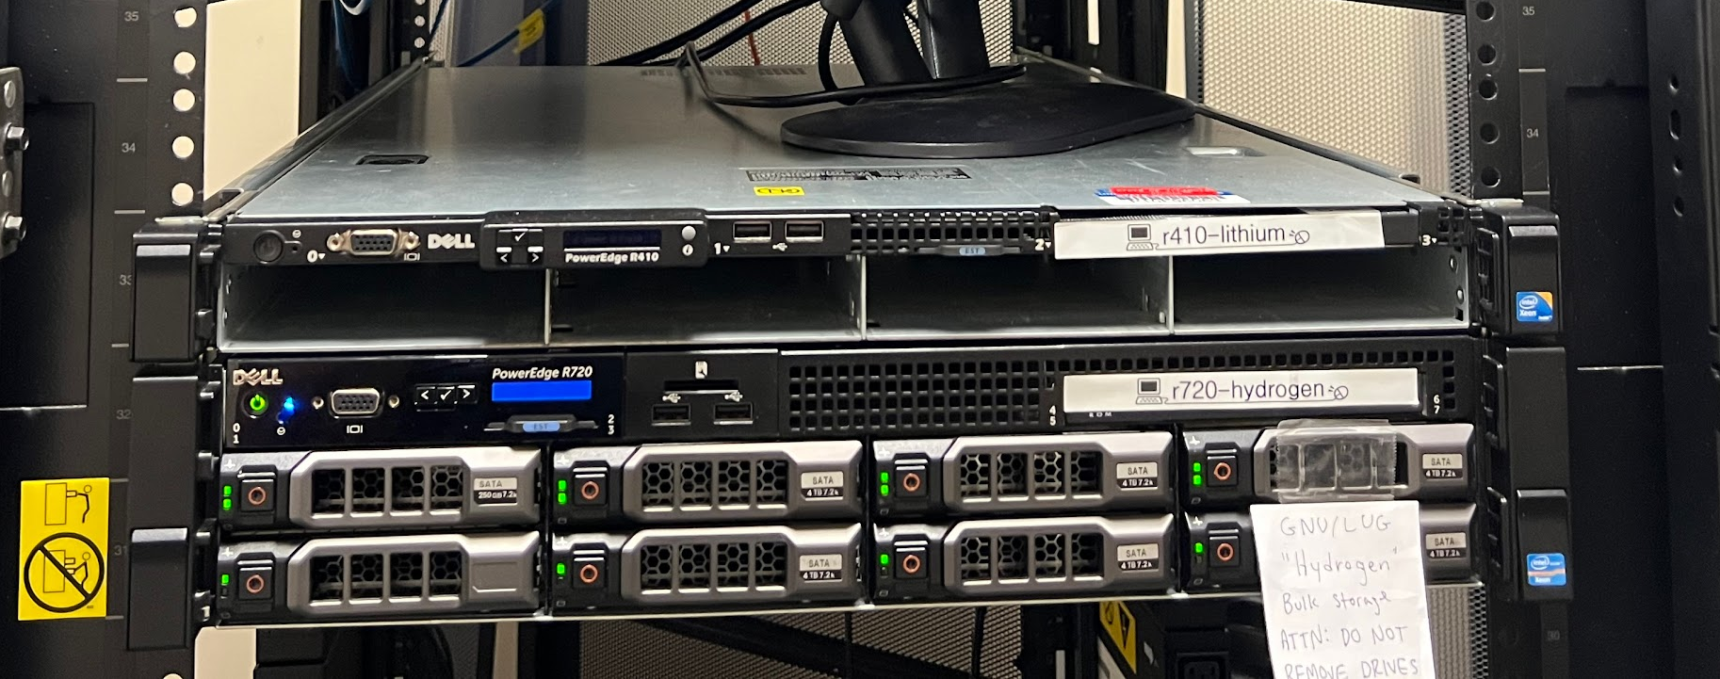
4. High-Availability Part 2
What if a server fails?
What if the whole rack loses power?

Slide 6

What is Ceph?

Slide 7
TL;DR
ZFS, but the drives are split among multiple servers (over the network).

Slide 8
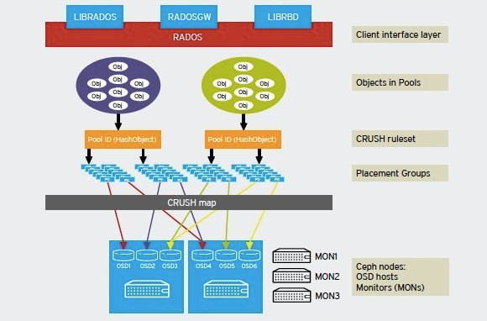
Ceph Architecture

Slide 9
Ceph from a Hardware POV

Slide 10
We want three copies of data
Why?
Sometimes, you’re in a situation where a drive doesn’t fail, but a few bits flip (see: bit rot)
The concept of quorum: If two copies of the data agree on something, that’s considered “truth”
101010111101001000010101110101
101010110101001000010101110101
101010111101001010010101110101

Slide 11
How do we account for both drive failures and server failures?

Slide 12
Server A
Server B
Server C

Slide 13
Quick Terminology Note
Individual drives are wrapped in OSDs (Object Storage Daemons)
Each “block” of data is called a PG (Placement Group)
The random-ish algorithm that assigns PGs to OSDs is called CRUSH (Controlled Replication Under Scalable Hashing)
There’s a paper about this!

Slide 14
We Still Need…
A way to route data requests to the right drives
If I want to read from , Ceph needs to find one of the copies and give it to me
If I want to write to , Ceph needs to write to all three copies of

Slide 15
Server D - Monitor
Server A
Server B
Server C

Slide 16
Read
Server D - Monitor
Server A
Server B
Server C

Slide 17
Write
Server D - Monitor
Server A
Server B
Server C

Slide 18
Write
Server D - Monitor
Server E - Monitor
Server F - Monitor
Server A
Server B
Server C

Slide 19
We Still Need…
A way to route data requests to the right drives
If I want to read from , Ceph needs to find one of the copies and give it to me
If I want to write to , Ceph needs to write to all three copies of

Slide 20
We Still Need…
A way to route data requests to the right drives
If I want to read from , Ceph needs to find one of the copies and give it to me
If I want to write to , Ceph needs to write to all three copies of
A way to scan all copies of data to find inconsistencies
101010111101001000010101110101
101010110101001000010101110101
101010111101001010010101110101

Slide 21
Scrubbing
Server D - Monitor
Server E - Monitor
Server F - Monitor
Server A
Server B
Server C

Slide 22
Scrubbing
Think of it like fsck
Light Scrubbing:
Happens daily (per PG)
Compare overall characteristics (object size, attributes, etc.)
Deep Scrubbing:
Happens weekly (per PG)
Compare data checksums
If they don’t match, compare data bit-by-bit

Slide 23
We Still Need…
A way to route data requests to the right drives
If I want to read from , Ceph needs to find one of the copies and give it to me
If I want to write to , Ceph needs to write to all three copies of
A way to scan all copies of data to find inconsistencies

Slide 24
Ceph from a Software POV

Slide 25
Ceph Architecture (So Far)
Server D - Monitor
Server E - Monitor
Server F - Monitor
Server A
Server B
Server C

Slide 26
What can we build on top of this architecture?
A lot.
CephFS - A journaling POSIX filesystem
It’s very complicated
There’s another great paper on this!
RBD - Block Device
Literally just splits data into blocks
Very powerful, especially for running VMs (great QEMU support)
RGW - Object Gateway
AWS S3-like Buckets of data
Provides an S3-compatible API

Slide 27
Ceph Pools
A high-level group of data
You could have a pool for:
Filesystem (CephFS)
VMs
Less important VMs
Logs
…
Main advantage: per-pool replication configuration
Filesystem should be replicated 5x
VMs should be replicated 5x
Less important VMs should be replicated 3x
Logs should be replicated 1x

Slide 28
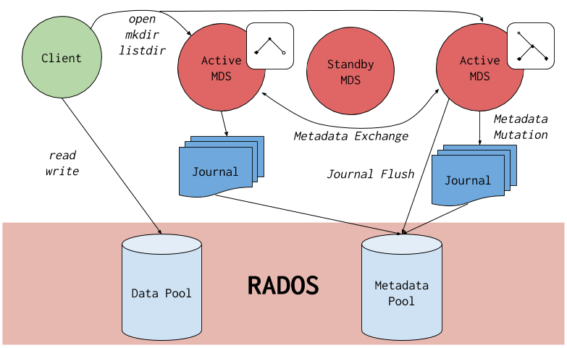
CephFS Architecture

Slide 29
MDS: Metadata Server
Server G - MDS
Server D - Monitor
Server A
Server B
Server C

Slide 30
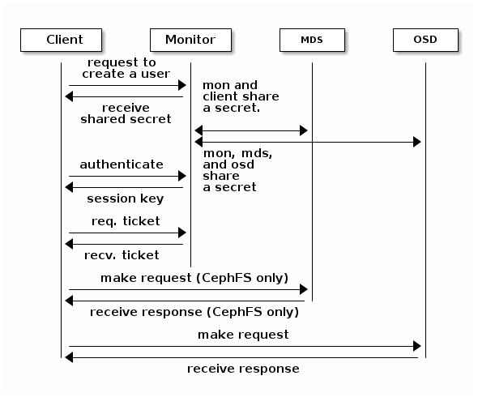
Authentication

Slide 31
Other Random (Potentially Cool) Things
CephFS works really well with NFS (The Network File System Protocol)
You can share specific directories within CephFS
These will generally be public-facing directories, as opposed to internal ones
This bypasses Ceph-based authentication, but allows for your own implementation (e.g. Kerberos)
Snapshots
Supported by both CephFS and RBD
These don’t store the entire state of your filesystem or VM (as that’s expensive…)
They use Copy-on-Write (COW) for future modifications
Surprisingly efficient

Slide 32
Demo

Slide 33
Thank You!
Questions? Comments?

