Slide 1
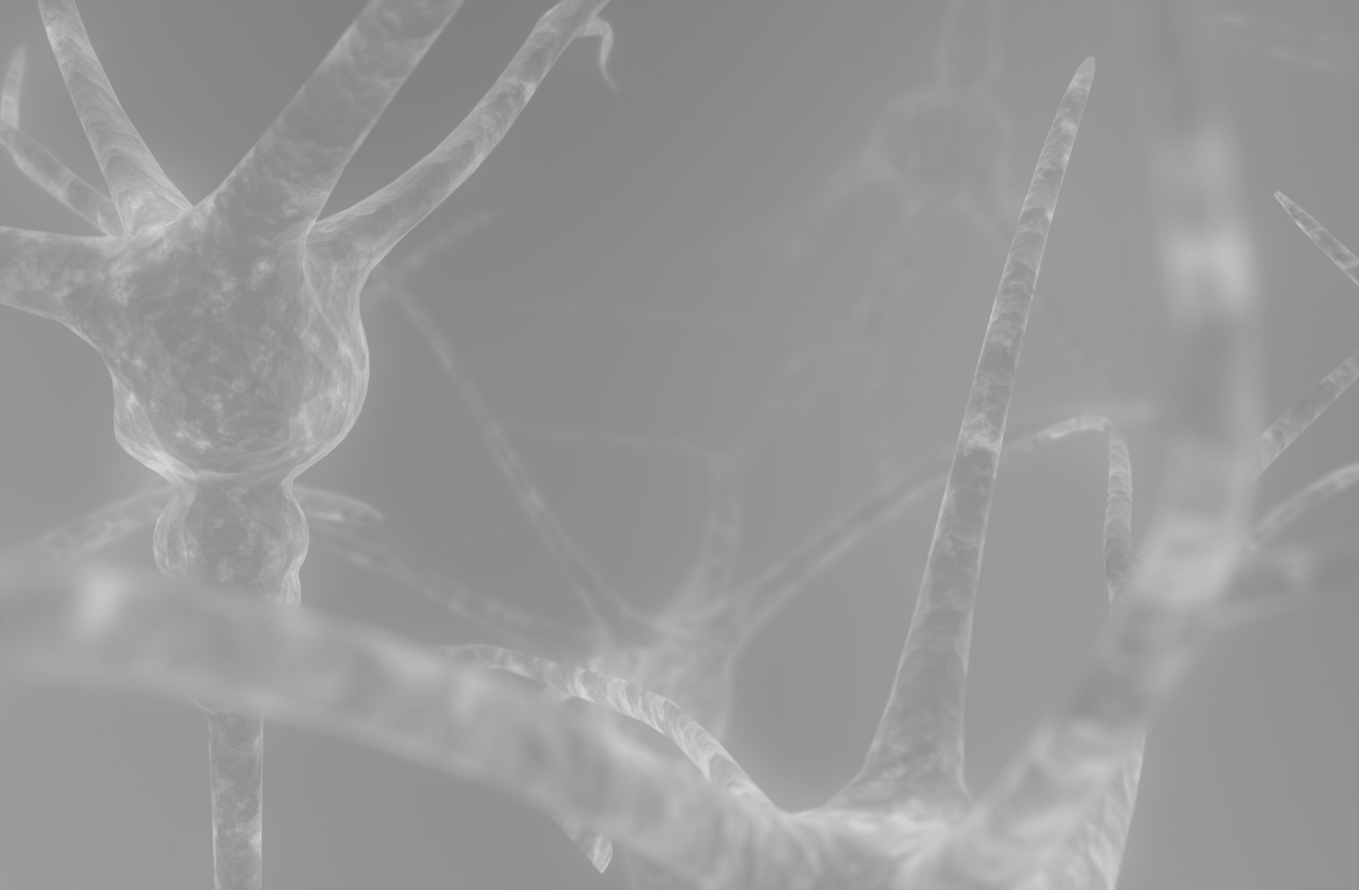
Spike Time Based Image Processing -
Reproducing Biological Vision in Hardware
29.06 2016 Daniel Mayer

Slide 2
Outline
Motivation
Silicon retina
Memristive arrays
Discusion

Slide 3
Motivation
Hebb's rule
Siegrid Löwel's phrasing of Hebb's rule(1992):
“Neurons wire together, if they fire together.”
Hebbs original meaning:
“Cell A must fire just before cell B as to strengthen the connection”
Hebb was foreseeing Spike Time Dependent Plasticity (STDP)

Slide 4
Motivation
STDP
In just 150 ms from the retina to the top level neurons in the Neocortex (face recognition)
About 10 layers of neurons to be passed
Neurons spike seldom faster than 100Hz (10ms) and stimuli travel at 1-2 m/s
That leaves in average one spike per neuron to transmit information

Slide 5
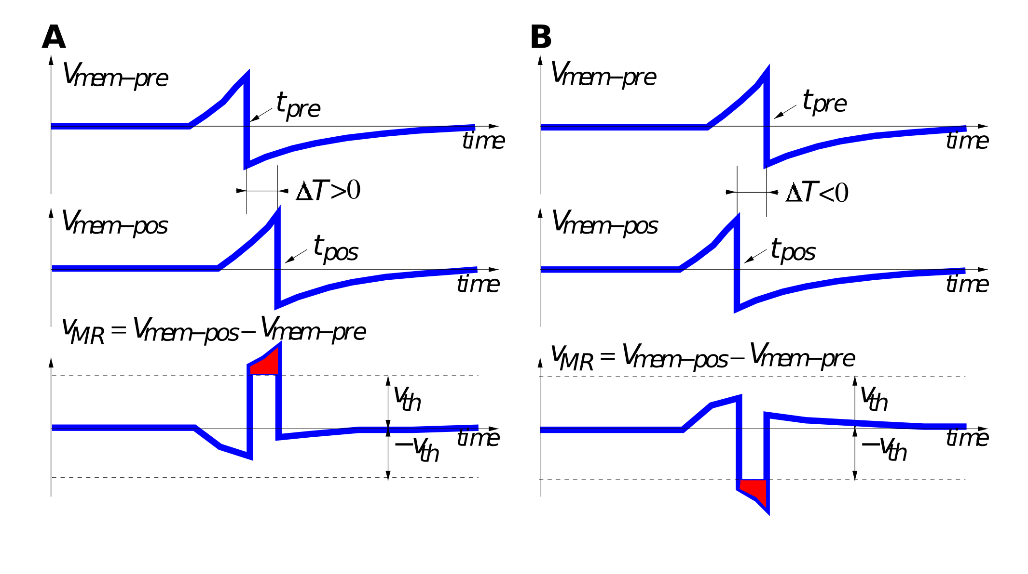
Motivation
STDP
How can the information be encoded in the frequency if in average every neuron receives one spike before firing itself?
→ information must be stored in the relative spike timing [Thorpe et al]

Slide 6
Silicon Retina
Conventional digital imaging chips have a frame-rate
→ nothing is ever communicated before the next frame
→ if nothing is changing, it still uses full bandwidth for communicating basically very little
Biological vision on the other hand transmits stimuli right away and sends more information when more is happening

Slide 7
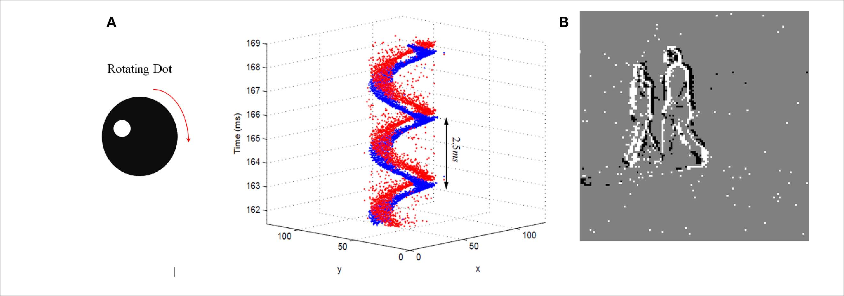
Silicon Retina by Lichtensteiner et al.
Asynchronous Temporal Contrast Vision Sensor

Slide 8
You may now
pose questions

