Slide 1

HEART DISEASE PREDICTION MODELS
CM4044
GROUP 3
Ashley Li
Scott Teo
Trung Huynh

Slide 2

Significance
Heart disease is one of the most significant causes of mortality
Cardiovascular disease prediction is a critical challenge in the area of clinical data analysis
Machine learning has been shown to be effective in making decisions and prediction from large quantities of data

Slide 3
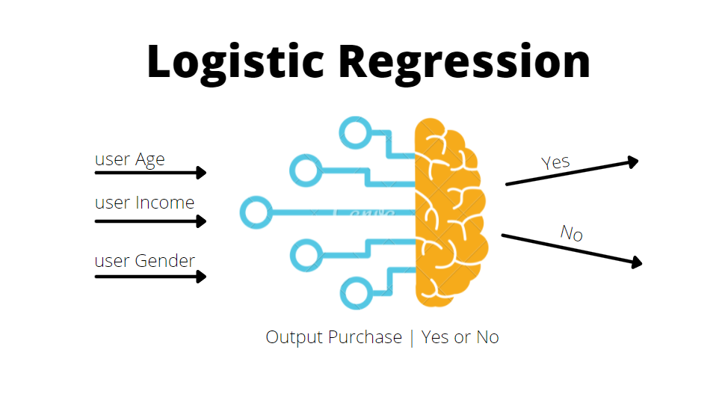

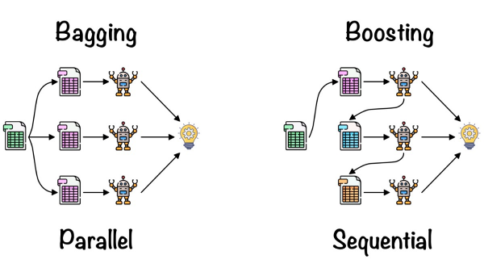
Problem Statement
We utilize different machine learning models to find the best performer algorithm to predict the absence and presence of heart disease
Target is a binary classification (1 = have disease, 0 = no disease)

Slide 4
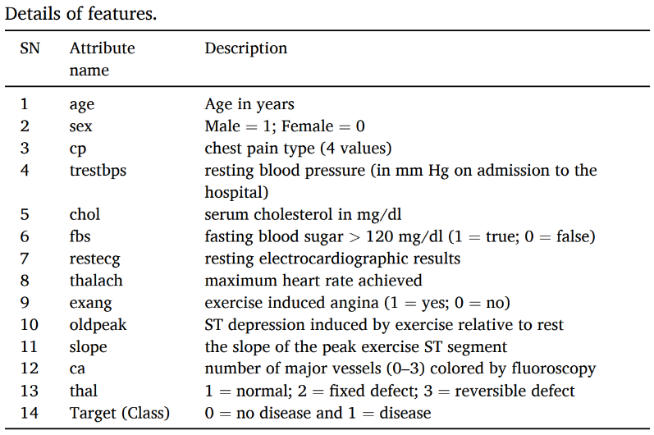
Dataset and Features
A heart disease dataset was processed to design our machine learning models
The dataset was gathered from Kaggle
The dataset contains 303 patient records with 14 attributes
https://www.kaggle.com/datasets/rashikrahmanpritom/heart-attack-analysis-prediction-dataset/data

Slide 5
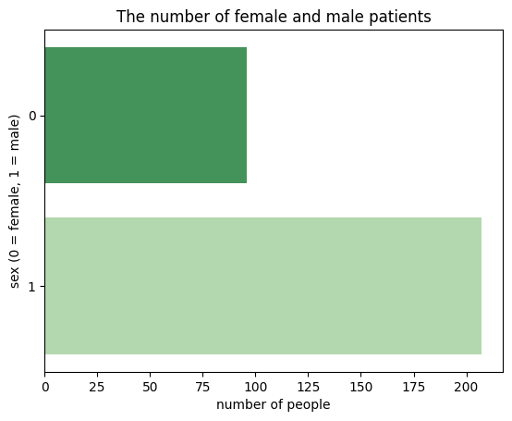
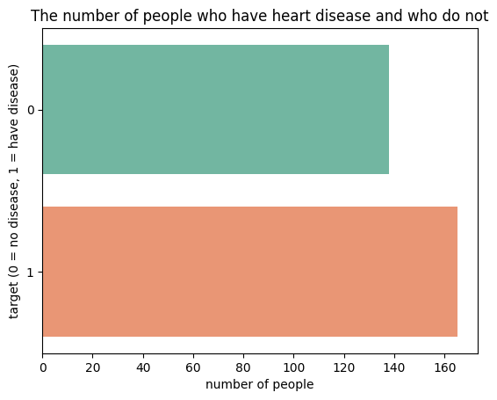
Exploratory Data Analysis
Percentage of male patients: 68.32%
Percentage of female patients: 32.68%
Percentage of those who have disease: 54.46%
Percentage of those who don’t: 45.54%

Slide 6
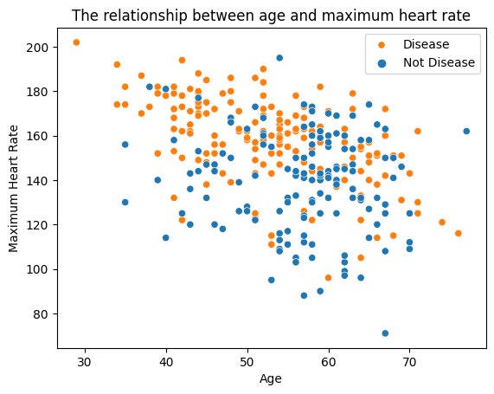
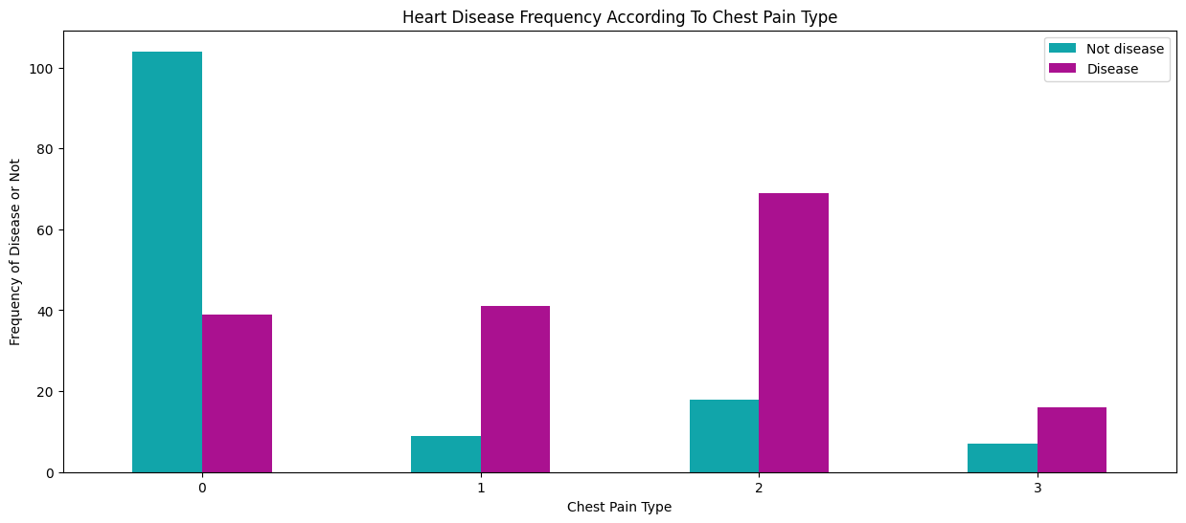
Exploratory Data Analysis

Slide 7
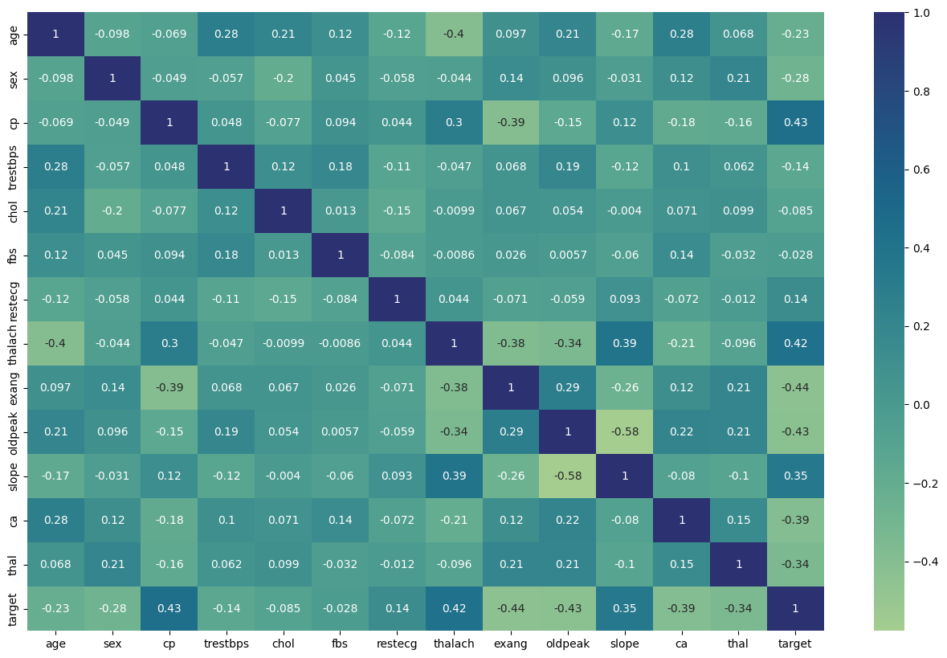
Exploratory Data Analysis

Slide 8
Data preprocessing
Convert the categorical variables to dummy variables.
Concatenate the new dummy variables and drop the categorical variables

Slide 9
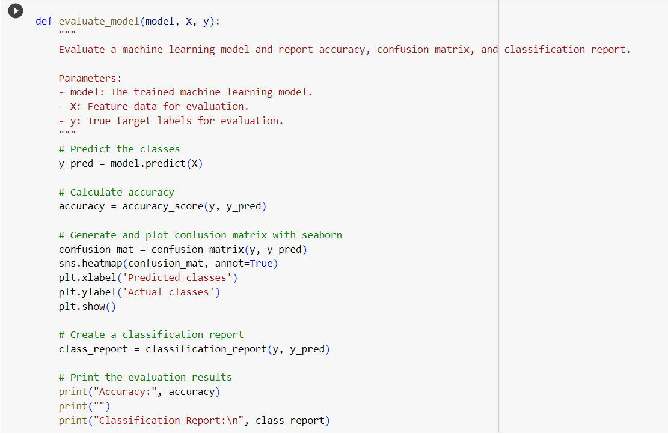
Model preparation
Import necessary packages
Split the dataset into 20% for testing and 80% for training with random state of 42
Check whether the dataset is balanced
Normalize the data with StandardScaler
Develop a function to generate the accuracy score, confusion matrix, and classification report

Slide 10

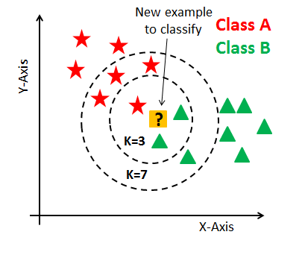
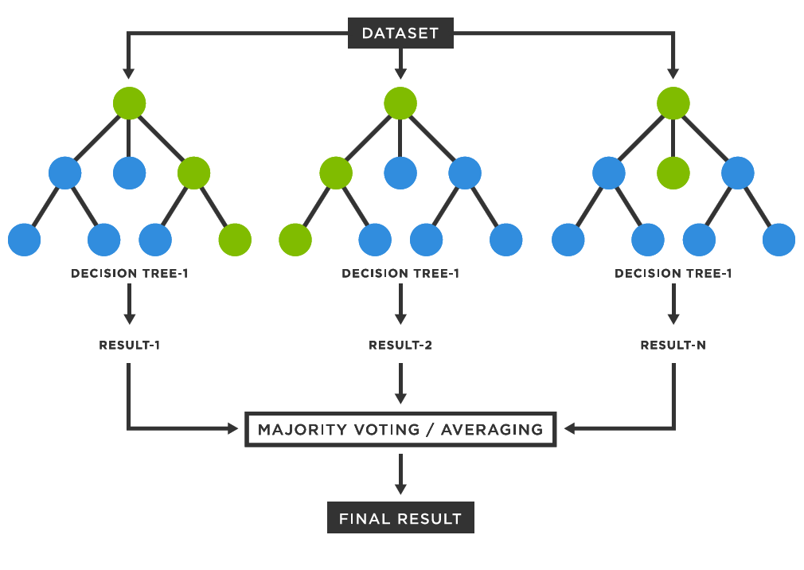
Approach and Methodology

Slide 11
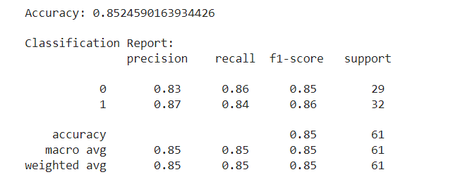
Logistic Regression
Notes:
Firstly, logistic regression. (insert background of logistic regression) As you can see, the accuracy of this model is roughly 85.25%

Slide 12
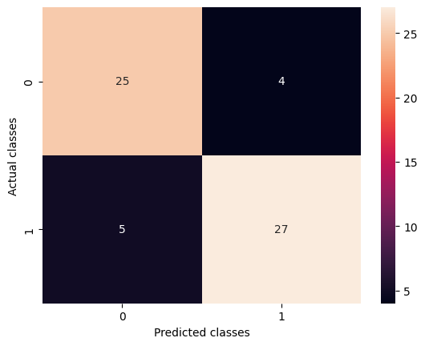
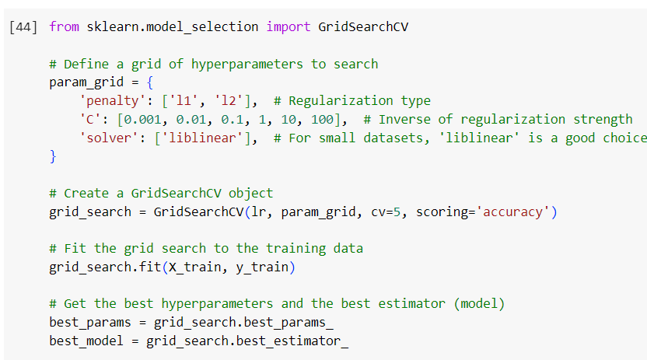
Logistic regression
There is no change in the accuracy of logistic regression model after tuning hyperparameters.

Slide 13
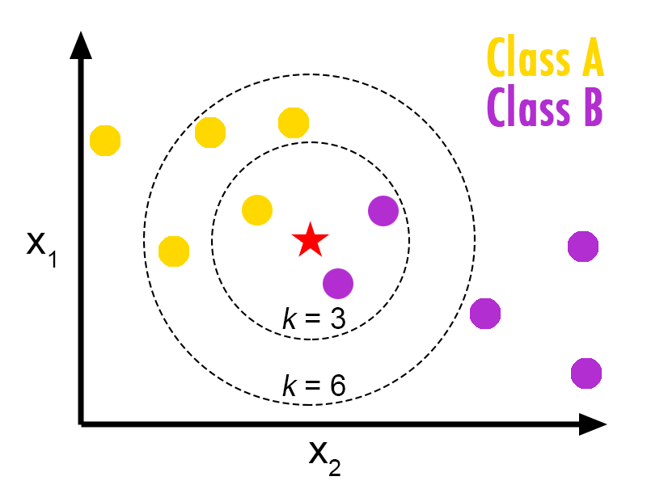
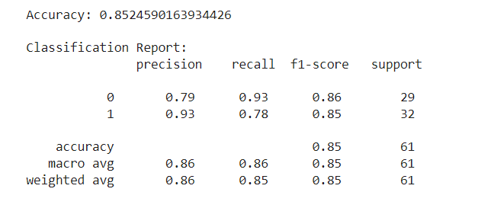
K-nearest Neighbor Algorithm
kNN was randomly implemented with 3 neighbors
It showed an accuracy of 85.24%
https://medium.com/learning-machine-learning-by-gc-nit/k-nearest-neighbors-algorithm-k-nn-937917329d4d

Slide 14
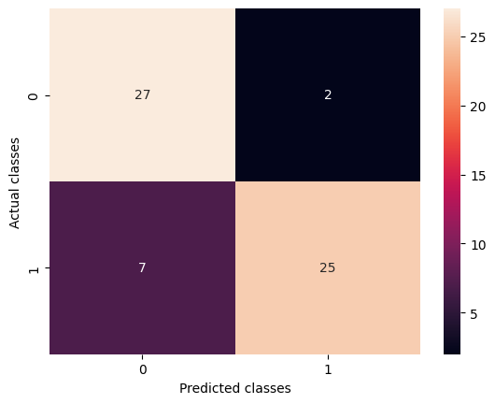
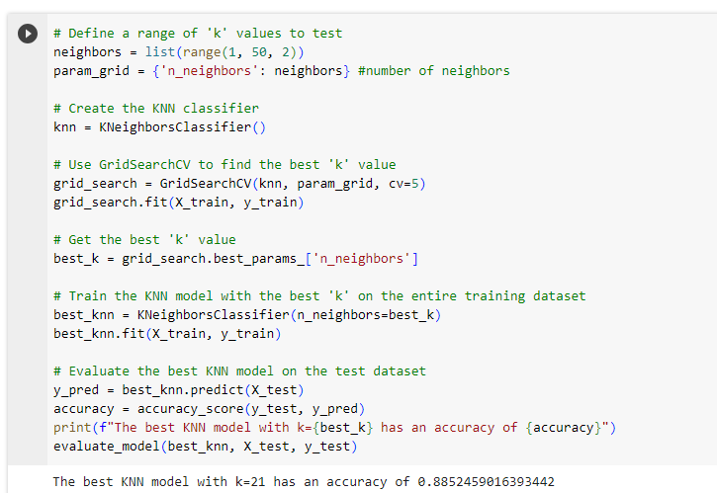
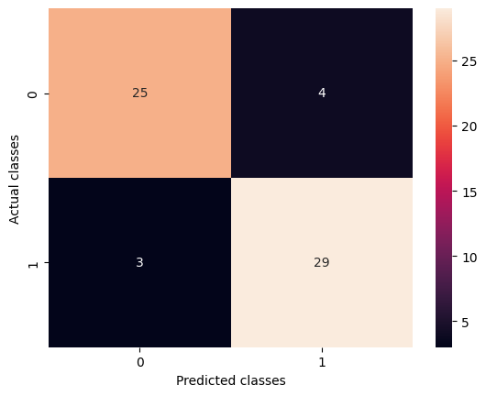
K-nearest neighbor Algorithm - Hyperparameter Tuning
Tune on different numbers of neighbors with 5-fold cross-validation.
Accuracy: 85.24%
after tuning
Accuracy: 88.52%

Slide 15
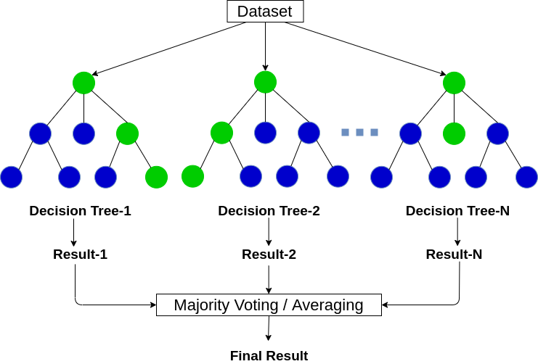
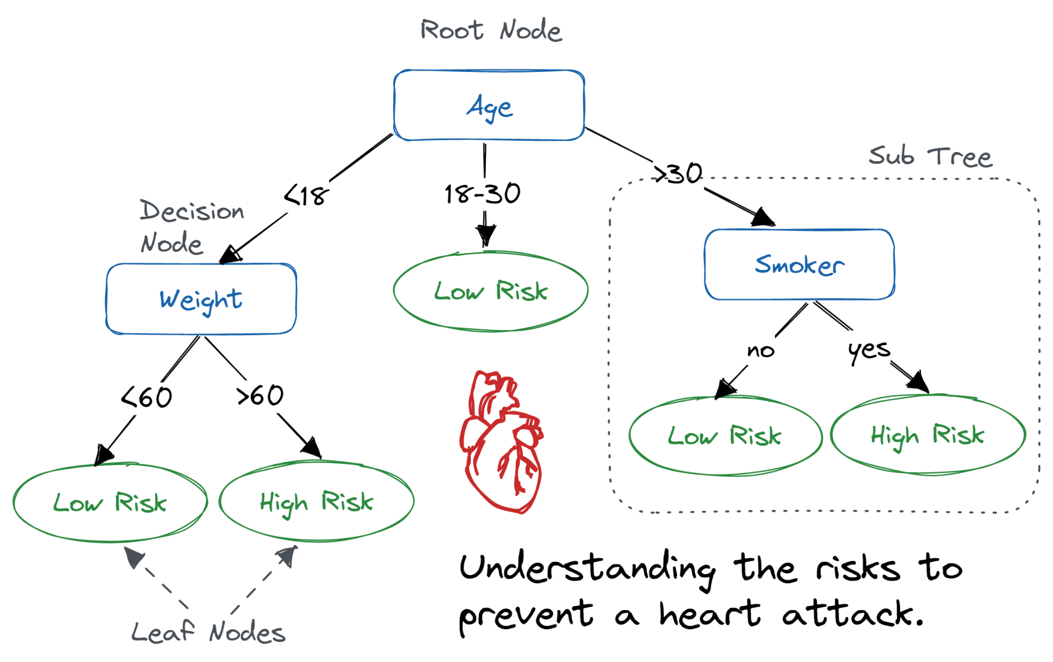
Decision Tree and Random Forest
Decision Tree
Random Forest
Notes:
Random forest is an ensemble learning method for classification and regression. It has a class of decision trees to learn the same dataset and each decision tree makes prediction. It then takes vote or average for final result.

Slide 16
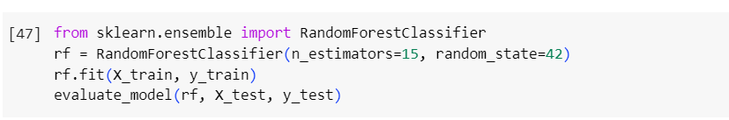
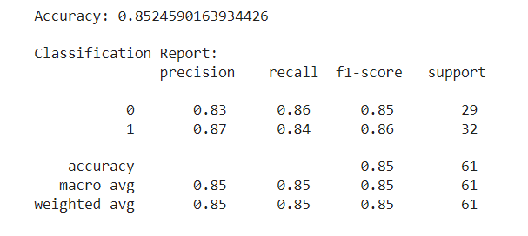
Random Forest
Random forest algorithm was first applied with 15 trees and a random state of 42.

Slide 17
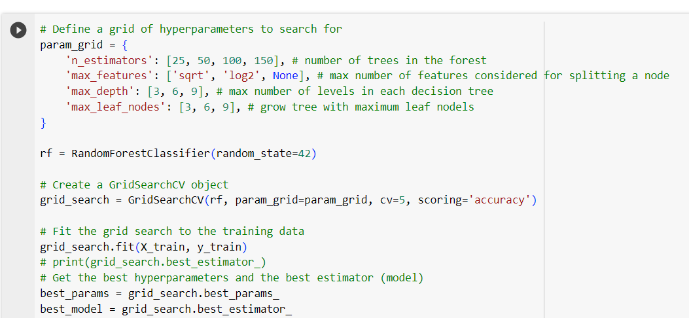
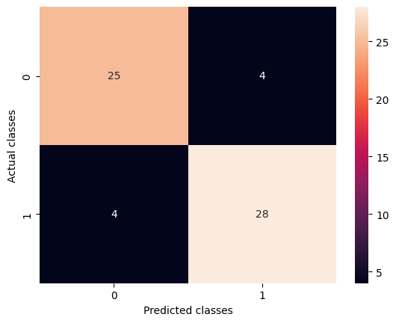
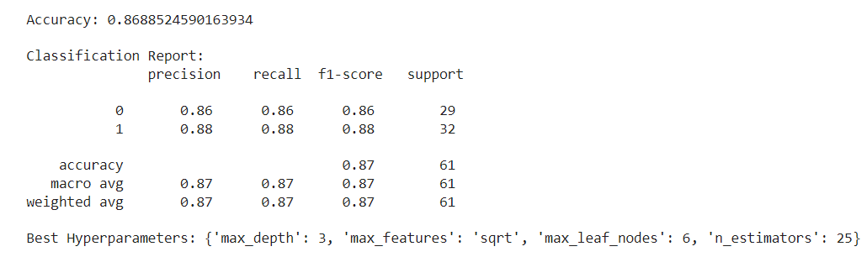
Random Forest - Hyperparameters Tuning

Slide 18
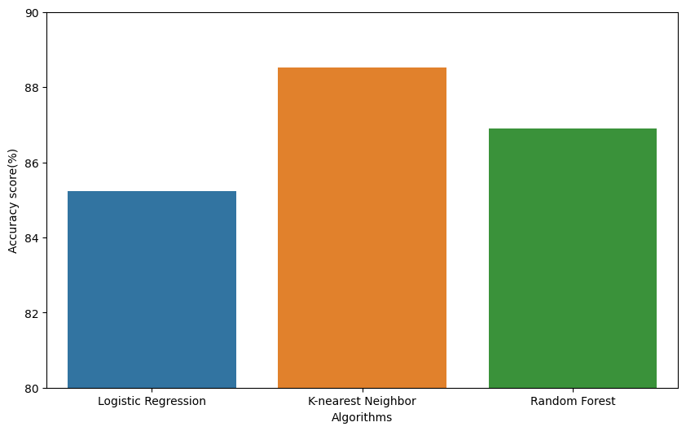
Conclusion and Future Work
The prediction model were developed using 13 features from the dataset.
The highest accuracy was achieved with K-nearest neighbor algorithm (n=21) comparing to the others two methods.
There is a need to know how well the models perform in a bigger dataset

Slide 19


Slide 20


Slide 21
References
https://www.who.int/health-topics/cardiovascular-diseases#tab=tab_1
https://www.kaggle.com/datasets/rashikrahmanpritom/heart-attack-analysis-prediction-dataset/data

