Slide 1
New Trends in Road Construction
Innovations, Sustainability, and Smart Technologies

Slide 2
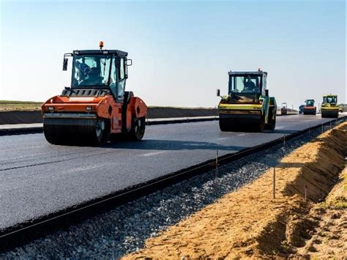
1. Introduction
Road construction is evolving with modern technologies.
Focus on safety, sustainability, and efficiency.

Slide 3
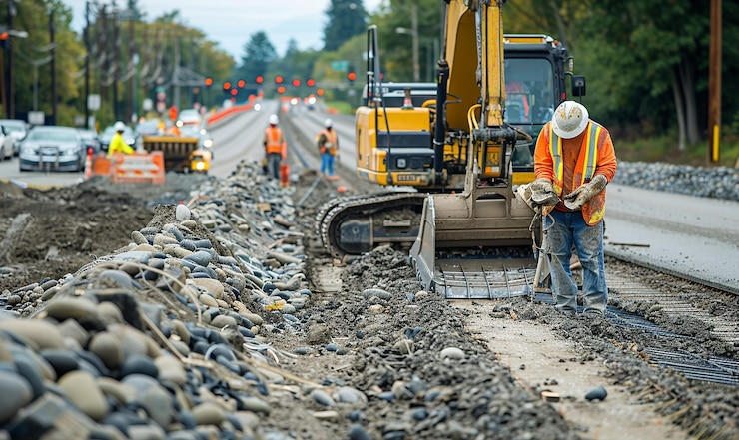
2. Sustainable Materials
- Recycled asphalt and concrete
- Use of plastic waste in roads
- Eco-friendly binders

Slide 4
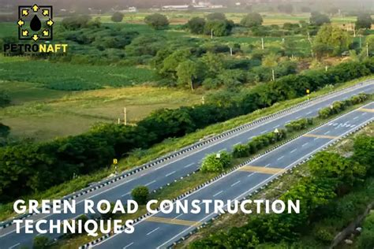
3. Smart Roads
- Roads with embedded sensors
- Communication with autonomous vehicles
- Traffic and weather monitoring

Slide 5

4. Green Construction Practices
- Reduced CO2 emissions
- Energy-efficient machinery
- Renewable energy in road projects

Slide 6
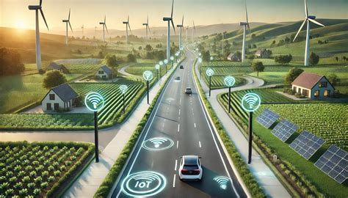
5. Advanced Construction Techniques
- 3D printing of road components
- Modular road construction
- Prefabricated road sections

Slide 7
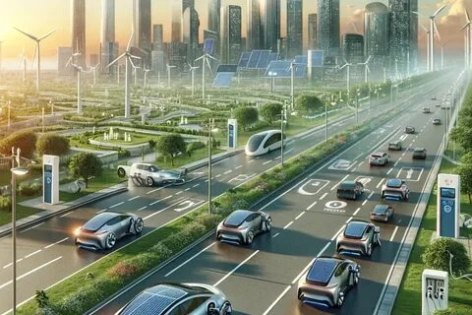
6. Safety Innovations
- Intelligent traffic signs
- Glow-in-the-dark road markings
- Crash-reducing road designs

Slide 8

7. Case Studies
- Netherlands: PlasticRoad project
- Sweden: Electrified roads for charging EVs
- USA: Smart highways with IoT technology

Slide 9

8. Conclusion
Future roads will be smart, sustainable, and safe.
Integration of technology will transform transportation.

