Slide 1
Big Mountain Ski Resort Ticket Pricing Strategy
Grace Nye

Slide 2
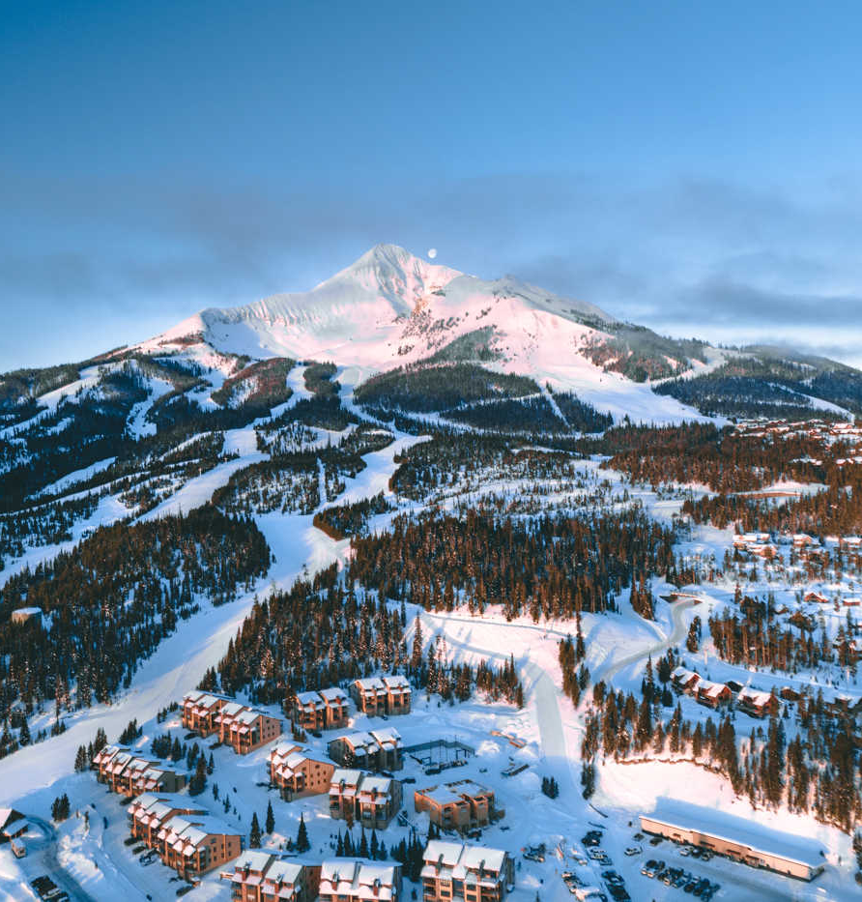
Big Mountain Ski Resort
New chair lift installed – need to offset the increase in operational costs by increasing revenue
Can the market support an increase in ticket pricing?
What facilities at the resort do customers value most?

Slide 3
Big Mountain Ski Resort
How can we increase revenue by 10% and offset the increased operational cost of the new chair lift over the next season by increasing ticket prices, adding new facilities that customers value, or removing facilities that customers do not value?

Slide 4
Recommendation and key findings
Number of fast quads
Total runs
Snow making coverage
Vertical drop
Skiable terrain
Number of chairs
Key facilities:
Recommendation: add a run, lengthen the longest run by 150 feet, add a chair lift
This scenario supports a ticket price increase of $1.99
Could be expected to add up to $3,474,638 in additional revenue over the season

Slide 5
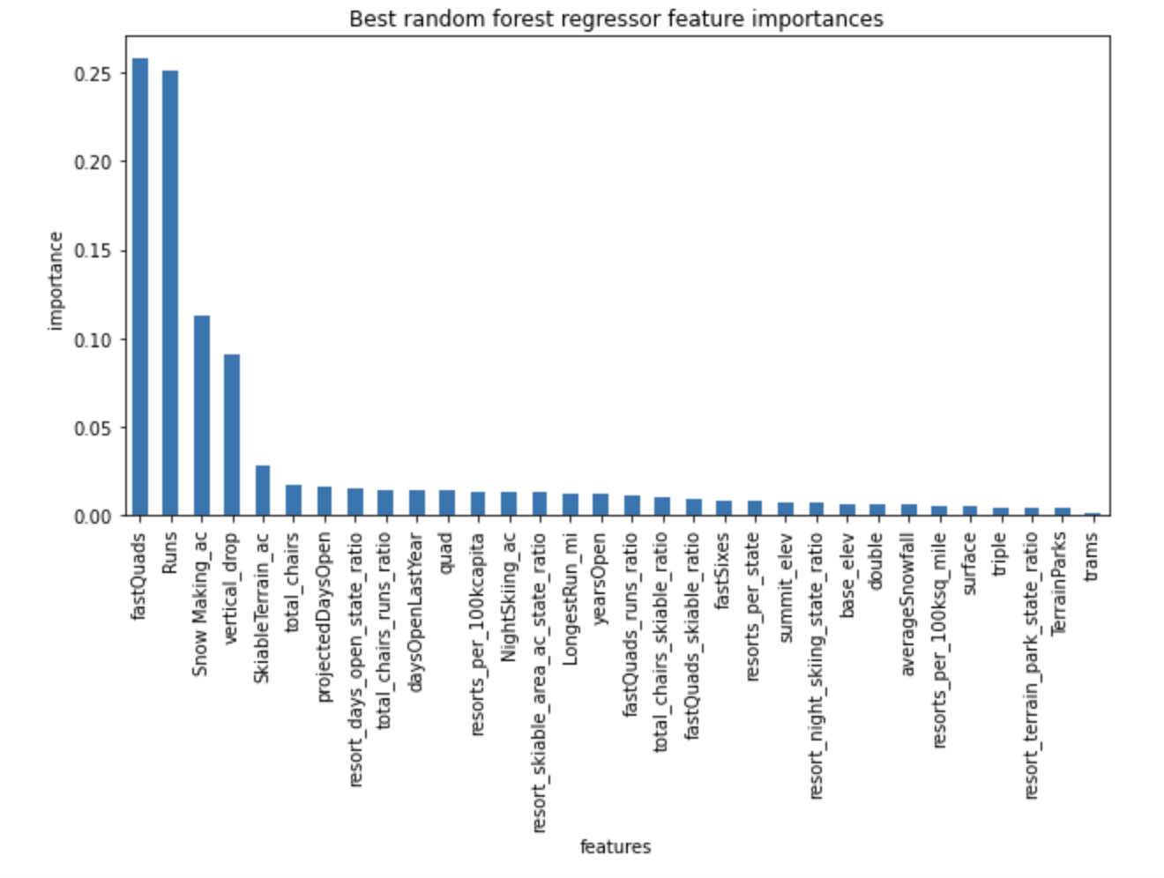
Modelling Results & Analysis
Model is a random forest regressor, chosen because of its performance on the test set and in cross-validation
Has a mean absolute error of $10.39

Slide 6
Modelling Results & Analysis
Model predicts a ticket price of $95.87, actual price is $81.00
Even assuming the full range of error, still suggests the market could support a ticket price of $85.48, a $4.48 increase
Big Mountain Resort falls at the high end of the distributions for each of the six valuable features mentioned above

Slide 7
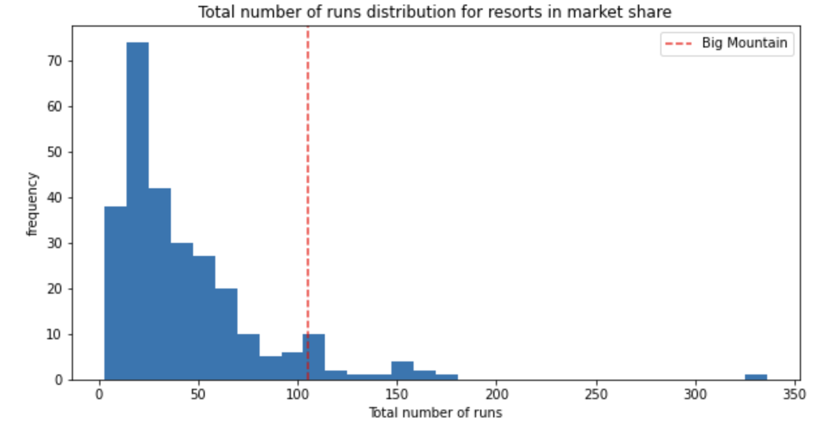
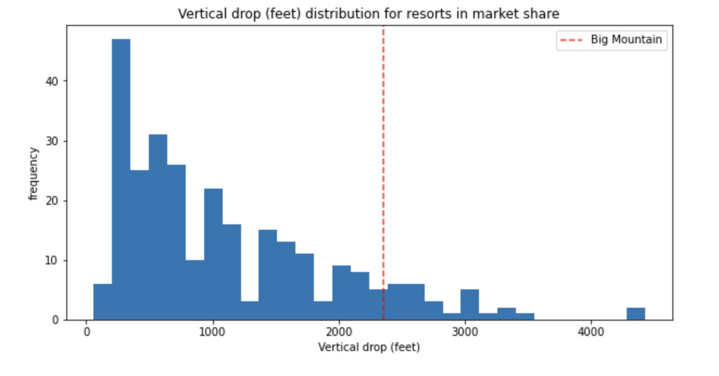
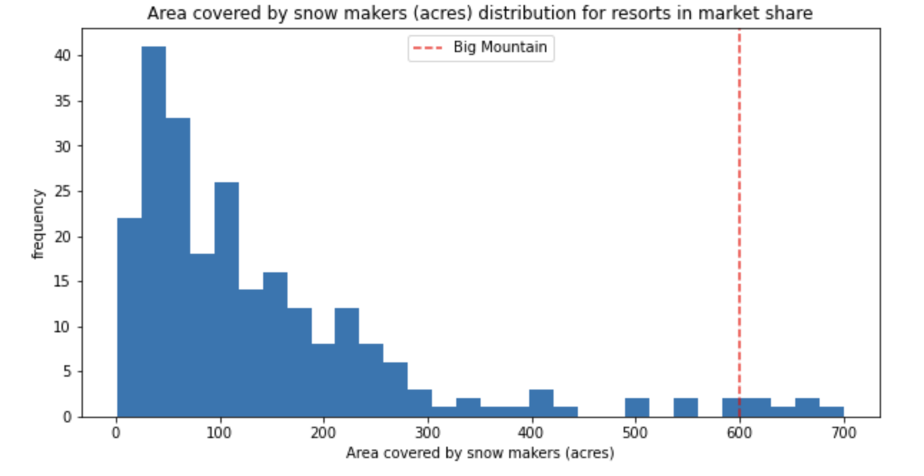
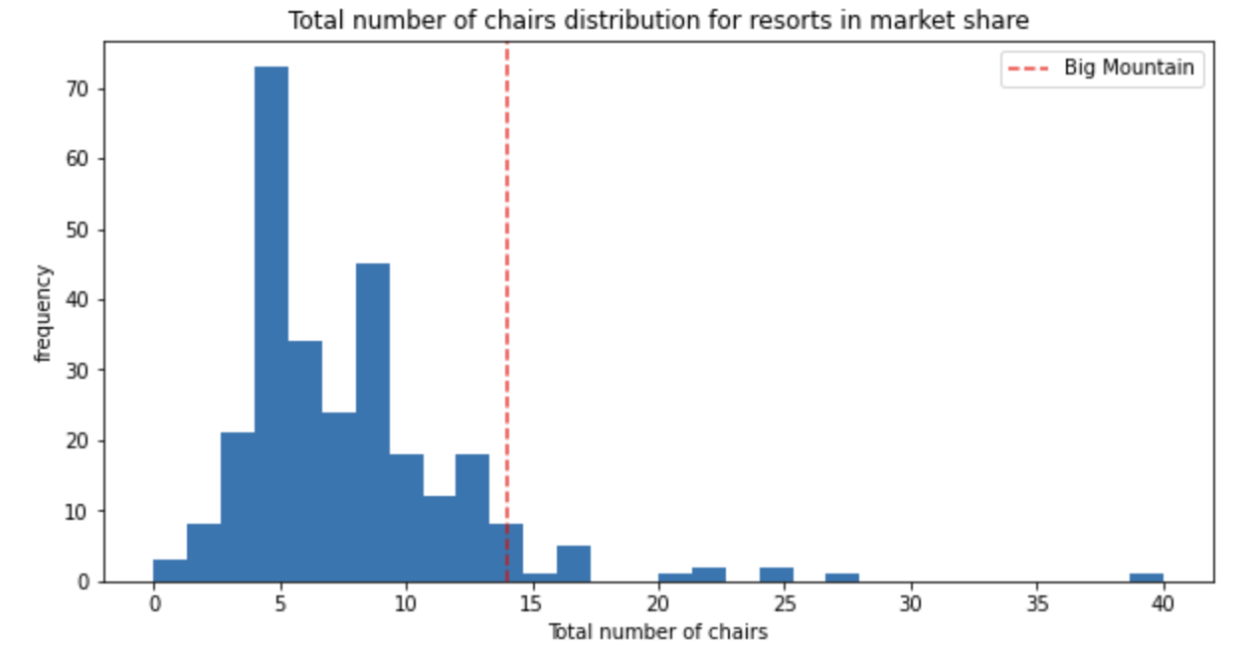

Slide 8
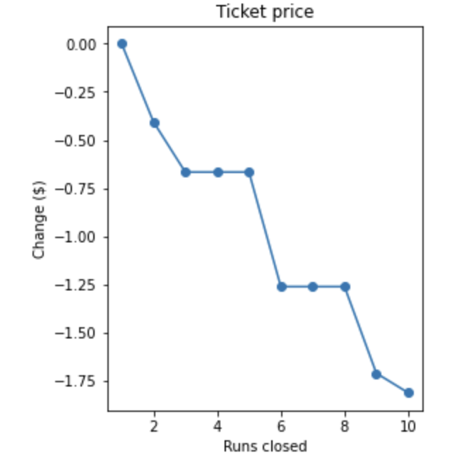
Modelling Results & Analysis
Scenario 1
Close up to ten runs
Data suggests that closing any more than 1 run will result in a decrease in ticket price
Scenario 2
Add a run, lengthen the longest run by 150 feet, add a chair lift
Supports an increase in ticket price of $1.99 → could lead to an increase in revenue of $3,474,638 over the season
Scenario 3
Add a run, lengthen the longest run by 150 feet, add a chair lift, add 2 acres of snow making coverage
Supports the same increase in ticket price as scenario 2, but with additional operational costs
Scenario 4
Lengthen the longest run by 0.2 miles, add 4 acres of snow making coverage
Data does not suggest this will affect ticket prices, either positively or negatively

Slide 9
Conclusion
Big Mountain Resort may be undercharging – the market can support an increase in ticket price, especially since Big Mountain boasts many of the features most attractive to customers
The model suggests that of the proposed scenarios, Scenario 2 will lead to the greatest increase in revenue with the least addition to operating costs
Uncertainty in our model is caused by the lack of some data that may be valuable, for example, number of visitors to each resort every year as well as operational costs

