Slide 1
Prediction binding sites of an RNA-binding protein (RBP)
Grace Nye

Slide 2
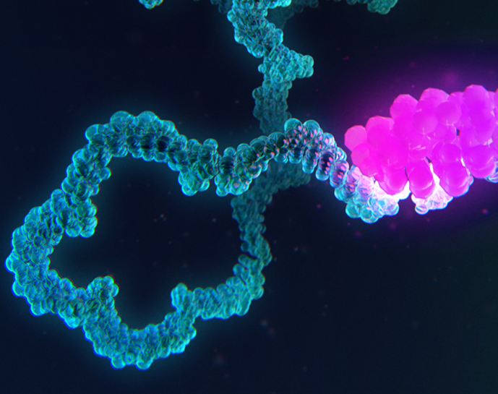
RNA binding proteins
5-10% of the proteome
Key roles in many biological processes
Experiments are time-consuming and costly!

Slide 3
How can we predict where an RBP might bind?

Slide 4
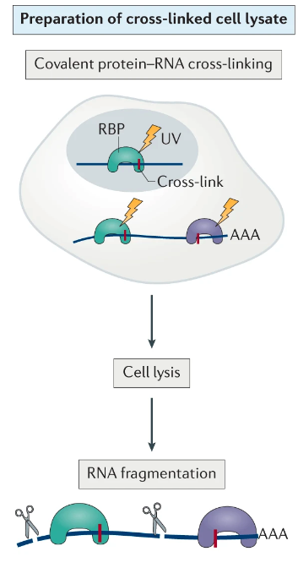
CLIP-seq Data
Cross-link RNA with bound proteins
Purify RNA
Sequencing and analysis

Slide 5
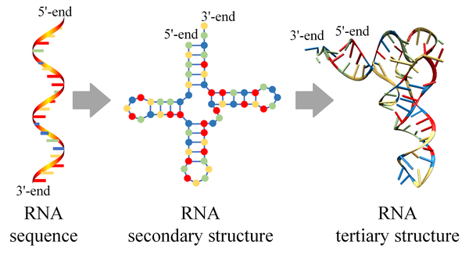
RNA Structure: EternaFold

Slide 6
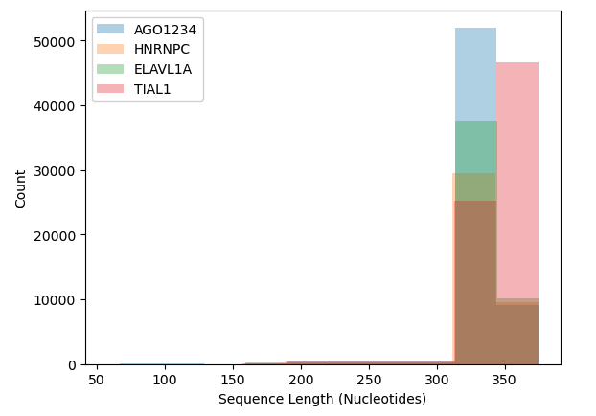
RBP Datasets

Slide 7
EternaFold Base Pairing Data
RNA helix

Slide 8
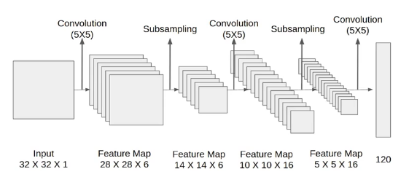
CNN Architecture
LeNet Architecture:
Accuracy = 0.83
Evidence of overfitting
VGG Architecture:
Accuracy = 0.53
LeNet Architecture

Slide 9
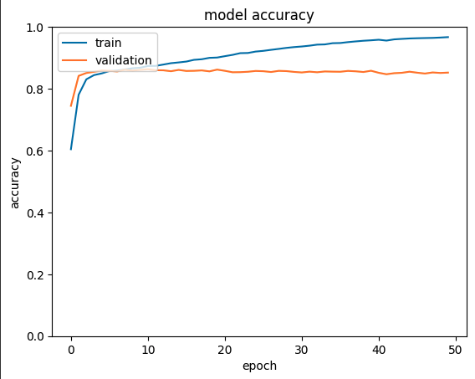
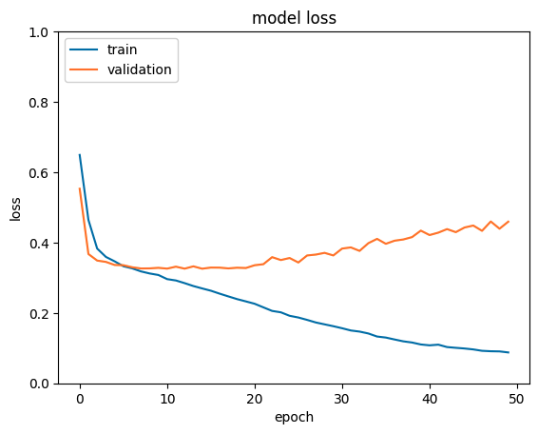
LeNet Overfitting?

Slide 10
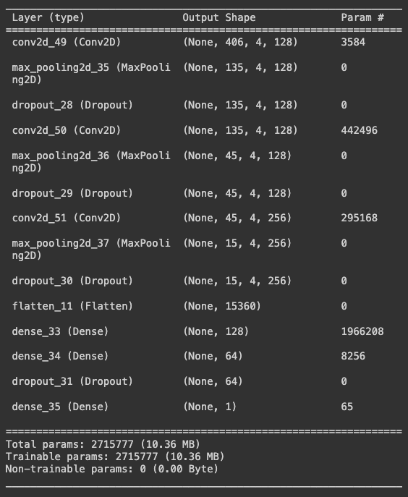
Customized LeNet
Added an additional convolution and subsampling step
Added dropout layers after each subsampling step to prevent overfitting

Slide 11
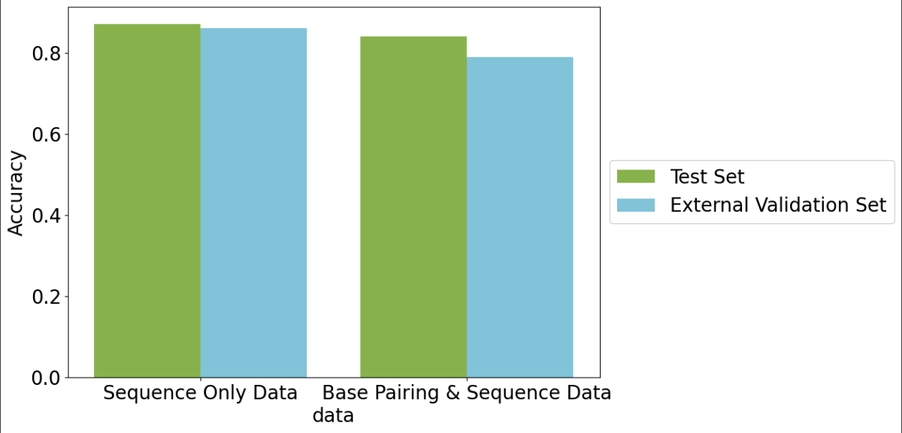
Model Accuracy

Slide 12
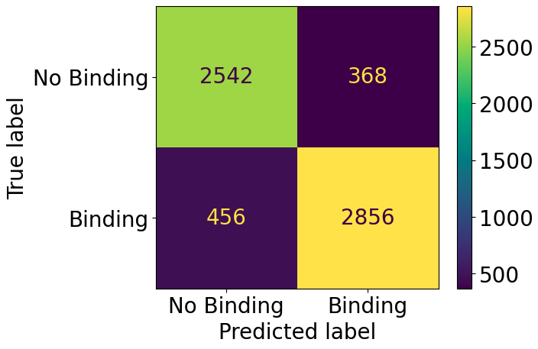
Negative f1-score: 0.86
Positive f1-score: 0.87

Slide 13
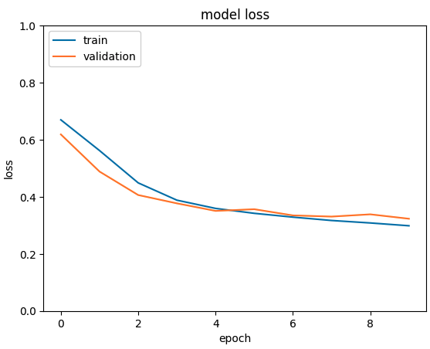
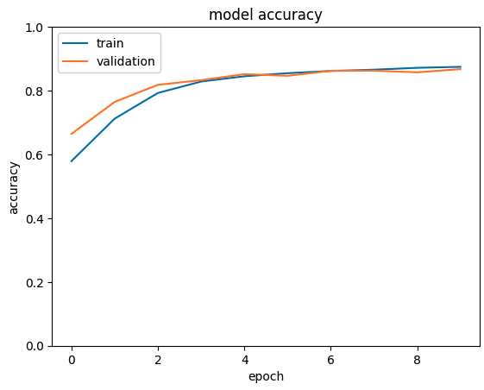

Slide 14
Conclusions & Future Directions
Surprisingly, the model trained with EternaFold data performed slightly worse
Best model had an overall accuracy of 0.87
Evaluation of model on 23 other RBP datasets

