Slide 1

Air Canvas
Team Python thinkers

Slide 2

Team Members
Anto Francis (C0825095)
Omer Volkan Guney (C0831373)
Rupesh Chandran (C0826779)
Sachin Sreekumar (C0825096)
Reporting Week: Feb 13, 2022 to Feb 19, 2022
Supervised by
Prof. Parissa Naraei

Slide 3
Week’s update
Canvas creation
Created ink buttons on the canvas
Created color point arrays

Slide 4
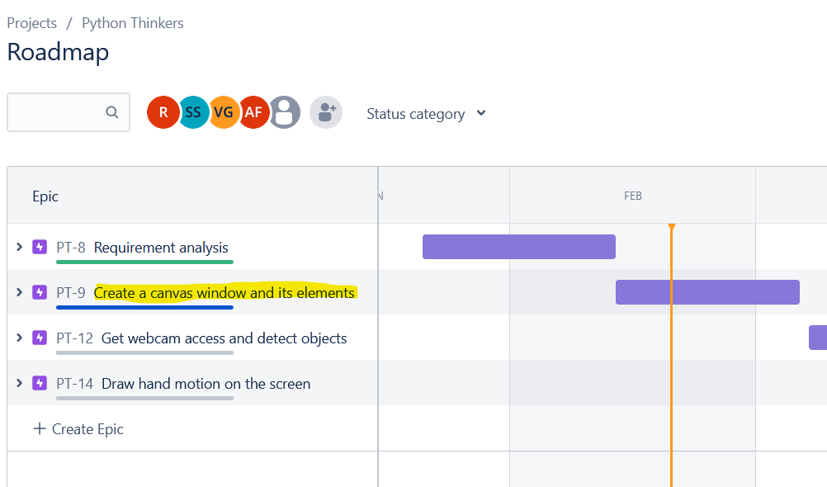
Week’s update
Stepping forward to second phase of the project
Next project milestone is creating the Canvas and color elements

Slide 5
Challenges/Learnings this week
Create Canvas
Create ink buttons
Create arrays for color points

Slide 6
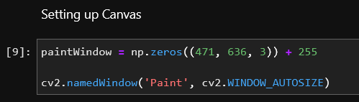
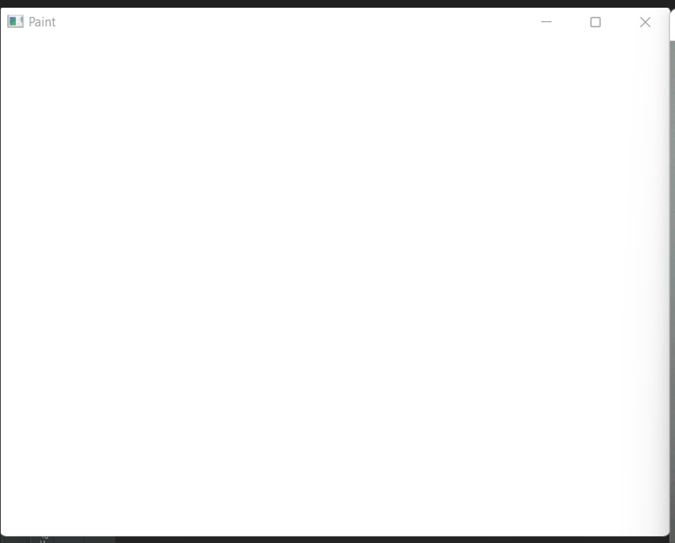
Canvas creation
Canvas refers to the workspace where the input is accounted.
Assigned individual tasks and decided the duration of each tasks
We coded a workspace of resolution 471x636 pixels with 3 color stages making it a 3-layer matrix.
Cv2 namedwindow library is used with window autosize parameter to implement the window

Slide 7
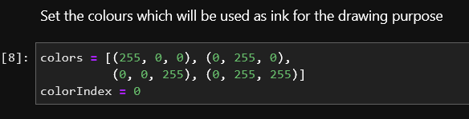
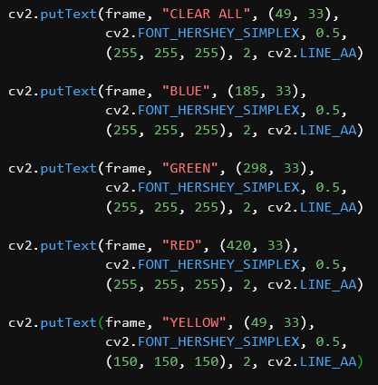
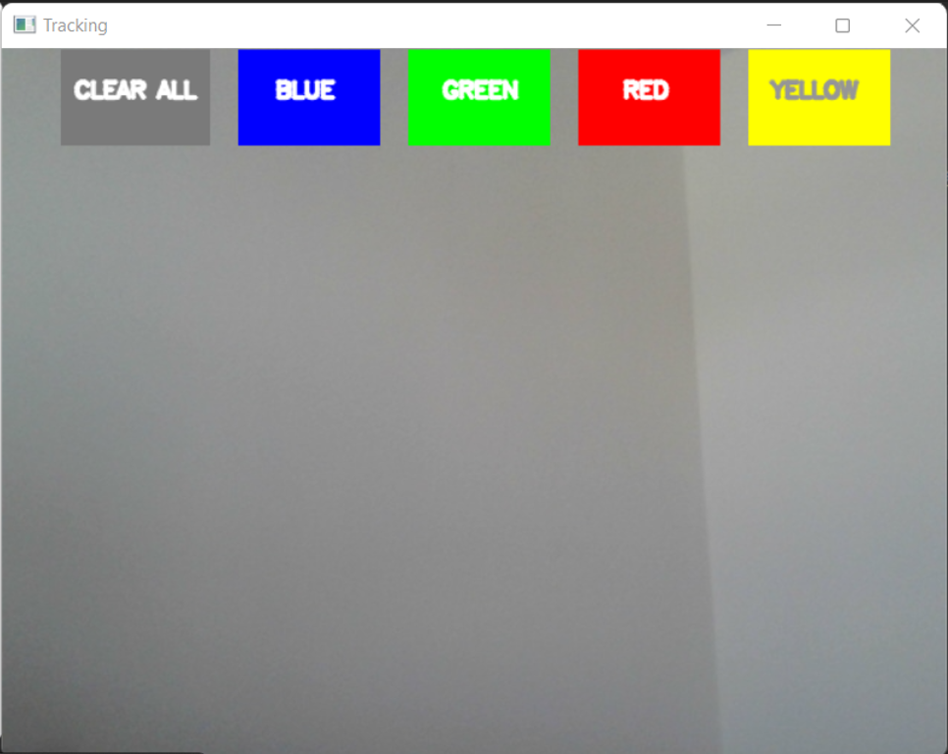
Create ink buttons
In-order to enable user to input different colours, primary colors, red, green and blue, and also additional yellow ink buttons are created.

Slide 8
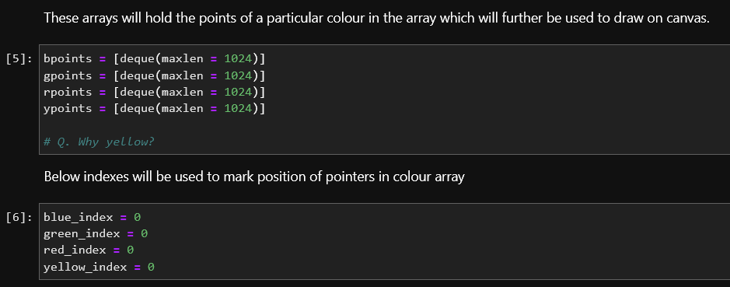
Create color arrays
For handling color points of different color, array has been defined for each color point with maximum points set to 1024

Slide 9
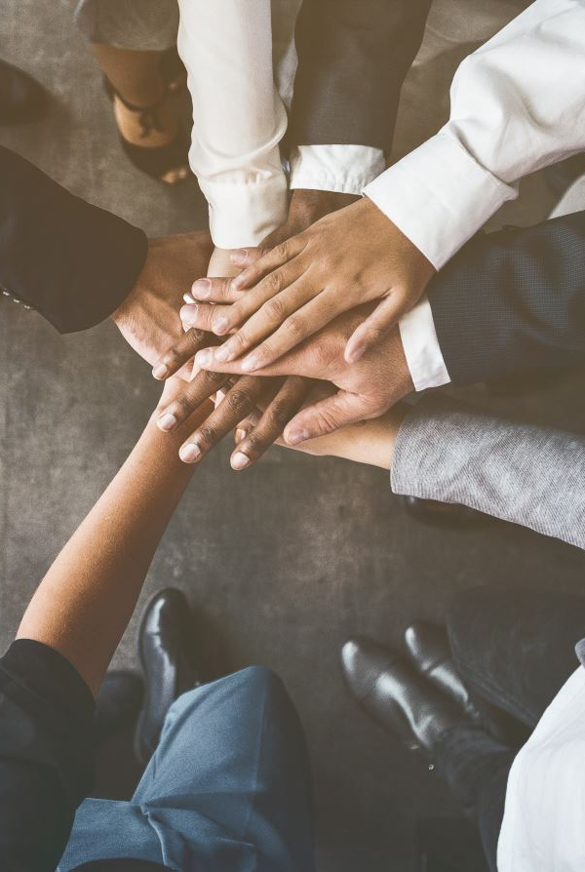
Team collaboration
We have made decisions about the subtask for the second stage of the Project (Creating Canvas UI) we will be using
Assigned individual tasks and decided the duration of each tasks
All project conversations are done using Slack/Teams
The tasks which have been identified in previous week is achived by each team individual by following the deadlines on Jira.

Slide 10
Task outline for next week
Next, we have to create trackbar for setting the colors for our marker object.
We have to further investigate on trackbar and how to implement.
Upon understanding, we will be able to break down tasks further.

Slide 11

Thank you

