Slide 1

Air Canvas
Team Python thinkers

Slide 2

Team Members
Anto Francis (C0825095)
Omer Volkan Guney (C0831373)
Rupesh Chandran (C0826779)
Sachin Sreekumar (C0825096)
Reporting Week: Apr 9, 2022 to Apr 15, 2022
Supervised by
Prof. Parissa Naraei

Slide 3
AIR CANVAS project (recap)
Air canvas helps to draw on a screen just by waiving your finger fitted with a simple colored cap. We are using the computer vision techniques of OpenCV to build this project. The preferred language is python due to its exclusive libraries and easy to use syntax.
We aiming to provide a natural human-system interaction in such way that it does’nt require keypad, pen or glove etc for character input.
Targeted features of Air Canvas;
It can track any specific colored pointer
User can draw in four different colors and even change them without any hussle.
Able to clean the board with a single location at the top of the screen.
No need to touch the computer once the program is run

Slide 4
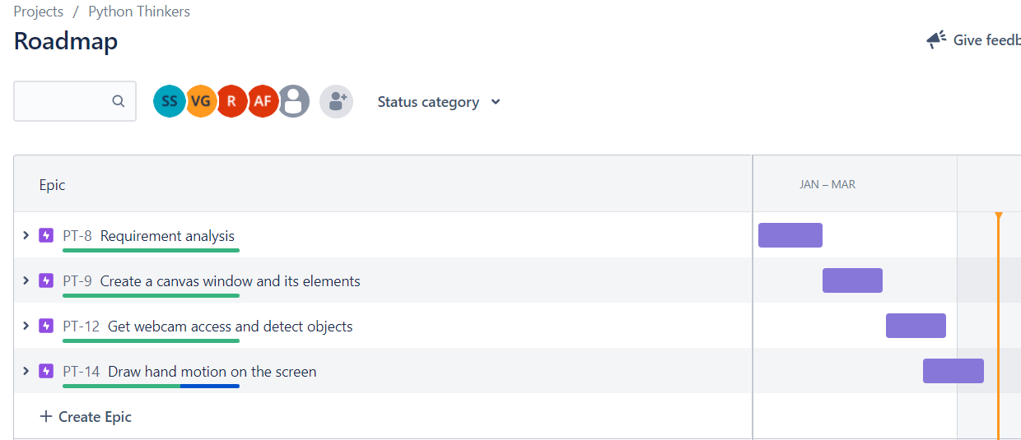
Week’s update
We have implemented every functionalities according to the plan.

Slide 5
Week’s update
Pixel points of each colors that are captured in the queue are drawn on the screen.
Unit testing of each functions have been completed.
Final presentation and Report

Slide 6
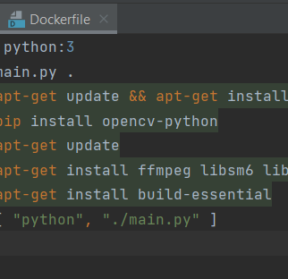
Challenges/Learnings this week
Deployment of our project
Issues during unit testing.

Slide 7

testing
Found out that the trackbar window is not displaying properly during startup – Layout issue
Exception when no contours are detected – Fixed using Exception handling

Slide 8
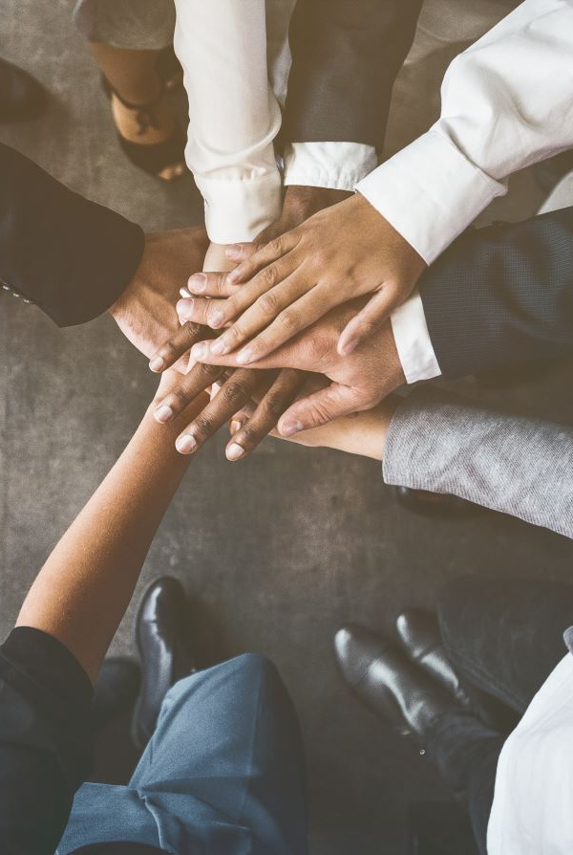
Team collaboration
Connected in Slack for team communication and merged each member’s code using tortoise git.
Mainly focused on testing and final project reports.

Slide 9
Task outline for next week
Final Presentation and Report

Slide 10

Thank you

