Slide 1

Air Canvas
Team Python thinkers

Slide 2

Team Members
Anto Francis (C0825095)
Omer Volkan Guney (C0831373)
Rupesh Chandran (C0826779)
Sachin Sreekumar (C0825096)
Reporting Week: Apr 2, 2022 to Apr 8, 2022
Supervised by
Prof. Parissa Naraei

Slide 3
AIR CANVAS project (recap)
Air canvas helps to draw on a screen just by waiving your finger fitted with a simple colored cap. We are using the computer vision techniques of OpenCV to build this project. The preferred language is python due to its exhaustive libraries and easy to use syntax.
We aiming to provide a natural human-system interaction in such way that it does’nt require keypad, pen or glove etc for character input.
Targeted features of Air Canvas;
It can track any specific colored pointer
User can draw in four different colors and even change them without any hussle.
Able to clean the board with a single location at the top of the screen.
No need to touch the computer once the program is run

Slide 4
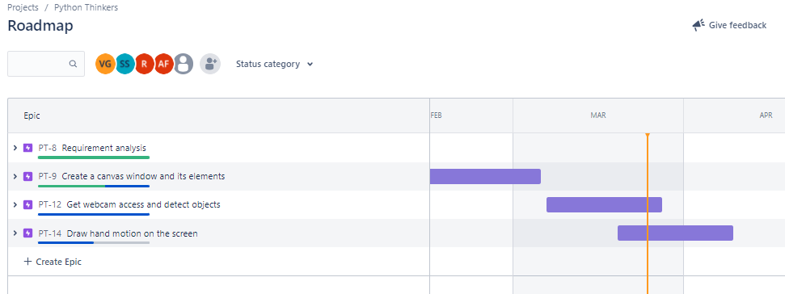
Week’s update
We have started working on the last phase of the project which is mainly categorized as «Draw hand motion on the screen».

Slide 5
Week’s update
Iterated through multiple HSV values to detect bare hand/finger tip, laser point
In process on implementing double marker
Explored drawing functions in OpenCv

Slide 6
Drawing on Canvas
Detecting bare hand is a tricky task, since the multiple points on hand is being selected.
When using laser pen, occasional laser hit directly on camera causes unintentional lines to be drawn
Center of the contour falls on the pixel range of any color buttons, the color of the drawings on the canvas change at that moment in real time.
Trying with double marker:
One marker to set the beginning of the drawing
This can also serve the purpose of snapping to the previously drawn line end.
Clicking on buttons without making unnecessary lines on the canvas
o Second marker to draw from the first marker location

Slide 7
Challenges/Learnings this week
Learning about drawing functions of OpenCV
Feature Calculation function Moments in OpenCv

Slide 8
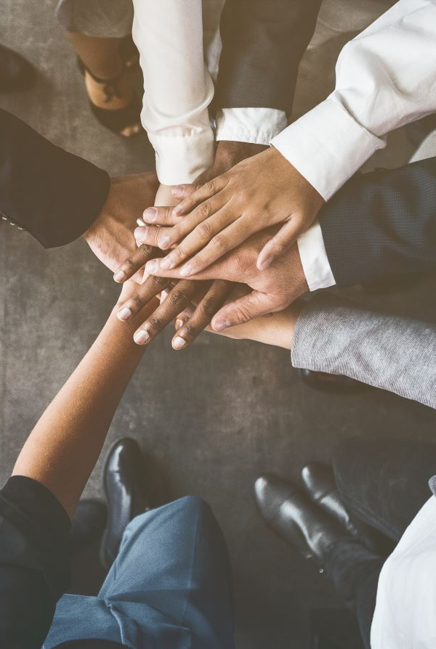
Team collaboration
Connected in Slack for team communication and merged each member’s code using tortoise git
Code reviews were done

Slide 9
Task outline for next week
Use double marker
Implement zoom in/out feature
Start on the final report.

Slide 10

Thank you

