Slide 1
Reflections on Trusting Trust for Go
Turing Award Lecture (1984)
Given by: Ken Thompson
https://www.ece.cmu.edu/~ganger/712.fall02/papers/p761-thompson.pdf
Fully Countering Trust through Diverse Double Compiling (2009)
By: David A. Wheeler
http://www.dwheeler.com/trusting-trust/dissertation/wheeler-trusting-trust-ddc.pdf
GopherconSG (4 May 2018)
By: Yeo Kheng Meng (yeokm1@gmail.com)
https://github.com/yeokm1/reflections-on-trusting-trust-go

Slide 2
Code
Compiler
Binary

Slide 3
Why Reflections on Trusting Trust?

Slide 4
Ken Thompson (left) and Dennis Ritchie
1983 Turing award for their work on Unix
Thompson presented “Reflections on Trusting Trust” in his acceptance speech

Slide 5
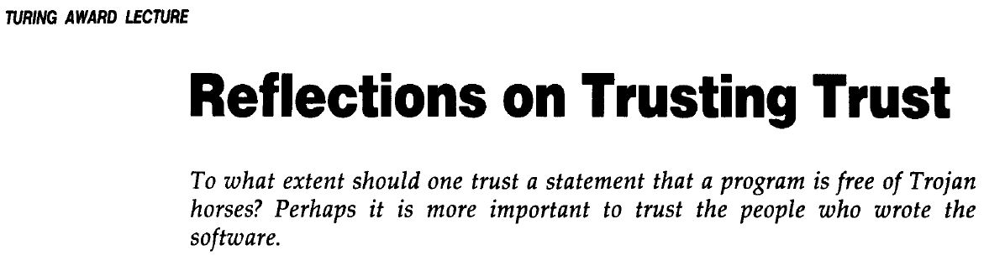

Slide 6
The problem
How do we know a program is safe?
Inspect the program’s source code.
But isn’t the program source code compiled by a compiler?
Inspect the compiler’s source code, eg. Golang Compiler
https://github.com/golang/go
But isn’t the compiler compiled by another compiler?
Self-hosting compilers compile themselves
-> Eg. Go compiler compiles Go compiler
So how? How deep do we go down the rabbit hole?

Slide 7
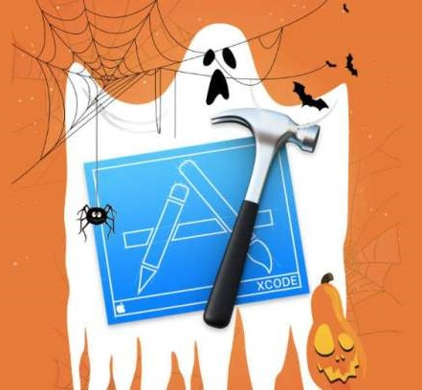
Real-life compiler attacks
Xcodeghost (found Sept 2015)
Malicious Xcode compiler hosted on Chinese websites
Injects spyware into output binary
Win32/Induc.A virus and its successors (found 2009)
Infects Delphi compiler to inject malicious code into output binary
Create a botnet
Further infects other Delphi compilers
Xcodeghost image: https://nakedsecurity.sophos.com/2015/11/09/apples-xcodeghost-malware-still-in-the-machine/

Slide 8
Attack Objectives
Create a malicious compiler to target a program eg: login program
Not leave a trace in compiler source
Subvert verification

Slide 9
Presentation Outline
Self-reproducing program (Quine)
Compiler knowledge propagation (Bootstrapping)
Attack on the login program
Initial Conclusion
Mitigation strategy?

Slide 10
Stage 1: Self-reproducing program (Quine)
A source program that when compiled and executed,
will produce as output an exact copy of its source.

Slide 11
Stage 2: Compiler knowledge propagation
Pass knowledge down compiler iterations

Slide 12
My ”clean” compiler
”compiler.go”
Reads input source file
Prints source file contents to stdout
Passes source file to Golang compiler

Slide 13
Compiler Knowledge Propagation Summary
My Complier
Source Code
Golang Compiler
Hello World
Source Code
Hello World
(Fetch)
Source Code
Compiler source that compiles “fetch”
Compiler source that uses “fetch”
My Compiler
Binary
Compiler can compile fetch
Hello World Binary
Latest compiler
Hello World (Fetch)
Binary 1
Hello World (Fetch)
Binary 2

Slide 14
What we have learned so far?
A program can output another program even itself.
Compiler bootstrapping

Slide 15
Stage 3: Adding an undetectable backdoor to a login program

Slide 16
Adding backdoor to login program
Malicious Compiler
Source Code
Golang Compiler
Login
Source Code
Clean Compiler
Source Code
Malicious Compiler binary
Still Malicious compiler
Malicious Login
Binary 1
Malicious Login
Binary 2

Slide 17
Verifying the compiler binary
Expected SHA-256 of Go 1.10.1 darwin/amd64 compiler
53b31f87d27bfa88c90789654c9dbec8297a6b157f61076037a85bf0c2687b1d

Slide 18
Stage 4: Subverting verification
Can we prevent the user from detecting the bugged compiler?

Slide 19
Hacking the SHA256 Program

Slide 20
Thompson’s conclusion
“You can’t trust code that you did not totally create yourself”
“No amount of source-level verification or scrutiny will protect you from using untrusted code.”
“We can go lower to avoid detection like assembler, loader or microcode”
-> You always have to trust somebody

Slide 21
Possible defence?

Slide 22
“Fully Countering Trusting Trust through Diverse Double-Compiling (DDC) - Countering Trojan Horse attacks on Compilers”
2009 PhD dissertation by David A. Wheeler
George Mason University
http://www.dwheeler.com/trusting-trust/dissertation/wheeler-trusting-trust-ddc.pdf

Slide 23
Diverse Double Compiling (DDC)
Objective
To detect the trusting-trust attack of a malicious C Compiler
Requirements
Use another compiler in the verification process
Source code of compiler under test needs to be available

Slide 24
DDC Process
Assume we are have GCC and Tiny C (TCC) compilers
We suspect GCC is malicious and want to test it
Compiler-under-test : GCC
Independent-compiler: TCC
Independent-compiler can be:
Small: just enough code to compile compiler-under-test
Generate inefficient code

Slide 25
DDC Process
Compiler-under-test: GCC
Independent-compiler: TCC
Source_{GCC}
GCC
TCC
Source_{GCC}
Source_{GCC}
GCC (c. GCC)
GCC (c. TCC)
Source_{GCC}
Self-regeneration test (Control)
GCC (c. GCC, c. GCC)
GCC (c. GCC, c. TCC)
Should be identical

Slide 26
Why DDC works?
TCC can be malicious but unlikely to be malicious in a way that affects GCC
Hacker must compromise both GCC and TCC to hack each other
Easier to review smaller verifying-compiler source code and binary

Slide 27
DDC Scaling
Compiler-under-test: GCC
Independent-compilers: TCC, Intel
Source_{GCC}
GCC
TCC
Intel
Source_{GCC}
GCC (c. GCC)
GCC (c. TCC)
GCC (c. Intel)
Self-regeneration test (Control)
GCC (c. GCC, c. GCC)
GCC (c. GCC, c. TCC)
GCC (c. GCC, c. Intel)
Should be identical
Hacker must compromise GCC, TCC and Intel to hack all other compilers to be successful
O(n²) problem for hackers, O(n) for defenders

Slide 28
But there are only 3 Go Compilers…
Google Go Toolchain (gc)
Gccgo
GCC Frontend
Written in C++
Llgo
LLVM Frontend

Slide 29
Possible Solution?

Slide 30
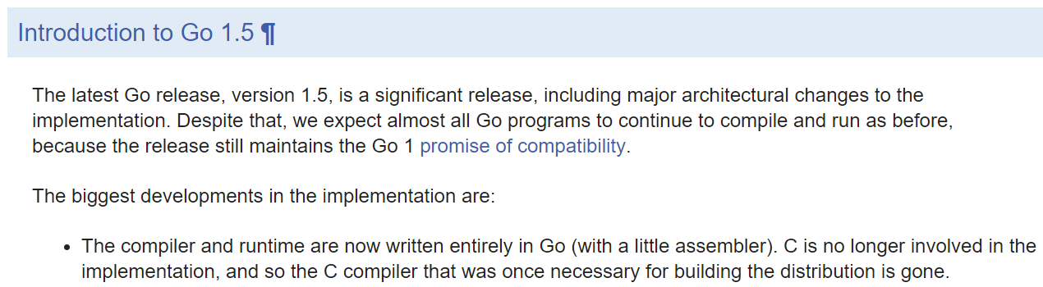
History of Go compiler implementation
Released: 19 August 2015
https://golang.org/doc/go1.5#introduction

Slide 31
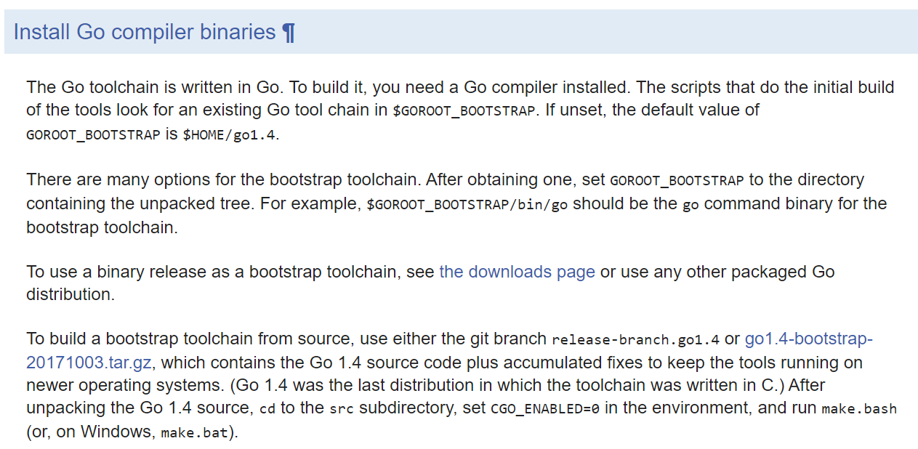
Go Compiler bootstrapping using Go 1.4
Released: 10 December 2014
https://golang.org/doc/install/source#go14

Slide 32
Possible Solution Summary
C Compiler
Rebuild Go 1.4 with any C Compiler
Build newer version of Go with Go 1.4
(Malicious) C compiler unlikely to affect Go Compiler
Source_{Go 1.4}
Source_{Go 1.10}
Go 1.4 (c. C Comp.)
Go 1.10 (c. Go 1.4)

Slide 33
Do you still trust your compiler?
By: Yeo Kheng Meng (yeokm1@gmail.com)
https://github.com/yeokm1/reflections-of-trusting-trust-go

