Slide 1
The New Zealand Muslim Diversity Study: Baseline Sample Information 2023-2024
M. Usman Afzali Aarif Rasheed Chris G. Sibley Kumar Yogeswaaran Joseph A. Bulbulia

Slide 2
Sample Life-Related Well-Being Statistics.
 | Not Religious | Muslim | Anglican | Buddhist | Catholic | Christian (NFD) | Christian (Others) | Hindu | Jewish | Presby Congreg Reform | Other Religions
 | (N=21551) | (N=658) | (N=1363) | (N=270) | (N=2017) | (N=3696) | (N=1095) | (N=136) | (N=87) | (N=576) | (N=744)
Belonging - Acceptance
Mean (SD) | 5.58 (1.30) | 5.49 (1.38) | 5.68 (1.22) | 5.57 (1.38) | 5.68 (1.27) | 5.70 (1.29) | 5.67 (1.33) | 5.52 (1.31) | 5.45 (1.28) | 5.72 (1.15) | 5.41 (1.50)
Median [Min, Max] | 6.00 [1.00, 7.00] | 6.00 [1.00, 7.00] | 6.00 [1.00, 7.00] | 6.00 [1.00, 7.00] | 6.00 [1.00, 7.00] | 6.00 [1.00, 7.00] | 6.00 [1.00, 7.00] | 6.00 [1.00, 7.00] | 6.00 [1.00, 7.00] | 6.00 [1.00, 7.00] | 6.00 [1.00, 7.00]
Missing | 1182 (5.5%) | 11 (1.7%) | 50 (3.7%) | 16 (5.9%) | 97 (4.8%) | 220 (6.0%) | 62 (5.7%) | 5 (3.7%) | 5 (5.7%) | 21 (3.6%) | 37 (5.0%)
Belonging - Shared Beliefs
Mean (SD) | 4.77 (1.31) | 4.57 (1.57) | 4.94 (1.28) | 4.80 (1.46) | 4.87 (1.30) | 4.81 (1.35) | 4.90 (1.42) | 4.63 (1.36) | 4.35 (1.39) | 4.96 (1.31) | 4.53 (1.51)
Median [Min, Max] | 5.00 [1.00, 7.00] | 5.00 [1.00, 7.00] | 5.00 [1.00, 7.00] | 5.00 [1.00, 7.00] | 5.00 [1.00, 7.00] | 5.00 [1.00, 7.00] | 5.00 [1.00, 7.00] | 5.00 [1.00, 7.00] | 4.00 [2.00, 7.00] | 5.00 [1.00, 7.00] | 5.00 [1.00, 7.00]
Missing | 1148 (5.3%) | 15 (2.3%) | 60 (4.4%) | 13 (4.8%) | 100 (5.0%) | 193 (5.2%) | 57 (5.2%) | 9 (6.6%) | 7 (8.0%) | 24 (4.2%) | 48 (6.5%)
Belonging - Outsider (Reversed)
Mean (SD) | 4.99 (1.77) | 4.44 (1.89) | 5.48 (1.61) | 4.64 (1.87) | 5.25 (1.70) | 5.05 (1.74) | 5.17 (1.72) | 4.78 (1.90) | 4.11 (1.85) | 5.46 (1.63) | 4.53 (1.94)
Median [Min, Max] | 5.00 [1.00, 7.00] | 4.00 [1.00, 7.00] | 6.00 [1.00, 7.00] | 5.00 [1.00, 7.00] | 6.00 [1.00, 7.00] | 6.00 [1.00, 7.00] | 6.00 [1.00, 7.00] | 5.00 [1.00, 7.00] | 4.00 [1.00, 7.00] | 6.00 [1.00, 7.00] | 5.00 [1.00, 7.00]
Missing | 1212 (5.6%) | 11 (1.7%) | 55 (4.0%) | 15 (5.6%) | 97 (4.8%) | 206 (5.6%) | 59 (5.4%) | 5 (3.7%) | 8 (9.2%) | 18 (3.1%) | 42 (5.6%)
Neighbourhood Community
Mean (SD) | 4.40 (1.65) | 4.17 (1.85) | 5.02 (1.47) | 4.69 (1.49) | 4.67 (1.59) | 4.60 (1.60) | 4.74 (1.52) | 4.80 (1.57) | 4.19 (1.69) | 5.03 (1.48) | 4.36 (1.79)
Median [Min, Max] | 5.00 [1.00, 7.00] | 4.00 [1.00, 7.00] | 5.00 [1.00, 7.00] | 5.00 [1.00, 7.00] | 5.00 [1.00, 7.00] | 5.00 [1.00, 7.00] | 5.00 [1.00, 7.00] | 5.00 [1.00, 7.00] | 5.00 [1.00, 7.00] | 5.00 [1.00, 7.00] | 4.00 [1.00, 7.00]
Missing | 1146 (5.3%) | 16 (2.4%) | 56 (4.1%) | 12 (4.4%) | 100 (5.0%) | 188 (5.1%) | 65 (5.9%) | 9 (6.6%) | 9 (10.3%) | 14 (2.4%) | 44 (5.9%)
Support - Help Availability
Mean (SD) | 6.02 (1.22) | 5.64 (1.48) | 6.11 (1.13) | 5.78 (1.45) | 6.07 (1.15) | 6.14 (1.15) | 6.11 (1.19) | 5.98 (1.29) | 5.88 (1.38) | 6.17 (1.12) | 5.89 (1.38)
Median [Min, Max] | 6.00 [1.00, 7.00] | 6.00 [1.00, 7.00] | 6.00 [1.00, 7.00] | 6.00 [1.00, 7.00] | 6.00 [1.00, 7.00] | 6.00 [1.00, 7.00] | 6.00 [1.00, 7.00] | 6.00 [1.00, 7.00] | 6.00 [1.00, 7.00] | 6.00 [1.00, 7.00] | 6.00 [1.00, 7.00]
Missing | 1654 (7.7%) | 18 (2.7%) | 81 (5.9%) | 26 (9.6%) | 174 (8.6%) | 289 (7.8%) | 90 (8.2%) | 6 (4.4%) | 14 (16.1%) | 37 (6.4%) | 64 (8.6%)
Support - No Guidance (Reversed)
Mean (SD) | 5.92 (1.44) | 5.45 (1.69) | 6.05 (1.36) | 5.73 (1.60) | 6.00 (1.41) | 6.06 (1.37) | 6.04 (1.42) | 5.82 (1.53) | 6.00 (1.29) | 5.90 (1.47) | 5.73 (1.59)
Median [Min, Max] | 6.00 [1.00, 7.00] | 6.00 [1.00, 7.00] | 7.00 [1.00, 7.00] | 6.00 [1.00, 7.00] | 6.00 [1.00, 7.00] | 7.00 [1.00, 7.00] | 7.00 [1.00, 7.00] | 6.00 [1.00, 7.00] | 6.00 [2.00, 7.00] | 6.00 [1.00, 7.00] | 6.00 [1.00, 7.00]
Missing | 1534 (7.1%) | 25 (3.8%) | 90 (6.6%) | 23 (8.5%) | 157 (7.8%) | 263 (7.1%) | 84 (7.7%) | 9 (6.6%) | 10 (11.5%) | 39 (6.8%) | 66 (8.9%)
Support - Someone to Turn To
Mean (SD) | 5.86 (1.33) | 5.56 (1.58) | 6.03 (1.18) | 5.65 (1.56) | 5.95 (1.24) | 6.00 (1.26) | 6.07 (1.23) | 5.89 (1.25) | 5.77 (1.46) | 5.95 (1.27) | 5.77 (1.45)
Median [Min, Max] | 6.00 [1.00, 7.00] | 6.00 [1.00, 7.00] | 6.00 [1.00, 7.00] | 6.00 [1.00, 7.00] | 6.00 [1.00, 7.00] | 6.00 [1.00, 7.00] | 6.00 [1.00, 7.00] | 6.00 [1.00, 7.00] | 6.00 [1.00, 7.00] | 6.00 [1.00, 7.00] | 6.00 [1.00, 7.00]
Missing | 1153 (5.4%) | 15 (2.3%) | 61 (4.5%) | 21 (7.8%) | 111 (5.5%) | 202 (5.5%) | 63 (5.8%) | 6 (4.4%) | 10 (11.5%) | 28 (4.9%) | 44 (5.9%)

Slide 3
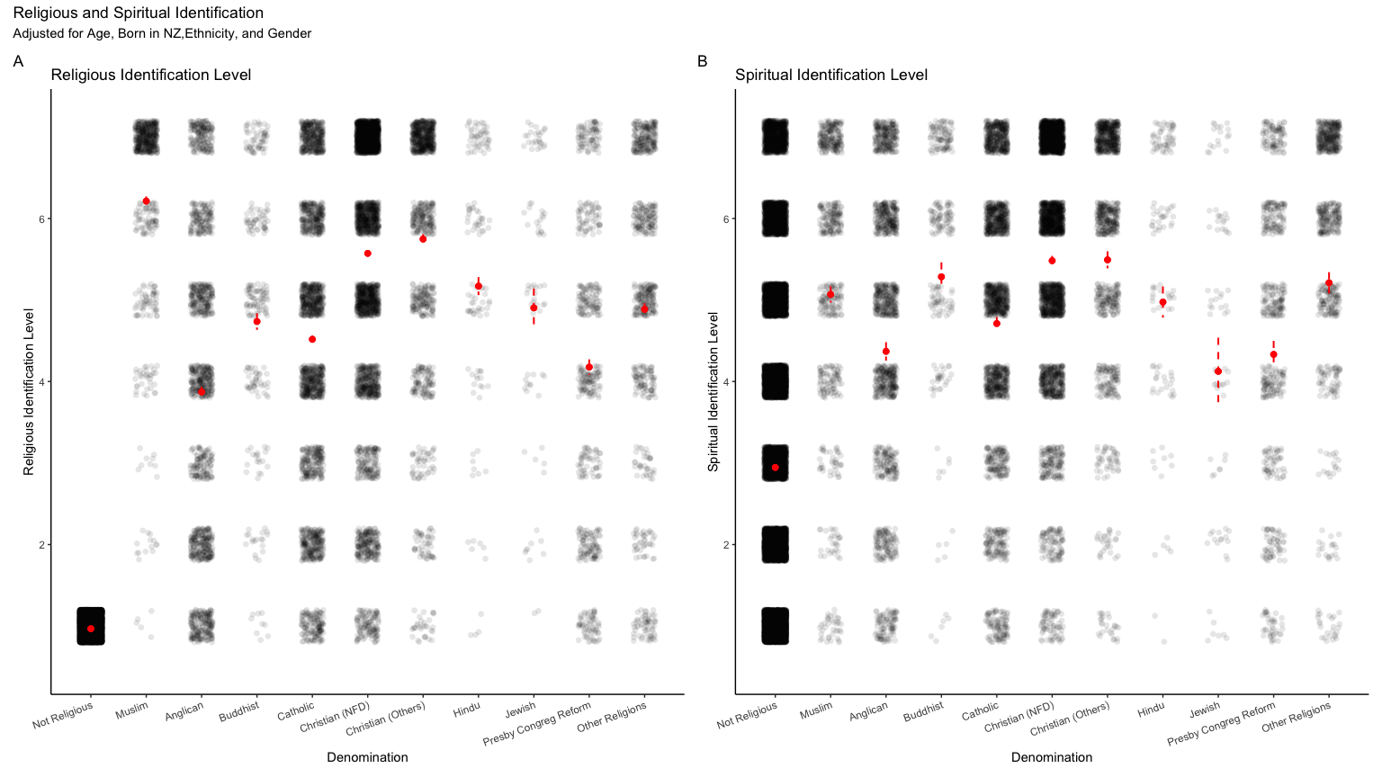
Figure 1: Religious and Spiritual Identity

Slide 4
References

