Slide 1
Making Markdown Acceptable

Slide 2
YAML (Yet Another Markdown Language)
Body

Slide 3
YAML (Yet Another Markdown Language)
Text
Code
Figures
Tables
Citations

Slide 4
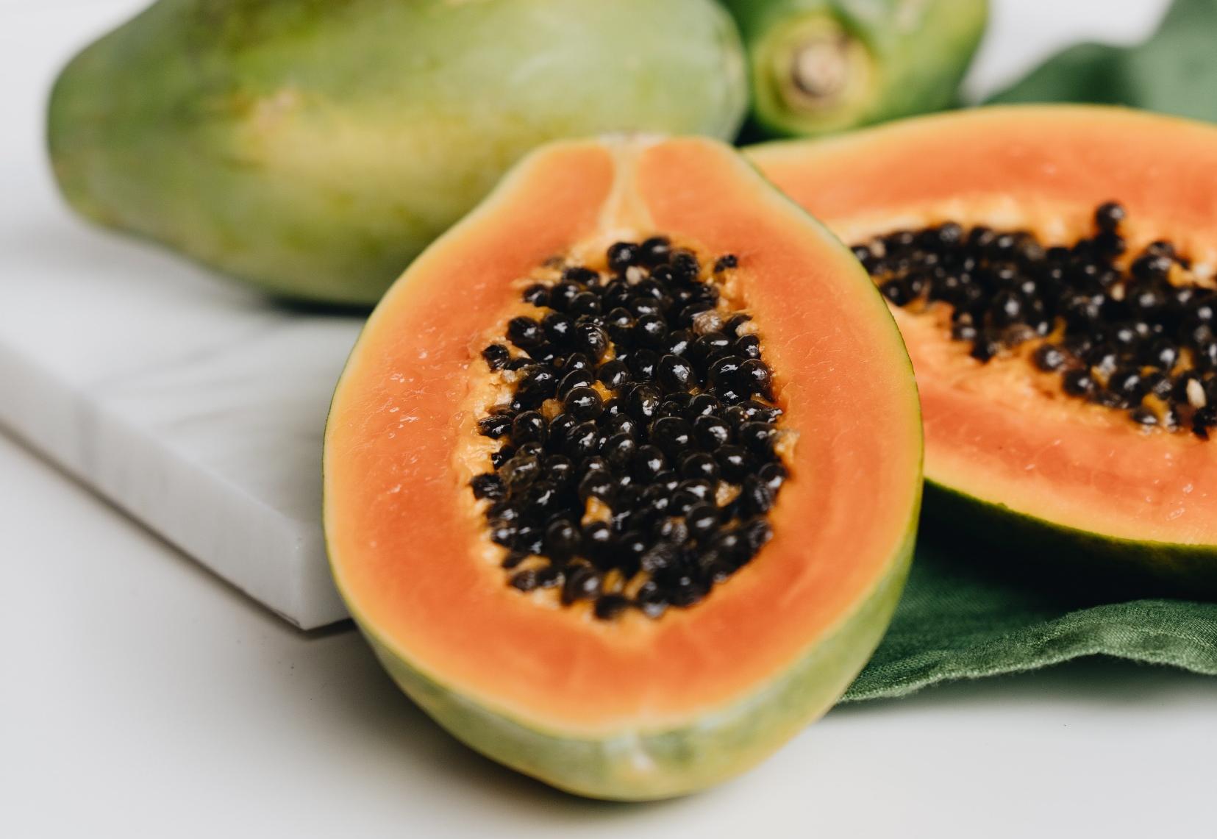

Slide 5
devtools::install_github(“crsh/papaja”)

Slide 6
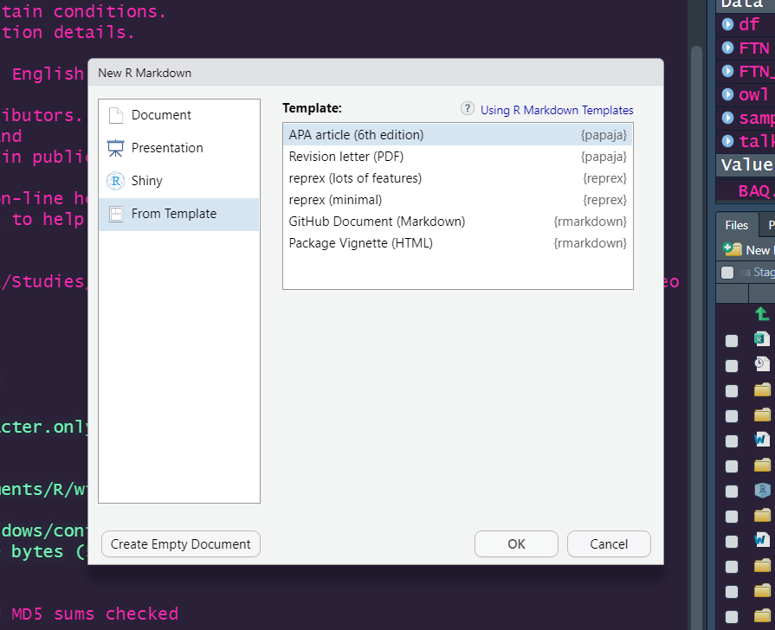

Slide 7
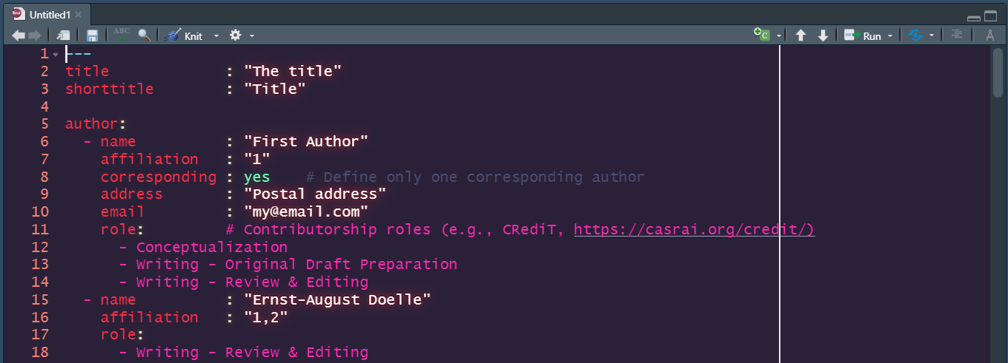

Slide 8
Working with Figures
Creating Figures in Code
Inserting Figures into the Document
Referencing Figures in Text

Slide 9
Creating Figures

Slide 10
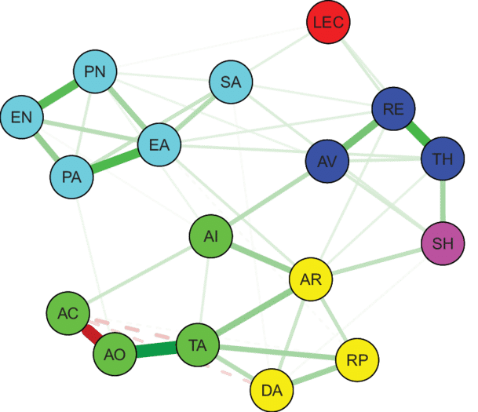


Slide 11
df %>%
ggplot() +
aes(x = BKQKA) +
geom_histogram(binwidth = 2) +
labs(x = "Knowledge", y = "Frequency") +
theme_apa()

Slide 12
2. Inserting Figures into the Document
https://yihui.org/knitr/options/
out.width = \\textwidth
fig.show = "hold“

Slide 13
3. Referencing Figures in Text
\@ref(fig:combined1-plot)

Slide 14
par(mar = c(4, 4, .1, .1))

Slide 15
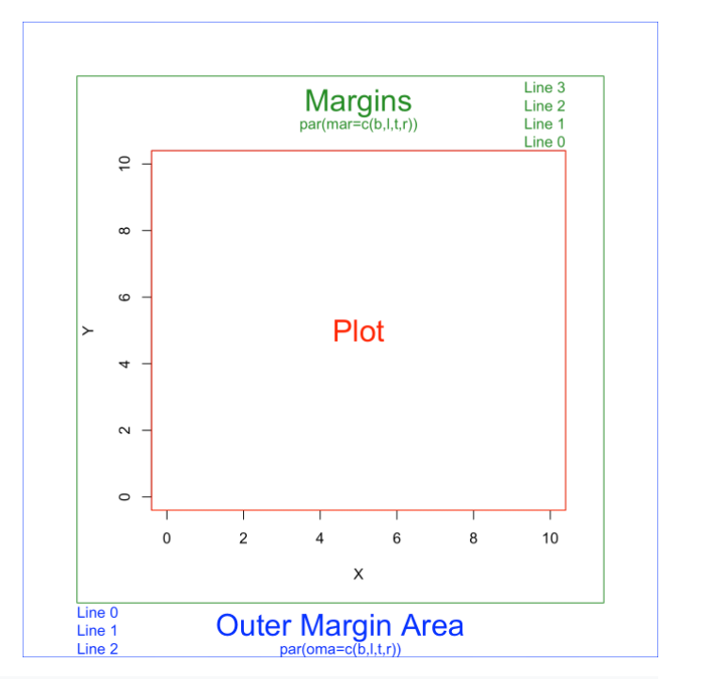

Slide 16
Working with Tables
Creating Tables in Code
Inserting Tables into the Document
Referencing Tables in Text

Slide 17
1. Creating Tables in Code
summary
glrstab
any function that creates a dataframe

Slide 18
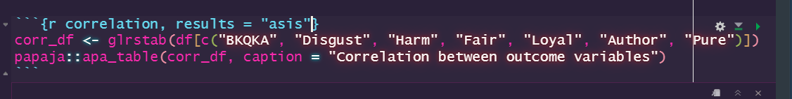
2. Inserting Tables into the Document
kable \ kableExtra
papaja::apa_table()

Slide 19
3. Referencing Tables in Text
\@ref(tab:correlation)

Slide 20
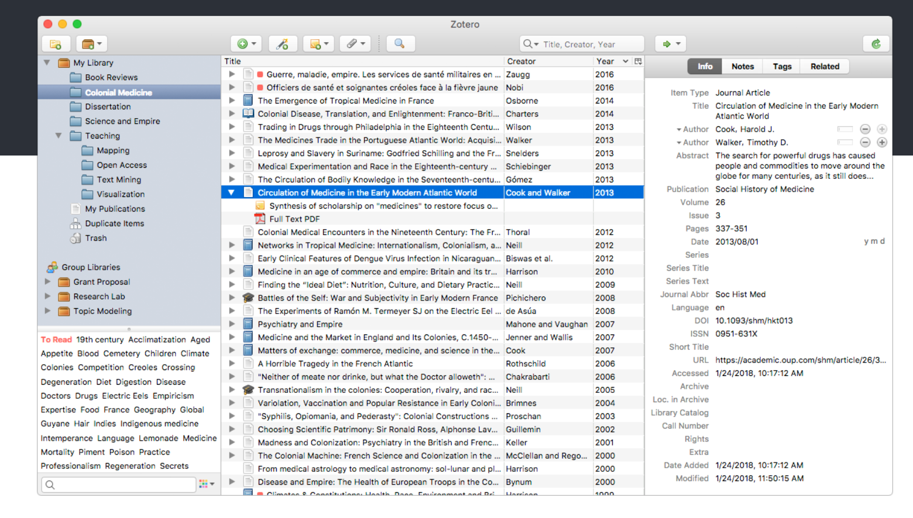
Working with References

Slide 21
devtools::install_github("crsh/citr")

Slide 22
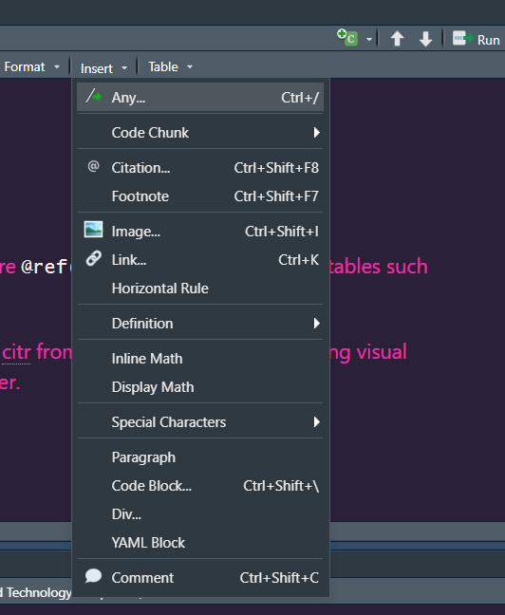
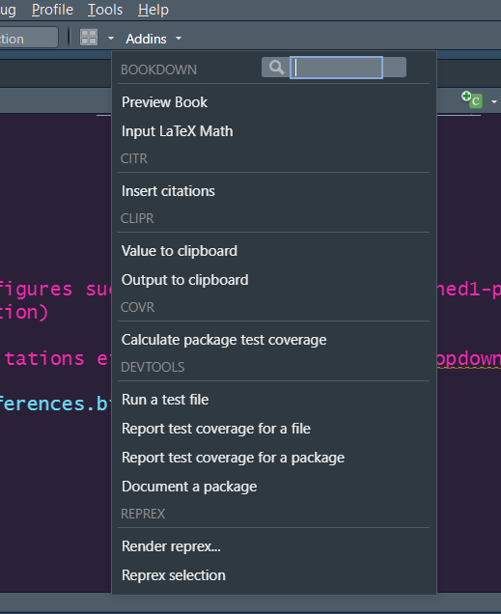

Slide 23
