Slide 1
GO tutorial
Nguyen Minh Duc
Bui Tan Dat

Slide 2
Agenda
Introduction
Basic GO
Hello world
Functions
Variables
Convert type
Loop
Defer
Array
Slice
Range
Method
Interface
Exercises
CRUD with mux and SQL
CRUD with gin and Mongo
CRUD with echo and gorm
Real project samples
GO service generator (low code)

Slide 3
1. Introduction
History
Project starts at Google in 2007 (by Griesemer, Pike, Thompson)
Open source release in November 2009
More than 250 contributors join the project
Version 1.0 release in March 2012
Go is a new, general-purpose programming language
Compiled
Statically typed
Concurrent
Simple
Productive

Slide 4
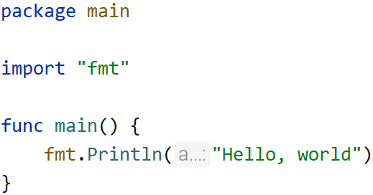
2. Basic GO
Every Go program is made up of packages
Start running in package main
Run here https://go.dev/tour/welcome/1
In this sample, use “fmt” package to print a string to console

Slide 5
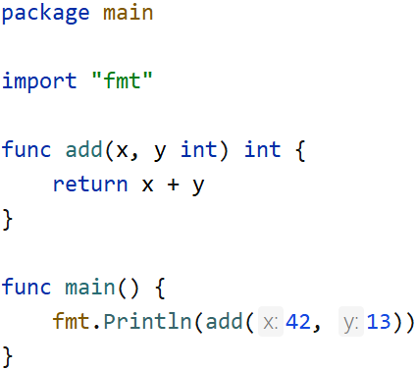
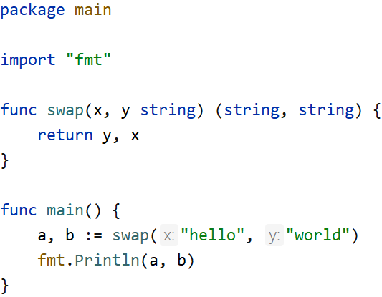
2. Function
Support to return multiple values
Exercise 1: write a function, to add 2 integer numbers
Run here https://go.dev/tour/basics/5
Exercise 2: write a function, to swap 2 strings
Run here https://go.dev/tour/basics/7

Slide 6
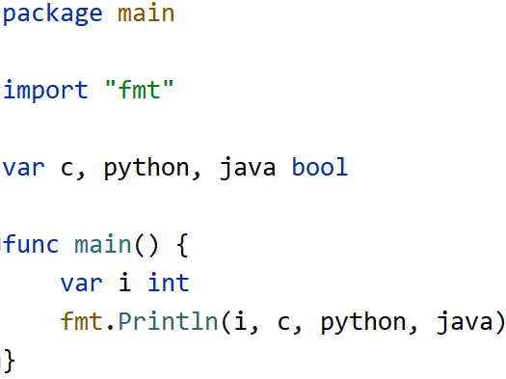
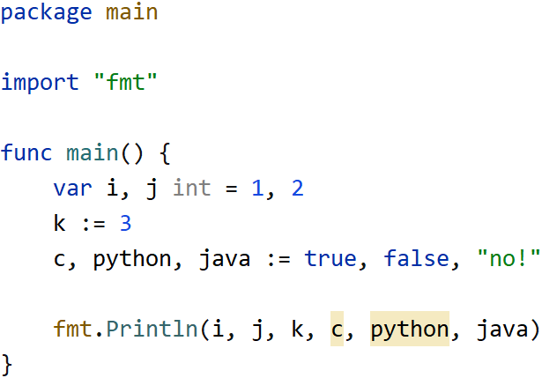
2. Variables
Declare variables
Exercise 1: use “var” to declare 3 variables
Run here https://go.dev/tour/basics/8
Exercise 2: use short variables declarations
Run here https://go.dev/tour/basics/10

Slide 7
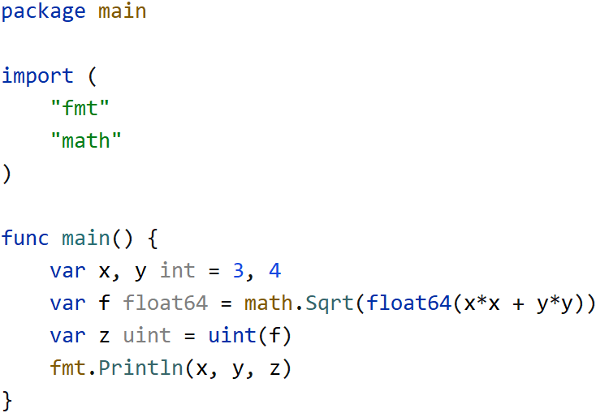
2. Convert type
Use expression T(v) to convert some number
Run here https://go.dev/tour/basics/13

Slide 8
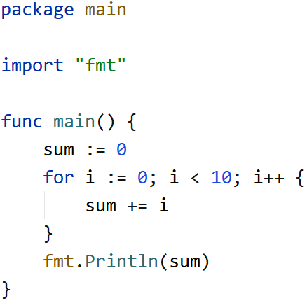
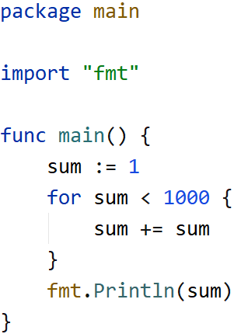
2. Loop
Only one loop construct, the for loop
Exercise 1: total from 1 to 10
Run here https://go.dev/tour/flowcontrol/1
Exercise 2: total from 1 to 10, with “while” loop logic
Run here https://go.dev/tour/flowcontrol/3

Slide 9
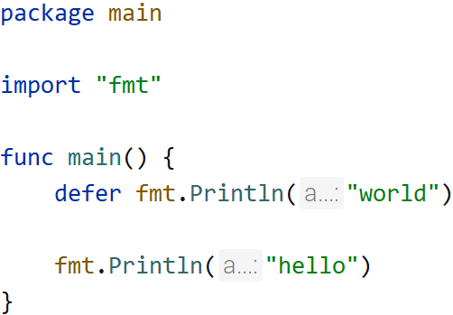
2. Defer
A defer statement defers the execution of a function until the surrounding function return
Exercise 1: print “hello world” with defer
Run here https://go.dev/tour/flowcontrol/12
Result
hello
world

Slide 10
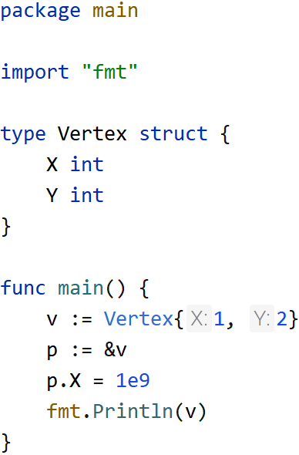
2. Pointer
Struct fields can be accessed through a struct pointer
Exercise 1: access a struct with a struct pointer
Run here https://go.dev/tour/moretypes/4

Slide 11
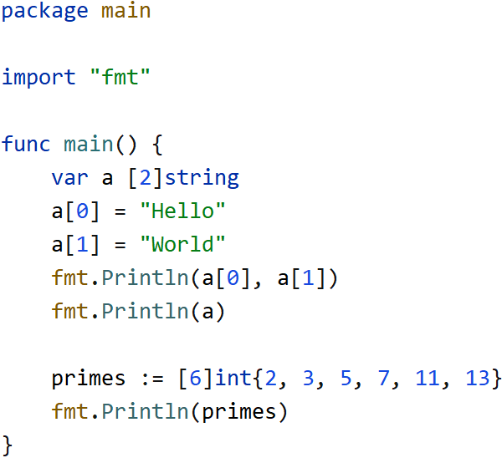
2. Array
Arrays cannot be resized
Exercise 1: create arrays with string & int
Run here https://go.dev/tour/moretypes/6

Slide 12
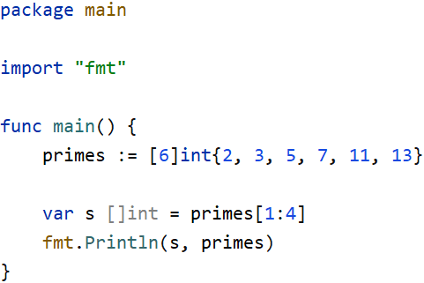
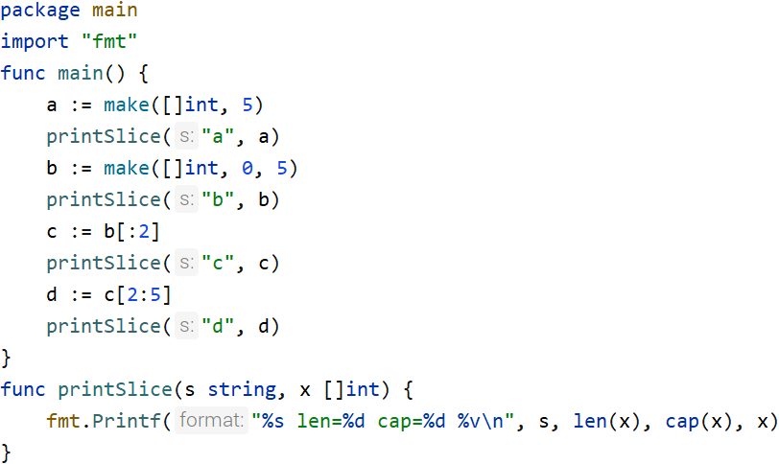
2. Slice
A dynamically-sized
Exercise 1: create a slice from an array
Run here https://go.dev/tour/moretypes/7
Exercise 2: create a slice with make function
Run here https://go.dev/tour/moretypes/13

Slide 13
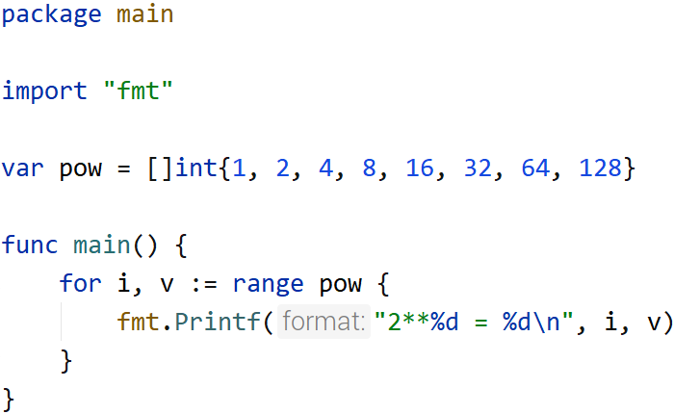
2. Range
The range form of the for loop iterates over a slice or map
Exercise 1: loop a slice and print 2 powers
Run here https://go.dev/tour/moretypes/16

Slide 14
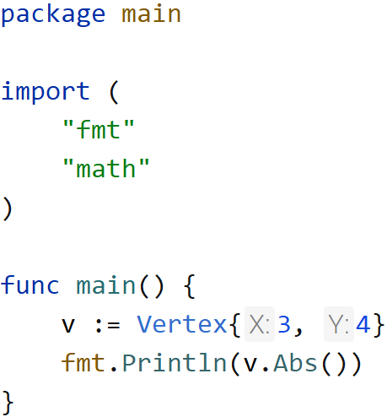
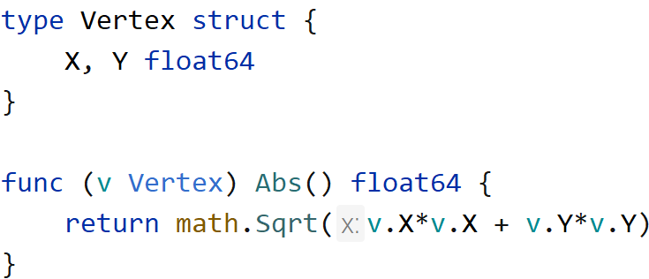
2. Method
Method is a function of struct
Exercise 1: Create a method, with struct receiver
Run here https://go.dev/tour/methods/1

Slide 15
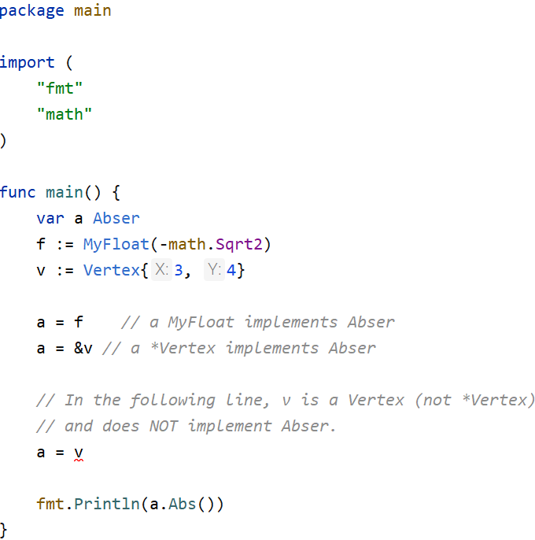
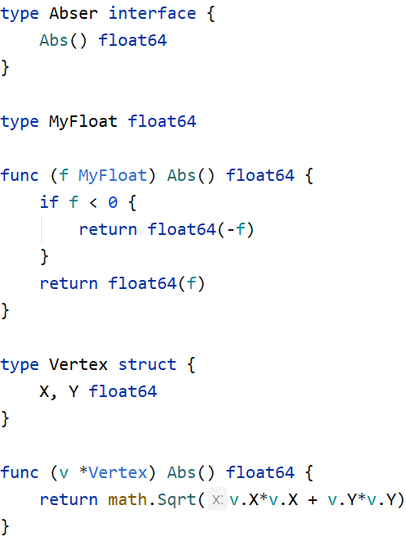
2. Interface
An interface type is defined as a set of method signatures
Exercise 1: Create an interface, with abs float number
Run here https://go.dev/tour/methods/1

Slide 16
3. Exercise 1
Objectives
Understand how to query data from RMS database, using "database/sql" package
Can insert, update, delete data
Use Mux to receive an http request, and return an http response
Create a CRUD REST API with mux and My SQL, table users, with these fields fields id, username, email, phone, dateOfBirth, and methods GetAll, GetByID, Insert, Update, Delete
Refer to go-sql-tutorial

Slide 17
3. Exercise 2
Objectives
Understand how to query data from Mongo
Can insert, update, delete data
Use gin to receive an http request, and return an http response
Create a CRUD REST API with gin and MongoDB: collection user, with these fields id, username, email, phone, dateOfBirth, and methods: GetAll, GetByID, Insert, Update, Delete
Refer to go-mongo-tutorial and go-gin-sql-tutorial

Slide 18
3. Exercise 3
Objectives
Understand how to query data from RMS database, using gorm
Can insert, update, delete data
Use echo to receive an http request, and return an http response
Create a CRUD REST API with echo and gorm with My SQL: table users, with these fields id, username, email, phone, dateOfBirth, and methods: GetAll, GetByID, Insert, Update, Delete
Refer to gorm-tutorial and go-echo-sql-tutorial

Slide 19
4. Real project samples - overview
Layer Architecture Samples
https://github.com/source-code-template/go-sql-layer-architecture-sample
https://github.com/source-code-template/go-mongo-layer-architecture-sample
Modular Samples
https://github.com/source-code-template/go-sql-modular-sample
https://github.com/source-code-template/go-mongo-modular-sample
Message Queue Samples
https://github.com/project-samples/go-subscription
https://github.com/project-samples/go-batch-subscription
Import/Export
https://github.com/project-samples/go-import
https://github.com/project-samples/go-export
go-admin
https://github.com/project-samples/go-admin

Slide 20
4. Real project samples - 1
Layer Architecture Samples
https://github.com/source-code-template/go-sql-layer-architecture-sample
https://github.com/source-code-template/go-mongo-layer-architecture-sample
To build a REST API to support
search, get by ID, create, update, delete
support "patch" method, using core-go/service
support "search" method, using core-go/search
Some standard features
config: load config from yaml files
health check: to check health of SQL
logging: can use logrus or zap to log
tracing request and response at the middleware
REST API Handler
Model
Business Logic
Repository

Slide 21
4. Real project samples - 2
Modular Samples
https://github.com/source-code-template/go-sql-modular-sample
https://github.com/source-code-template/go-mongo-modular-sample
One Micro Service
Package 1 (Order)
Package 2 (Inventory)
Package 3 (Reporting)
REST API Handler
Model
REST API Handler
Model
REST API Handler
Model
Business Logic
Business Logic
Business Logic
Repository
Repository
Repository

Slide 22
4. Real project samples - 3
Message Queue Samples
https://github.com/project-samples/go-subscription
https://github.com/project-samples/go-batch-subscription
Flow to consume a message
Support
Google Pub/Sub
Amazon SQS
RabbitMQ
Active MQ
IBM MQ
Kafka
NATS
Start
Consume a message
Validate data
Write to somewhere
(DB, files)
Yes
Success
Retry
Handle error
No
End

Slide 23
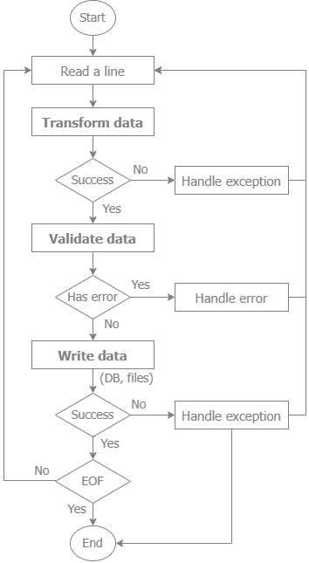
4. Real project samples – 4.1 Import
Flow chart

Slide 24
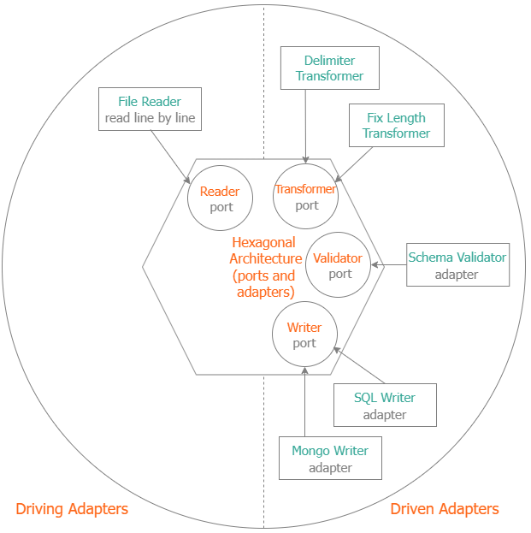
4. Real project samples – 4.1 Import
Common Architectures
Layer Architecture
Popular for web development
Hexagonal Architecture
Suitable for Import Flow
REST API Handler
Model
Business Logic
Repository

Slide 25
5. Real project samples – 5.1
Service Monitor
Client
One Micro Service (go-admin)
health
LDAP
authenticator
authorization
middleware log tracing
Package 1 (User)
Package 2 (Role)
REST API Handler
Model
REST API Handler
Model
config
logging
(zap, logrus)
Service
Service

Slide 26
5. Real project samples – 5.2
go-admin
https://github.com/project-samples/go-admin
User and role management, with these features
Authentication
Log in by LDAP
After logged in, get all privileges based on roles of that user
Security: Separate the "read" and "write" permissions for 1 role, using bitwise. For example
001 (1 in decimal) is "read" permission
010 (2 in decimal) is "write" permission
100 (4 in decimal) is "delete" permission
"read" and "write" permission will be "001 | 010 = 011" (011 is 3 in decimal)
Some standard features
config: load config from yaml files
health check: to check health of SQL
logging: can use logrus or zap to log, support to switch between logrus or zap
tracing request and response at the middleware

Slide 27
6. GO project generator - Components
RDBMS
Command line
export
input: database, project settings
output: metadata
generate
input: metadata, project templates
output: project (working application)
GUI
generator
GUI, include “export” and “generate”
Download
https://github.com/lowcode-tech/windows
project
settings
export
metadata
project templates
generate
project
(working application)

Slide 28
6. GO project generator – Business View
Working application:
CRUD
Search: Sort, Paging
Languages:
GO
nodejs
Java
Deployed Application
Integration CI/CD
Application Generator
Libraries
Developer
generate metadata from database
https://github.com/core-go
https://github.com/core-ts
Export
Meta Data
End User Configure Service/UI
Business User
RDBMS
Support:
My SQL
SQL Server
Postgres
Oracle
SQLite
Download
https://github.com/lowcode-tech/windows
https://github.com/lowcode-tech/mac
https://github.com/lowcode-tech/linux

Slide 29
6. GO project generator – Output Samples
Download
https://github.com/lowcode-tech/windows
https://github.com/lowcode-tech/mac
https://github.com/lowcode-tech/linux
Output Samples
GO Layer Architecture Sample
https://github.com/source-code-template/mongo-layer-architecture-sample
https://github.com/source-code-template/go-sql-layer-architecture-sample
GO Modular Sample
https://github.com/source-code-template/go-mongo-modular-sample
https://github.com/source-code-template/go-sql-modular-sample
nodejs Layer Architecture Sample
https://github.com/source-code-template/mongo-layer-architecture-sample
https://github.com/source-code-template/sql-layer-architecture-sample
nodejs Modular Sample
https://github.com/source-code-template/mongo-layer-architecture-sample
https://github.com/source-code-template/sql-layer-architecture-sample
nodejs Simple Modular Sample
https://github.com/source-code-template/mongo-simple-modular-sample
https://github.com/source-code-template/sql-simple-modular-sample

Slide 30
Questions and Anwers
Thank you
Refer to https://github.com/go-tutorials/overview

