Slide 1
Comparing Proposed to Current Reference Price
9/--/2017

Slide 2
Background
Current reference price calculation results in collateral requirements that can be excessive, particularly on paths that have historically been valued negative
We propose a reference price calculation that follows statistical methods to estimate a 5%-tile monthly or seasonal values from sampling the historical hourly values.

Slide 3
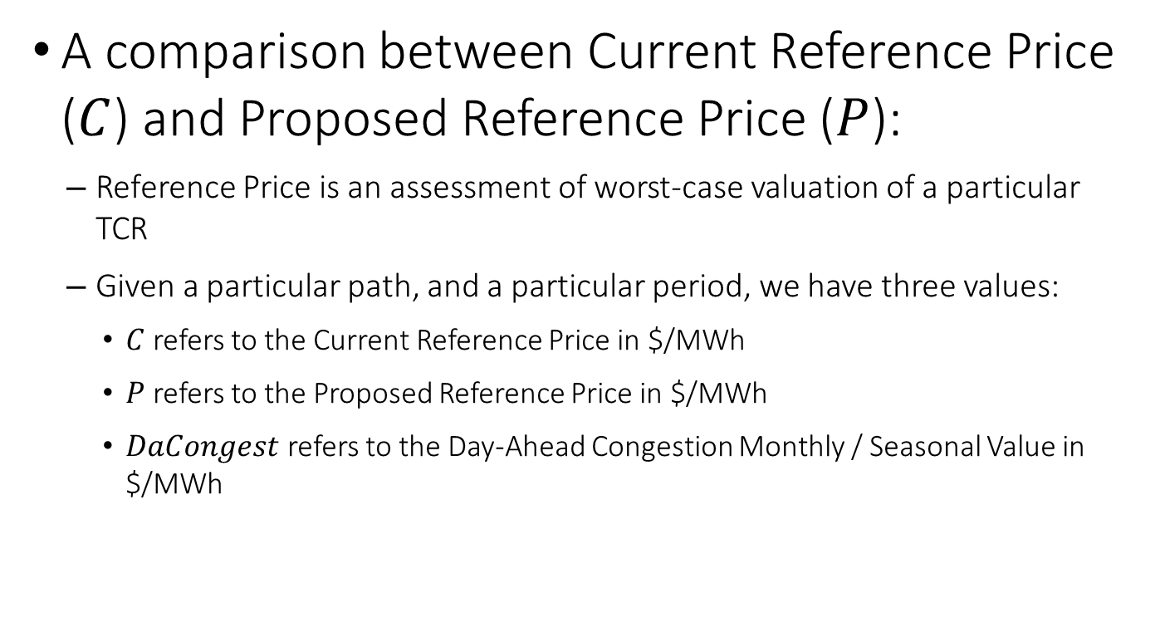
Comparison
A comparison between Current Reference Price ($C$) and Proposed Reference Price ($P$):
Reference Price is an assessment of worst-case valuation of a particular TCR
Given a particular path, and a particular period, we have three values:
$C$ refers to the Current Reference Price in $/MWh
$P$ refers to the Proposed Reference Price in $/MWh
$DaCongest$ refers to the Day-Ahead Congestion Monthly / Seasonal Value in $/MWh

Slide 4

Comparison
We can assess how far the Day-Ahead Congestion value is with respect to the worst-case value derived from $C$ and from $P$
DaCongest – WorstCase > 0 implies WorstCase works as intended
DaCongest – WorstCase < 0 implies that there is significant topological changes to where historical hourly values are no longer sufficient to derive a WorstCase valuation
DaCongest - Current

Slide 5



X-Y Chart
DaCongest - Proposed
48.3% of the total paths evaluated show that
DaCongest exceeds both the Proposed and Current Reference Price
$$48.3\%$$
DaCongest - Current
41.7% of the total paths evaluated show that
DaCongest is below both the Proposed and Current Reference Price Implies significant topological changes
$$7\%$$
7% of the total paths evaluated show that
DaCongest is above the Current Reference Price, but below the Proposed Reference Price
Average exceedance is represented by
the coordinate placement.
$$41.7\%$$

Slide 6
How are the 4 dots generated? (1)
PY2016 and 2017 unique paths that are in LTCR nominations and Annual Auctions
PY 2016 evaluates 3,702 unique paths
PY 2017 evaluates 8,557 unique paths
The dots represent the average deviations on all paths that belong to that quartile.

Slide 7
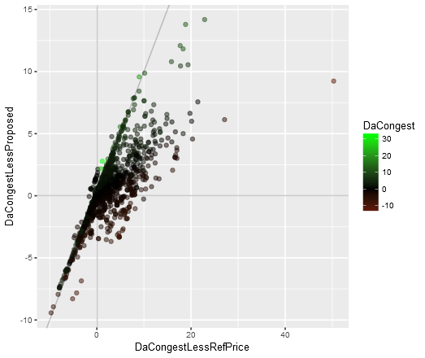
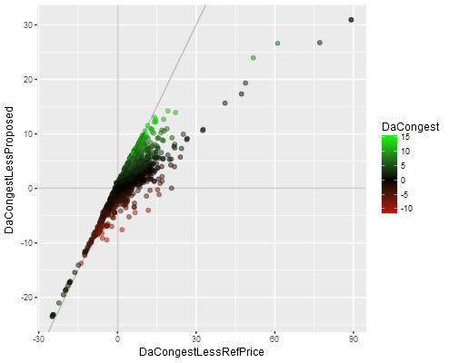
How are the 4 dots generated? (2)
Examples:
Jun_16 OFF
Jun_17 OFF

Slide 8
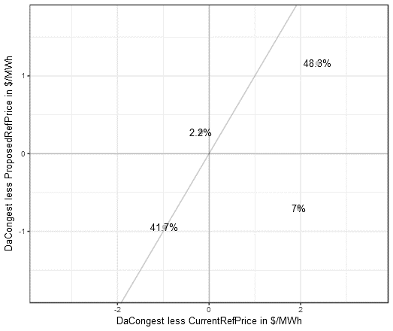
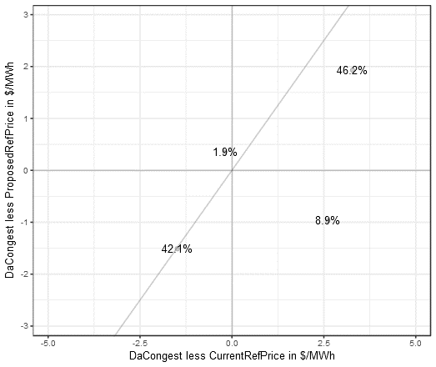
Jun_16
OFF
ON

Slide 9
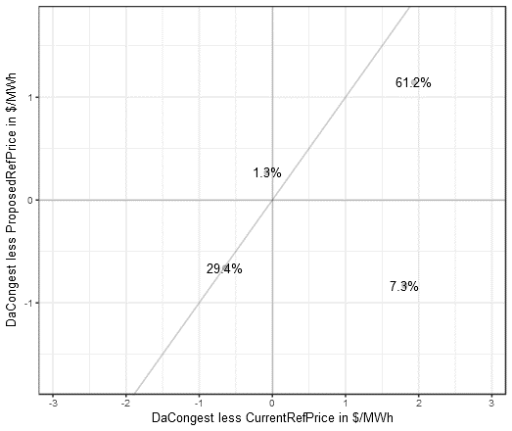
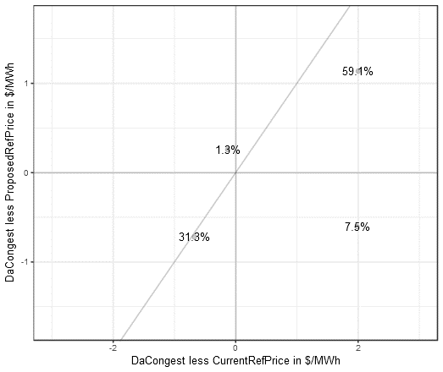
Jul_16
OFF
ON

Slide 10
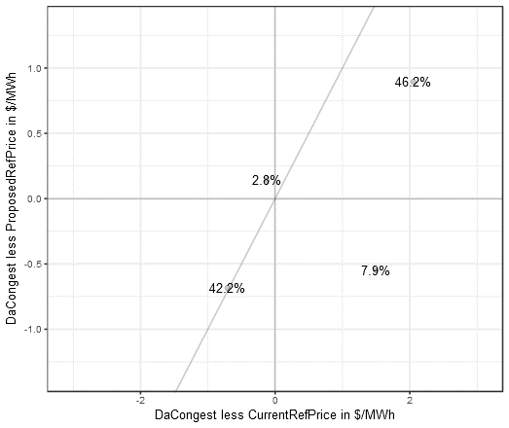
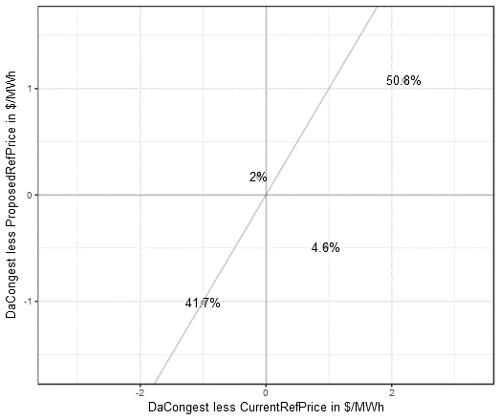
Aug_16
OFF
ON

Slide 11


Sep_16
OFF
ON

Slide 12
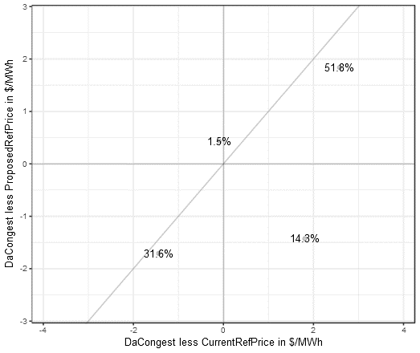

Fall_16
OFF
ON

Slide 13

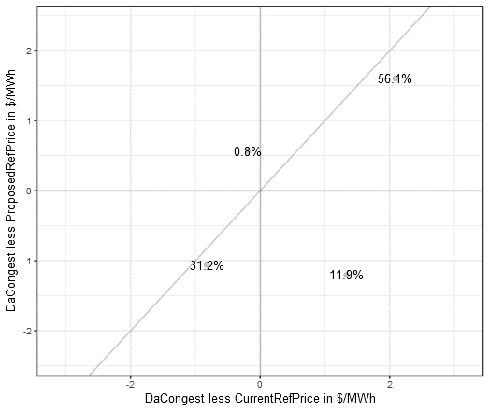
Winter_16
OFF
ON

Slide 14
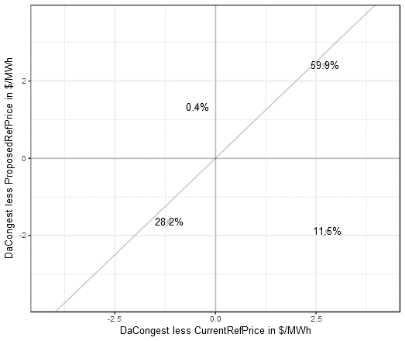
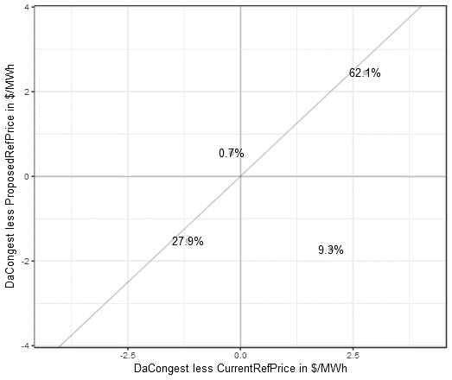
Spring_17
OFF
ON

Slide 15
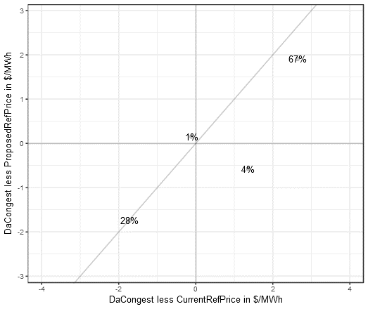
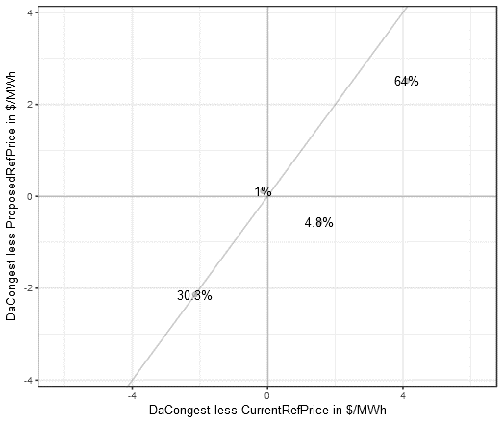
Jun_17
OFF
ON

Slide 16

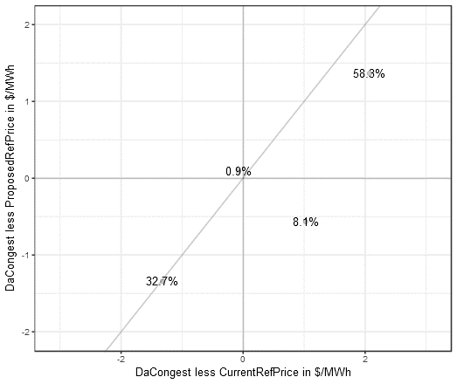
Jul_17
OFF
ON

Slide 17
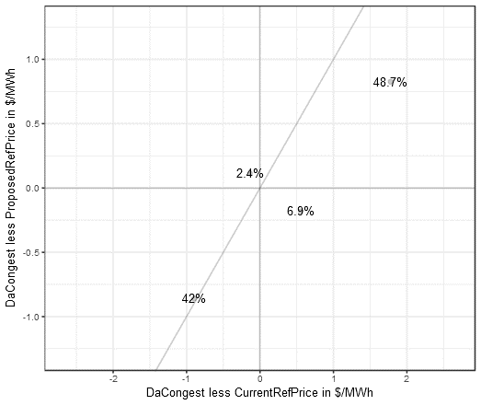
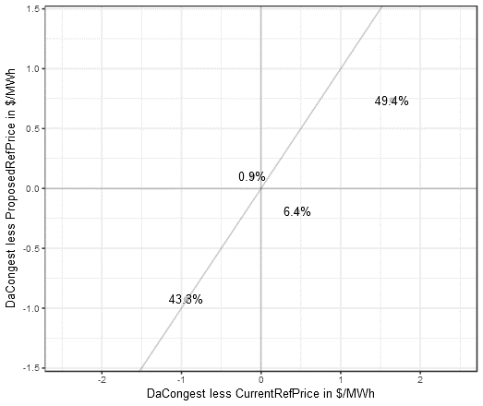
Aug_17
OFF
ON

Slide 18
Concluding Remarks
The exercise is meant to show that in general the Proposed Reference Price is as good as the Current Reference Price when it comes to assessing a worst-case value.
When Day-Ahead congestion exceeds the Current Reference Price, it also exceeds the Proposed Reference Price
When Day-Ahead congestion is below the Proposed Reference Price, it is also below the Current Reference Price
We show 80% - 95% of the paths evaluated belong to this “as-good” category. Lowest 80% was shown in Spring_17 ON period.
Note also that in general DaCongest is farther away from the Current Reference Price, showing the extremity of the Current Reference Price

Slide 19
Concluding Remarks (2)
The exercise points out also the shortcomings of the Proposed Reference Price when
DaCongest exceeds the Current Reference Price but DaCongest is below Proposed Reference Price
This accounts for 4% – 14.3%, with the highest gap found in Fall_16 OFF period
Average DaCongest – Current Reference Price = 1.8 $/MWh
Average DaCongest – Proposed Reference Price = -1.4 $/MWh
The Fall_16 OFF period is mostly driven by the outlier:
This is skewed by Oct_16 when the path was valued at -48.42 $/MWh due to binding constraint WDWFPLTATNOW
Insufficient samples may as well be due to changes in network topology

Slide 20
Concluding Remarks (3)
Given the analysis from 20 periods (Jun_16 – Aug_17 OFF and ON), we can say that the Proposed Reference Price is as good as the Current Reference Price in assessing a “worst-case” value
Proposed Reference Price however would save Market Participants from having to post significant amount of collaterals in the Auction.

Slide 21
Contact
Justin Riddell
jriddell@teainc.org
Yohan Sutjandra
ysutjandra@teainc.org

