Slide 1
SOCIAL DISTANCING CHECKER
HACKATHON 2020
ONLINE WEB BASED SOLUTION
Team KanSoRiMa
ID:39
By: Manendra Nath Shukla
Rishu Raj
Soumya Michael

Slide 2
BEAT SARS-CoV-2
ABSTRACT
This project is developed in view of maintaining and detecting social distancing among people.
It is a user-friendly interface which will allow you to capture a picture and get the result as the people is following social distancing or not. If the captured image doesn’t follow social distancing, the geolocation of the place will be sent to the security police helpline via Whatsapp using Twilio API.

Slide 3
ALGORITHM USED
Step-1 Capture or Upload the Image
Step-2 Detection of the human body in image
Step-3 Labeling the detected human body in image with
rectangle over the body
Step-4 Find the coordinates of the rectangle
Step-5 calculate the distance in between them
Step5.1 if the distance is less then 100 cm
then put the alert text on image
Step-5.2 else if distance >=100 cm
then put text as ok or green color

Slide 4
PACKAGE STRUCTURE
The package has two files – Image.py and App.py
Image.py is model code
App.py is used to process the picture with final output.

Slide 5
TWILIO API
It is an API which is used to send whatsapp messages, voice messages etc online directly using program code.
It is a cloud communication based API which simplifies communication between users worldwide using different platforms.

Slide 6
FRONT END
BACK END
JAVASCRIPT
HTML
CSS
PHP
Webcam.min.js
Python
Opencv
Flask

Slide 7
WEB BASED INTERFACE
In this project, we are using a web based interface to get the picture from user. A javascript module, Webcam-min.js is used to get the picture from user and save using php.
User can click and get the results of whether the given picture has the people who are following Social Distancing.
Directly sent to police officials on the given Whatsapp number in-built via Twilio API.
Can also be set on Live Streaming to live stream the place, if violated with social distancing rules.

Slide 8
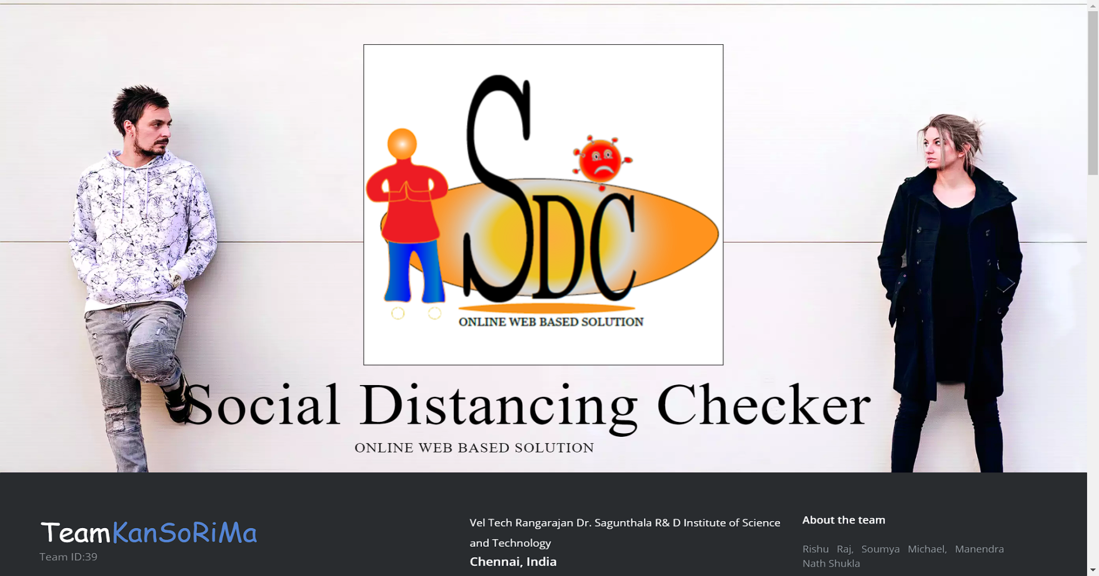
WEB-VIEW

Slide 9
Object detection
The project will capture and perform object detection to detect the person. The detected persons will be marked with Labels around them.
Implemented using python uses OpenCV.
Object Detection is a computer technology related to computer vision, image processing and deep learning that deals with detecting instances of objects in images.

Slide 10
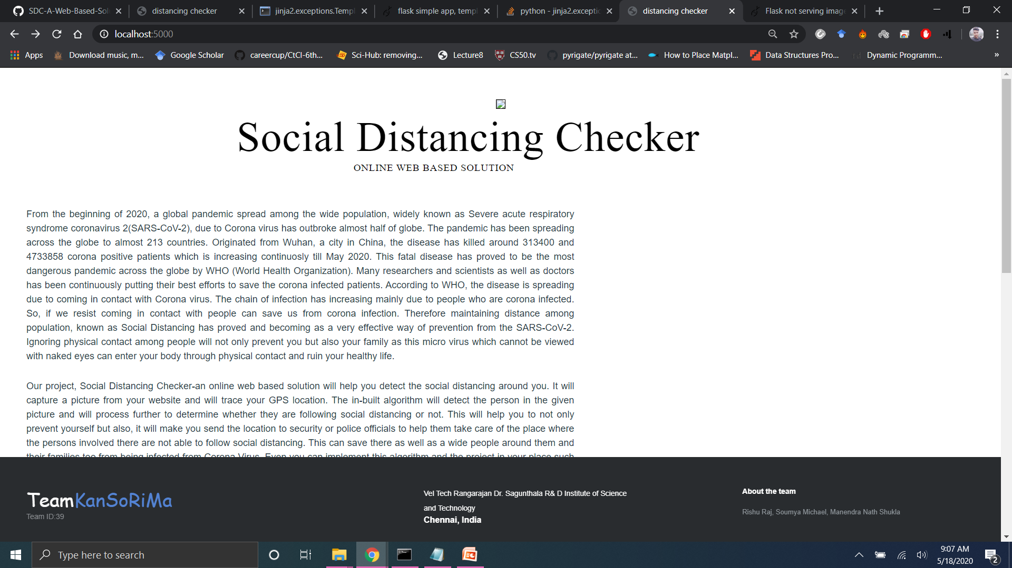
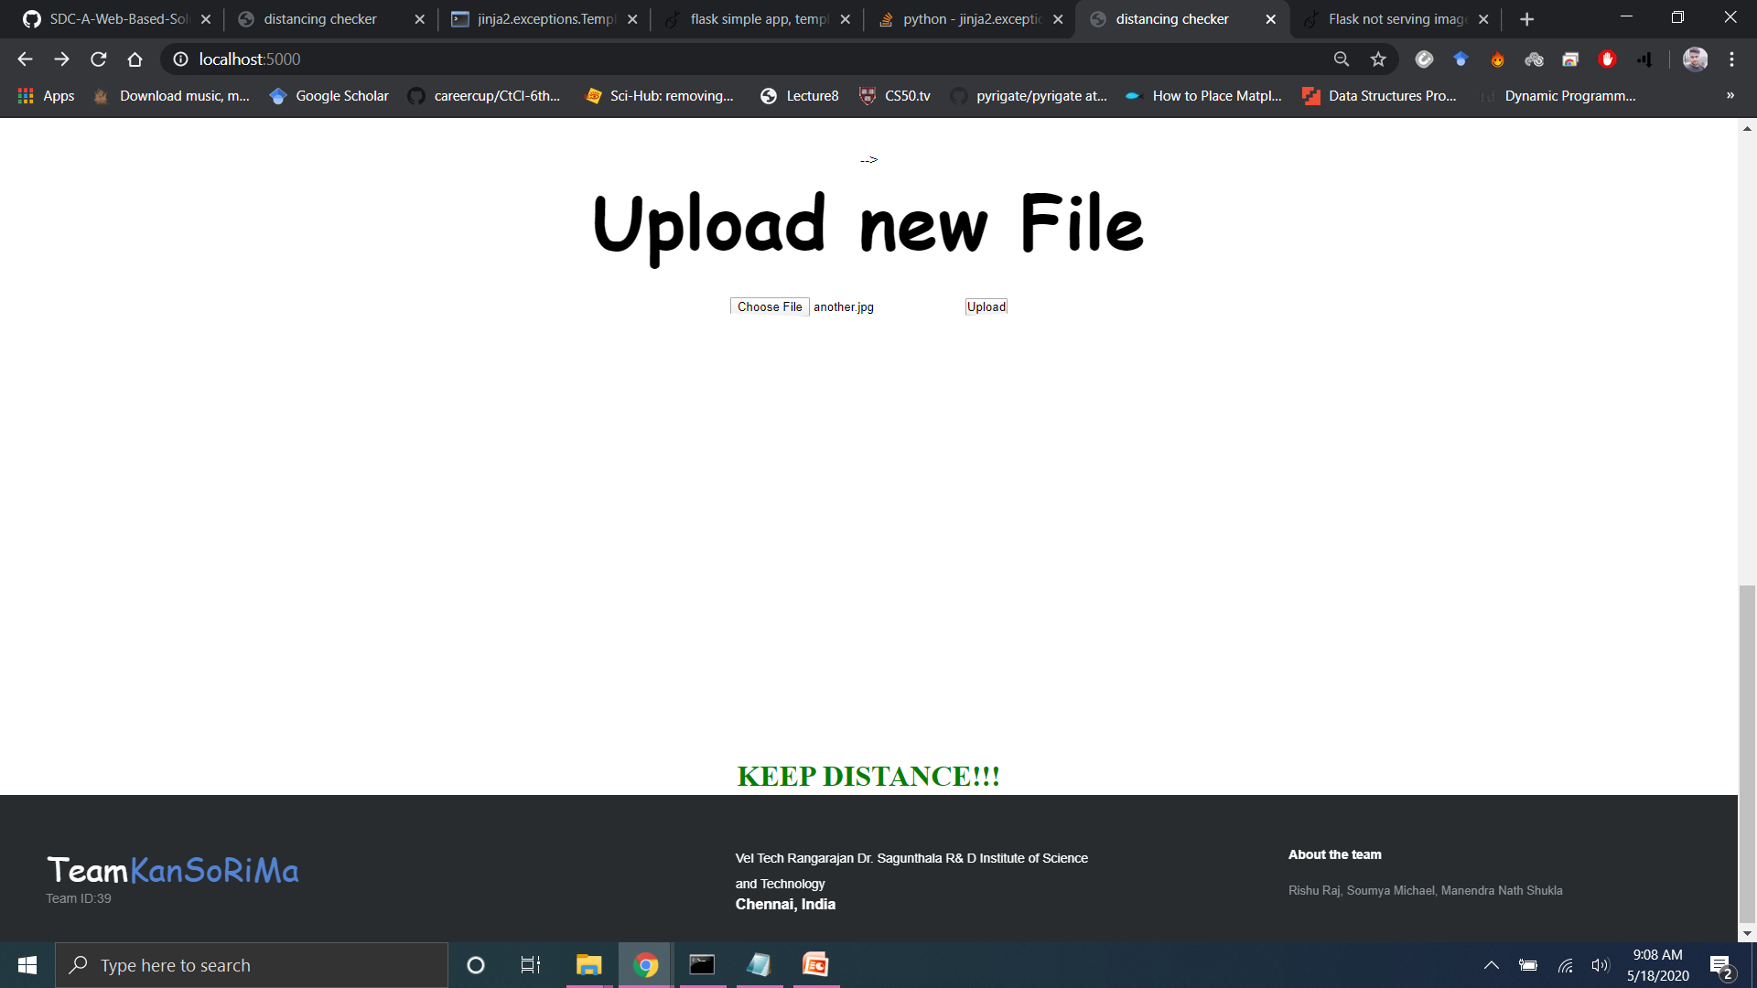
RESULT

Slide 11
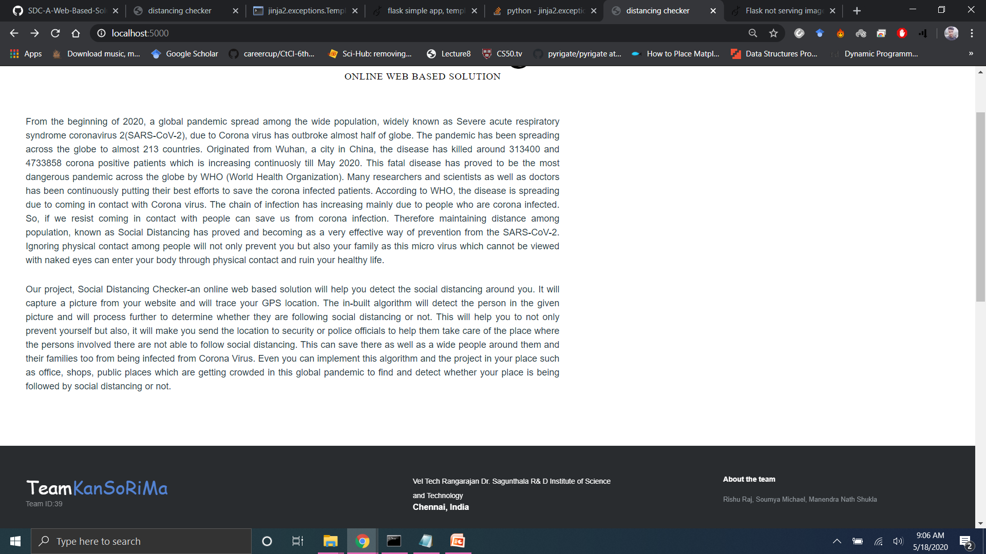

Slide 12
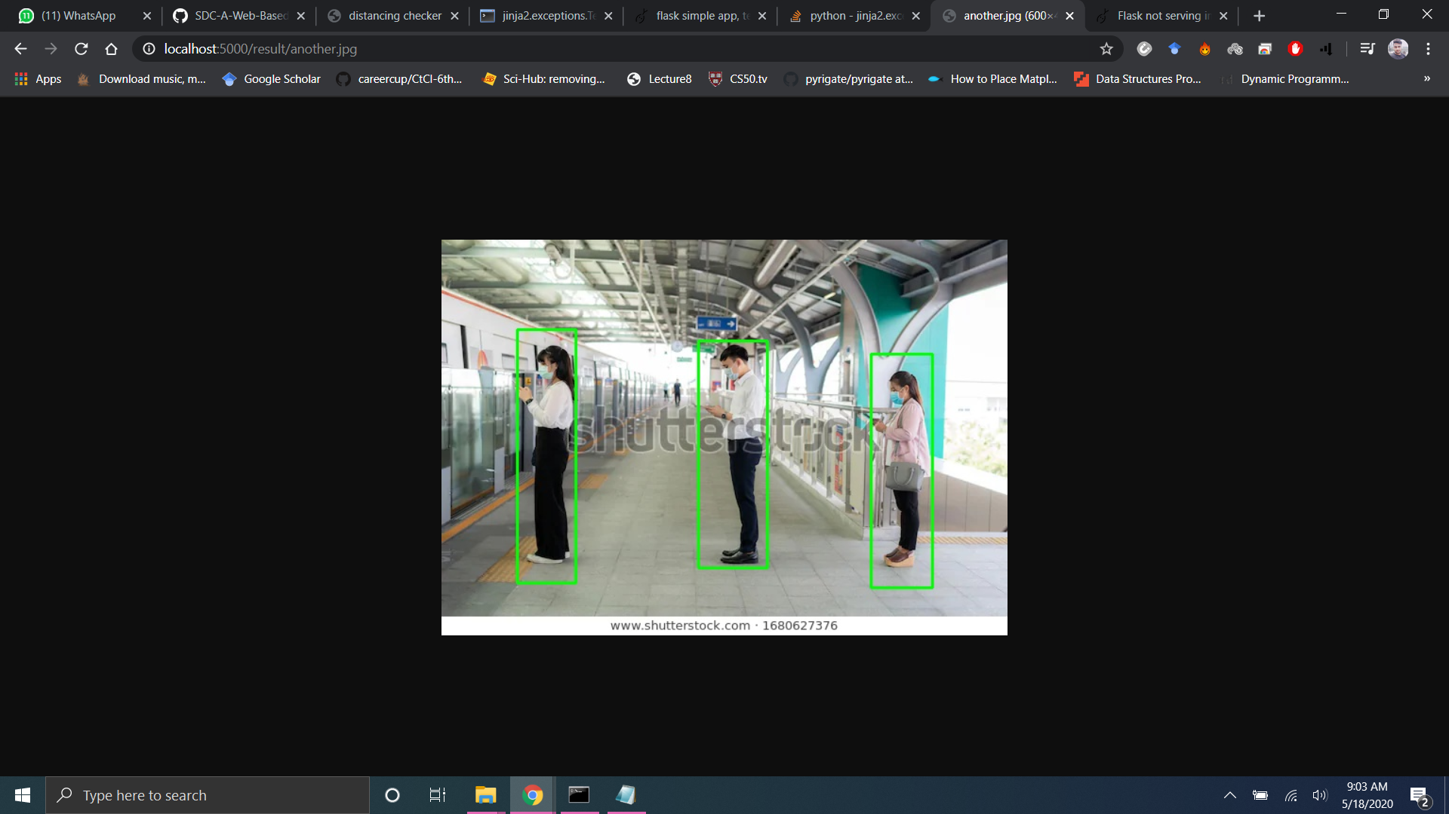

Slide 13
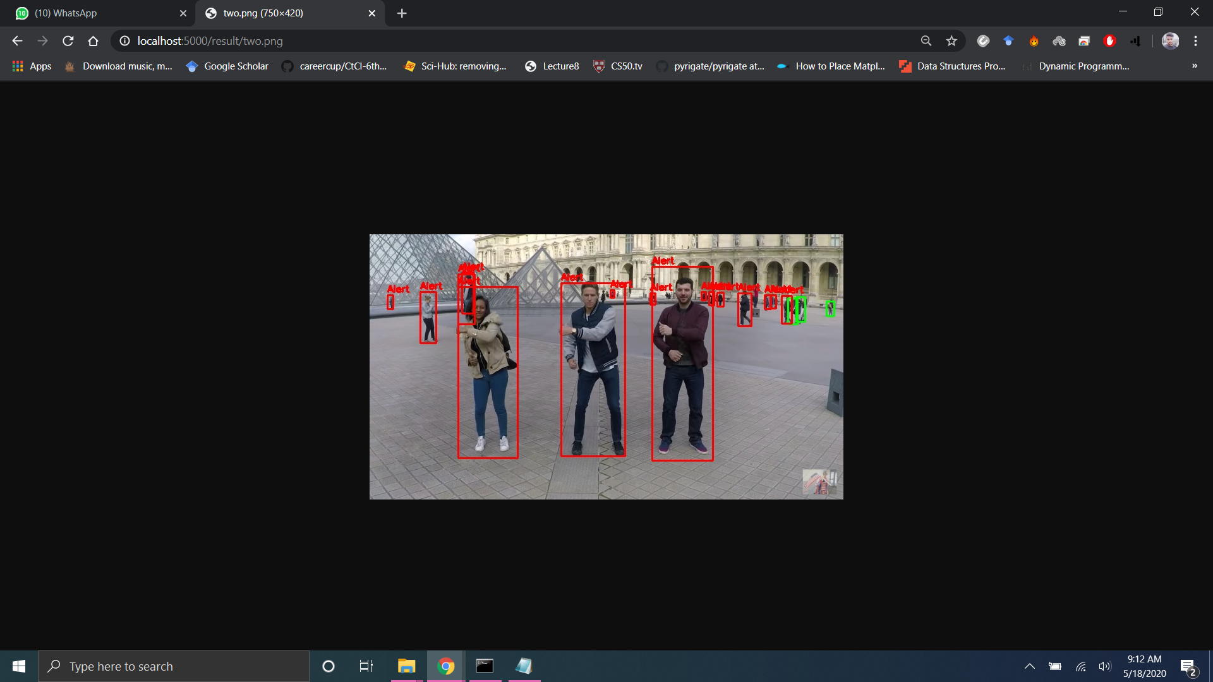

Slide 14
Uses
Can be implemented at malls, offices, medical shops, public halls, traffic lights and crossings, wherever the public is allowed to go in this lockdown.
Users can be implemented with live streaming option where user can adjust the Whatsapp service as per their authority.
A helpful system to be implemented at medical shops and liquor shops where people are needed to follow the social distancing. We can adjust the message system where we can send the camera codes stating the location of the camera or can be default option as police officials.
Alert system can be changed to Hooter or Alarm or a smart alarm where alarm will alert with the floor number or place name guiding as the place is getting violated with social distancing rules.

Slide 15
ADVANTAGE
Can save people from getting infected at social gatherings in this CORONA time.
Real time monitoring if enabled Live Streaming.
Fully automated system with SMS and Alert systems.

Slide 16
DISADVANTAGE
Needs high processing for image detection. Requires a high speed processor.

Slide 17
THANK YOU

