Slide 1
MTQ315
Water Potability
Yash Gohel
2018MT10773

Slide 2
Why is it important?
Water is used for drinking, electricity generation, transportation, irrigation etc.
Water quality is one of the most important factor in public health
Clean water is important for growth of any living being
Contaminated water may result in transmission of diseases
According to UNICEF, only 3 out of 4 people have ready access to safe drinking water
Notes:
Healthcare sector for point 4
By ready access we mean trip collection time < 30 minutes

Slide 3
Check whether the water is potable or not on given parameters
The parameters used to determine potability are,
pH value, hardness, solids, chloramines, sulfates, conductivity, organic carbon, trihalomethanes and turbidity

Slide 4
Parameter Description
pH value
pH of water
Hardness
Concentration of Mg²⁺ and Ca²⁺ in water in ppm
Solids
Concentration of total dissolved solids in ppm
Often caused by industrial sewage and waste
Chloramines
Concentration of chlorine and chloramines in ppm
Chloramine are used for water disinfection
Sulfate
Concentration of sulfate in ppm
Runoff from fertilized agricultural lands

Slide 5
Parameter Description
Conductivity
Conductivity of water in μS/cm
Organic Carbon
Total amount of carbon in organic compounds in water in ppm
Trihalomethanes
The chemicals generally found in water treated with chlorine(in ppb)
Turbidity
The quantity of solid matter present in water in suspended state (in NTU)
Notes:
Nephelometric Turbidity Unit

Slide 6
Permissible range
pH | 6.5 - 8.5
Hardness | 200
Solids | 500
Chloramines | 4
Sulfate | 250
Conductivity | 200-800
Organic Carbon | 25
Trihalomethanes | 80
Turbidity | 4

Slide 7
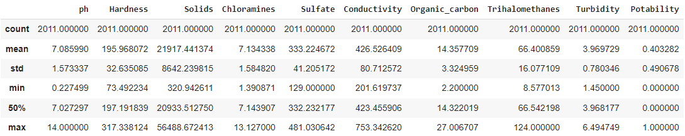
Dataset Description
There were many data points with NaN values which are dropped as we do not want to play with data in such serious case of predicting water potability.

Slide 8
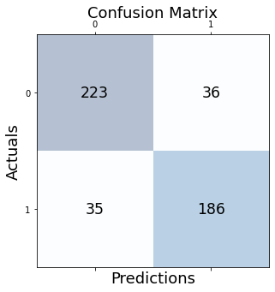
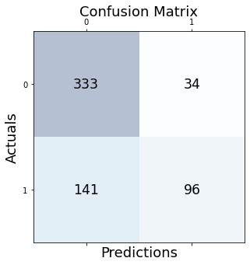
Model
Used Random Forest model for classification
Accuracy of the model : 85.21 %

Slide 9
SHAP and LIME

Slide 10
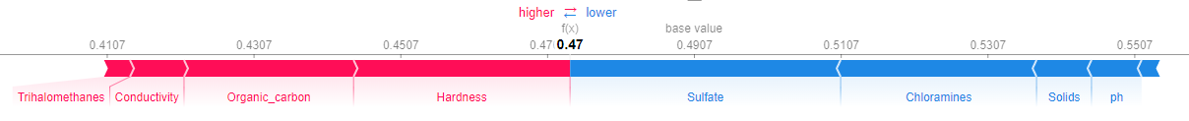
Explanation on one datapoint in SHAP
pH | 6.05 | 6.5 - 8.5
Hardness | 149.12 | 200
Solids | 23603.5 | 500
Chloramines | 6.54 | 4
Sulfate | 302.7 | 250
Conductivity | 393.29 | 200-800
Organic Carbon | 17.61 | 25
Trihalomethanes | 54.22 | 80
Turbidity | 4.26 | 4

Slide 11
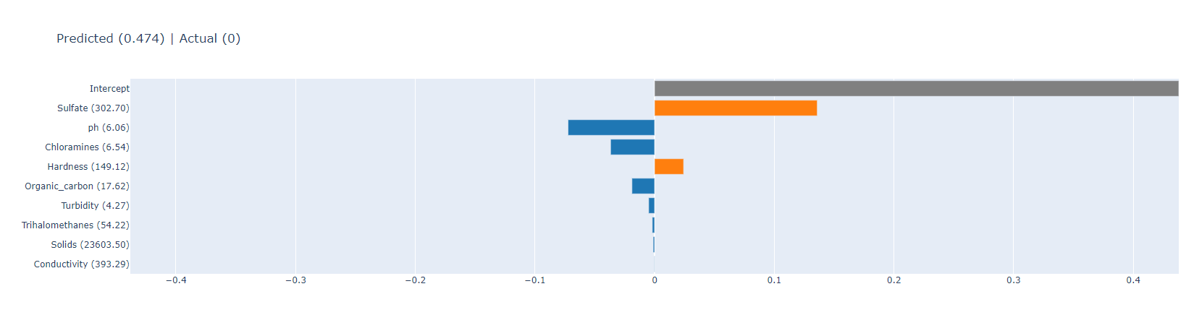
Explanation on one datapoint in LIME

Slide 12
Some wrong interpretations
pH | 7.28 | 6.5 - 8.5
Hardness | 228.54 | 200
Solids | 29690.92 | 500
Chloramines | 7.87 | 4
Sulfate | 322.27 | 250
Conductivity | 392.53 | 200-800
Organic Carbon | 15.17 | 25
Trihalomethanes | 84.37 | 80
Turbidity | 2.92 | 4

Slide 13
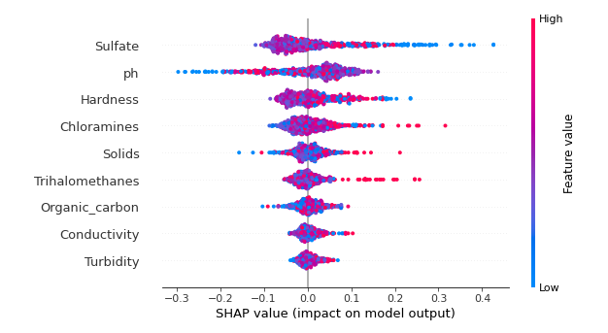
Summary Plot

Slide 14
Counterfactuals

Slide 15
DiCE (Diverse Counterfactual Explanations)
Used DiCE to generate counterfactuals
Allowed all features to vary in first case
Some features are interdependent on condition
Used independent features to vary

Slide 16
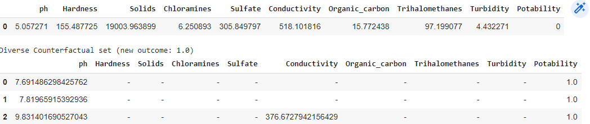
All features Varies

Slide 17
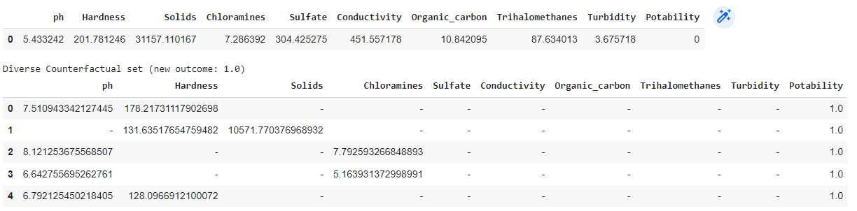
Varied Hardness, pH, Solids and Chloramines
Notes:
pH 5.5 is approx of coffee or banana which is not fully ripe

Slide 18
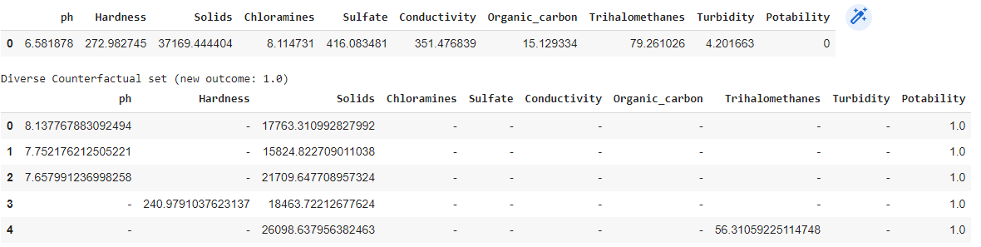
Varied pH, Hardness, Solids and Trihalomethanes

Slide 19
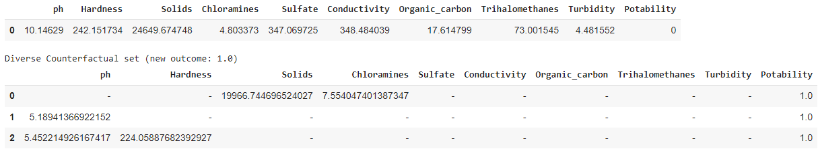
Some wrong results

Slide 20
Feature Importance
Feature that is changed more often to generate counterfactual
pH | 0.264
Hardness | 0.215
Solids | 0.175
Chloramines | 0.164
Sulfate | 0.373
Conductivity | 0.116
Organic Carbon | 0.099
Trihalomethanes | 0.124
Turbidity | 0.131

Slide 21
Why model is not explaining well?

Slide 22
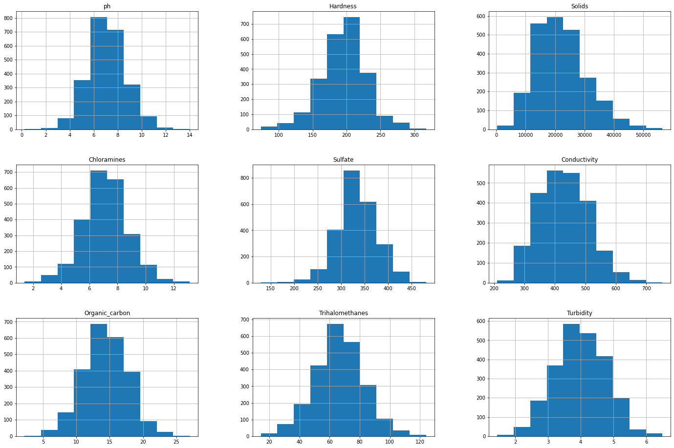

Slide 23
References
https://data.unicef.org/topic/water-and-sanitation/drinking-water/
https://www.kaggle.com/datasets/adityakadiwal/water-potability

Slide 24
Thank You

