Slide 1
Learnings on Ethereum - Decentralized Applications
Kiran Kumar Guntumadugu
Metro State University
ICS 690 Blockchain Technology
Date: 04/19/2022

Slide 2
Outline
Introduction
Background
CryptoZombies
ChitFund DApp
Conclusion

Slide 3
Introduction
Whitepaper based on learnings from
CryptoZombies
ChitFund DApp
Contributions made to ChitFund DApp
Energy Optimization (Greenhave seen increasing at a faster rate including smart appliances, smart homes, smart retail stores, smart educational institutions, smart hospitals etcData Analytics in Smart City

Slide 4
Background
Centralized Systems vs De-centralized Systems
Blockchain
Bitcoin - digital currency exchange
Ethereum
execute programmable code on a decentralized virtual machine
non fungible tokens

Slide 5
Background
OpenZeepelin library
Open Source
Community reviewed code
Reusable smart contract implementations
ERC20 and ERC721 token standardizations
Flexible role-based permission setup
Defender – monitoring and automating the operations

Slide 6
CryptoZombies
Interactive learning tool to build a decentralized gaming application
Offer courses on
Solidity
Smart Contracts
Blockchain infrastructure and deployment
Kubernetes and Golang
Notes:
of sensors, actuators, security cameras, smoke detector, lighting control and HVAC

Slide 7
CryptoZombies
Completed the module Solidity Path Beginner to Intermediate Smart Contracts
Making the Zombie Factory
Zombies Attack Their Victims
Advanced Solidity Concepts
Zombie Battle System
ERC721 & Crypto-Collectibles
App Front-ends & Web3.js
Notes:
of sensors, actuators, security cameras, smoke detector, lighting control and HVAC

Slide 8
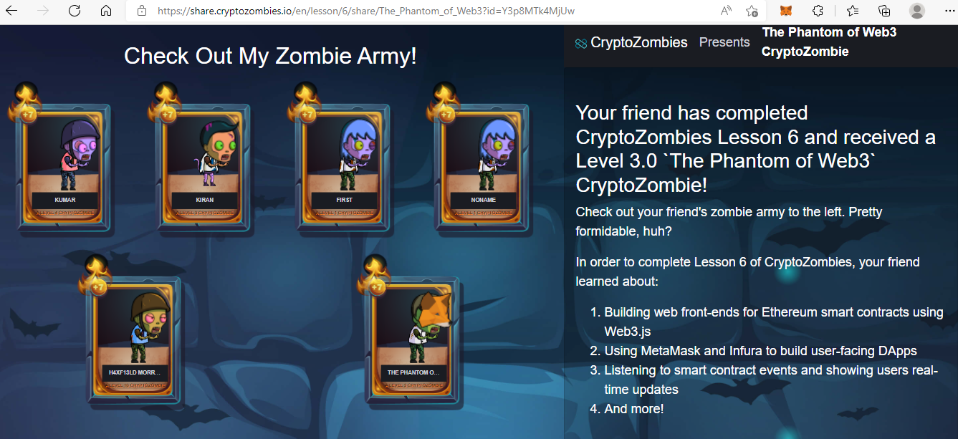
CryptoZombies
Notes:
of sensors, actuators, security cameras, smoke detector, lighting control and HVAC

Slide 9
ChitFund DApp
Group project idea for the Maghribi-Foundation
Identify and select if there is any reusable code that can be used as a baseline code
Steps performed to run the DApp in local machine:
Install node v16.13
Setup Metamask wallet and Infura project
Create env file to specify the network chain for deployment and wallet to pay the gas fees.

Slide 10
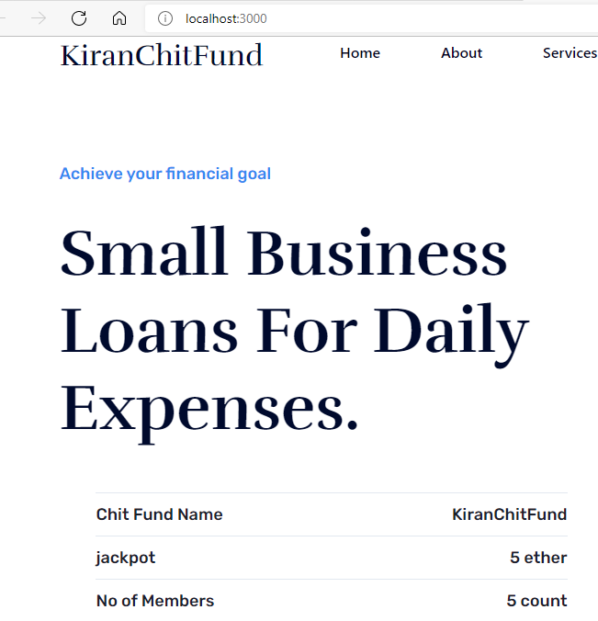
ChitFund DApp
Steps contd…
Compile the code using Truffle
Deploy the code into Rinkeby network
using Truffle

Slide 11
ChitFund DApp
Worked on the Insurance smart contract
Approach
Fire an Event when a new member joined
Verify the if the member has underwriter or not
If Yes - then approve and have the member joined
If No - invoke the underwriter function
Create separate functions to verify the underwriters, assign an underwriter and decision making
Have couple of compilation issues

Slide 12
Conclusion
Several DApps in the market in Proof of Work or Proof of Stake
Understood the importance of anonymity, governance, security while building DApps
Spend time on ChitFund DApp for self learning
Notes:
Numerous developments and research is in place for Big Data analytics integration with smart buildings and smart cities.
Big data analytics for smart residential buildings are relatively less complex and achievable sooner than in the smart cities.
Challenges like stability, reliability, security, intrusion detection and more heterogenous data structures.
Basic overview of smart buildings, smart cities and various data challenges that paved way for big data analytics, machine learning integration in smart buildings and smart cities.

Slide 13
Coding Takeaways:
In Solidity uint reserves 256 bits of storage
msg.sender is a global function
keccak256 built in SHA3 hash function
Types of modifiers:
Visibility, State, Custom, Payable
Solidity libraries will have reusable smart contracts that can be accessed in building decentralized applications.
Notes:
Numerous developments and research is in place for Big Data analytics integration with smart buildings and smart cities.
Big data analytics for smart residential buildings are relatively less complex and achievable sooner than in the smart cities.
Challenges like stability, reliability, security, intrusion detection and more heterogenous data structures.
Basic overview of smart buildings, smart cities and various data challenges that paved way for big data analytics, machine learning integration in smart buildings and smart cities.

Slide 14
Whitepaper Reference
ICS-690/WhitePaper_Blockchain_Kiran.pdf at main · go2kiran/ICS-690 (github.com)
“Everything will be tokenized and connected by a blockchain one day.” – Fred Ehrsam
“The old question ‘Is it in the database?’ will be replaced by ‘Is it on the blockchain?’ “ – William Mougayar
Notes:
Numerous developments and research is in place for Big Data analytics integration with smart buildings and smart cities.
Big data analytics for smart residential buildings are relatively less complex and achievable sooner than in the smart cities.
Challenges like stability, reliability, security, intrusion detection and more heterogenous data structures.
Basic overview of smart buildings, smart cities and various data challenges that paved way for big data analytics, machine learning integration in smart buildings and smart cities.

Slide 15
References
[1] IEEE Xplore Full-Text PDF:
[2] #1 Solidity Tutorial & Ethereum Blockchain Programming Course | CryptoZombies
[3] samarth30/chitFund: chitFund - built using smart contracts , web3 , reactjs (github.com)
[4] OpenZeppelin/openzeppelin-contracts: OpenZeppelin Contracts is a library for secure smart contract development. (github.com)
[5] ProvidentOne/contracts: Solidity contracts that run Provident One insurance fund (github.com)
[6] 11 Best Blockchain Quotes: Know this Amazing Technology (techpikk.com)

Slide 16
Questions
Thank You

