Slide 1

uLTImEM
Ultimate Expansion for the Commodore VIC-20
Jim Brain
World of Commodore 2015
December 5, 2015
Toronto, Canada

Slide 2
Project Goals
Initial Goal
Add cartridge rom capabilities to VIC-MIDI, while allowing the rom image to be updated
Final Goal
Create configurable ROM capabilities for VIC-20 with field re-programming capability
Create configurable RAM capabilities for VIC-20

Slide 3
Features
Independently control memory capabilities for 7 memory ranges
RAM1/RAM2/RAM3, BLOCK1, BLOCK2, BLOCK3, BLOCK5, IO2, IO3
Independently control read/write capabilities
Not Present, ROM, Read Only RAM, R/W RAM
Utilize 2 user defined switches
Utilize 1 user defined LED
Hide registers for maximum compatibility
Perform machine hard reset under software control
Unhide registers using “magic reads”

Slide 4
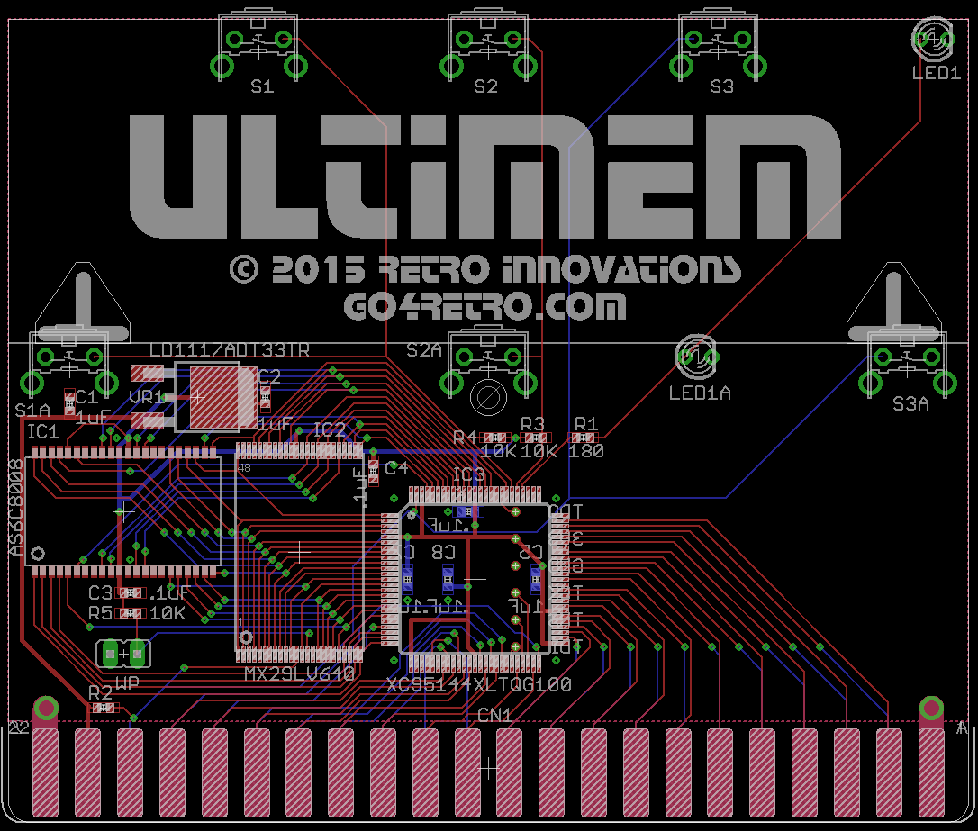
VICMIDI+Ultimem

Slide 5
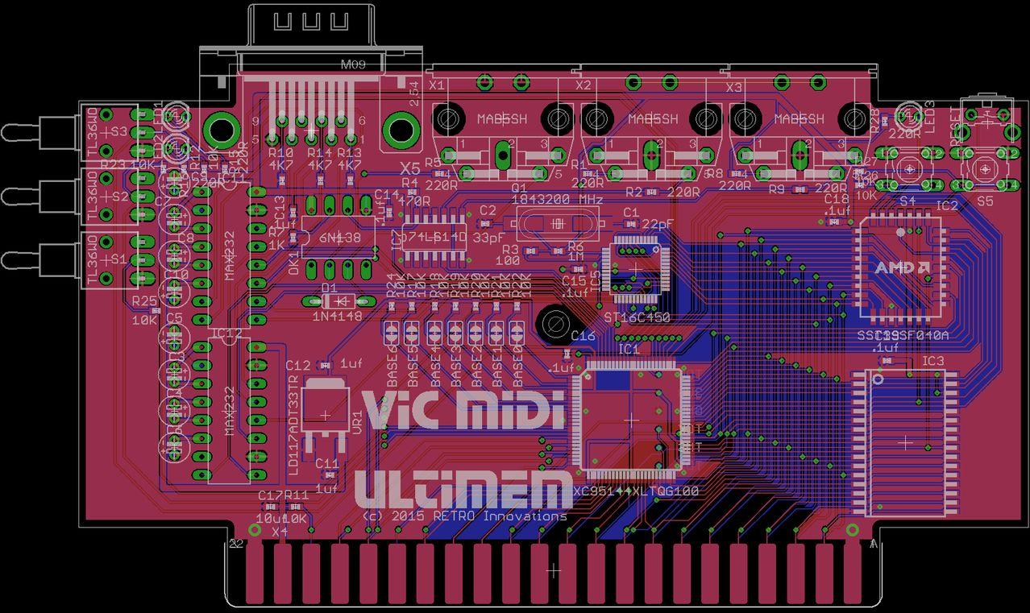
VICMIDI+Ultimem

