Slide 1
goFIT: Midway Milestone
Brought to you by Team FITLIT
Notes:
Hi everyone! My name’s Christina, and I’m here to present goFIT’s midway milestone

Slide 2
Team FITLIT
Christina Ramsey
Olivia Gregory
Bryce Tham
Denis Russu
Notes:
To start real quick I’m going to introduce Team FITLIT, which is me, Olivia, Bryce, and Denis.
I’m also going to do a quick refresher on out problem/solution overview and value proposition before starting with the new material that will be the focus of this presentation.

Slide 3
Value Proposition
Inspiration to maintain a healthy lifestyle.
Notes:
Altogether, this can be summed up in our value proposition, which we saw as “inspiration to maintain a healthy lifestyle.” This has guided the focus of our target audience, our design choices, and much of our process as we create our product.

Slide 4
Problem Overview
Although many people want to stay healthy, they rarely prioritize their health, saying they don’t have time, don’t want to wait for the long-term benefits, or prefer to do other, more social, activities.
Notes:
Based on our needfinding interviews at the beginning of the quarter, we articulated the following problem overview:
Although many people want to stay healthy, they rarely prioritize their health, saying they don’t have time, don’t want to wait for the long-term benefits, or prefer to do other, more social, activities.

Slide 5
Solution Overview
We want a product that offers meaningful social connection and immediate rewards when users meet fitness and nutrition goals.
This should motivate people to be more excited about maintaining a healthy lifestyle, demonstrating that the act itself - not the incentives - is worth prioritizing.
Notes:
So in response, we developed the following solution:
We want a product that offers meaningful social connection and immediate rewards when users meet fitness and nutrition goals.
This should motivate people to be more excited about maintaining a healthy lifestyle, demonstrating that the act itself - not the incentives - is worth prioritizing.

Slide 6
Talk Overview
Heuristic Evaluation Results
Overview of Revised Design
Prototype Status
Notes:
Now we can fast forward to today. In order to show where we’ve come to stand, I’m going to talk about the following.
The first two, which our our group’s Heuristic Evaluation Results and our Revised Design, are definitely intertwined. So there I’ll be showing you the feedback we received on our medium fi prototype and how we incorporated that into the hifi prototype that we’re constructing right now.
Lastly I’m going to talk about our prototype status and give a quick demo of where it stands currently.

Slide 7
Heuristic Evaluation and Revised Design
Violations, fixes, and takeaways
Notes:
So we’re going to start off by talking about our Heuristic Evaluation and the takeaways we got from that feedback.

Slide 8
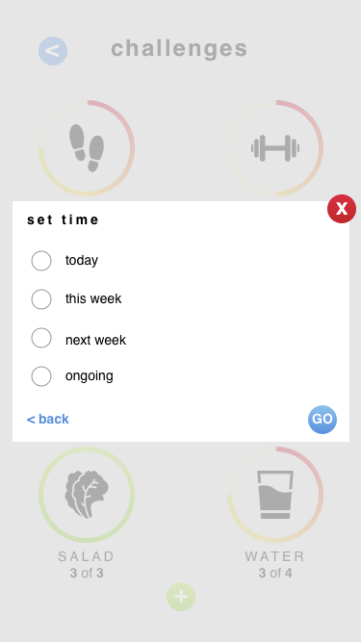
4- Visibility of System Status
At the time setting page, what time we are setting should be clearly notified.
Is this time the due date?
Is it the time we are supposed to start the activity?
Additionally, the deadlines of challenges are unclear.
Does the user have to complete a week after they accept it or a week after they receive it?
Notes:
We received 2 severity 4 violations, which we knew that we definitely needed to address.
The first was about confusion over our time setting page, which was the last step in creating a challenge. We had originally envisioned that here, users would be able to set a deadline to complete a challenge, but our evaluators were rightfully confused by it’s function, what it meant, and how they should be using it.
They noted in particular that they weren’t sure whether they were setting the start or end time of the challenge, especially in regards to challenging friends and letting them start the challenge with you.

Slide 9
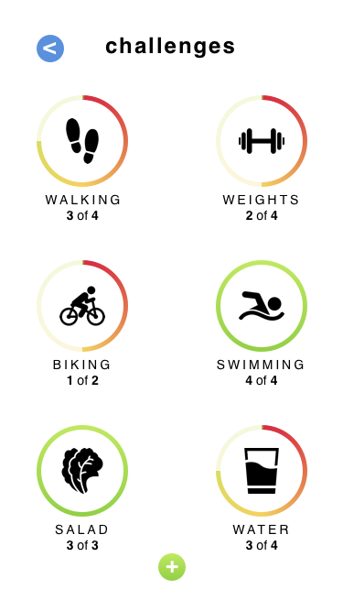
4- Match Between System and Real World
What the challenges are supposed to involve is a bit unclear.
On the homescreen, for instance, there’s a symbol representing a challenge to walk 4 times this week, but there is no information about how far the user is expected to walk.
Notes:
There was also confusion about what specific challenges entailed, which is fair. Our previous iteration was pretty vague, and although we played with the thought of defining more specific challenges for the user to create, we never actually followed through.
As a result, the evaluators were unsure about when they should be logging progress or even what they should be doing to keep up with a challenge. For example, if the challenge is walking, do we log progress whenever we get up to walk? Or whenever we walk, like, 3 miles? Or walk for 15 minutes? Overall it was confusing.

Slide 10
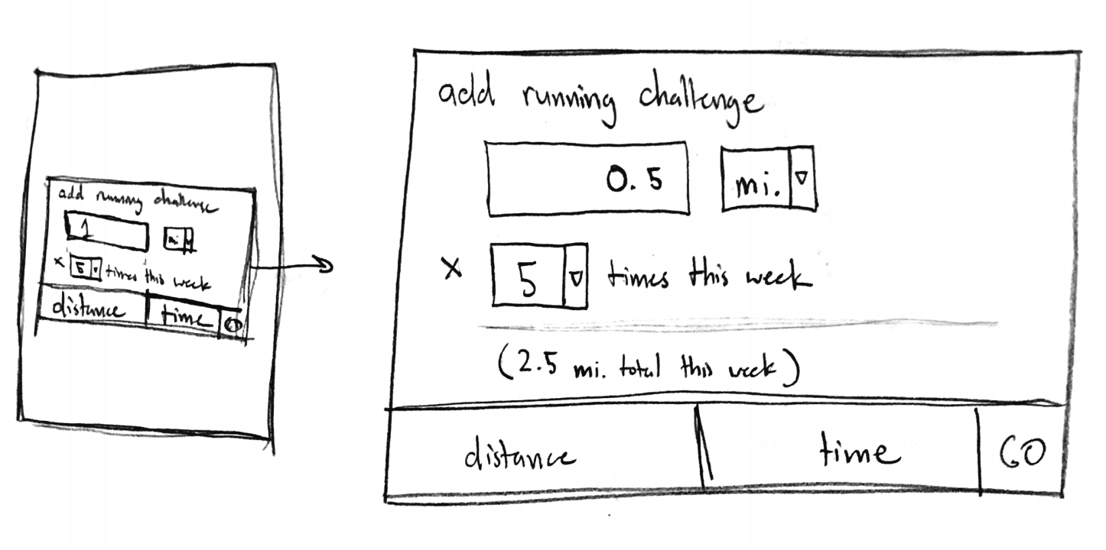
Fixing Severity 4s
Remove “set time” screen
Make all challenges weekly
Define challenges in terms of distance (if applicable) or time
Notes:
We came up with a few changes to address these issues. The first was to remove our “set time” screen. Instead, we would make all challenges start at the beginning of the week and end when that week was up. We also changed the benchmark for what challenges involve.
Now users keep track of distance they want to cover, or some other applicable benchmark, like reps or weights for weightlifting or ounces for drinking water.
They could also choose to work for some amount of time, like going for a walk for 15 minutes.
We thought this was still flexible even though it was less open ended and more clearly defined. Before, it would be easy for users to flake on a running challenge - if they went for a run that was half of the distance or time they had in mind, they could still log it. It’s also explicit what they have to do in order to reach their goal for the day, which is more clear and less overwhelming.

Slide 11
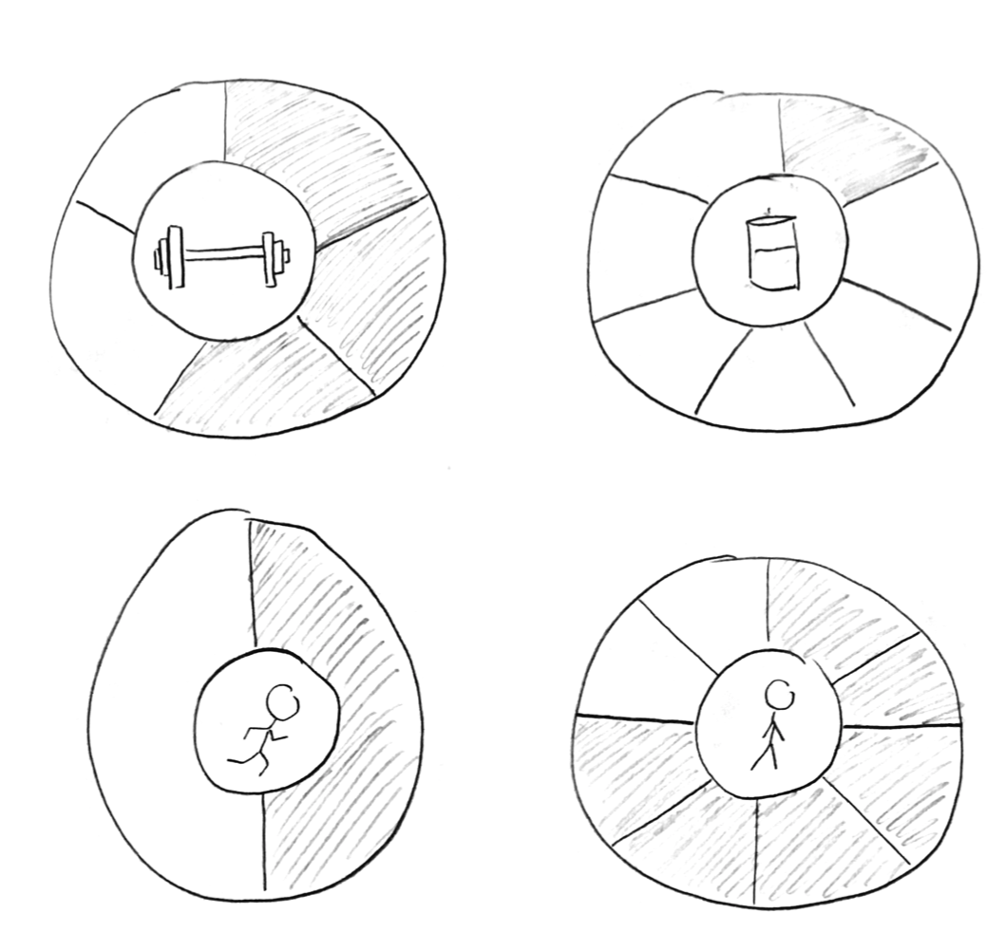
Fixing Severity 4s
Track progress in terms of what you do
Standardize challenge deadlines
Better way of displaying progress
Easier for scheduling
Easier for understanding
Easier for keeping track
Notes:
The second change we came up with was modifying the way progress was shown visually,
Here, we split up the border into segments where 1 segment means 1 time that you want to perform that activity per week. When you perform that action, one more border slot gets filled in.
It’s still an easy way to track progress.
It’s also less overwhelming - the goal isn’t to complete the entire border at once, it’s to fill in one segment at a time. It’s easier to think of progress in terms of “I completed the activity that I’d allotted to for today” or “this is all that I need to do to stay on track today.”
The second change we came up with was modifying the way that progress is shown visually per challenge.
Border is split up - 1 segment per time that you want to perform that activity that week
Weights 5x week
Drink enough water 7x week
Go for a run 2x week
Walk for at least x amount of time 8x week
This is just a sketch - more information about the specific goals of the challenge would be available in the prototype and when clicked to get more information
The idea here is that each time you perform this action, one slot of the border gets filled in
It’s still an easy way to visually track your progress
The goal isn’t to complete the entire circle at once, which could be overwhelming - it’s to fill in some portion of the border at a time. That way, if you want to do something 7x a week, it won’t be as disheartening as seeing a barely filled progress bar at the beginning of the week. It’s easier to think of progress as in terms of “I completed the goal that I had allotted for today” or, if you haven’t done it yet, “this is all I have to do today to stay on track towards my goal.”

Slide 12
Severity 3
How do you receive, accept, or reject challenges/friends?
Visibility of System Status
What is the green button for on the social page?
Consistency and Standards
How do you incentivize health without a defined rewards system?
Aesthetic and Minimalist Design
What happens if a challenge is failed?
Help and Documentation
Why isn’t there a way to see what options a user has chosen while creating a new challenge?
Visibility of System Status
Notes:
We also had a few severity 3 issues. These were
How do you receive, accept, or reject challenges?
What is the green button for on the social page? Is it for creating challenges or adding friends?
How do you incentivize health without a defined rewards system?
What happens if a challenge is failed?
Why isn’t there a way to see what options a user has chosen while creating a new challenge?
This is all good feedback and brought up some good points, so we definitely revised our design to encompass fixes.

Slide 13
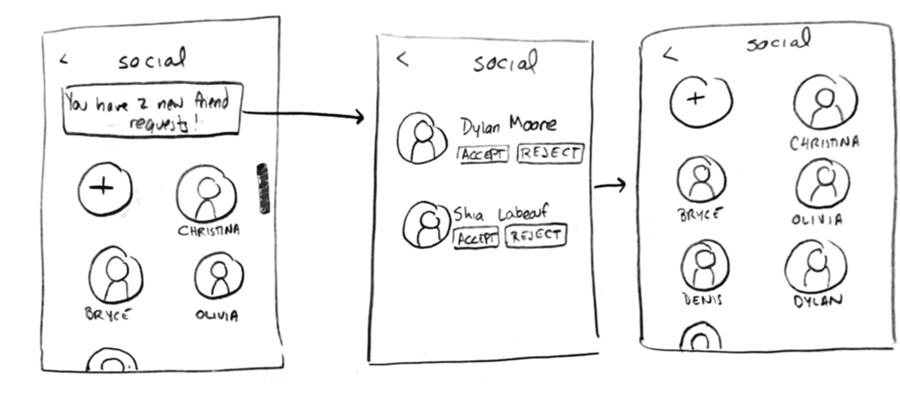
Severity 3
How do you receive, accept, or reject challenges/friends?
What is the green button for on the social page?
How do you incentivize health without a defined rewards system?
What happens if a challenge is failed?
Why isn’t there a way to see what opens a user has chosen while creating a new challenge?
Notes:
One of the things we were lacking in previous iterations was a clear explanation of how someone could accept and reject friend and challenge requests.
Now on the main screen, we’d have a little red number on the challenges or social icon corresponding to how many new notifications you had in each one. There’d also be a message about notifications when you open the screen itself.
If you click the message, you see a new screen where you see all the requests (for challenges or friends), along with the option to accept or reject them. Accepting updates the info on the relevant social/challenges page
Our evaluators were also concerned about the green button we had on the social page. We now placed both green buttons within the layout of the page, in the very first slot. Ideally it’s intuitive enough that when you click it here, it’ll allow you to add a friend, while clicking it on the challenges page lets you create a new challenge.

Slide 14
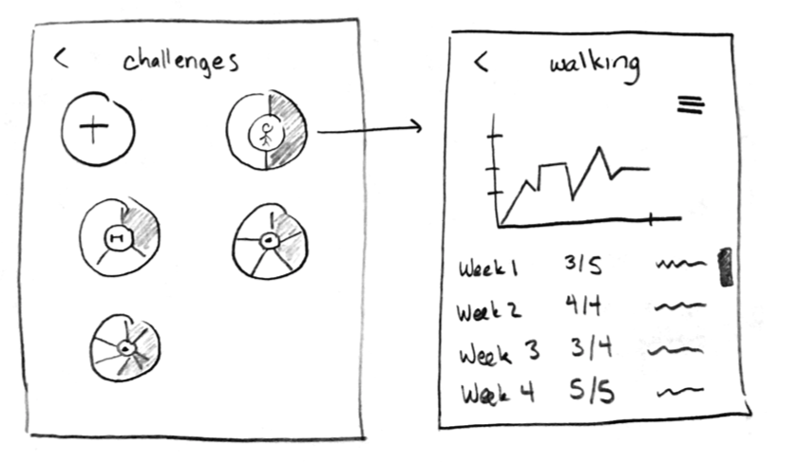
Severity 3
How do you receive, accept, or reject challenges/friends?
What is the green button for on the social page?
How do you incentivize health without a defined rewards system?
What happens if a challenge is failed?
Why isn’t there a way to see what opens a user has chosen while creating a new challenge?
Notes:
Another idea we kept pushing was that our product would incentivize health, but so far, aside from talking about intrinsic motivation, we haven’t really shown a tangible way that we would do that.
One idea that we had but never really implemented in the past was to show your own past history and statistics, usually in a graphical and really easy to read format. Now, when clicking on a specific challenge, you could see past statistics you’ve logged about that activity, either in terms of distance or time or some other characteristic.

Slide 15
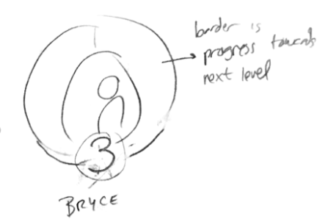
Severity 3
How do you receive, accept, or reject challenges/friends?
What is the green button for on the social page?
How do you incentivize health without a defined rewards system?
What happens if a challenge is failed?
Why isn’t there a way to see what opens a user has chosen while creating a new challenge?
Notes:
To further this idea, we’re also starting to offer users a chance to level up their profile, which they can do by meeting goals, creating and achieving challenges, and winning challenges against their friends. In keeping with our aesthetic and theme, we also had the idea that the border color would represent how close you are to leveling up.
We don’t want to demotivate users, so you can’t level down or backtrack on your progress towards the next level. There might be some confetti or cute congratulatory animation if you win, or maybe some motivational message if you lose, but we don’t want the fallout from losing challenges to be too rough since we don’t want to disincentivize users from taking the initial risk to push themselves and reach for a challenge.

Slide 16
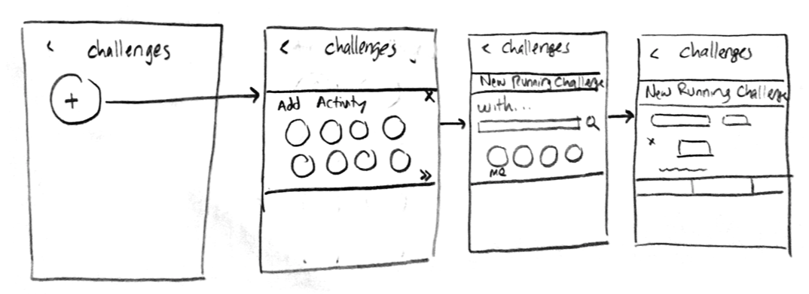
Severity 3
How do you receive, accept, or reject challenges/friends?
What is the green button for on the social page?
How do you incentivize health without a defined rewards system?
What happens if a challenge is failed?
Why isn’t there a way to see what opens a user has chosen while creating a new challenge?
Notes:
Lastly, our evaluators also pointed out that once you start creating a challenge, you don’t see what options you’ve chosen in the past, so we tweaked our layout for creating a challenge just slightly.
We’re experimenting with two ideas: the first is to carry over info from past screens. When you advance through creating a challenge, the activity and the people you’ve chosen will be visible as you progress.
Our other idea is to combine choosing an activity and a friend onto one screen, and then choosing a frequency and a benchmark on the next. This way it’ll be easy to view, edit, and play around with what specific activity and which, if any, friends you want to involve without switching between screens whenever you change your mind.

Slide 17
Takeaways
Simplify many features
Give users more visual information
Make tasks even simpler and more intuitive
Narrow target audience
Focus on audience that wants to get into exercising
Cater less to experienced user
Notes:
All in all, we had two major takeaways when redesigning our idea to fall in line with the feedback we got from our evaluators. The first one was that we needed to simplify some of our features.
We don’t need a continuous progress bar around each challenge
we don’t need to have scheduling be so open ended to the point where users can be overwhelmed with choices and possibility.
What we do need is to make tasks simpler and more defined while still offering choices. This will make it easier for us to standardize and easier for users to track progress.
A second takeaway we recognized was that we needed to shift our target audience.
Based on what we were thinking, we realized that we were refocusing our app to a more defined audience: specifically those who wanted to get into exercising but hadn’t yet.
These were the people whose interests we held in mind while making our changes (i.e. flexible and focused, with lots of graphical and visual data and intuitive tasks).
We still have the option and the opportunity to collect and display data, which we liked because it would be more of interest to extreme fitness users and seekers, but what makes our app different is that it’s more accessible, intuitive, and new-fitness-user friendly.

Slide 18
Prototype Status
Progress and planning

Slide 19

Tools
Xcode to build the prototype
All additional Xcode features
iOS simulator
Apple’s libraries for building UI’s
Swift
Notes:
a. We are using Xcode exclusively to build the prototype, and all of the features that come with xcode (e.g. the iOS simulator, apple's vast libraries for building UI's, Swift for the language)
We used xcode to build the prototype, which is in the form of an iOS app
We also used all the features that come with xcode, like
The ios simulator
Apple’s vast libraries for building UI’s
Swift for a language
We’re also probably going to use Cocoapods for some of our animation and borders, but I don’t think we’ve implemented those yet.

Slide 20
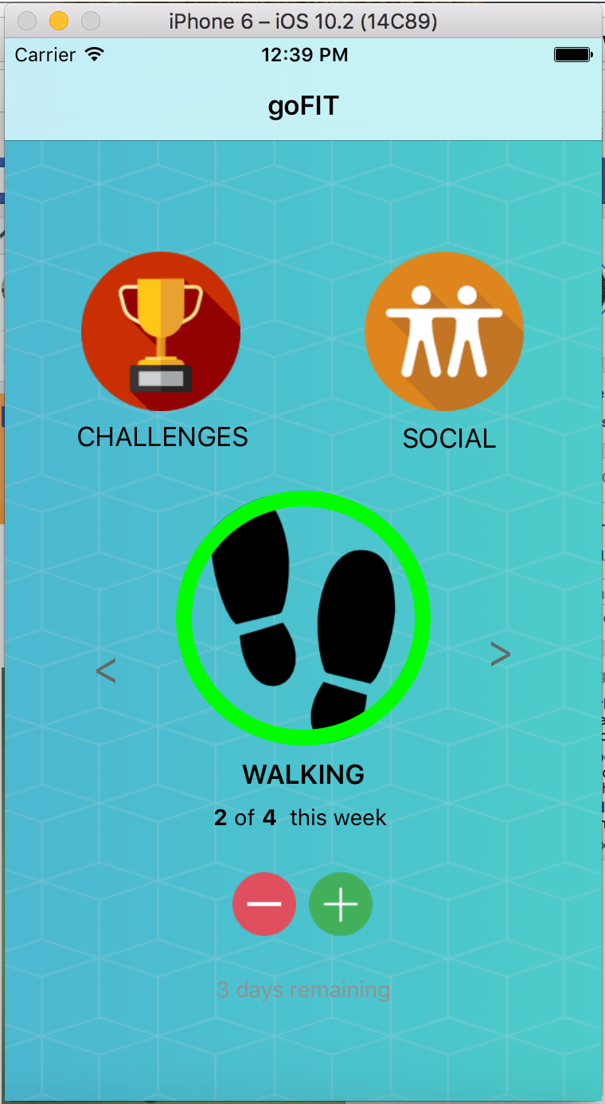
Progress towards completion
Current features
Main structure/skeleton
Task: Create a challenge
Plan going forward
Task: Log progress
Task: Challenge friends
Focus more on UI
Incorporate changes made from feedback
Fine tune details and aesthetic
Notes:
We have gotten one of our tasks done, adding a new challenge
c. Everything else isn't implemented, and the task that we do have implemented still has lots of work to be done, the UI looks clunky and obviously still in prototype stage
So far we’ve built the main structure and skeleton of the app, as well as our first task, which is creating a challenge. We thought that this would be the hardest to physically implement, especially since our other tasks just build off of this one, so that was definitely our priority going in.
We still have to fully implement the other two tasks, which are logging progress and challenging friends. You can log progress on the home screen, but because the animation isn’t finished I don’t want to say that this task is completed yet.
We do want to focus more on our UI - we haven’t fully implemented all of the design changes that I’ve talked about in these slides, and so some of what you’ll see in our demo comes from an earlier version of our prototype. The functionality is there, but we’re still changing the appearance to fall in line with our ideas.
We’re also interested in really fine tuning some aesthetic details, but that shouldn’t be super difficult since the skeleton is already in place.

Slide 21
Wizard of Oz and Hard-Coded Elements
Current friends list
Challenges available to add
Cannot scroll through users
Database (history and stats) will likely be hardcoded
Notes:
Behind the scenes, we have had to hard code and play with a few things.
The current friends list and the challenges that you can add are hardcoded
There’s currently no functionality to scroll through users
Looking ahead into the future, our history and stats for challenges and so on will likely be hardcoded and won’t currently draw from any actual stats on your phone

Slide 22
Demonstration
Featuring our current prototype
Notes:
And now for our demonstration

Slide 23
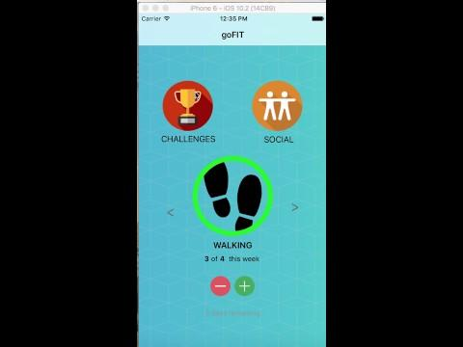

Recorded Demo
Definitely a prototype
Haven’t fully incorporated all the design changes I’ve mentioned just now
Place your screenshot here
Notes:
Some things I want to say before we show the video
It’s very definitely an in progress prototype
Some of it is rough, and some of the UI is currently being modified
Not all of the design changes have made it in
Still has earlier versions of borders without animation
Add challenges button is still in its previous position and is anchored in the page
New screen for creating challenges that deals with choosing the frequency and benchmark isn’t yet in its final form.
Video starts at 20 seconds

Slide 24
The results of our heuristic evaluation allowed us to make design changes that focus on a more specific target audience.
We’re on our way towards implementing our final design and crafting an aesthetic that falls in line with our overall vision.
Notes:
In summary, I can say that the results of our heuristic evaluation allowed us to make design changes that focus on a more specific target audience.
We’re definitely on our way towards implementing our final design and crafting an aesthetic that falls in line with our overall vision.

Slide 25
Thanks!
Any questions?

Slide 26
Credits
Special thanks to all the people who made and released these awesome resources for free:
Presentation template by SlidesCarnival
Photographs by Unsplash

