Slide 1
Needfinding for Preventative Healthcare
Bryce Tham | Christina Ramsey | Denis Russu | Olivia Gregory

Slide 2

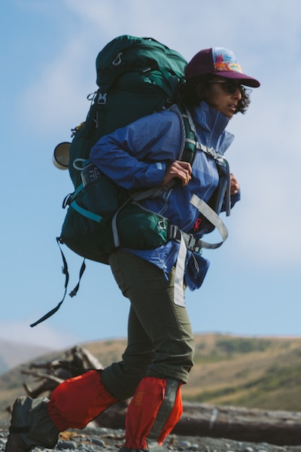

Interviews
College Students & Recent Graduates
Recreational Fitness Hobbyists
Healthcare Workers & Professionals
Notes:
We interviewed a total of 7-8 people. College students and recent graduates are just now taking care of their own health by themselves. Recreational fitness hobbyists have developed healthy habits to keep themselves in shape. Healthcare workers and professionals have extensive experience and knowledge in the health field.

Slide 3
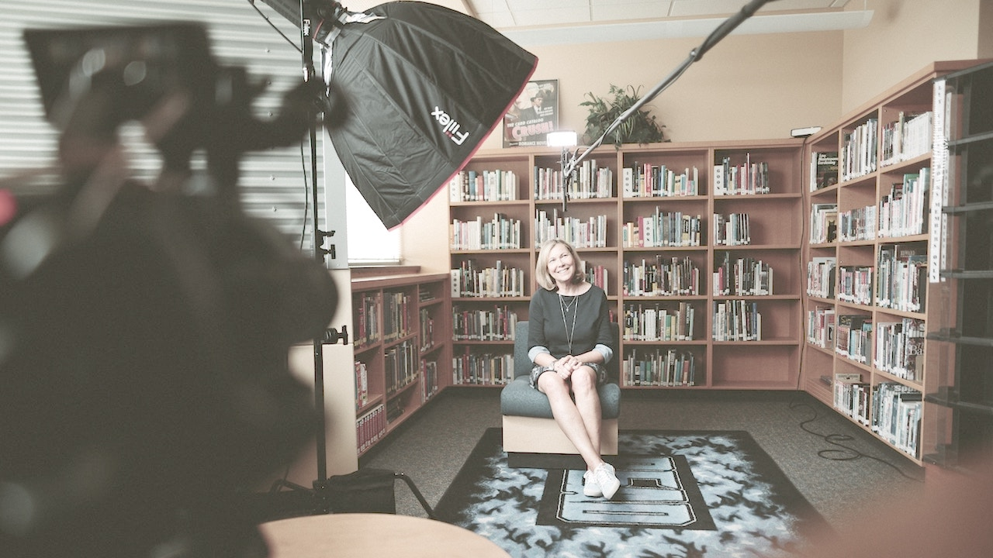
Interview Techniques
Notes:
We wanted to get as many interviews from as many different people as we could. We performed interviews both in-person and on the phone. Our goal was to find specific stories about their interests, hobbies, and work to better understand how people view their health.

Slide 4
Questions
Can you tell me about a time you reached a fitness goal?
Why is exercising so important to you?
What is your favorite part about hiking?
Can you tell me more about what you meant when you said that exercise is primarily social?
Is there one experience you found particularly interesting?
What does health mean to you?
How active are you in maintaining your wellbeing?
How do you discover new trails?
What are some of the ways that you keep yourself healthy?
How does dealing with patient health in a professional context affect how you think about your own health?
What motivates you to exercise?
Notes:
Here is a small sample of questions we asked during our interviews.

Slide 5
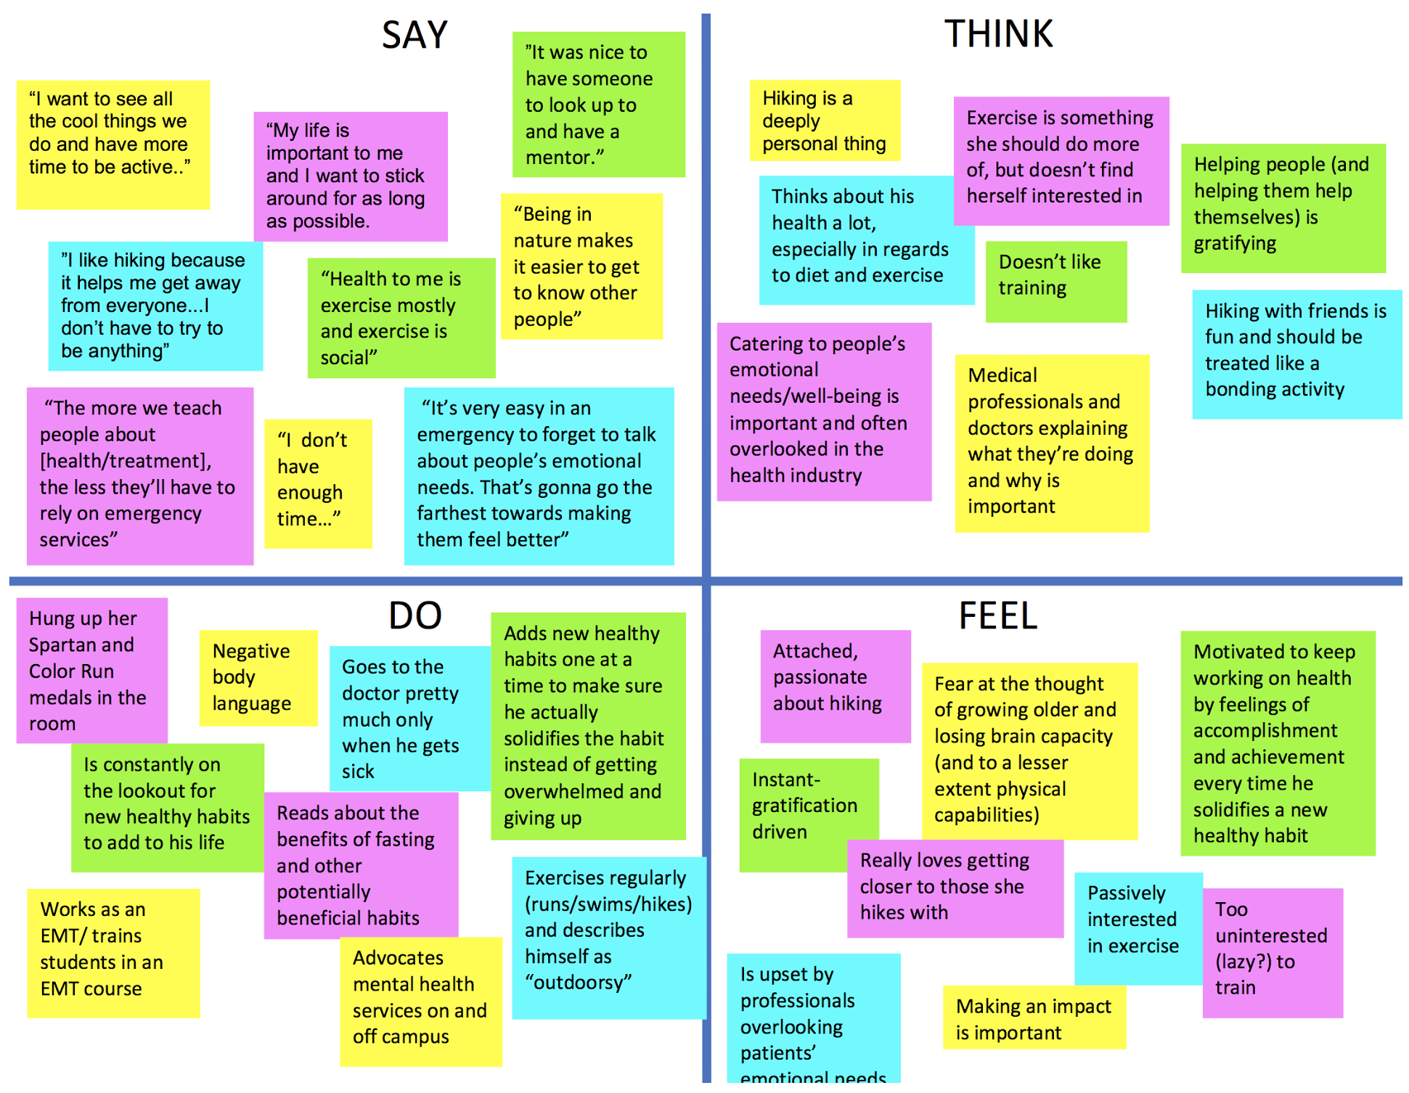
Notes:
Here is an empathy map of our findings.

Slide 6

Interesting Quotes
“My life is important to me and I want to stick around for as long as possible.”
“The more we help people understand health and treatment, the less they’ll have to rely on [emergency services].”
“I get more out of exercising knowing that I’m doing it with other people.”
“I feel like I don’t have enough time to do all the work it takes to reach my goals.”
Notes:
Here are some interesting quotes that the people we interviewed shared with us.

Slide 7
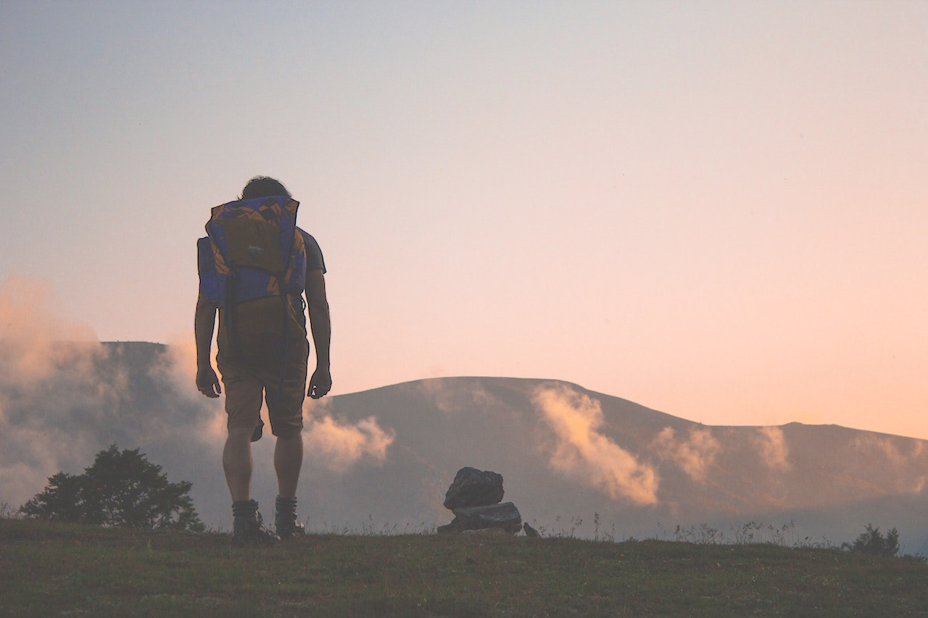
Contradictions
“I like hiking because it lets me get away from everyone.”
“I like hiking because it gives me a way to bond with others.”
Notes:
Some answers we received in some interviews contradicted the answers we received in other interviews. One person’s perspective on their health might be different from the perspective of others. For example, some people enjoy hiking as a means of social activity while others enjoy hiking because it gives them a chance to be alone.

Slide 8
People Enjoy Goal-Driven Preventative Healthcare
(even though those goals may not be the same)
Notes:
There is one thing that almost everyone we interviewed had in common: people are driven to fitness and exercise because of their goals.

Slide 9
Thank You

