Slide 1
Chimera - Simple Language Agnostic Framework
Go Frendi Gunawan, 2017

Slide 2


Who I am
Go Frendi Gunawan
  Lecturer at STIKI Malang,
  Indonesia
  Coder
  Fire Dancer (somehow)
  Expert Procrastinator :)
Contact
  frendi@stiki.ac.id

Slide 3

The Beginning
2010 - 2015
  CodeIgniter
    MVC
    OOP
  No-CMS (http://getnocms.com)
    CodeIgniter + authentication/authorization +
    widgets + layouts + page management

Slide 4
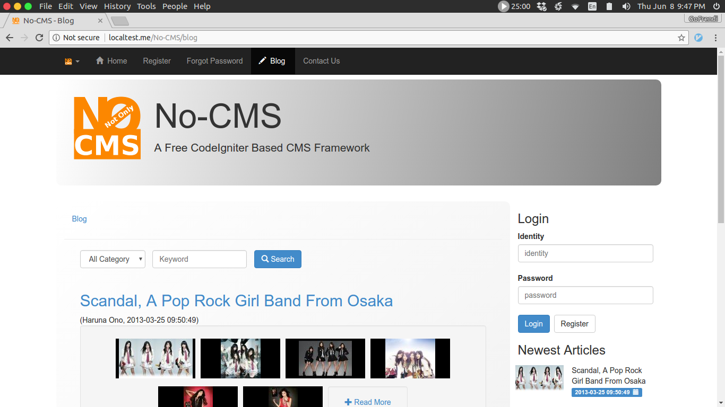
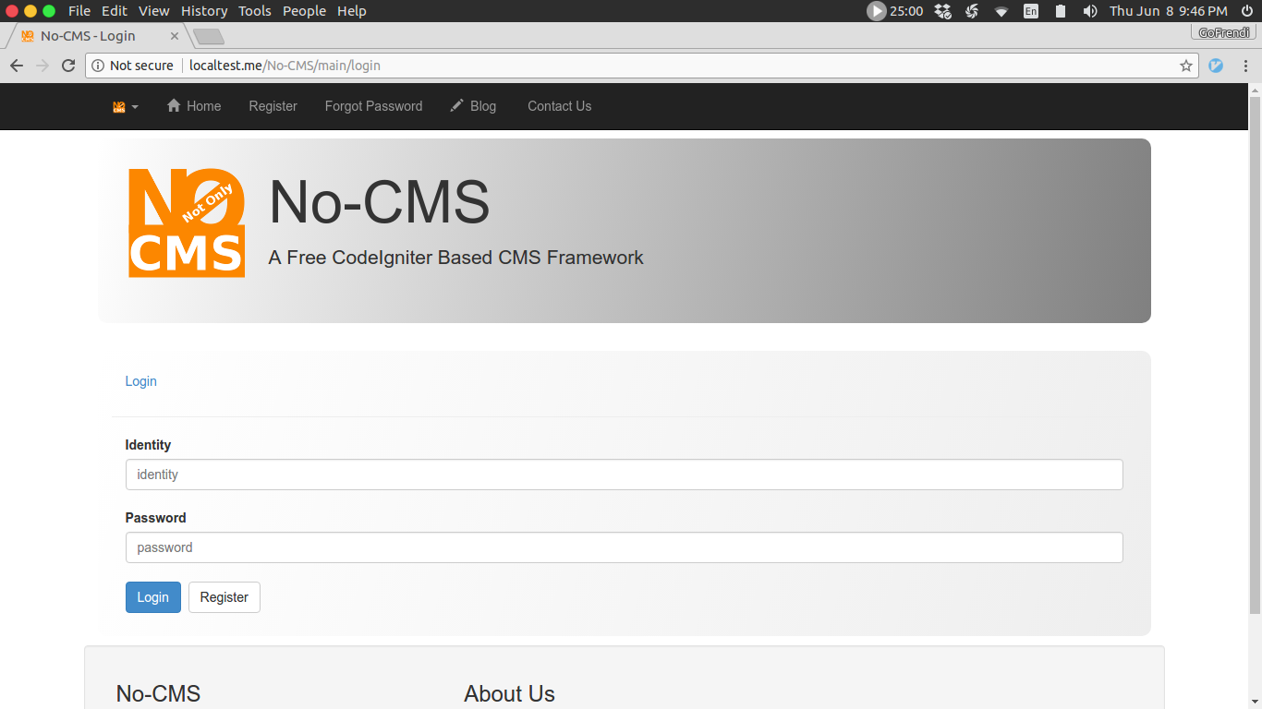
No-CMS

Slide 5
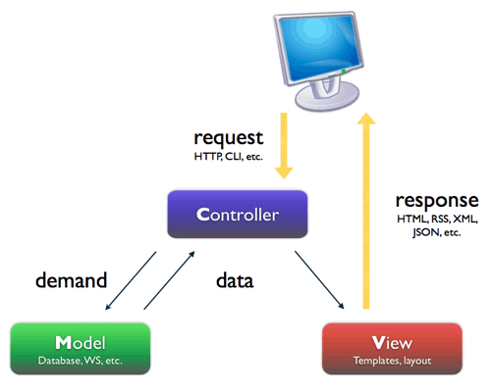
Lesson Learned
Code Separation → Maintainability
Good Design → Reusability → Less Works
But No (Forever) Good Design

Slide 6

Lesson Learned
OOP Sucks (at some point)
New Technologies born
  IOT
  Kotlin, Scala, Node JS
Old Technologies die (or dying)
  CORBA
  Symbian

Slide 7
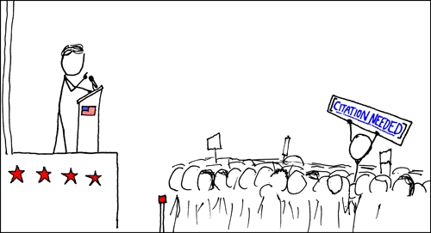
What We Need?
Technology Agnostic Framework
Simple Tools
Use Protocols and Languages We Already Familiar with

Slide 8
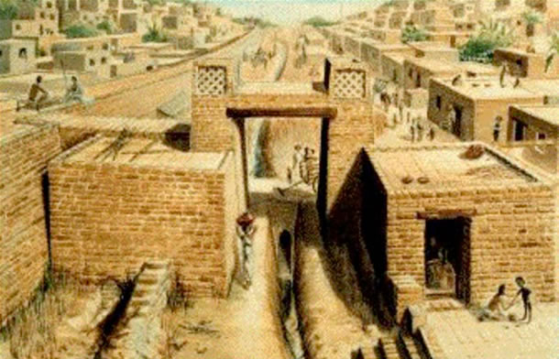
Wisdom of The Past
Unix Pipe
CORBA
XML-RPC, SOAP, JSON-RPC
DEF
Beaker Notebook

Slide 9
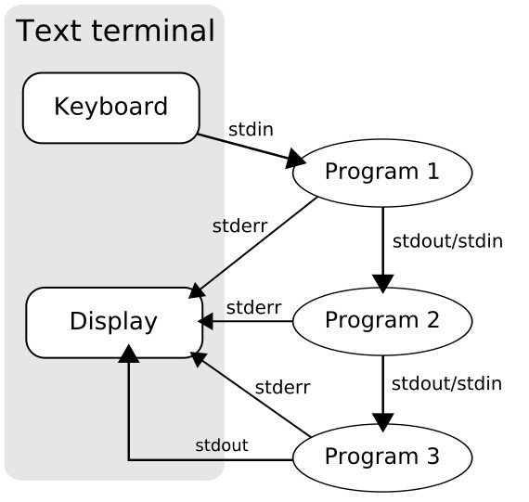
Unix Pipe
Good Points:
  Simple
  Easy
  Parallel
Considerations:
  Distributed Computing
  More than one inputs

Slide 10
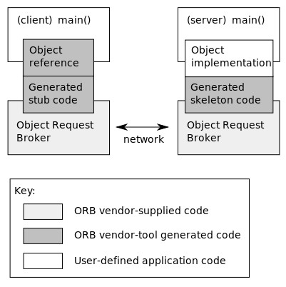
CORBA
Good Points:
  Supported By OMG
  Mature
  Distributed
Considerations:
  Last Release was 2012
  Steep Learning Curve
  Hard to Use Old UNIX Commands

Slide 11
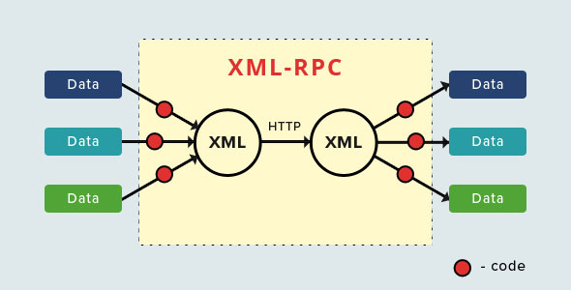
XML-RPC, SOAP, JSON-RPC
Good Points:
  HTTP
  Secure (SOAP)
  Distributed
Considerations:
  Less Standard (except SOAP)
  Hard to Use Old UNIX Command

Slide 12
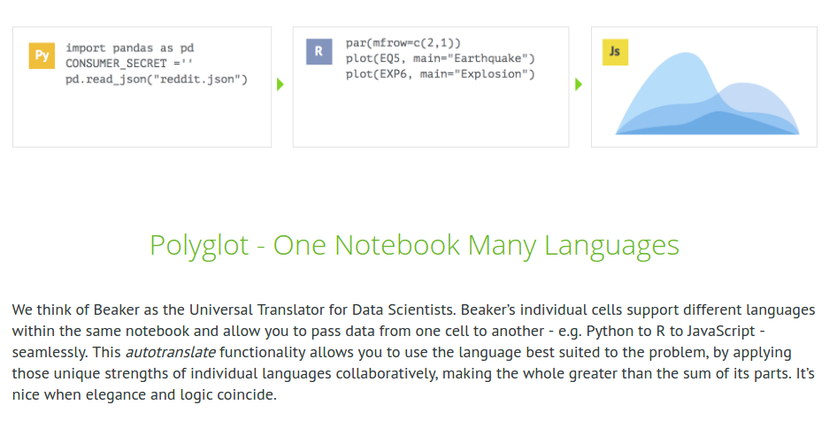
Beaker Notebook

Slide 13
Beaker Notebook
Good Points:
  Looks Good
  Fun
Considerations:
  BeakerLab was Closed
  Only for Research
  Hard to Use Old UNIX Command

Slide 14

The Past & The Future
Past
  Maturity
Future
  Big Data
  Deep Learning
  Distributed Computation
  Parallel Computation

Slide 15
Chimera – The Simple Bridge
UNIX Pipe is excellent
Node JS runs (almost) everywhere
HTTP is the most common protocol
Data Transfer:
  JSON is better than XML
Configuration:
  YAML is better than JSON
(inputs) → Process → Output

Slide 16
Chimera YAML-Chain
Single Process:
ins: a, b
out: c
command: node add.js
Single Process (shorthand):
(a,b) → node add.js → c
a
node add.js
c
b

Slide 17
Chimera YAML-Chain (series)
Series
ins: a,b
out: d
series:
- (a,b) → node add.js → c
- (a,c) → node add.js → d
a
node add.js
a
node add.js
d
c
c
b

Slide 18
Chimera YAML-Chain (parallel)
a
node add.js
c
c
Parallel
ins: a,b
out: e
series:
- parallel:
- (a,b) → node add.js → c
- (a,b) → node substract.js → d
- (c,d) → node add.js → e
node add.js
b
e
a
node
substract.js
d
d
b

Slide 19
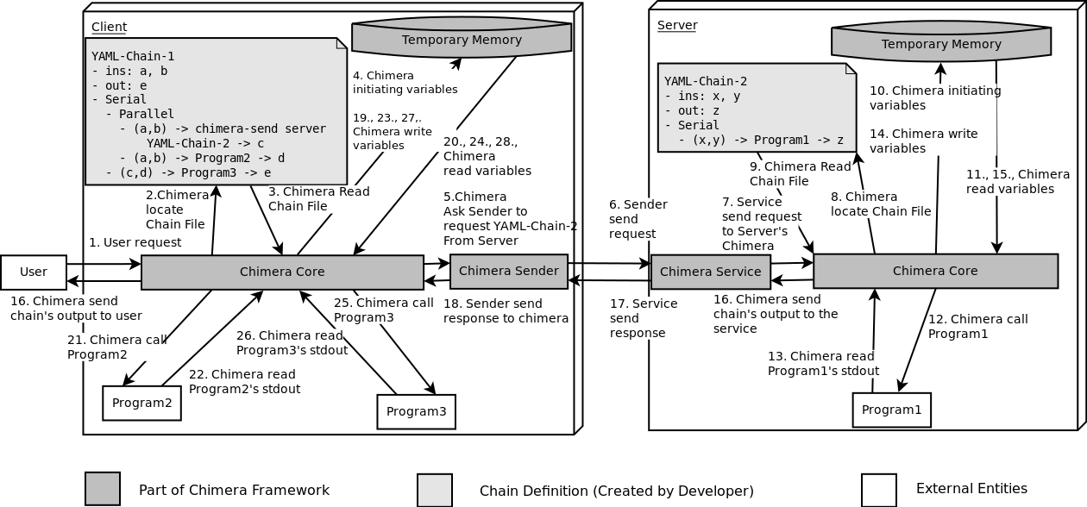
Chimera YAML-Chain
(distributed)

Slide 20
Chimera YAML-Chain
(distributed)
ins: a,b,server
out: e
vars:
server_chain: tests/chain-minimal.yaml
verbose: true
series:
- parallel:
# Process 1
- (a,b) -> php programs/add.php -> c
# Process 2
- (server, server_chain, a,b) -> chimera-send -> d
# Process 3
- (c,d) -> node programs/add.js -> e

Slide 21
Chimera Server & Client (distributed)
Server
  chimera-serve
Client
  chimera-send http://server.com:3000 chain.yaml input1 input2

Slide 22
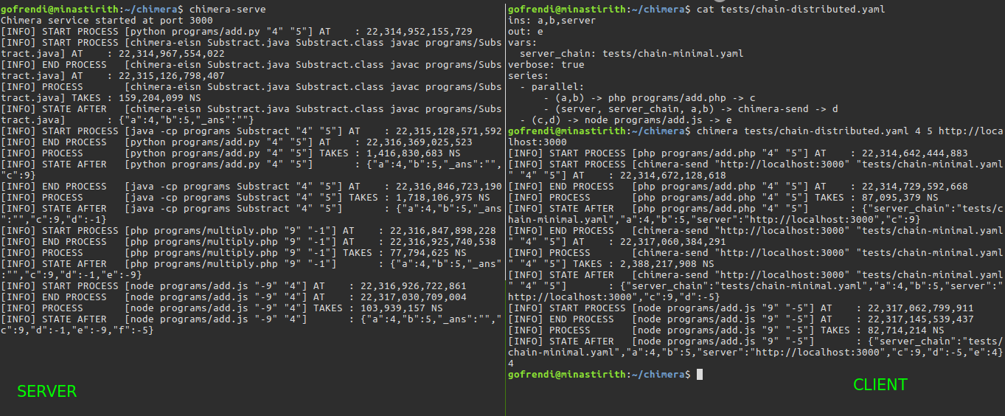
Chimera-serve & Chimera-send

Slide 23
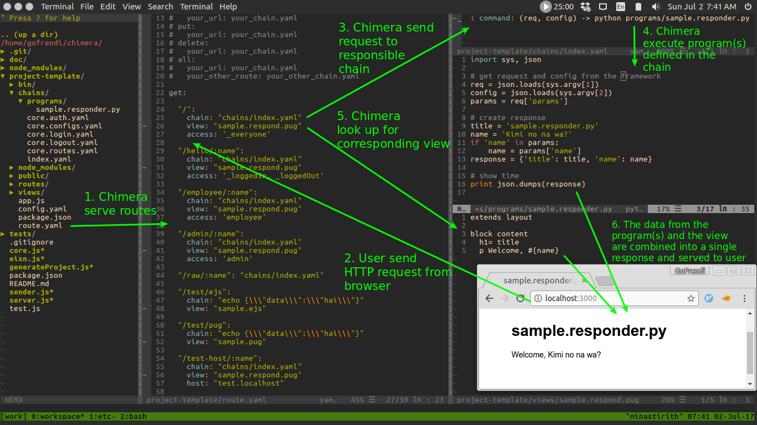
Chimera-init-web?

Slide 24
Conclusion
Chimera: Simple Language Agnostic Framework
No New Protocols (YAML Chain is Exception)
Works on Parallel and Distributed Environment

Slide 25
THANK YOU !!!
Chimera Github Repository:
https://github.com/goFrendiAsgard/chimera
Also on npm:
https://npmjs.com/chimera-framework
Follow me at:
@gofrendiasgard
Or email me at:
frendi@stiki.ac.id

