Slide 1
Introducing to Microservice using Moleculer Framework
Go Frendi Gunawan,
Lecturer at STIKI Malang,
Backend Engineer at Kata.ai

Slide 2
Before We Start
Goal
  You will understand what microservice is/is not
  You know how microservice works
  You can implement minimal microservice using moleculer.js
Non Goal
  Building enterprise application

Slide 3
Architecture
Monolithic vs Microservice

Slide 4


Architecture
Monolithic vs Microservice

Slide 5
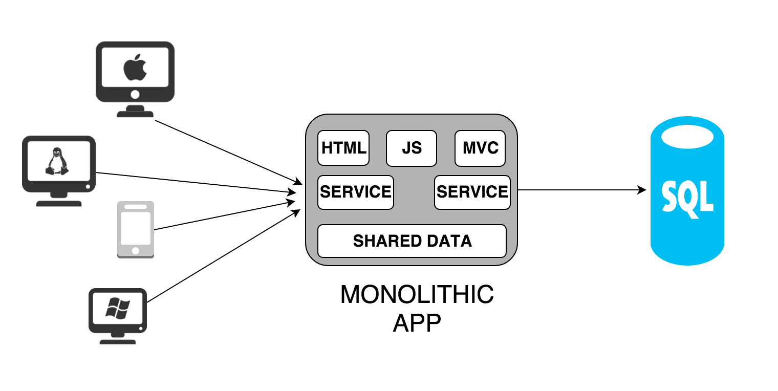
Architecture (Monolithic)

Slide 6
Monolithic
Pros
Easy to develop
Easy to deploy
Easy to debug
Cons
Difficult for Horizontal Scalling
Tightly coupled
Framework-centric

Slide 7
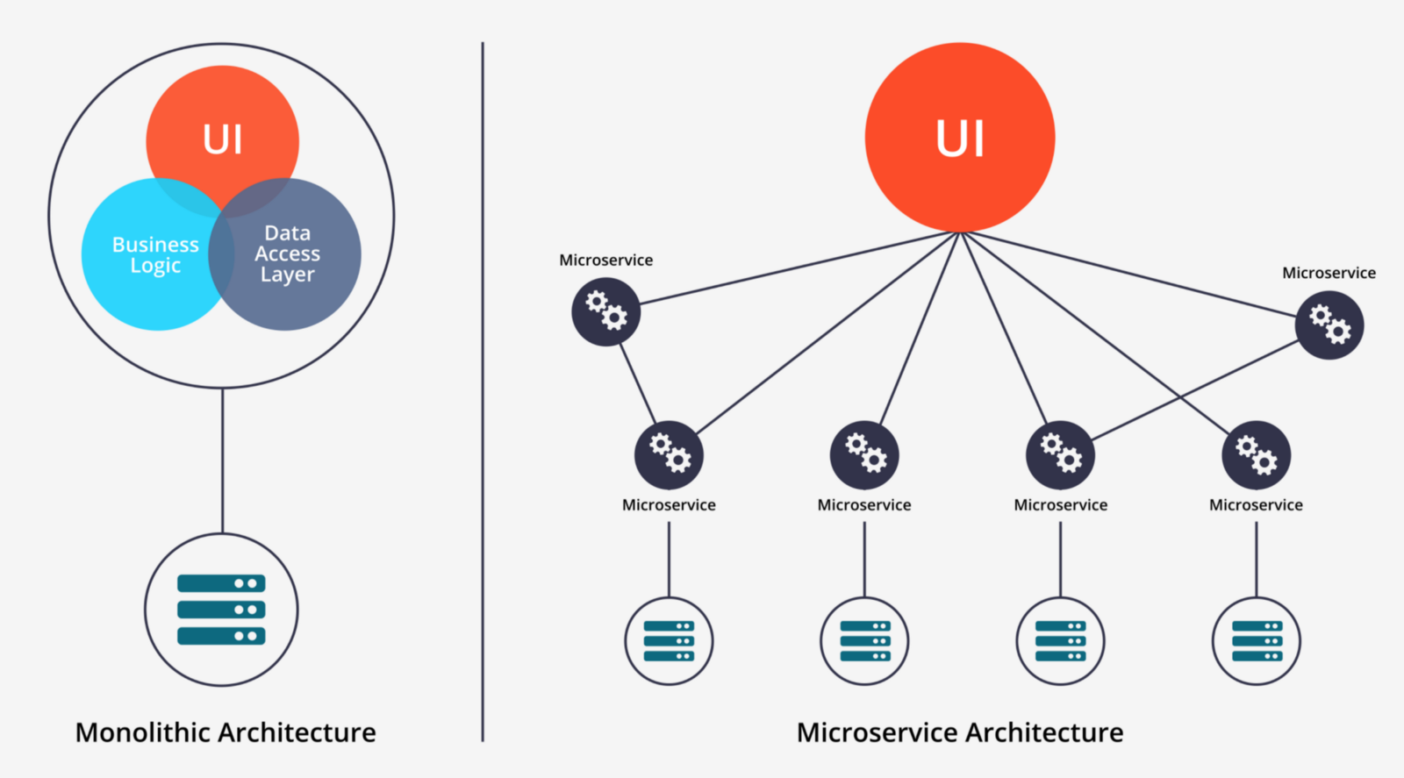
Architecture (Microservice)

Slide 8
Microservice
Pros
Built for Horizontal scalling
Independent
Each service can be written in different programming language
Cons
Difficult to develop
Difficult to deploy
Difficult to debug

Slide 9
Monolithic vs Microservice
Which one is Better?

Slide 10


Monolithic vs Microservice
Which one is Better?
It’s depend

Slide 11
Monolithic vs Microservice
Best-cases
Monolithic
Few users
Single fighter
Shared hosting
Microservice
A lot of users
Teams of remote workers
PaaS / IaaS

Slide 12
Communication
Pub/Sub vs Client/Server

Slide 13


Communication
Req/Res vs Pub/Sub

Slide 14
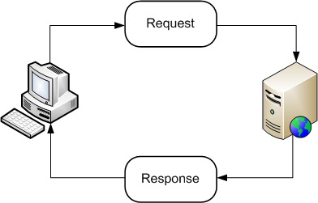
Req/Res
Request/Response

Slide 15
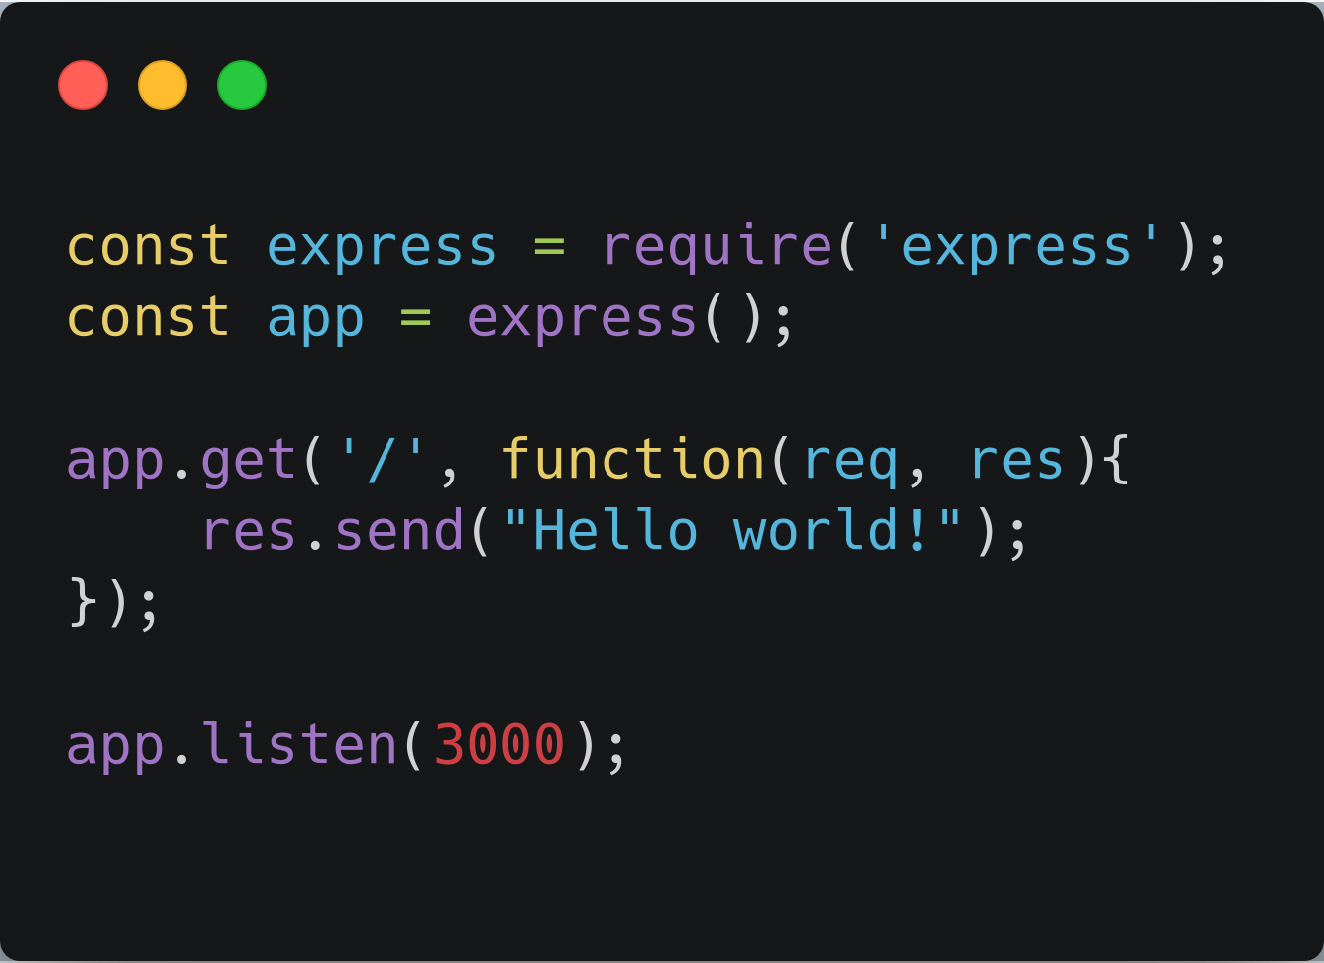
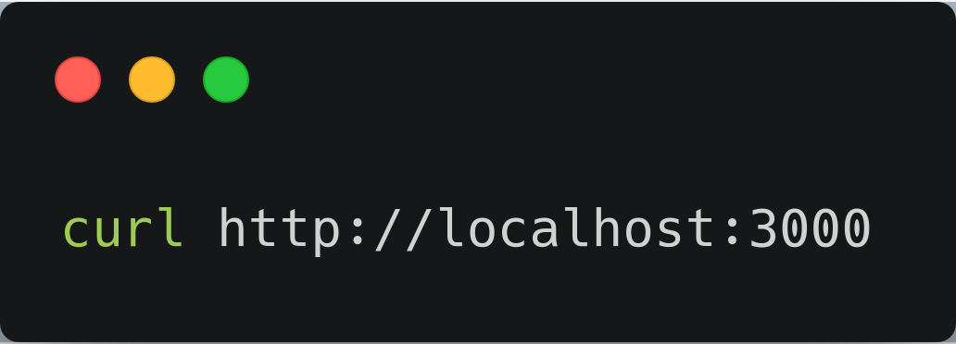
Req/Res
Client
Server

Slide 16
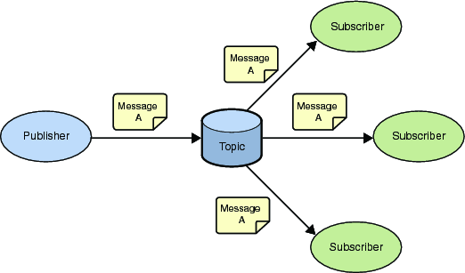
Pub/Sub
Publish/Subscribe

Slide 17
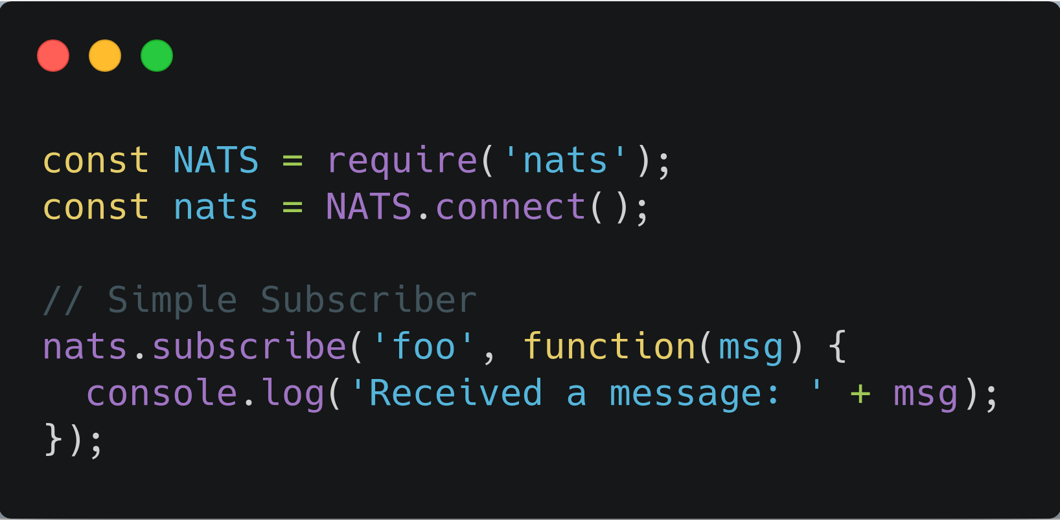
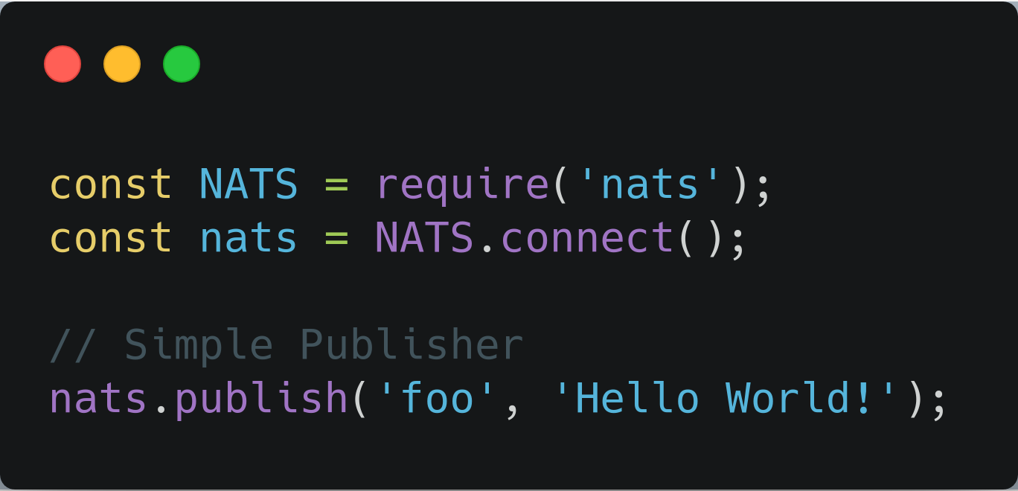
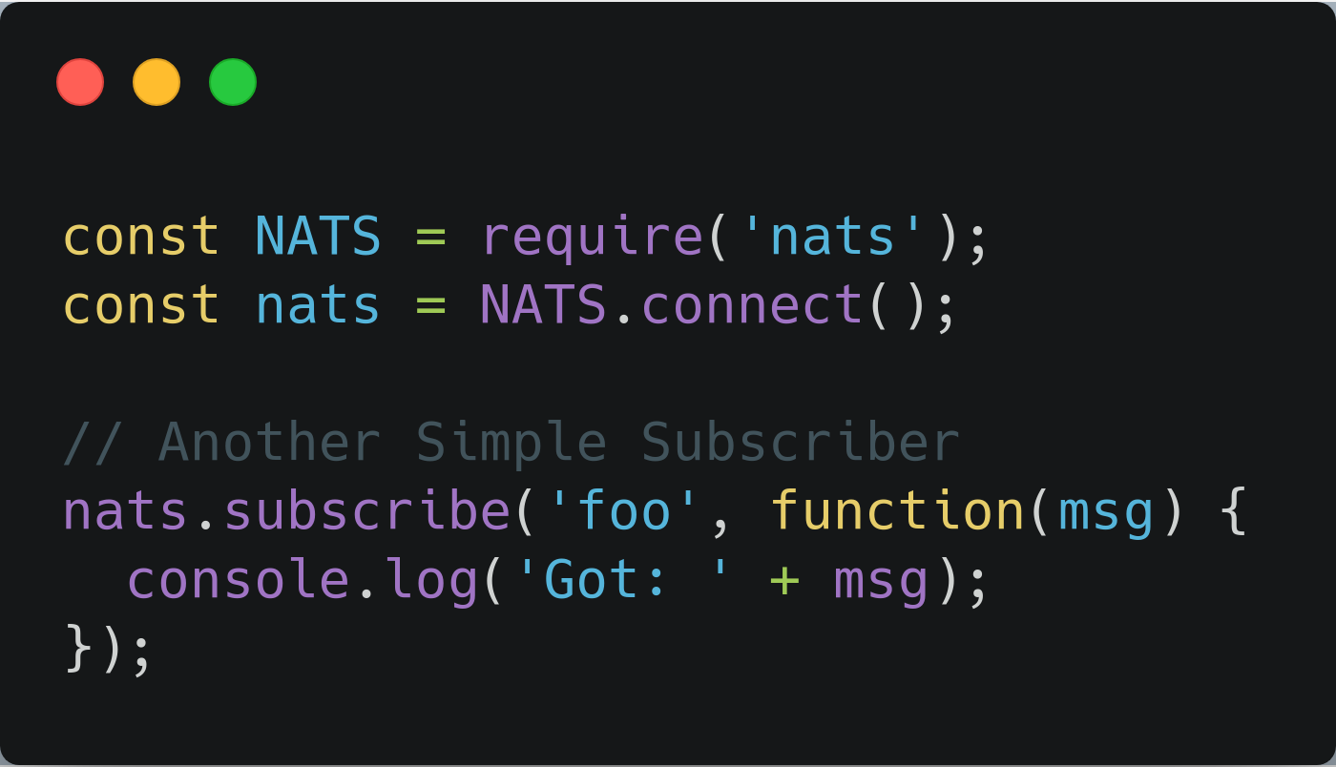
Pub/Sub
Subscribers
Publisher

Slide 18
Req/Res vs Pub/Sub
Best-cases
Req/Res
Immediate response
Tight coupled services
Single Listener
Pub/Sub
No response needed
Independent services
Multiple Listeners

Slide 19
Moleculer
Progressive microservices framework for Node.js.

Slide 20
Moleculer Service Broker
Create Service
  broker.createService(serviceConfig);
Start
  broker.start();
Req/Res
  await broker.call(“service.action”, payload);
Publish
  broker.emit(event, payload);

Slide 21
Let’s Make It
Gateway → Greeter → Logger

Slide 22
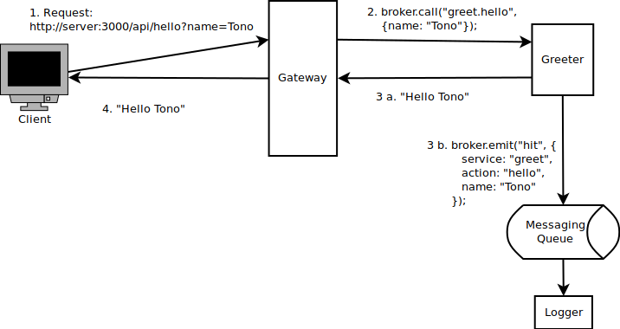
The Blue Print

Slide 23
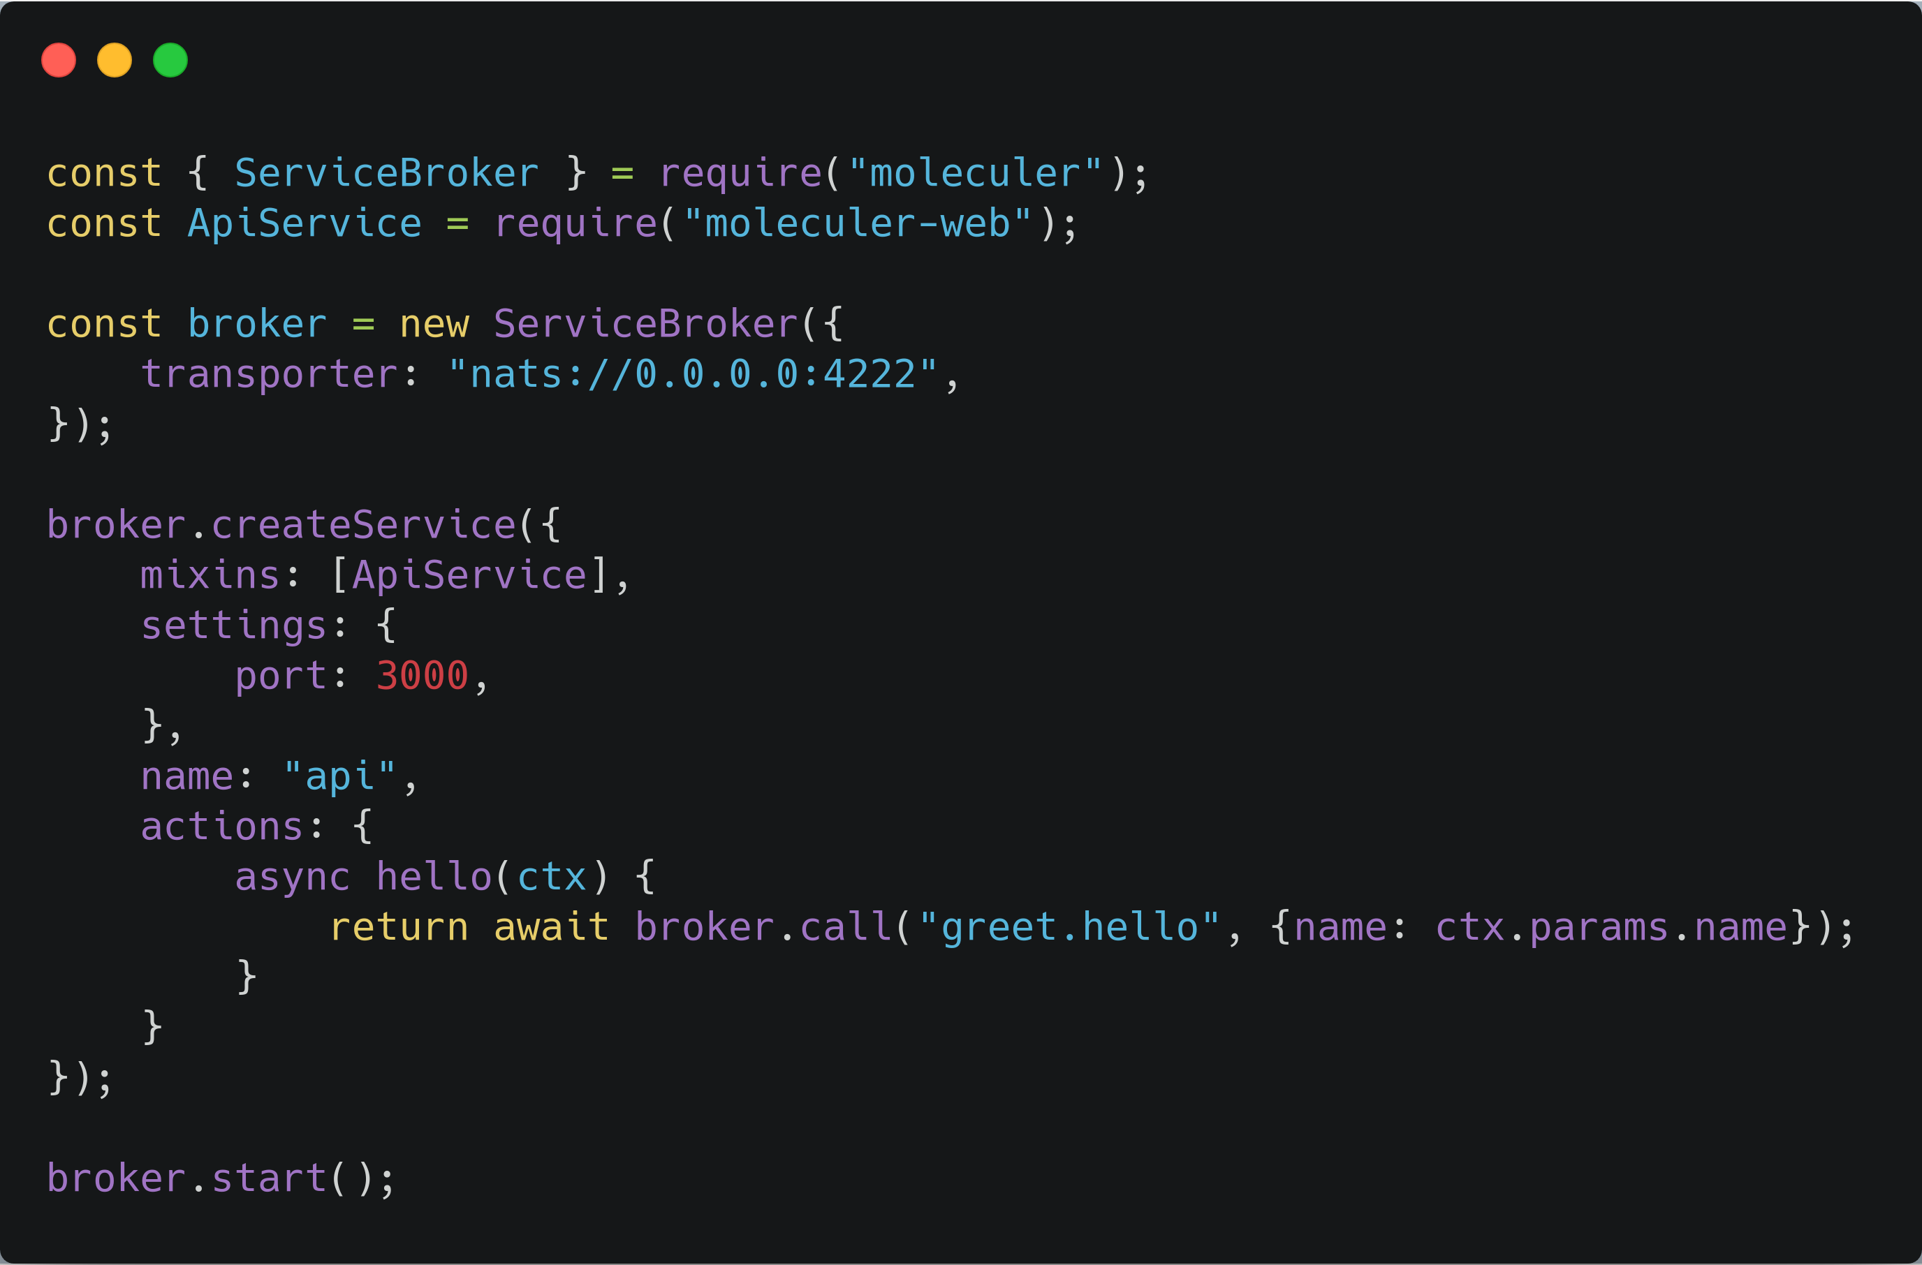
Gateway

Slide 24
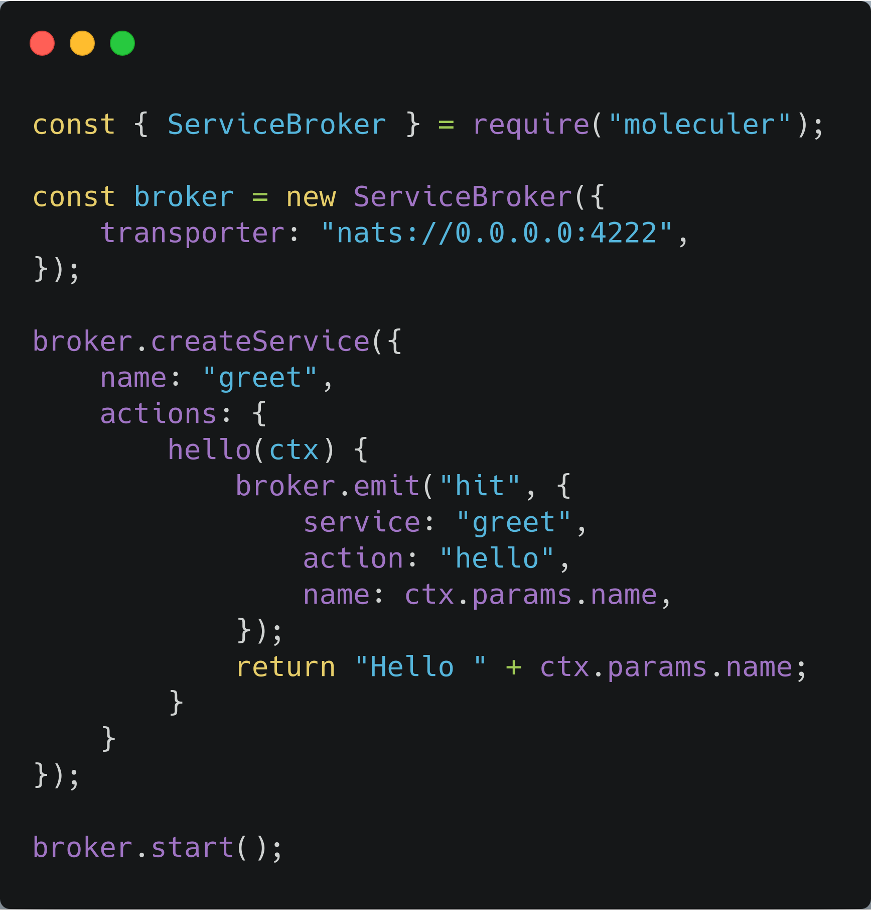
Greeter

Slide 25
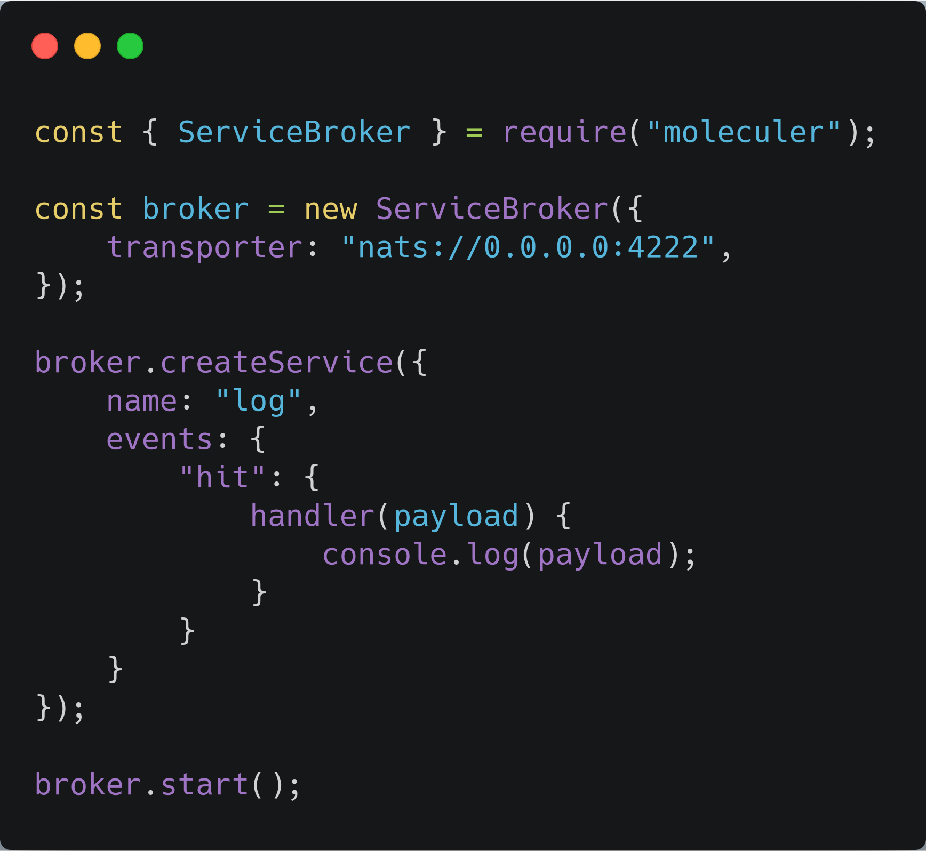
Logger

Slide 26
It’s Done !!!

Slide 27
Bonus
Environment + Docker

Slide 28
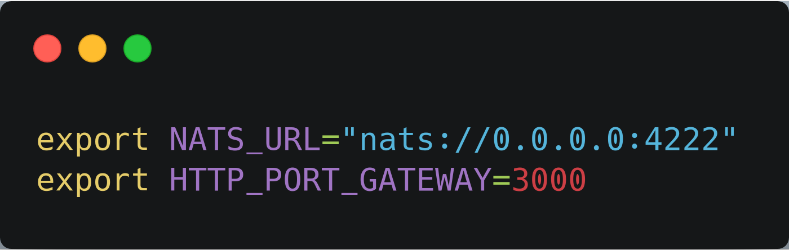
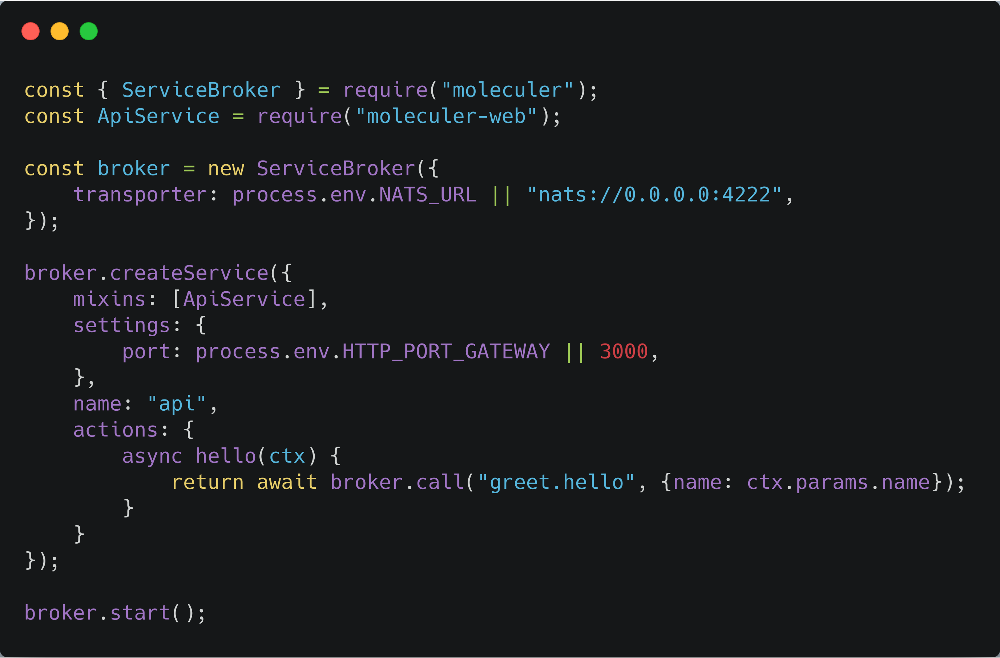
Environment

Slide 29
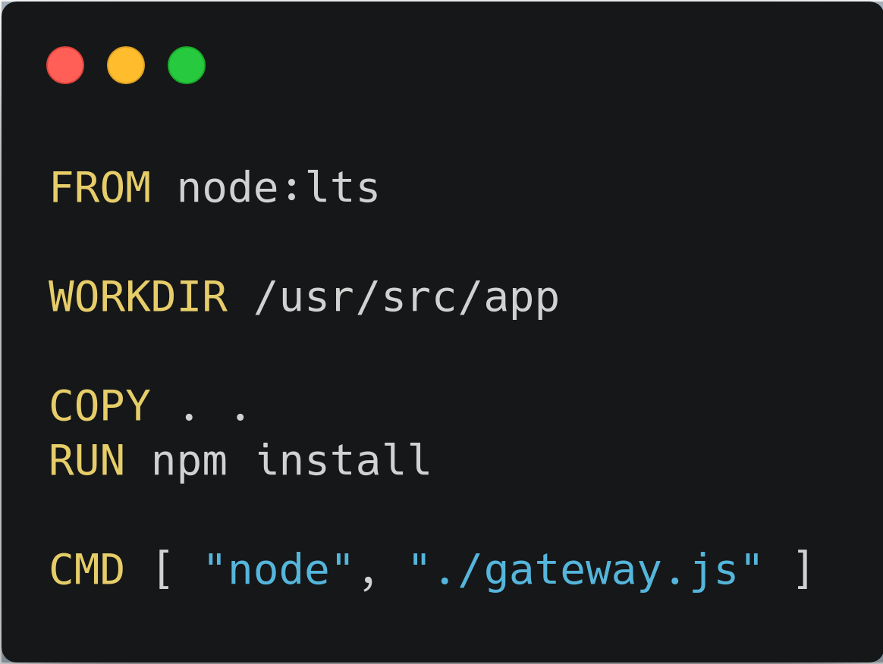
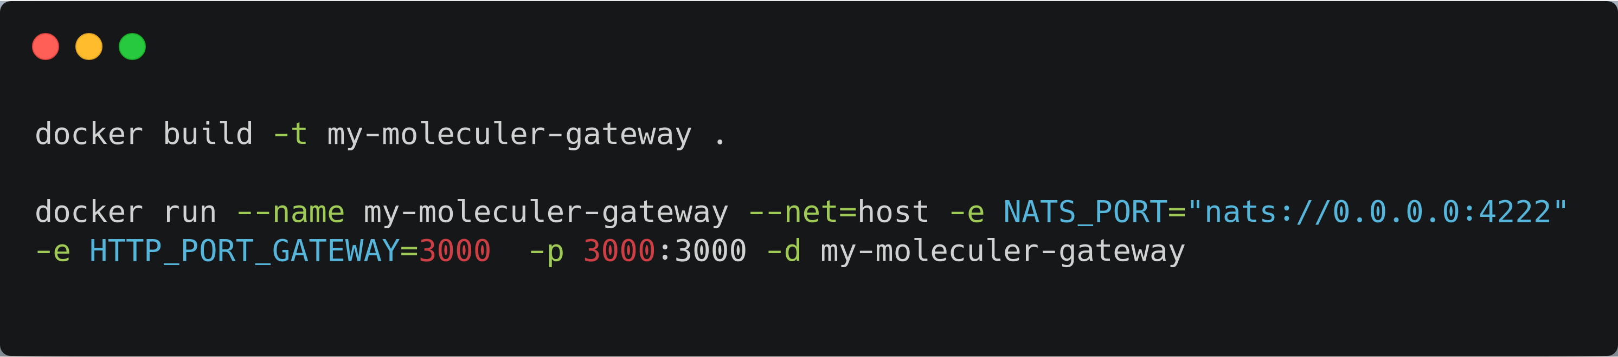
Docker

Slide 30
Conclusion
Microservice is more complex than monolithic
Two Common way to communicate between services:
  Req/Res
  Pub/Sub
Progressive microservice framework (like moleculer) make things easier
Moleculer was built for Node.Js. Using golang / python / other languages is not going to be easy
There is no silver bullet

Slide 31
Further Reading
https://moleculer.services/
https://microservices.io/
https://www.martinfowler.com/articles/microservices.html

Slide 32
Special Thanks
Ziyad Bazed (https://www.facebook.com/ziyadbazed) for correcting some miss-conception about micro-service scalability.

