Slide 1
Overview
Go Frendi Gunawan,
Lecturer at STIKI,
Backend Engineer at Kata.ai
Crew at Facebook Developer Circle Malang

Slide 2
Your goal?

Slide 3
Installing Anaconda

Slide 4
Data

Slide 5
Data
Data is what we collect and store.
It becomes information once we analyze it.
It becomes knowledge once we understand it.
~ @kelseyhightower, CloudNativeCon, 2018

Slide 6
Iris dataset
https://scikit-learn.org/stable/auto_examples
Iris dataset
(http://archive.ics.uci.edu/ml/datasets/Iris/)
Iris dataset in scikit
(https://scikit-learn.org/stable/modules/generated/sklearn.datasets.load_iris.html)
  from sklearn.datasets import load_iris
  data = load_iris()

Slide 7
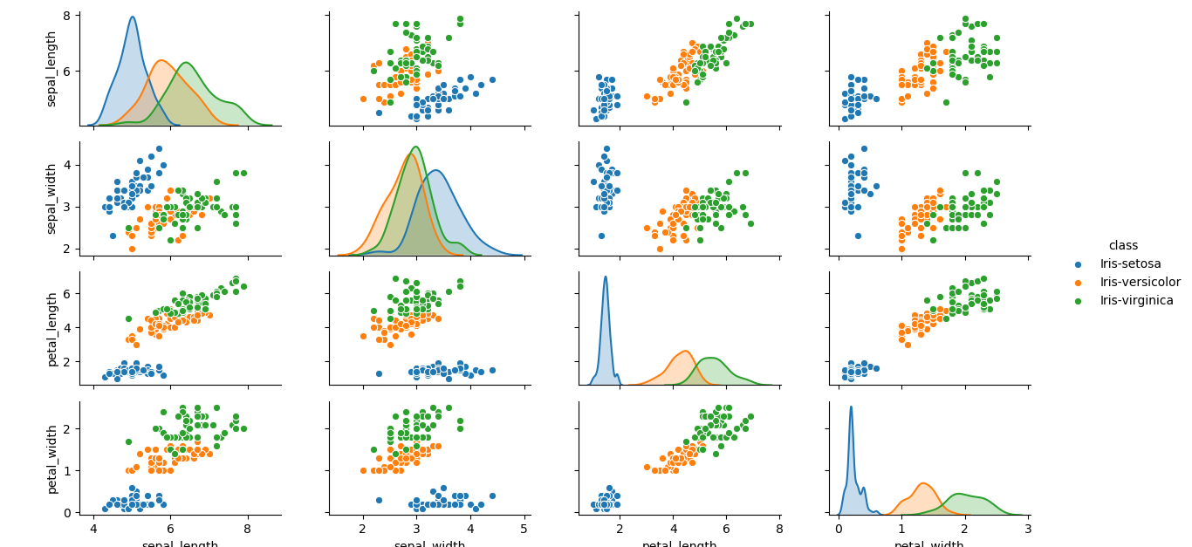
Iris dataset

Slide 8
Titanic
https://www.kaggle.com/c/titanic
https://github.com/venky14/Data-Analysis-Project-Titanic/

Slide 9
Data natures
Numeric
Text
Geographics

Slide 10
Simple data analysis
Means
Variance
Correlation

