Slide 1
Overview
Go Frendi Gunawan,
Lecturer at STIKI,
Backend Engineer at Kata.ai
Crew at Facebook Developer Circle Malang

Slide 2
Your goal?

Slide 3
Installing GCC + OpenGL
Windows user: https://ariefrahmansyah.wordpress.com/2013/06/16/pemasangan-glut-pada-codeblocks/

Slide 4
Program Skeleton https://github.com/goFrendiAsgard/kuliah-2.0/blob/master/lecture-graphics-programming/praktikum-01-line.cpp
Compile: g++ filename.cpp -o filename -lglut -lGL -lGLU

Slide 5
Main Function
int main(int argc, char **argv)
{
glutInit(&argc, argv);
glutInitDisplayMode(GLUT_DOUBLE |
GLUT_DEPTH);
glutInitWindowSize(640, 480);
glutInitWindowPosition(50, 50);
glutCreateWindow("praktikum 1");
glutDisplayFunc(display);
glutReshapeFunc(reshape);
initGL();
glutTimerFunc(0, timer, 0);
glutMainLoop();
return 0;
}

Slide 6
Display
int main(int argc, char **argv)
{
glutInit(&argc, argv);
glutInitDisplayMode(GLUT_DOUBLE |
GLUT_DEPTH);
glutInitWindowSize(640, 480);
glutInitWindowPosition(50, 50);
glutCreateWindow("praktikum 1");
glutDisplayFunc(display);
glutReshapeFunc(reshape);
initGL();
glutTimerFunc(0, timer, 0);
glutMainLoop();
return 0;
}
void display()
{
glClear(GL_COLOR_BUFFER_BIT |
GL_DEPTH_BUFFER_BIT);
glMatrixMode(GL_MODELVIEW);
glLoadIdentity();
glTranslatef(0.0, 0.0, -6.0);
glBegin(GL_LINES);
glColor3f(1,0,0); // red
glVertex3f(0,0,0);
glVertex3f(3,0,0);
glEnd();
glFlush();
glutSwapBuffers();
}

Slide 7
Reshape, Timer, InitGL
int main(int argc, char **argv)
{
glutInit(&argc, argv);
glutInitDisplayMode(GLUT_DOUBLE |
GLUT_DEPTH);
glutInitWindowSize(640, 480);
glutInitWindowPosition(50, 50);
glutCreateWindow("praktikum 1");
glutDisplayFunc(display);
glutReshapeFunc(reshape);
initGL();
glutTimerFunc(0, timer, 0);
glutMainLoop();
return 0;
}
void reshape(GLsizei width, GLsizei height)
{
if (height == 0) { height = 1; }
GLfloat aspect = (GLfloat)width / (GLfloat)height;
glViewport(0, 0, width, height);
glMatrixMode(GL_PROJECTION);
glLoadIdentity();
gluPerspective(45.0f, aspect, 0.1f, 100.0f);
}
void initGL()
{
glClearColor(1.0f, 1.0f, 1.0f, 1.0f);
glClearDepth(1.0f);
glEnable(GL_DEPTH_TEST);
glDepthFunc(GL_LEQUAL);
glShadeModel(GL_SMOOTH);
glHint(GL_PERSPECTIVE_CORRECTION_HINT, GL_NICEST);
}
void timer(int value)
{
glutPostRedisplay();
glutTimerFunc(15, timer, 0);
}

Slide 8
Coordinate System

Slide 9
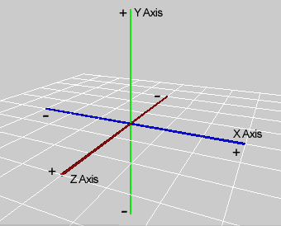
X-Y-Z

Slide 10
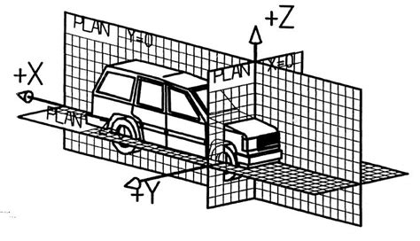
X-Y-Z

Slide 11
Assignment: Your Name

