Slide 1
Preprocessing
Go Frendi Gunawan,
Lecturer at STIKI,
Backend Engineer at Kata.ai
Crew at Facebook Developer Circle Malang

Slide 2
Data Preprocessing
Normalization
Outliers Handling
Missing Atributes Handling
Data transformation

Slide 3


Statistical Atribute
Max, Min
Mean, Median, Modus
Standard Deviation
Correlation

Slide 4
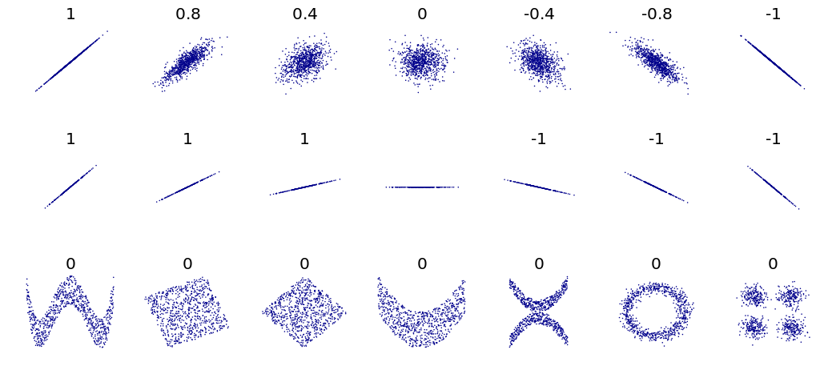
Correlation

Slide 5
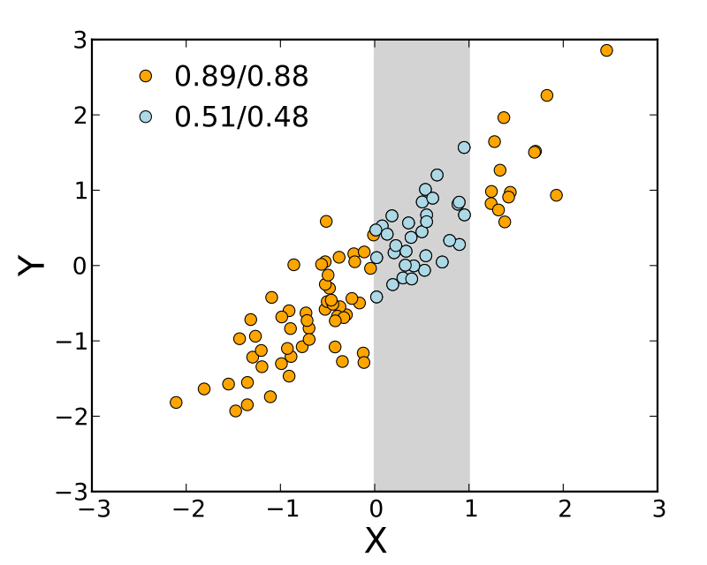
Correlation: More data = better

Slide 6
Range Normalization
Why?
  Age vs Capita
  Gender vs Age
How?
  (x-min)/(max-min)

Slide 7
Outlier Detection
Z-Score
DBScan
Isolation Forest
Ref: https://towardsdatascience.com/a-brief-overview-of-outlier-detection-techniques-1e0b2c19e561

Slide 8
Compensate Missing Data
Delete Row
Mean/Median/Modus
KNN
MICE
Deep Learning (Datawig)
Ref: https://towardsdatascience.com/6-different-ways-to-compensate-for-missing-values-data-imputation-with-examples-6022d9ca0779

