Slide 1
Circle and Triangle
Go Frendi Gunawan,
Lecturer at STIKI,
Backend Engineer at Kata.ai
Crew at Facebook Developer Circle Malang

Slide 2
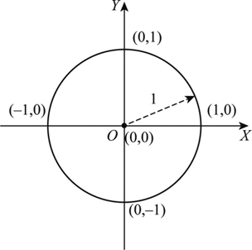
Circle

Slide 3
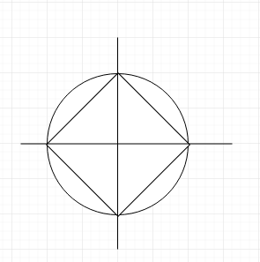

Slide 4
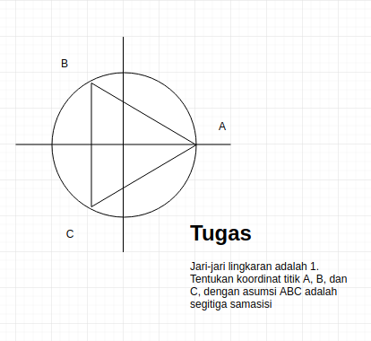
Brain Teaser

Slide 5
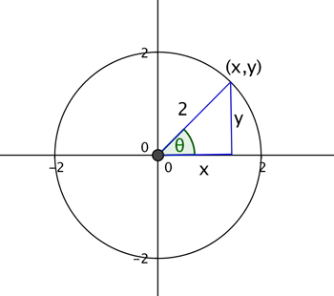
Circle + Triangle

Slide 6
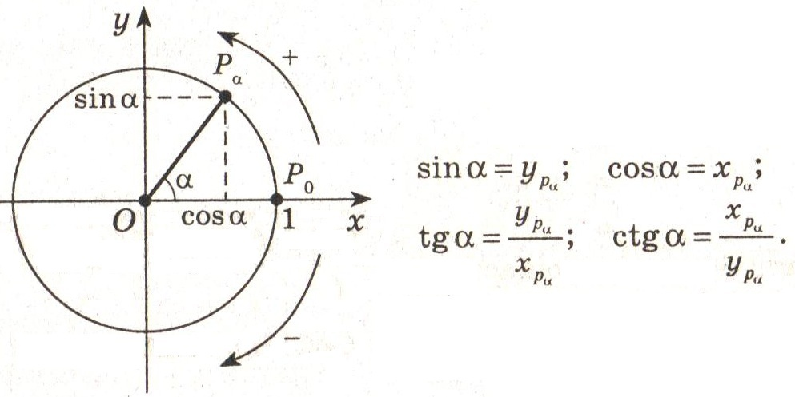
Circle + Triangle

Slide 7
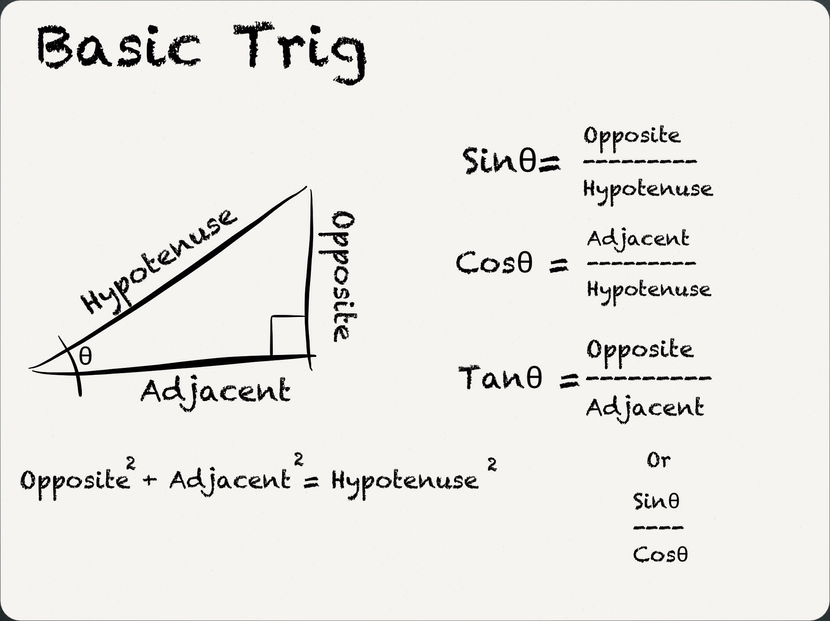
Trigonometry

Slide 8
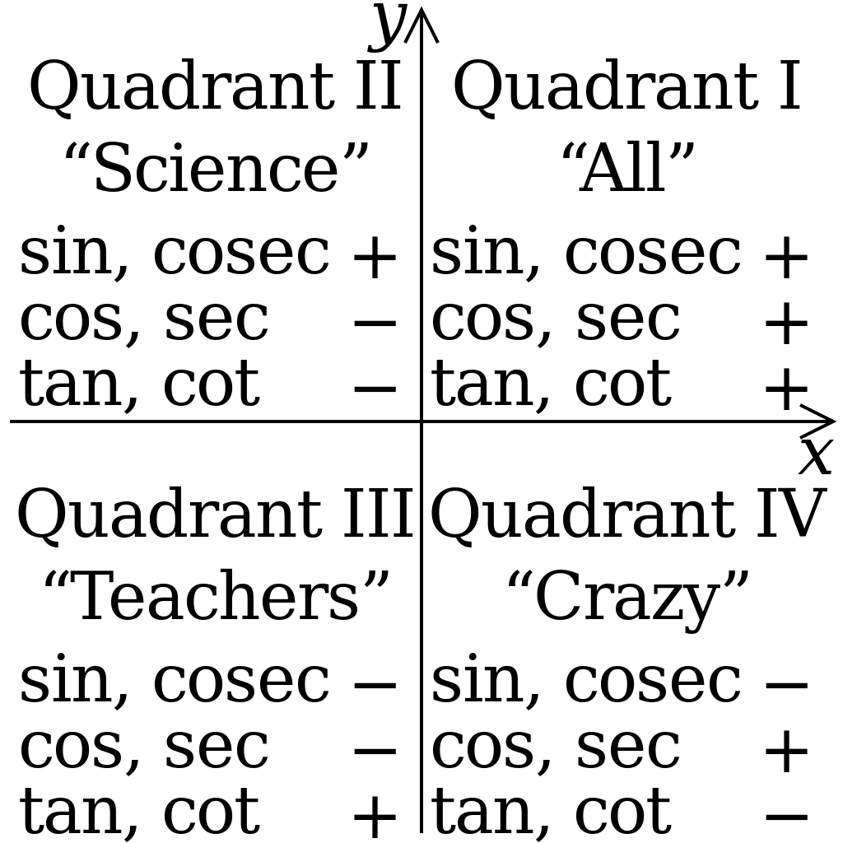
All Science Teacher are Crazy

Slide 9
Let’s do it again

Slide 10
Program?

