Slide 1
ALSET
-----------Self-Driving Car Game

Slide 2
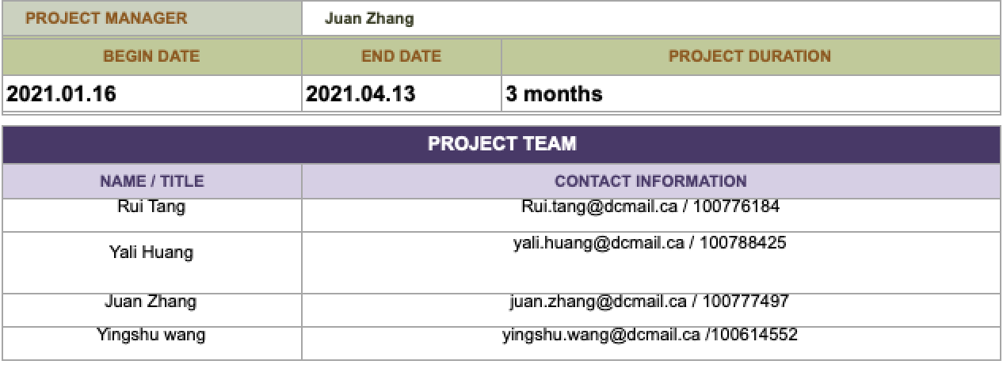
Project members

Slide 3
Introduction
Our department is going to develop a self driving car game, unlike the traditional car racing game, which requires the user to take control of car, Our self-driving car game will run on fully autonomous mood. Moreover, we will set different driving scenes for the Autonomous car.

Slide 4
Deliverables
Because our company is still trying to build the hardware team, on the other hand, the project develop time is limited as well. Thus we can not run the test on real road and real car. We will first launch the self-driving game on jupyter /Colab notebook or other IDE.
We will use Carla, a virtual driving environment platform to simulate our self-driving car environment.

Slide 5
Objectives
Fetch and parse signals from cameras and radars.
Maintain speed and distance.
Lane centering assistance.
Traffic light recognition system (optional).

Slide 6
Algorithm
Like most computer vision system, in this project, CNN will be used.

Slide 7
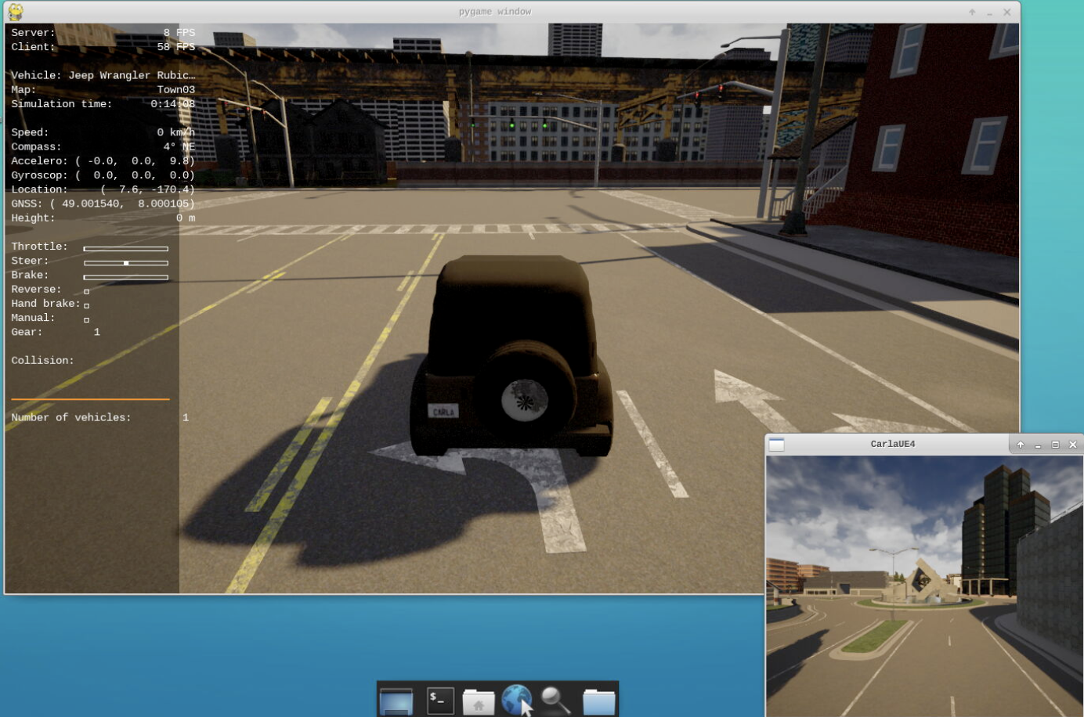
Demo Example

