Slide 1
Book1
File created on: 10/22/23 6:52:16 PM EDT

Slide 2
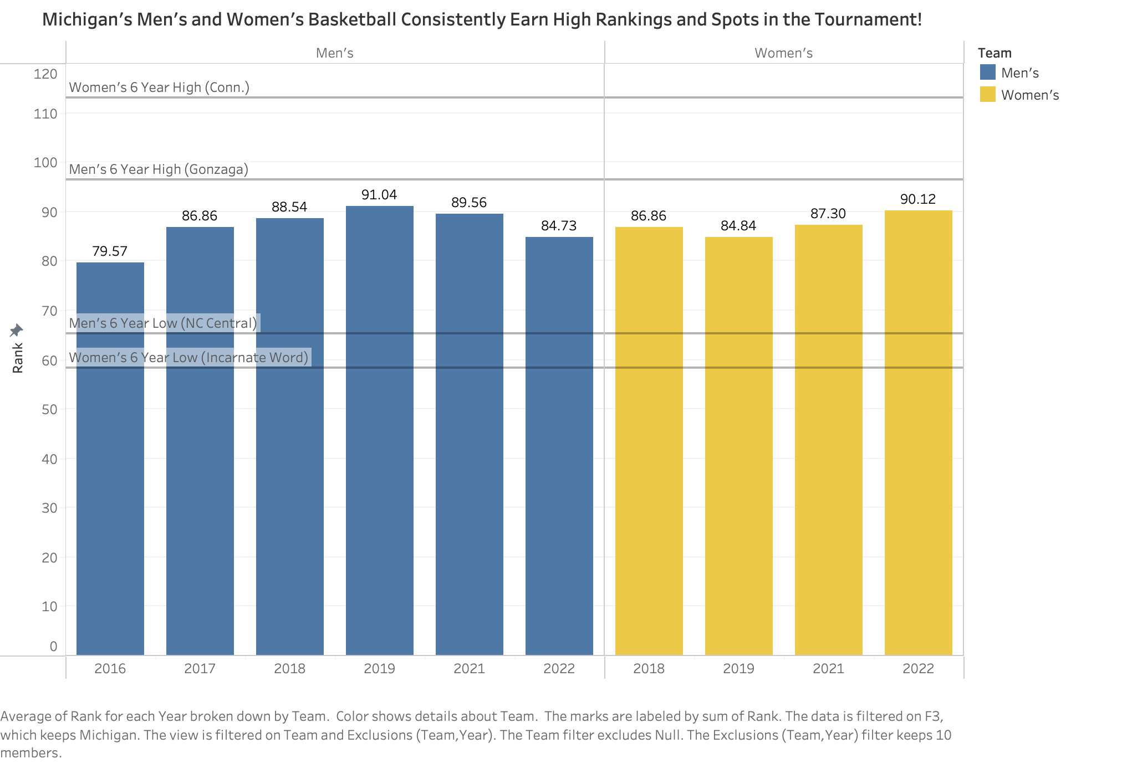

Slide 3
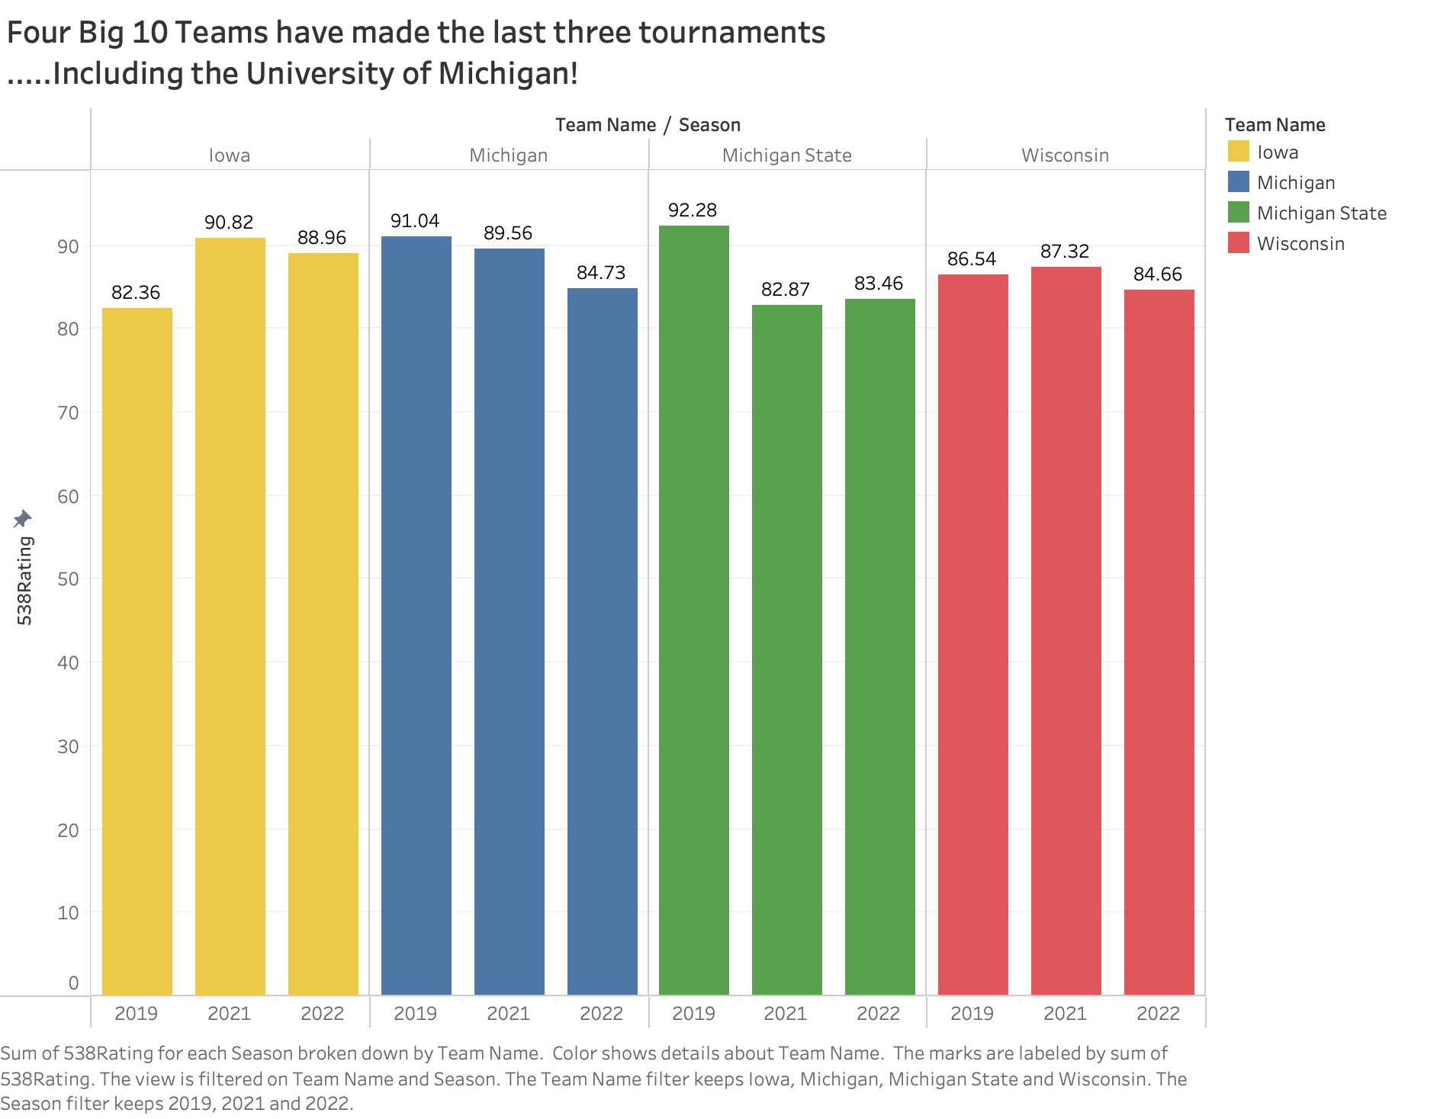

Slide 4
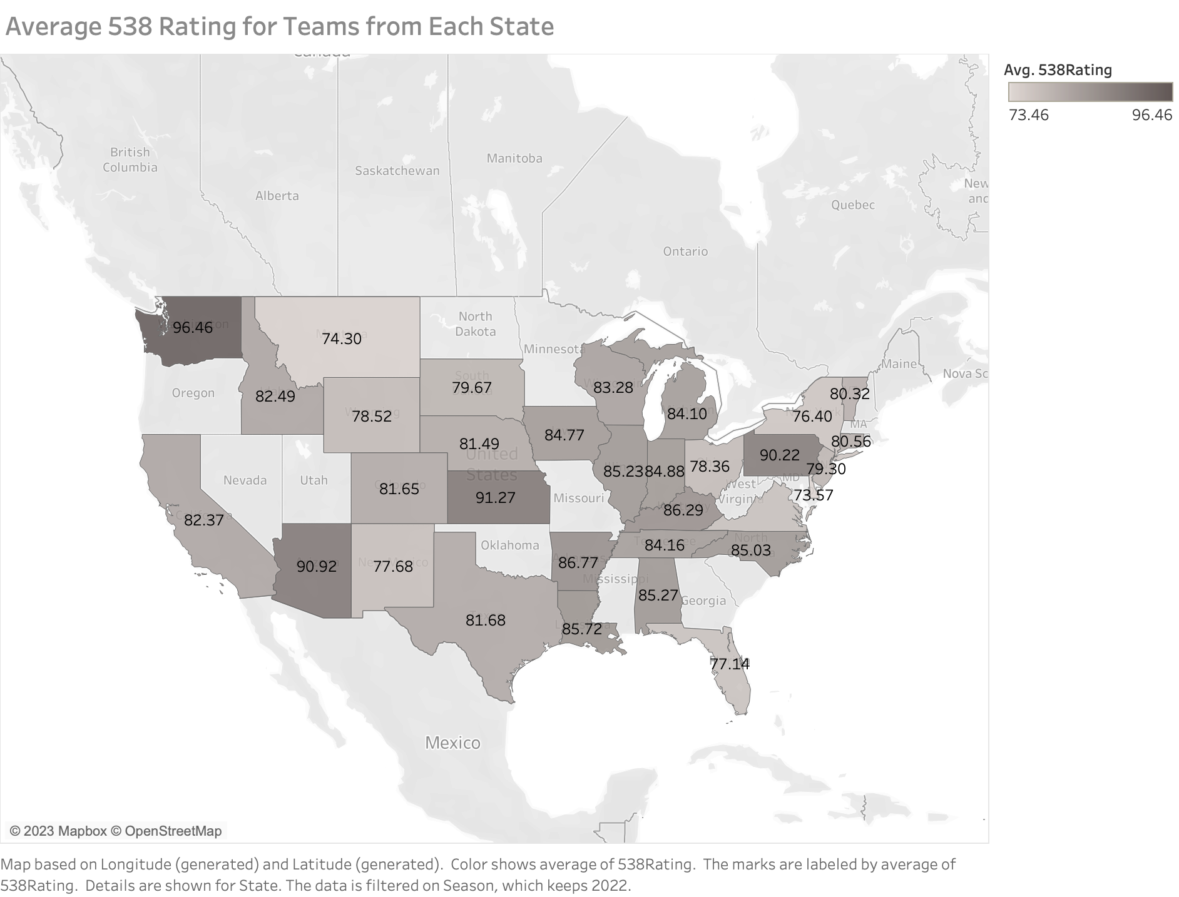

Slide 5
