Slide 1

IILM UNIVERSITY
GREATER NOIDA
ARPAN PANDEY
B.Tech CSE | Roll No. 2410030086 | Batch 2024–2028
INTERNSHIP
PRESENTATION
Agriculture & Agribusiness
A four-week virtual internship covering
data collection, visualization,
forecasting and performance evaluation.
Junior Data Analyst
– Agribusiness
REMOTE
4 WEEKS
01
DATA
YUVAINTERN
INSIGHT
02
31 JULY — 28 AUGUST 2026
03
DECISION

Slide 2
SNAPSHOT
Internship at a glance
04
04
01
ON TIME
WEEKS
TASKS
DOMAIN
SUBMISSION
ROLE
MODE
Junior Data Analyst – Agribusiness Virtual Intern
Remote / Virtual
INSTITUTE
FOCUS
IILM University, Greater Noida
Agriculture & Agribusiness Data Analytics
Arpan Pandey • YuvaIntern • IILM University
02

Slide 3
ORGANIZATION
YuvaIntern
Role
yuva
Junior Data Analyst – Agribusiness Virtual Intern
intern
VIRTUAL INTERNSHIP
& JOB SIMULATION
Focus
Agricultural and agribusiness data analysis.
Duration
31 July – 28 August 2026.
Structured virtual internship experience with role-specific tasks and professional exposure.
Responsibility
Analyze agricultural and agribusiness data using R programming and provide insights and recommendations.
REMOTE LEARNING
Arpan Pandey • YuvaIntern • IILM University
03

Slide 4
PROBLEM
The analytical challenge
RAW AGRIBUSINESS DATA
ANALYTICAL RESPONSE
Raw information is not automatically useful.
01
COLLECT
Relevant data
02
CLEAN
Reliable data
• Missing values and inconsistencies can affect quality.
• Important trends may be hidden in raw tables.
• Future patterns need structured forecasting.
• Business decisions need measurable KPIs.
→
03
VISUALIZE
Clear trends
04
FORECAST
Future patterns
05
EVALUATE
KPIs + action
Arpan Pandey • YuvaIntern • IILM University
04

Slide 5
OBJECTIVES
Six goals of the internship
01
COLLECT
02
CLEAN
03
VISUALIZE
Explore public agribusiness data
Improve data quality
Communicate trends clearly
04
FORECAST
05
EVALUATE
06
RECOMMEND
Study future patterns
Use KPIs and benchmarks
Support data-driven decisions
Arpan Pandey • YuvaIntern • IILM University
05

Slide 6
SCOPE & TOOLS
What the project covered
PROJECT SCOPE
TOOLS / TECHNIQUES
01
Data collection & exploration
R Programming
Data Analysis
02
Data cleaning & preprocessing
Data Cleaning
Data Visualization
03
Visualization & reporting
ARIMA
Exponential Smoothing
04
Predictive analysis & forecasting
05
KPI evaluation & benchmarking
Regression Models
KPI & Benchmarking
06
Strategic recommendations
R programming is specifically mentioned in the internship offer letter.
Arpan Pandey • YuvaIntern • IILM University
06

Slide 7
ARCHITECTURE
A simple end-to-end workflow
01
DATA SOURCES
02
COLLECTION
03
EXPLORATION
04
CLEANING
→
→
→
Public data
Gather variables
Understand patterns
Handle gaps
05
VISUALIZATION
06
PREDICTIVE ANALYSIS
07
KPI EVALUATION
08
RECOMMENDATIONS
→
→
→
Communicate trends
Study future patterns
Measure performance
Support decisions
Arpan Pandey • YuvaIntern • IILM University
07

Slide 8
METHODOLOGY
Four weeks of structured work
WEEK 01
WEEK 02
WEEK 03
WEEK 04
DATA FOUNDATION
COMMUNICATION
PREDICTION
EVALUATION
Data Collection, Exploration & Cleaning
Data Visualization & Reporting
Predictive Analysis & Trend Forecasting
Performance Evaluation & Recommendations
Identify sources, data types, cleaning steps and challenges.
Plan metrics, chart types, layouts and storyboard.
Study ARIMA, smoothing, regression and validation.
Define KPIs, compare benchmarks and formulate recommendations.
1
2
3
4
All four assigned DOC tasks were completed and submitted on time.
Arpan Pandey • YuvaIntern • IILM University
08

Slide 9
OUTCOMES
Skills developed through the internship
✓
Understanding of the agribusiness data analytics workflow.
✓
Knowledge of KPI evaluation and benchmarking.
✓
Knowledge of data collection, exploration and cleaning.
✓
Improved analytical and problem-solving skills.
✓
Ability to plan effective visualizations and reports.
✓
Ability to formulate data-driven recommendations.
✓
Basic understanding of predictive analysis and forecasting.
✓
Practical exposure to Junior Data Analyst responsibilities.
Arpan Pandey • YuvaIntern • IILM University
09

Slide 10
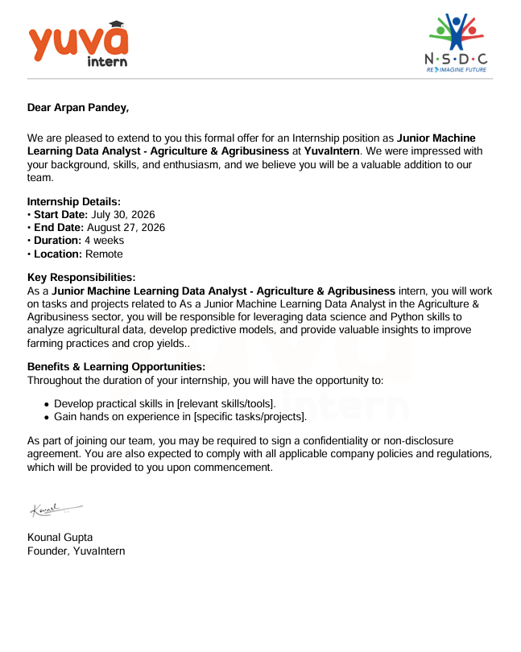
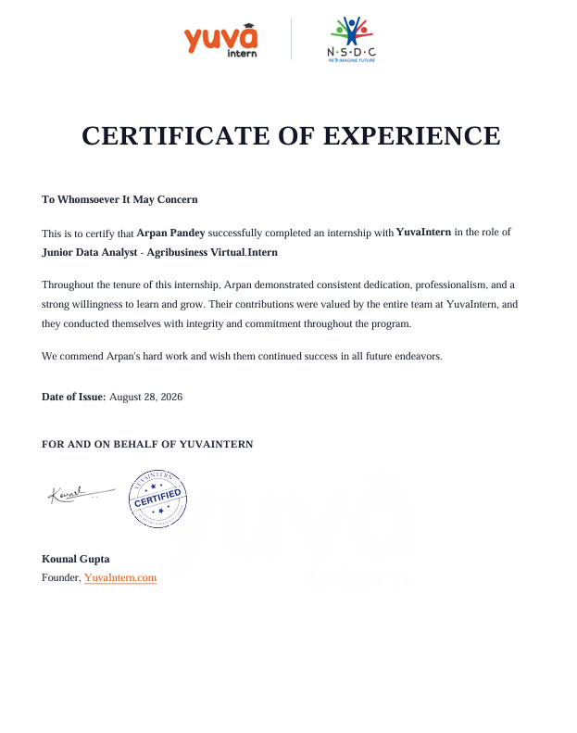
PROOF
Internship documentation
INTERNSHIP OFFER LETTER
CERTIFICATE OF EXPERIENCE
Arpan Pandey • YuvaIntern • IILM University
10

Slide 11
IILM UNIVERSITY
THANK
YOU
DATA → INSIGHT → DECISION
Junior Data Analyst – Agribusiness Virtual Intern
AGRIBUSINESS
ANALYTICS
Arpan Pandey
Roll No. 2410030086 • B.Tech CSE
YuvaIntern • 31 July – 28 August 2026

