Slide 1
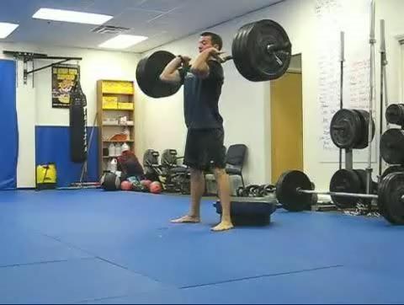
CSCE 5222 Feature Engineering
Team 5: Parth Bhanderi
Darshit Kajavadra
Squat Position Detection from a video

Slide 2
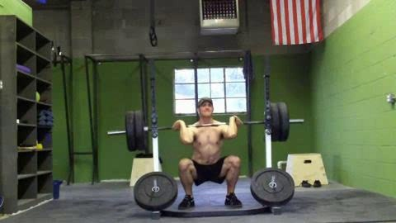
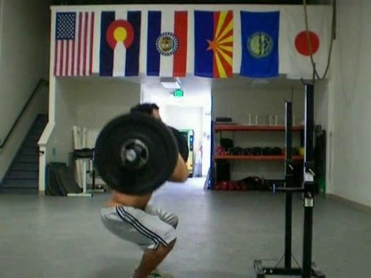
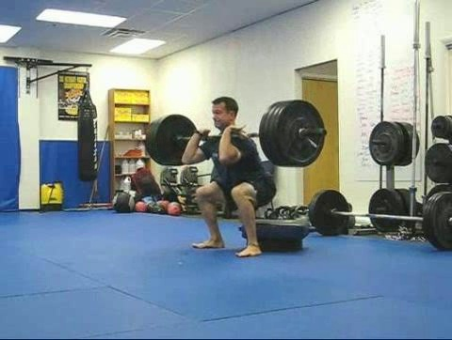
Challenges
Detecting the ideal squat position poses a challenge without utilizing Deep Learning
Various camera perspectives further complicate the task
Cluttered background

Slide 3
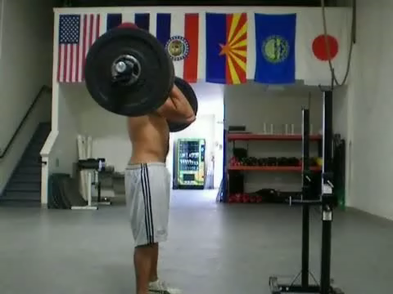
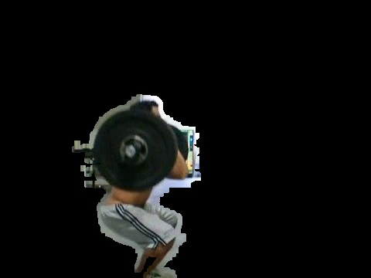
Methodology
Video
Squat position frame
Segmented Image
Structural Similarity Score Calculation
Frame Comparison for Similarity
Contour Analysis: frame differencing, blurring, and thresholding to highlight changes, finding contours, filtering contours based on area and bounding rectangle characteristics, and sorting contours to identify the most relevant one
Image Masking and Bitwise Operations

Slide 4
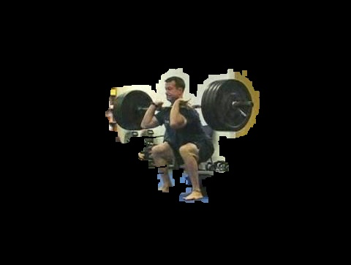
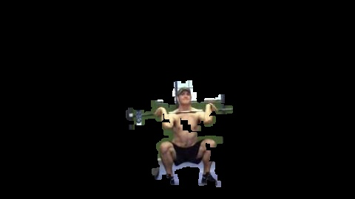
Squat_1667.mp4
Squat_1668.mp4
Squat_1677.mp4

Slide 5
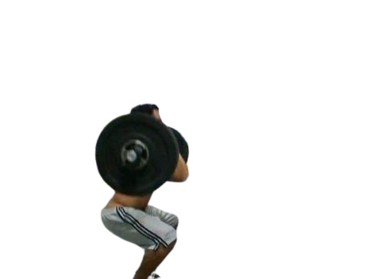
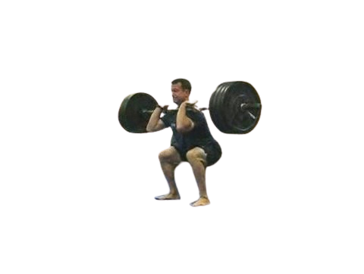
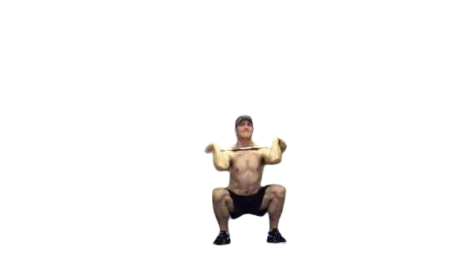
Obtained results:
Ground Truth:

Slide 6
Evaluation: SSIM (Structural Similarity)
Name | Size | Type | Accuracy
squat_1677_segmented | 480 x 362 | JPG | 0.70
squat_1667_segmented | 480 x 360 | JPG | 0.89
squat_1668_segmented | 480 x 270 | JPG | 0.76

Slide 7

Evaluation: MAE(Mean Absolute Error) for the frames MAE = $\frac{1}{n}$ ∣Desired Frame Index − Selected Frame Index∣
Name | Size | Type | Accuracy
squat_1677 | 480 x 362 | JPG | 0.15
squat_1667 | 480 x 360 | JPG | 0.05
squat_1668 | 480 x 270 | JPG | 0.02

Slide 8
Evaluation: Pixel Accuracy Score
Name | Size | Type | Accuracy
squat_1677_segmented | 480 x 362 | JPG | 0.87
squat_1667_segmented | 480 x 360 | JPG | 0.87
squat_1668_segmented | 480 x 270 | JPG | 0.92

Slide 9
Evaluation: IoU (Intersection over Union)
Name | Size | Type | Accuracy
squat_1677_segmented | 480 x 362 | JPG | 0.64
squat_1667_segmented | 480 x 360 | JPG | 0.73
squat_1668_segmented | 480 x 270 | JPG | 0.53

Slide 10
Timeline
Phase | Tasks | Status | Date
1. Project Planning and Setup | Define objectives and requirements | Completed | 09/05/2023
2. Data Preparation | Collect or select video data Extract frames from the video | Completed | 09/05/2023
3. Frame Comparison and Similarity Analysis | Implement frame comparison using SSIM Identify the frame with the highest similarity | Completed | 11/01/2023
4. Contour Analysis | Implement contour detection and analysis | Completed | 11/07/2023
5. Image Masking and Processing | Implement image masking and bitwise operations | Completed | 11/10/2023
6. Evaluation | Evaluate results using SSIM and other metrics | Completed | 11/14/2023
7. Fine-Tuning | Fine-tune parameters for better performance | Completed | 12/05/2023
8. Documentation and Code Cleanup | Document code and add comments Clean up code and organize project files | Completed | 12/05/2023

Slide 11
Thank You

