Slide 1
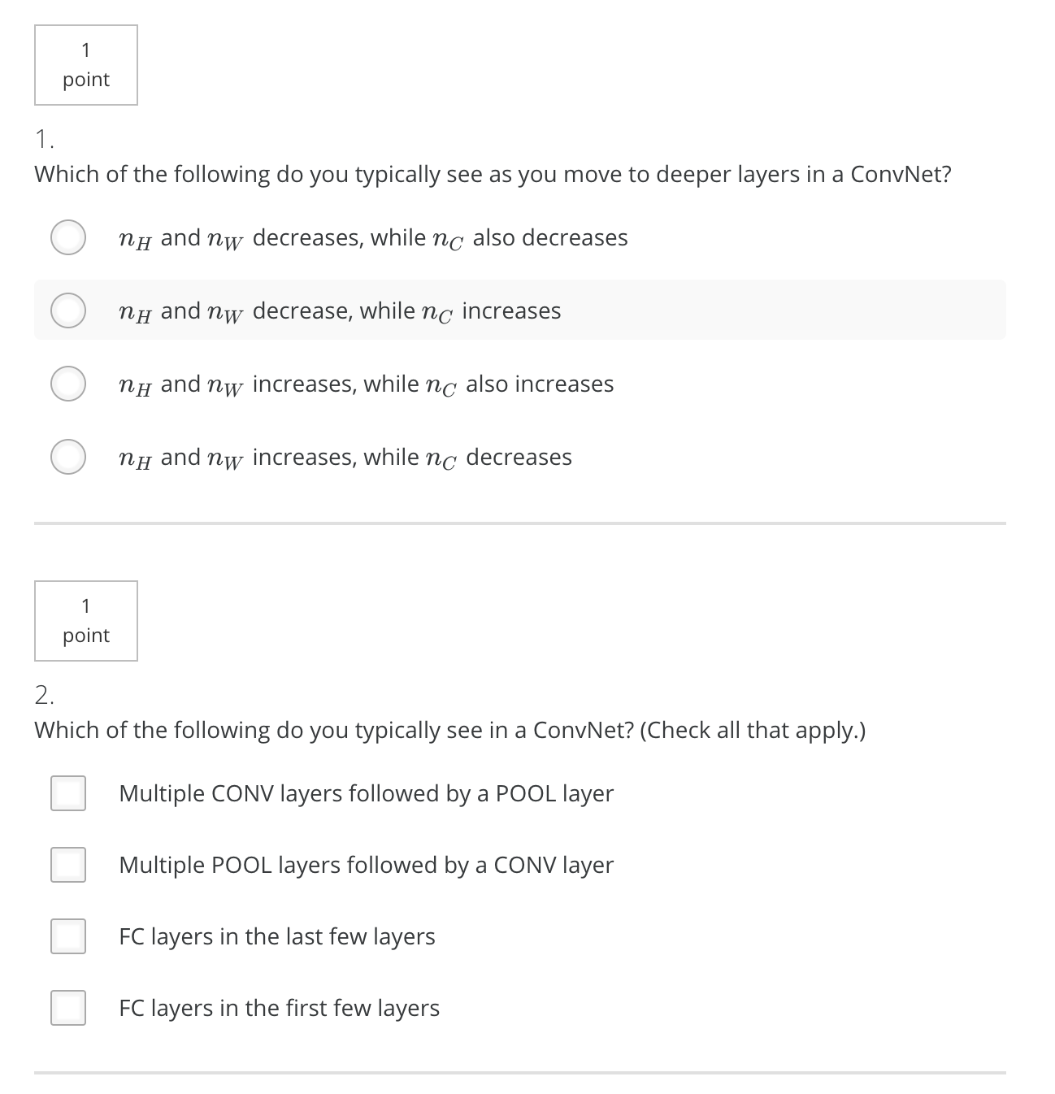
B
AC

Slide 2
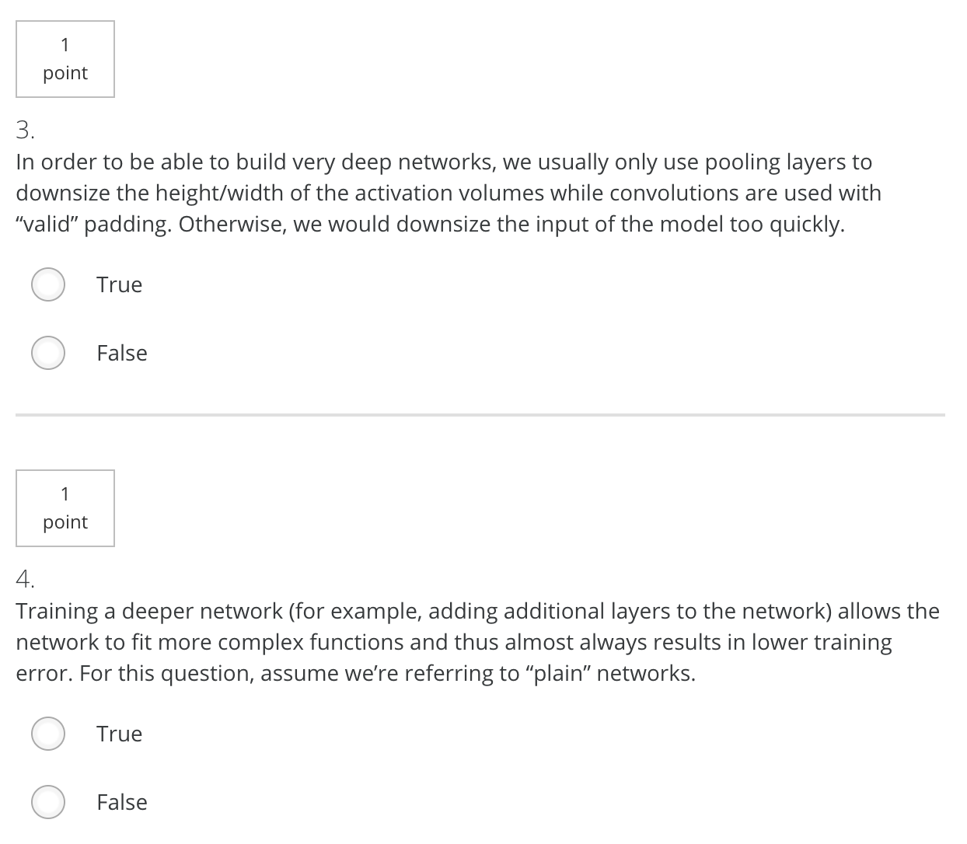
3. False
4. False. As the network goes deeper, the training error will increase

Slide 3
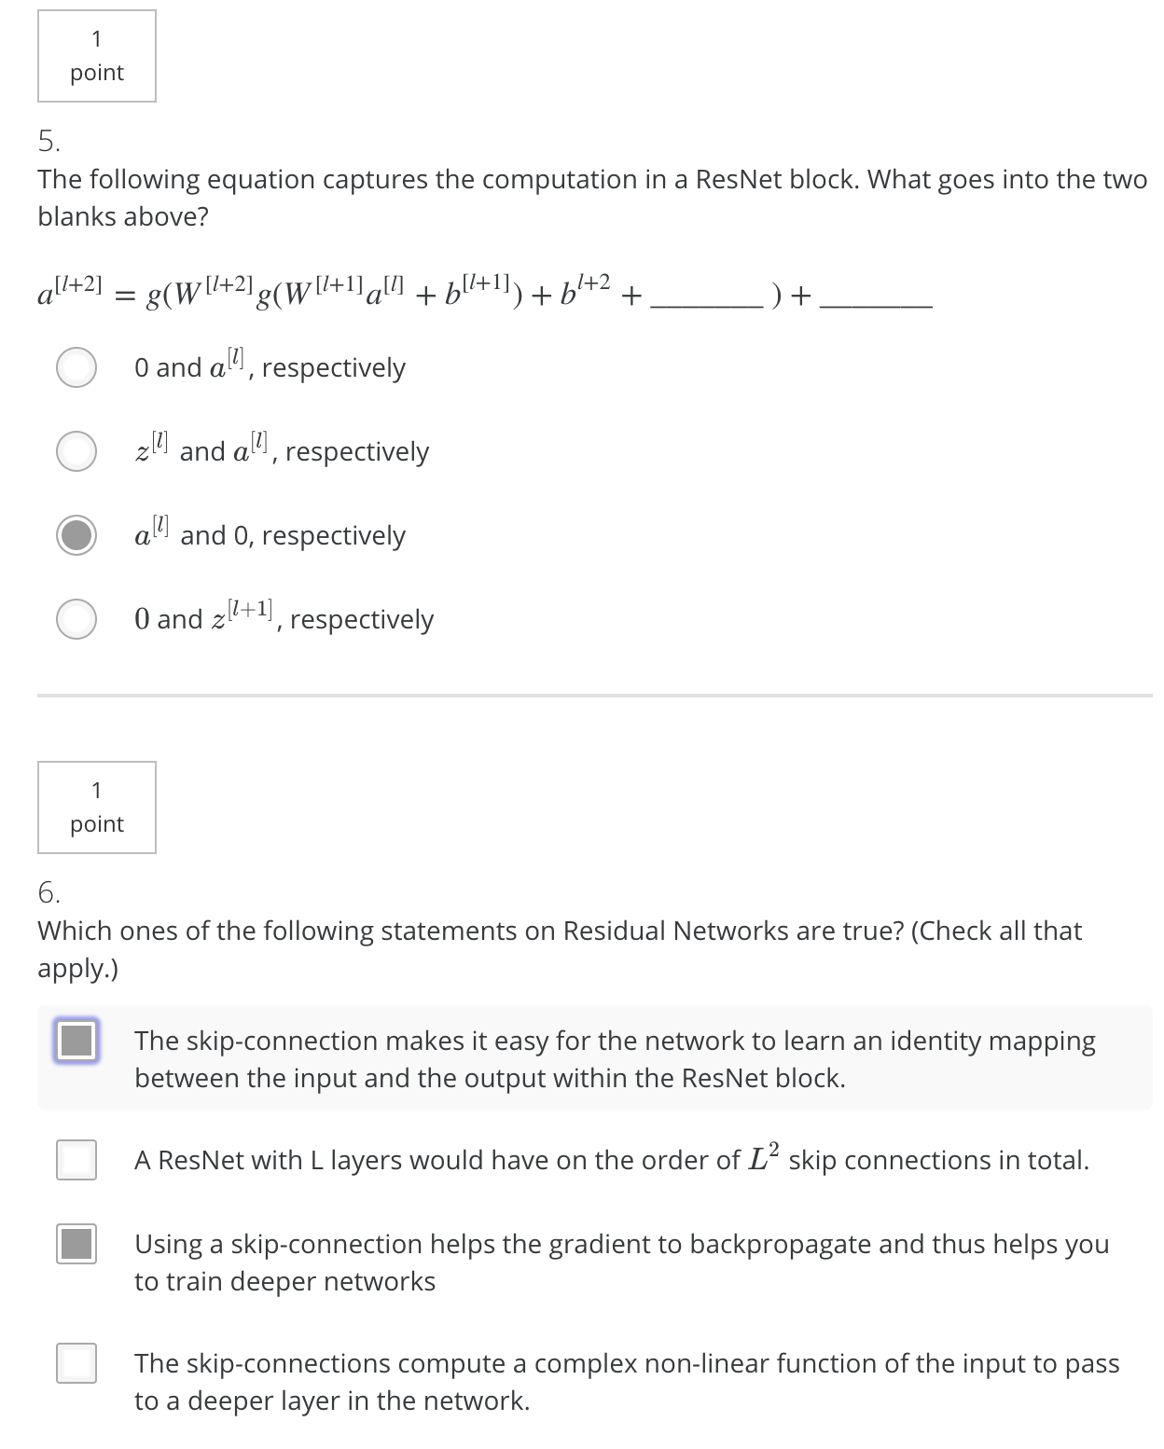
5. C
6. AC

Slide 4
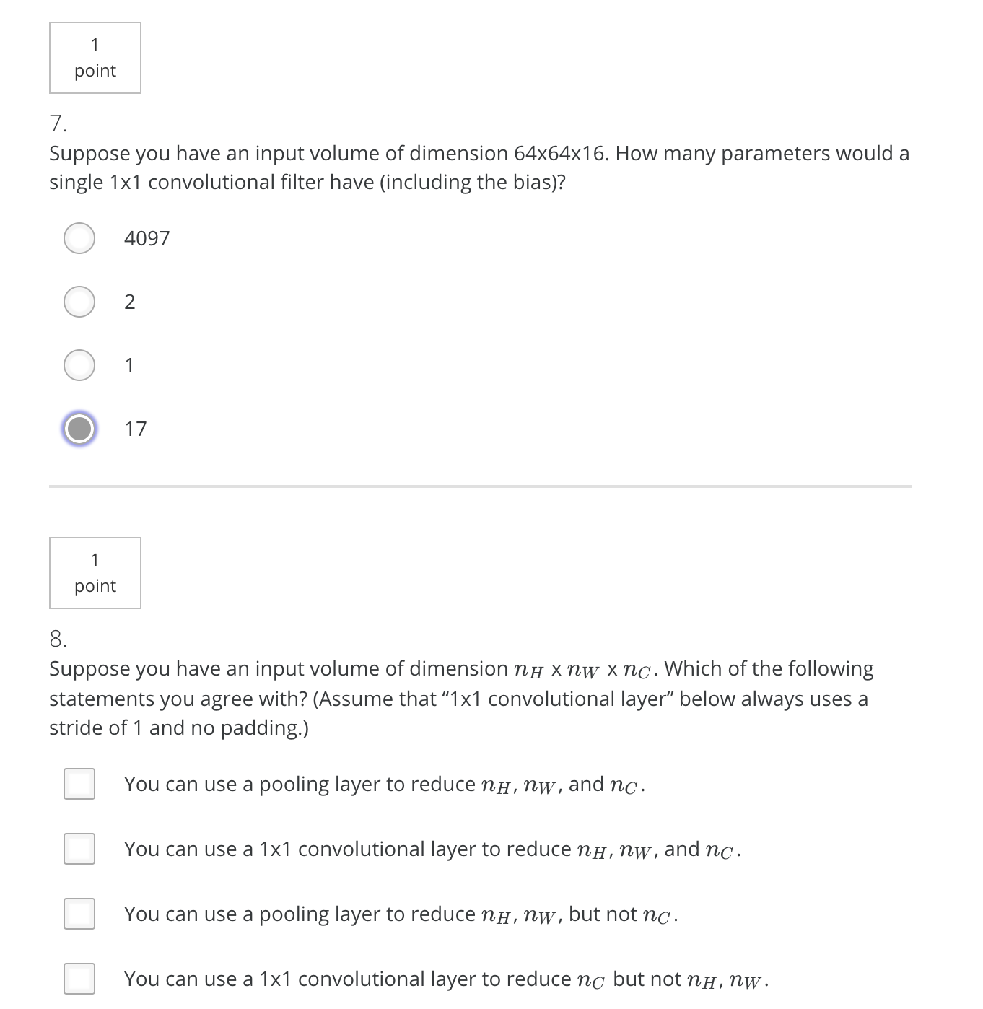
7. D
8. CD

Slide 5
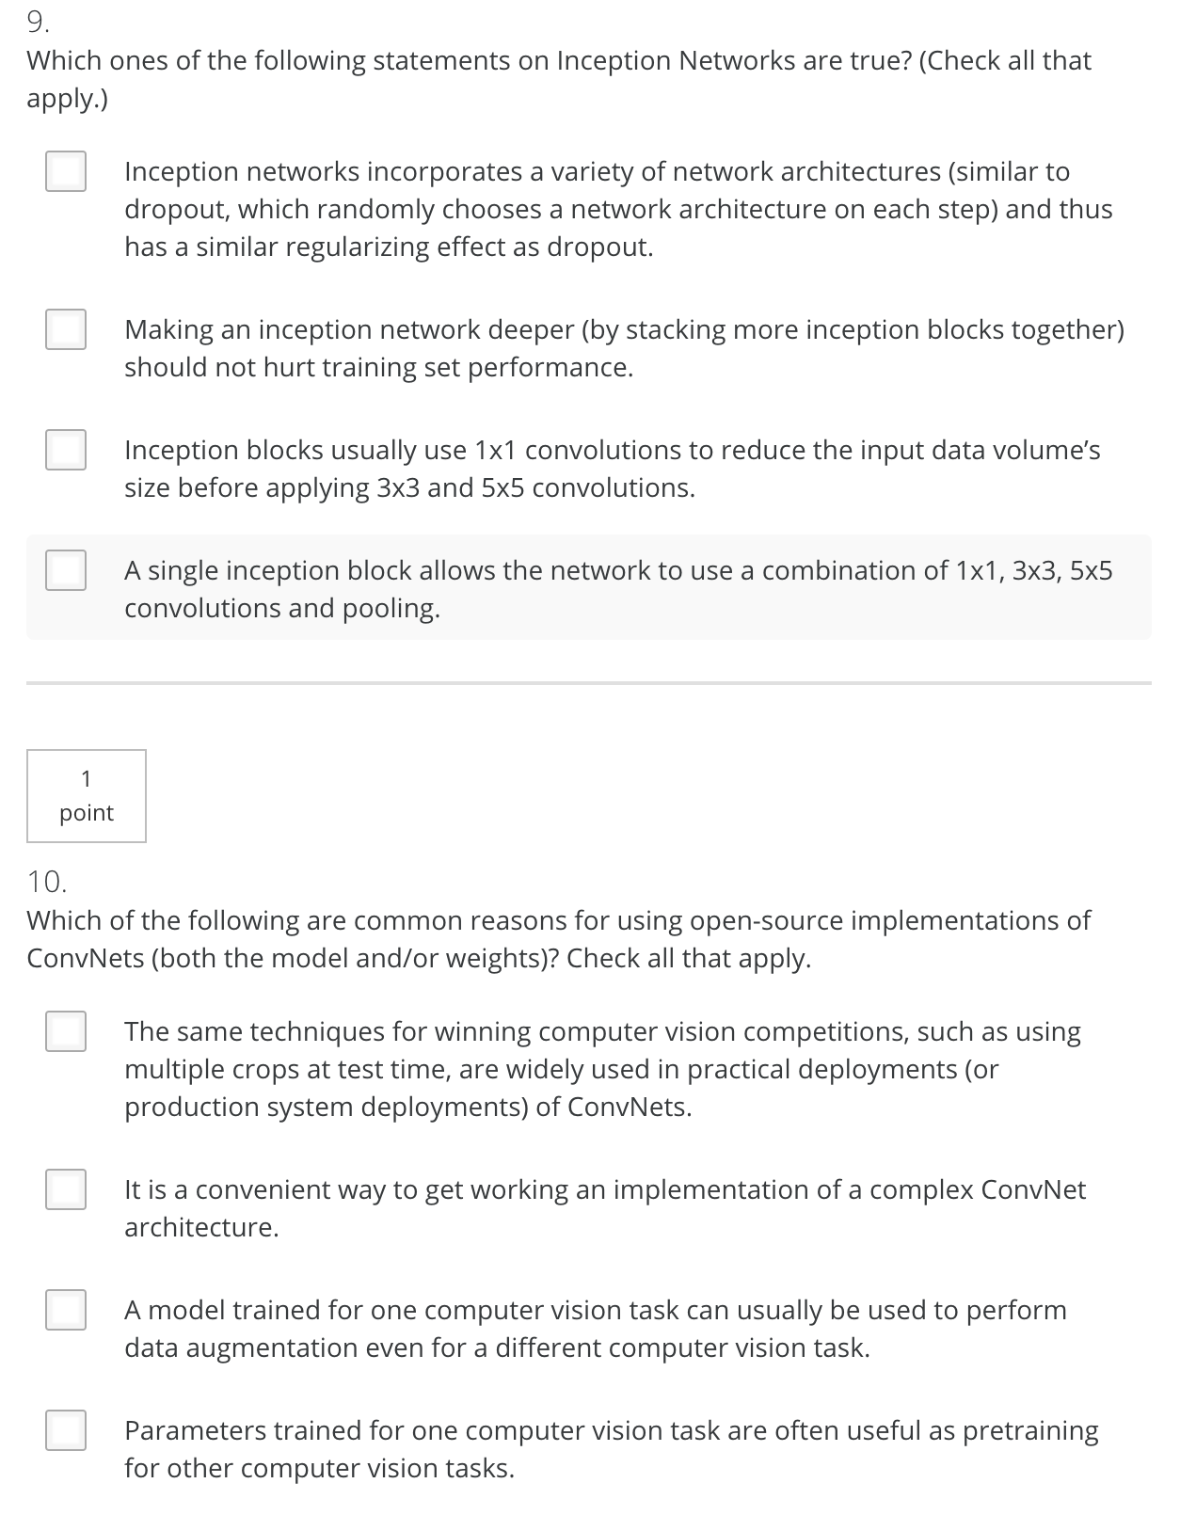
9. CD
10. BD

