Slide 1
Data Streaming in a Real World Application
Gustavo Almeida – May, 2020

Slide 2
Define the workshop vision and goals
Day 1
Introductory Concepts
Sprint Presentation
Day 2
Intro to Computer Vision
Annotation
Day 3
Applied Object Classification
Object Detection
Day 4
Day 5
Cloud Services
Amazon and Google
Preparation for Project execuction
Readings

Slide 3
Bootcamp Style
https://colab.research.google.com/notebooks/intro.ipynb

Slide 4
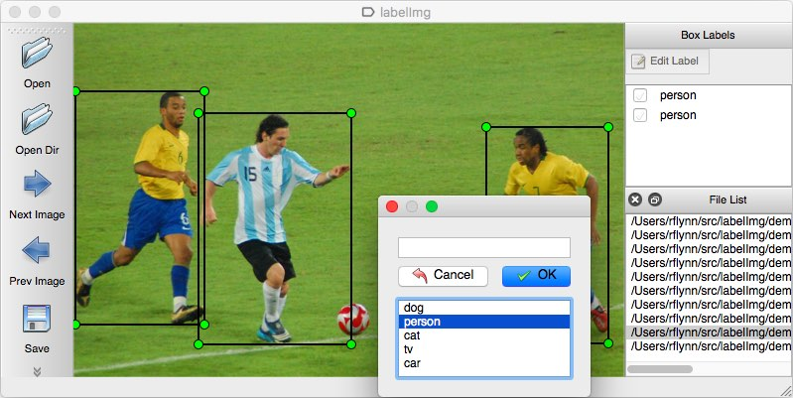
labellmg SOP
LabelImg is a graphical image annotation tool.
It is written in Python and uses Qt for its graphical interface.
Annotations are saved as XML files in PASCAL VOC format, the format used by ImageNet. Besdies, it also supports YOLO format
https://github.com/tzutalin/labelImg
https://github.com/wkentaro/labelme

Slide 5
Annotation Tool
After running the program, you should see the interface to annotate images. If some of the buttons on the left are cut off, just make the window larger.
Click the "Create RectBox" button and then click to drag the first bounding boxover one of the crossing signals in the image. Select the classes as follows:

Slide 6
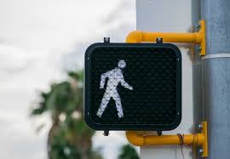
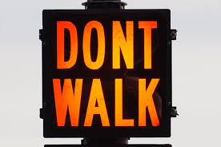
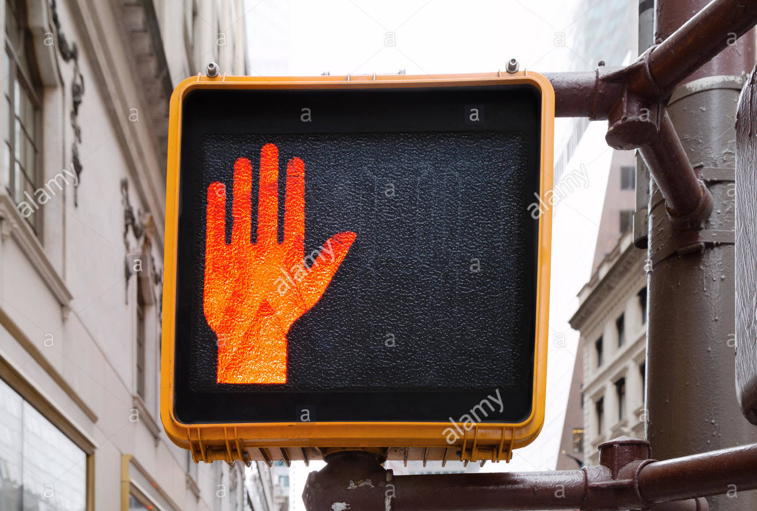
Classes for our repository
"walk" - The signal indicates that it is safe to cross the road
"dont walk" - The signal is displaying the orange don't walk signal. There is no countdown being displayed on the signal.
"countdown" - The signal is displaying a countdown.
"off" - The signal does not have any lights on
"other" - There is a problem with the signal. For example, both the "walk" and "don't walk" icons could be displayed at once.

Slide 7
Important Information
It is important to draw a bounding box on every single crossing signal in the image.
If an image does not display any crossing signals, do not draw any bounding boxes.
Select the classes for each bounding box based upon only the one signal the box is drawn around. Do not change a label based on what other crossing signals in the image are displaying.
Do not use the "difficult" checkbox or the "verify image" button.

Slide 8
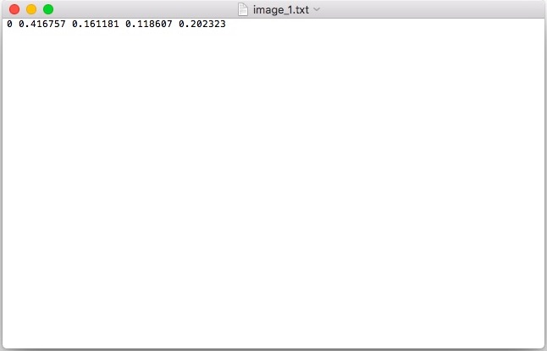
Yolo OR XML
object-id center_x center_y width height

Slide 9
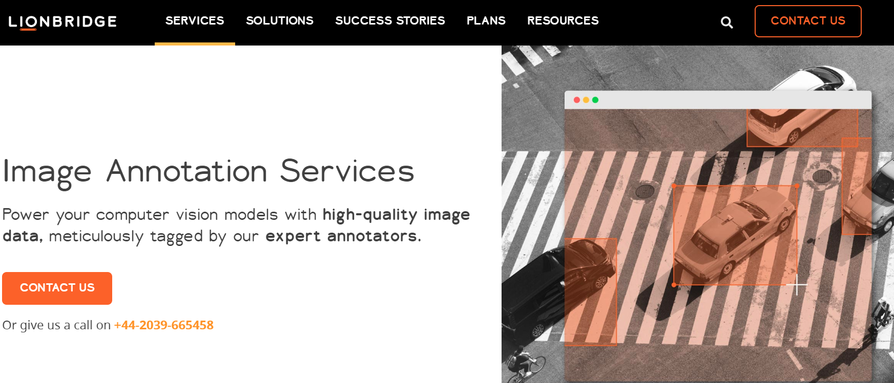

Better ways to do it
https://blog.mturk.com/tutorial-annotating-images-with-bounding-boxes-using-amazon-mechanical-turk-42ab71e5068a

Slide 10

Top 10 Computer Vision APIs: AWS, Microsoft, Google and more
https://medium.com/rakuten-rapidapi/top-10-computer-vision-apis-aws-microsoft-google-and-more-fe6fe9a9bc8c

Slide 11
Google Cloud
Advantages
They have no upfront costing and it is a pay as you go service with no termination fees.
Google comes with the highest security, privacy and compliance control where it provides ISO and SOC certification for the products
Cloud vision API can detect any object using Google Image Search.
Cloud Vision can moderate content search using the powerful Google Analytics.
Multiple filter parameters can be applied to a single image.
Disadvantages
Cloud Datastore is feature-limited and hard to switch out from
Google CDN does not work with custom sources
StackDriver (GCP logs) feels detached
Facial Recognition is not supported.

Slide 12
GC - Use cases
Run image detection and animation on a batch of images
Face Detection detects multiple faces within an image along with the associated key facial attributes such as emotional state or wearing headwear
Detects popular product logos within an image
Text Detection performs Optical Character Recognition. It detects and extracts text within an image with support for a broad range of languages. It also features automatic language identification.
Landmark Detection detects popular natural and man-made structures within an image.

Slide 13
Microsoft computer vision
Advantages
The API learning curve is made easier in different ways with quick starts, tutorials, and samples.
The options of either uploading the image or passing a URL are both available.
The response times are very good.
High level of SLA guarantying that the standard tier will be available at least 99.9 percent of the time.
Tightly Integrated with Microsoft Azure, blog Storage, SQL database and Virtual machine so can be packaged as an end to end solution.
Disadvantages
If you go beyond the mentioned number of transactions per second, your response time will be throttled to be within the agreed-upon limit, so if you get bursts of calls — you will have a problem.
Usage based pricing model can be difficult to comprehend and implement effective cost controls.

Slide 14
Microsoft – Use Cases
Image classification applications using 2000 recognizable objects, living beings, scenery, and actions
Identification, categorization, and tagging images
Identifying faces, mood, age, and scene
Optical Character Recognition (OCR) to detect text content in an image and helpful for maintaining records for medical, security, banking and in general record keeping
Intelligent manipulation of photos and restriction to show moderated content

Slide 15

AWS Rekognition
Advantages
This API can analyze 5,000 images per month
Store up to 1,000 face metadata per month
Limitations:
The maximum image size that can be stored as an Amazon S3 object is limited to 15 MB.
The minimum pixel resolution for height and width is 80 pixels
It supports only JPEG and PNG image formats. The video must be encoded using the H.264 codec. The supported file formats are MPEG-4 and MOV.
For detection, the face dimension must be no smaller than 40×40 pixels in an image with 1920X1080 pixels. Images having dimensions higher than 1920X1080 pixels will need a larger minimum face size proportionally.

Slide 16
Amazon Rekognition - Use Cases
Use cases:
Use Label detection across multiple images, do face detection and comparison, image moderation and text in image detection
Ability to correct images for uploading the right orientation
Ability to detect and breakdown scene elements
Do monitoring for statistics like how many faces are tracked and how many requests are sent per second
It is able to facial recognition like the position of the eye and other facial feature

