Slide 1
Weather AI App

Slide 2
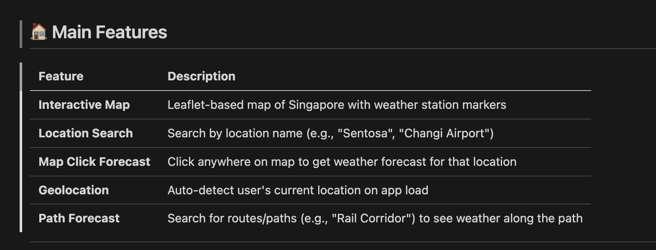
Weather AI provides 5 features to provide weather at fingertip

Slide 3
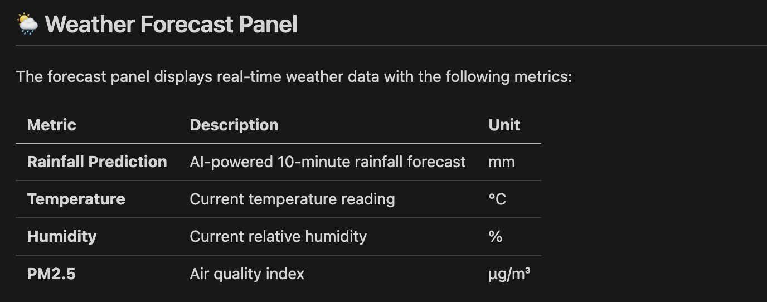
Weather Forecast displays 4 types of data
impacting on outdoors Activity

Slide 4
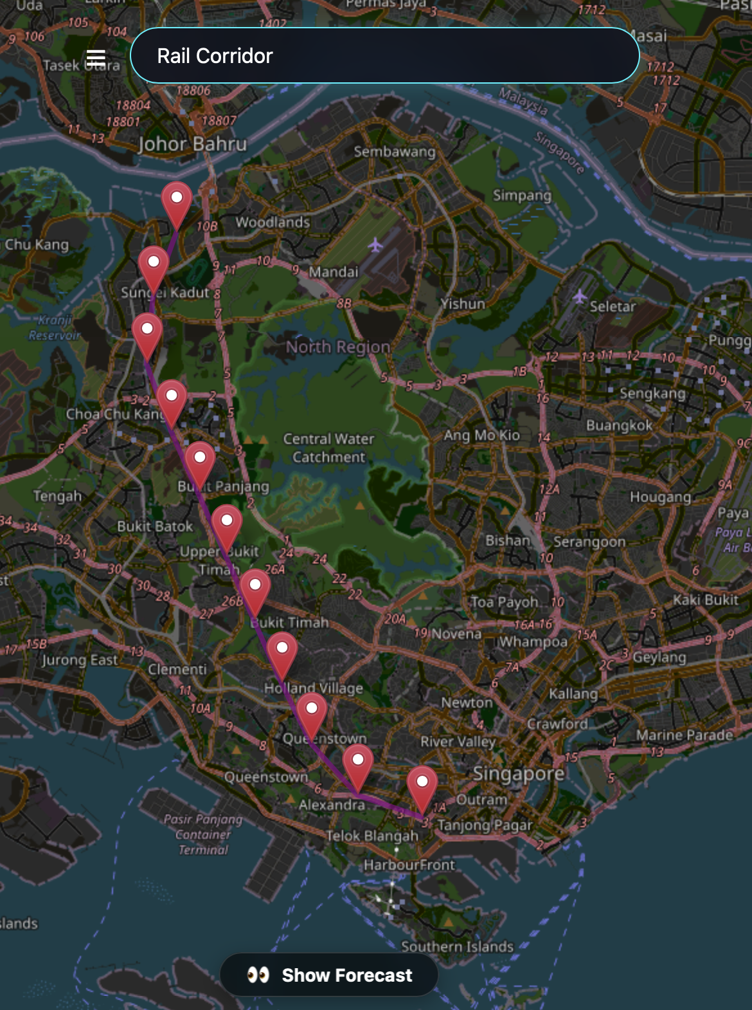
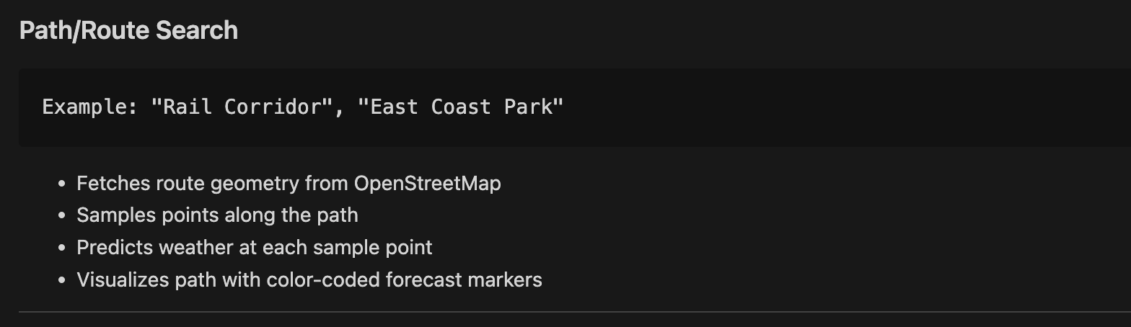
Path / Route Search makes the search easier

Slide 5
Live demo is available for feedback
Weather AI app - http://3.0.28.161:8000/
Training Monitoring - http://3.0.28.161:8000/training
Forecast weather
Forecast if it will rain based on the location asked
Store the data (location and forecast outcome for further improvement on the accuracy of the model
This is live monitor for the training process
Download raw data including
satellite from Japan site and
raining, temperature, humanity and PM2.5 data.gov.sg
All data will be parked in S3 bucket for further processing
Pre-Processing data will download the data perform
cleansing,
data alignment based on different frequency
Train the model for forecast

Slide 6
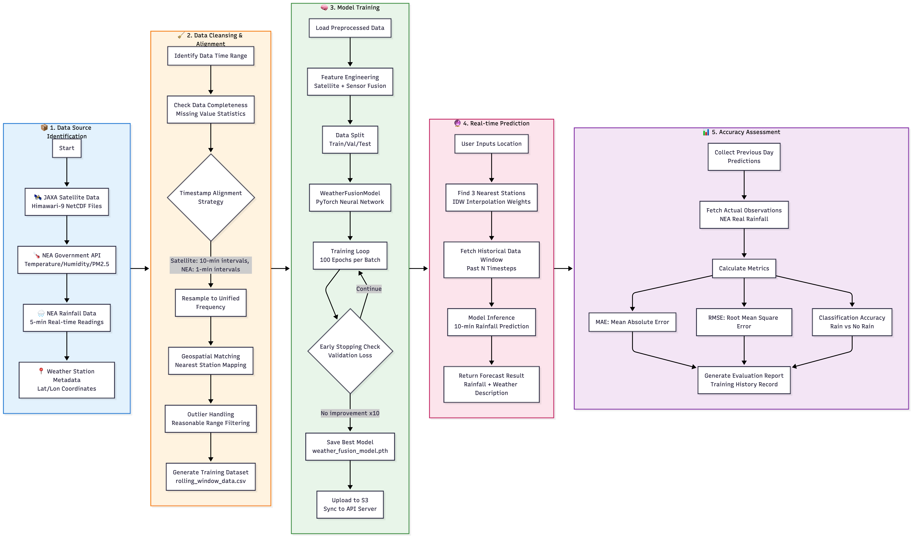
End-2-End Flow Chart of Data Process

