Slide 1
Feture Selection summary – before noralization & standardization
● : seleted
 | RFE | Reg |  | RFE | Reg
Tip | ● | ● | Tip | ● | ●
Sex |  |  | Sex
Smoker | ● |  | Smoker | ●
Day |  | ● | Day
Time | ● | ● | Time |  | ●
size | ● | ● | Size | ● | ●
 |  |  | Tip_rate | ● | ●

Slide 2
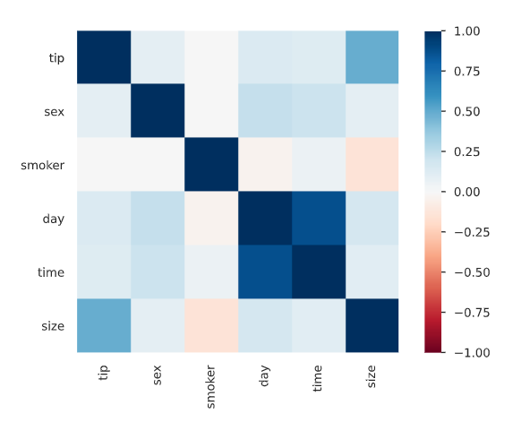
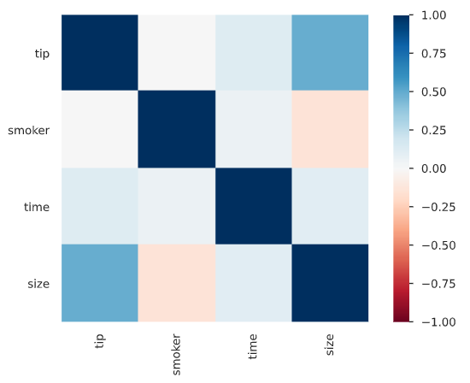
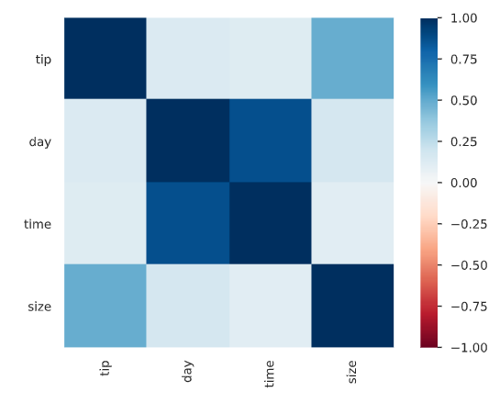
Feture Selection summary
Data without mutate variable
RFE
REG

Slide 3
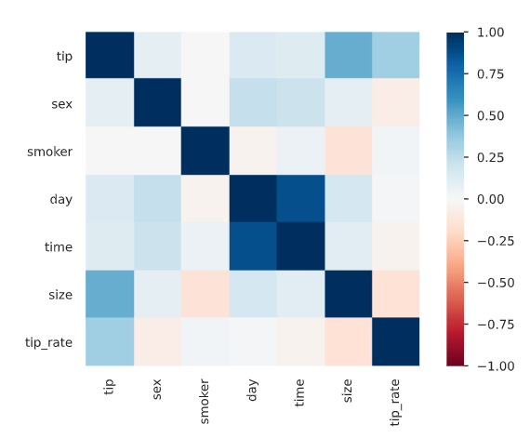
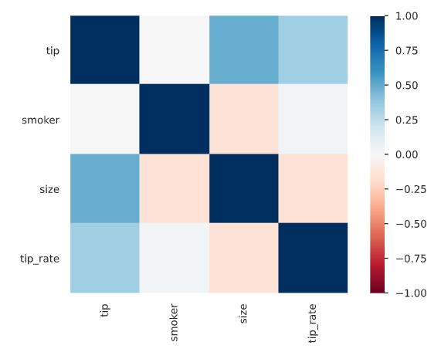
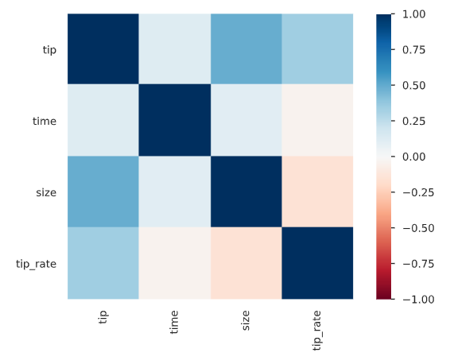
Feture Selection summary
Data with mutate variable
RFE
REG

Slide 4




PCA before normalization & standardization
Data without mutate variable
Data with mutate variable
PCA after normalization & standardization
Data without mutate variable
Data with mutate variable

Slide 5
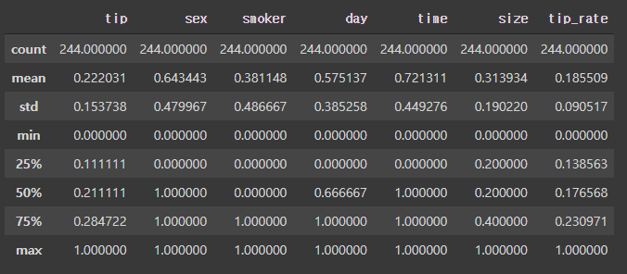
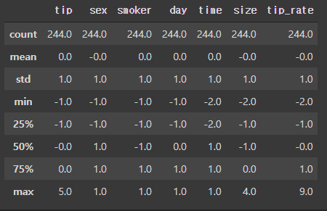
Normalization & standardization
Normalization
standardization

Slide 6
Feture Selection summary – After noralization & standardization
● : seleted
 | RFE | Reg |  | RFE | Reg
Tip | ● | ● | Tip | ● | ●
Sex |  |  | Sex
Smoker |  |  | Smoker | ●
Day | ● | ● | Day
Time | ● | ● | Time |  | ●
size | ● | ● | Size | ● | ●
 |  |  | Tip_rate | ● | ●

Slide 7
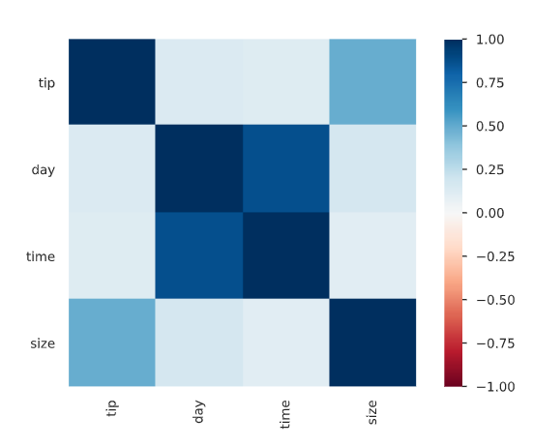
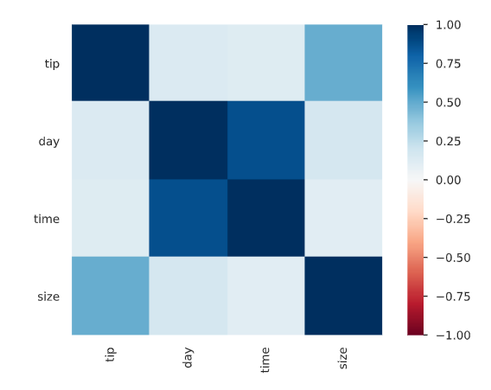
Feture Selection summary – After noralization & standardization
Data without mutate variable
RFE
REG

Slide 8
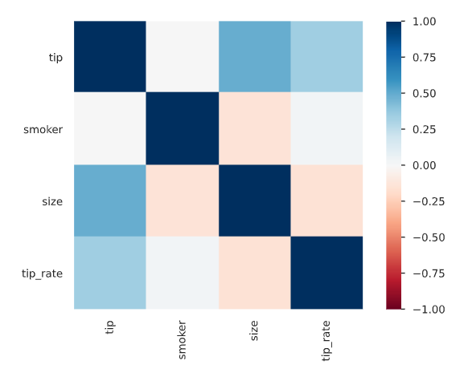
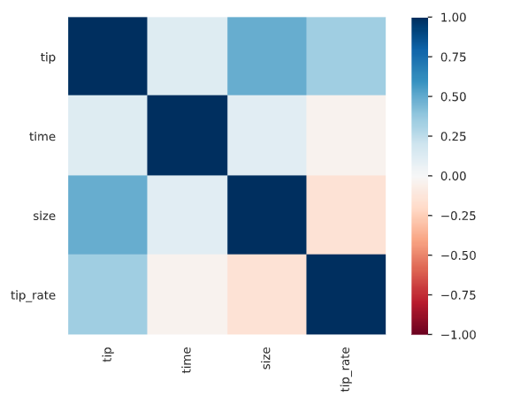
Feture Selection summary – After noralization & standardization
Data with mutate variable
RFE
REG

