Slide 1
Wheel Time
A real-time radial launcher for fast actions, scripts, and hotkeys
Release 1.0
CSE 115A
7/22/26
Team Wheelest Wheels
Ronan Wong • Muneeb Syed • Ethan Jackson • Mithil Harish • Aedan Benavides
Notes:
Introduce Wheel Time as a launcher that brings fast actions into one radial interface. Keep the title slide simple.

Slide 2
CONTEXT
Why we built it
Intended users
The pain point
Fast actions are scattered across hotkeys, scripts, desktop apps, and menus.
Gamers, streamers, developers, and general users who want quick access to actions without leaving their current task.
Opportunity
Gamers cannot pause to hunt for tools
Power users forget rarely used hotkeys
Existing launchers are often keyboard-first
Visual actions should be one hotkey away
Make actions visual, searchable, and low-interruption. One quick menu instead of memorizing many shortcuts.
Design target
A lightweight radial menu that appears fast, runs the selected action, then gets out of the way.
Wheel Time • Release 1.0
2
Notes:
Explain why this app is useful beyond games: it reduces friction and memory load for repeated actions.

Slide 3
PRODUCT
What Wheel Time does
1
2
3
4
Open
Choose
Run
Return
Global hotkey brings up a radial menu
Click an action item or search for one
Launch apps, scripts, key presses, or sequences
Menu closes fast and gives focus back
One visual interface for many actions
Wheel Time • Release 1.0
3
Notes:
Walk through the user flow. This slide explains the what/how before jumping into the demo.

Slide 4
GOALS
Goals we set out to achieve
Goal | Result
Functional radial launcher | Achieved
Run apps, hotkeys, scripts, and sequences | Achieved
Low latency / non-interruptive feel | Achieved
Configurable actions/settings | Achieved
Search for programs/actions | Achieved
Release 1.0 moved from prototype → usable launcher.
Wheel Time • Release 1.0
4
Notes:
Tie goals to outcomes. Mention that the team kept the MVP focused first and then added configurability/search.

Slide 5
CHALLENGES
Biggest challenges
System architecture
Windows behavior
Integration
Separating GUI, action execution, scheduling, and platform APIs so the app could grow without becoming hardcoded.
Hotkeys, focus restoration, overlay rendering, and simulated input all depended on OS-level details.
Many features worked alone first; the hard part was making them work together through the radial menu.
Development process
Testing GUI behavior
Early tasks were too vague and ownership was not always clear, so sprint tracking improved over time.
Some behavior required manual system tests because GUI/hotkey/focus behavior is difficult to unit test directly.
Wheel Time • Release 1.0
9
Notes:
This slide covers both final product challenges and development process challenges.

Slide 6
DEMO
Live Demo!
Wheel Time • Release 1.0
5
Notes:
This slide should introduce the demo. If the team has a video, link it in PowerPoint or switch to it from here.

Slide 7
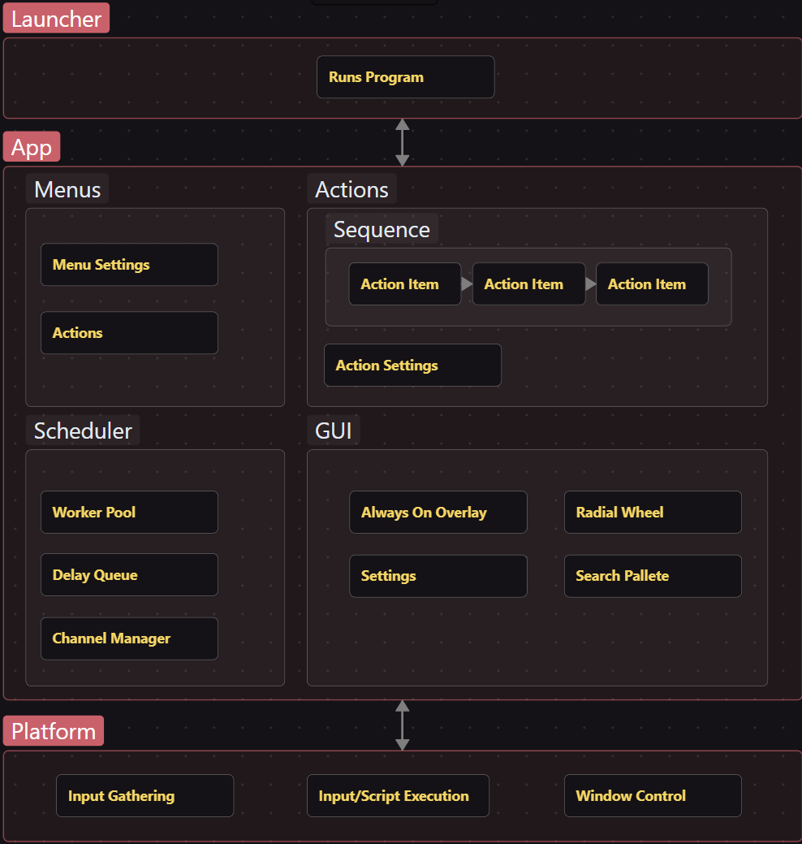
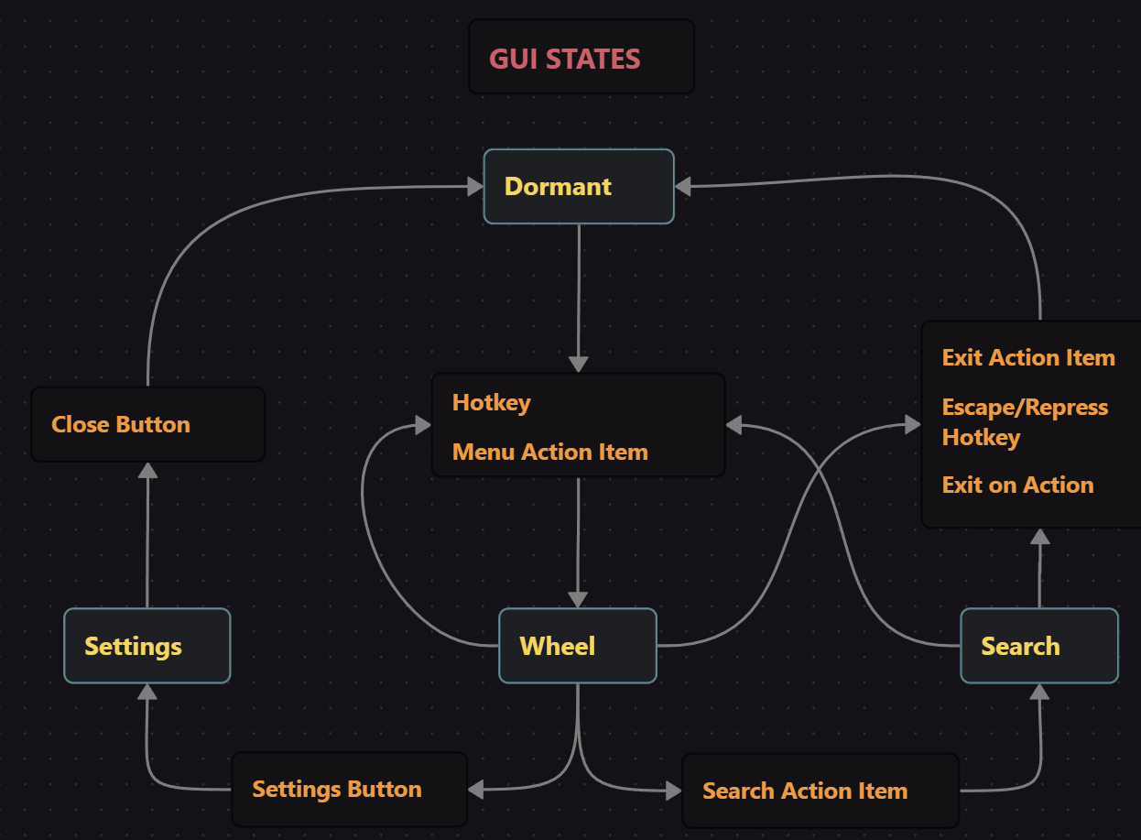
HOW IT WORKS
System architecture
Launcher = UI + action system + scheduler + platform APIs
The diagram separates menus/actions, GUI states, scheduling, and platform-level input/execution.
Wheel Time • Release 1.0
6
Notes:
Describe the main modules: menu actions, scheduler, GUI states, and platform layer. Point to the architecture diagram from the draft.

Slide 8
IMPLEMENTATION
Technologies and responsibilities
Qt
Windows API
C++ / CMake
GUI windows, radial menu, settings menu, search palette, visual button interactions.
Global hotkeys, input gathering, key simulation, app/script execution, window focus behavior.
Core architecture, action abstractions, scheduler, build targets, integration between modules.
GitHub + Trello
VS Code / Cursor
Code collaboration, PRs, task tracking, sprint planning, docs, and issue/bug tracking.
Development environment and support tools for navigating code and speeding up implementation.
Wheel Time • Release 1.0
7
Notes:
Avoid logo soup. Explain what each technology did in the system, as the outline asks.

Slide 9
PROCESS
Product management approach
Sprints
Trello board
Rotating roles
Four short sprints with planning, reports, burnup charts, and sprint goals.
Columns for user stories, to do, in progress, blocked, testing, and done.
Scrum Master responsibility rotate while Product Owner kept product direction aligned.
Deviation from pure Scrum
What improved
We used research spikes heavily early on because Windows API, overlay behavior, and scheduler design had technical uncertainty.
Tasks became smaller, owners got clearer, and PRs/doc updates gave better evidence of work.
Wheel Time • Release 1.0
8
Notes:
Focus on additions/deviations: research spikes, rotating scrum master, and board adjustments as the team learned.

Slide 10
REFLECTION
What we enjoyed… and not so much
Enjoyed
Did not enjoy
- Using the app ourselves
- Seeing the radial menu become real
- Connecting UI buttons to real actions
- Solving OS-level problems
- Debugging focus and hotkey edge cases
- Build/configuration friction
- Late task assignment pressure
- Keeping docs updated while coding
Overall the project was hardest when hidden system behavior mattered more than normal app logic.
Wheel Time • Release 1.0
10
Notes:
Use this slide as a quick reflection. Keep it honest but positive.

Slide 11
RETROSPECTIVE
Lessons learned
Keep doing
Stop doing
Start doing earlier
Small PRs, regular check-ins, demo-driven goals, and keeping stretch features separated from required sprint work.
Leaving tasks vague or unclaimed too long. It makes sprint progress harder to see and harder to prove. Late/no response. Meeting cancelations.
Define architecture and interfaces sooner, write tests for core logic earlier, and document decisions while they are fresh.
We learned that teamwork accelerates progress but increases chaos if communication isn’t treated with care.
Wheel Time • Release 1.0
11
Notes:
This addresses what worked, what did not, and what the team would do differently.

Slide 12
WRAP-UP
Release 1.0 takeaway
Wheel Time delivers:
Fast hotkey-open launcher
Visual radial action menu
Apps, scripts, hotkeys, sequences
Settings and custom actions
Search-based program/action launch
Q&A
Thank you
Team Wheelest Wheels
Wheel Time • Release 1.0
12
Notes:
Close with the release summary and invite questions.

