Slide 1
Distributed Scala:
Sublime to Practical
Martin Odersky & David Pollak
February 18th, 2010
@Cloudera

Slide 2
About...
Martin
  ACM Fellow
  Modula 2 → Pizza/GJ/javac → Scala
David
  Spreadsheets
    Mesa: first real time spreadsheet
    Integer: Distributed, multi-user & core, browser
  Java → Ruby/Rails → Scala/Lift

Slide 3
Scala
Scala is now the main alternative language on the JVM.
Fits seamlessly into a Java environment
Scala can call Java methods, select Java fields, inherit Java classes, implement Java interfaces, etc.
None of this requires glue code or interface descrptions
Java code can also easily call into Scala code
Performance is usually on a par with Java

Slide 4
A Scalable Language
Agile with lightweight syntax
Object-Oriented Scala Functional
Safe and performant, with strong static typing

Slide 5
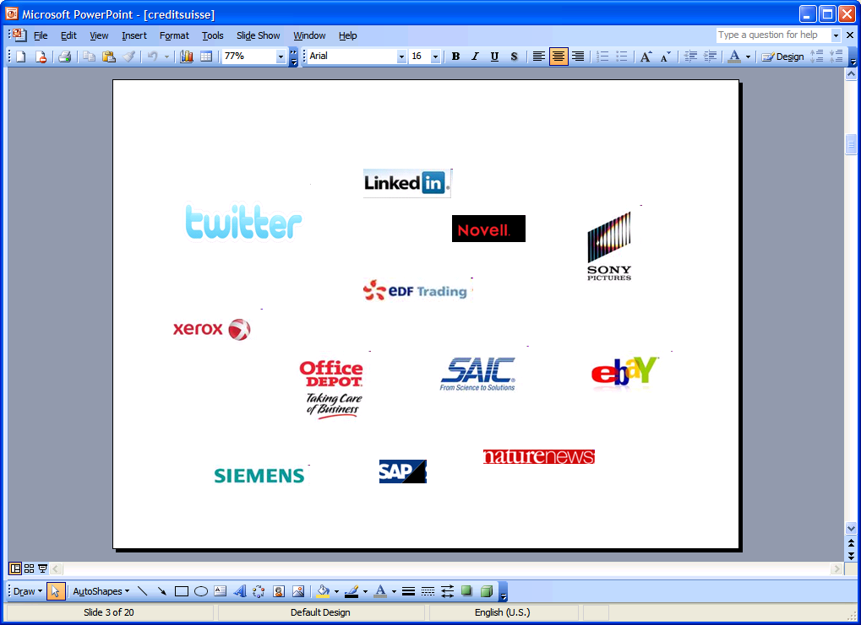

Who uses Scala

Slide 6
Swarm
By Ian Clarke (Freenet, SenseArray)
“Transparently Distributed Computation in the cloud”
Scala's Delimited Continuations → Move Computation to Data

Slide 7
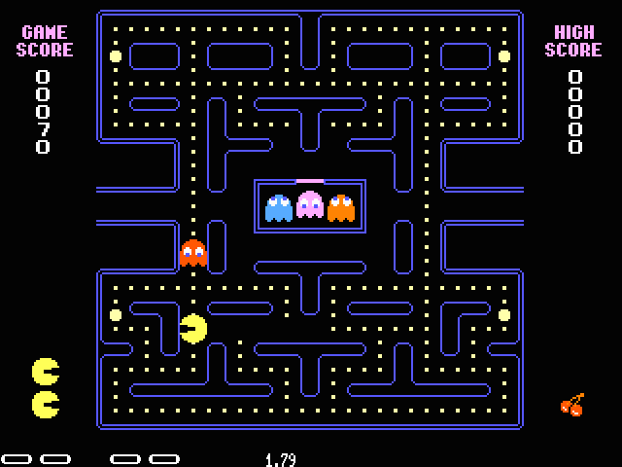
What do continuations do?
Store the state of a computer program
Like saving your position in a video game
Resume execution at some point in the future

Slide 8
What if we could distribute data and computation across multiple computers such that the programmer need not think about it?
?

Slide 9
But how?
Move the computation, not the data
Handle this transparently within the framework
Arrange the data to minimize movement of the computation

Slide 10
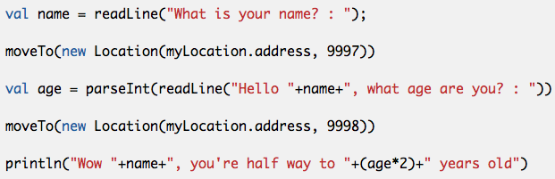
Forcing Swarm to migrate the continuation

Slide 11
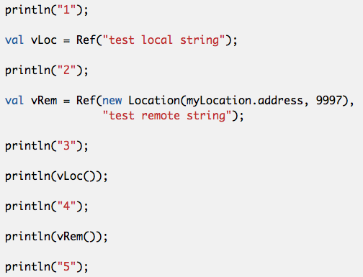
Forced remote variable

Slide 12
Interested in helping with Swarm?
http://code.google.com/p/swarm-dpl/
ian@uprizer.com

Slide 13
Jonas Bonér (Terracotta, AspectWerkz)
  and 7 more committers
“Simpler Scalability, Fault-Tolerance, Concurrency & Remoting through Actors”
Erlang OTP-style Actors + STM
Microkernel or library JAR
In production at +3 companies
OSS under Apache 2
http://akkasource.org

Slide 14
Actors
Running or Stopped
Asynchronous message passing
Unityped messages
Guaranteed single message processed at once
Supervisor Hierarchies for Erlang-style fault-tolerance
Very lightweight (6.5 million on 4G RAM)

Slide 15
Active Objects
Plain POJOs as actors
  val service = ActiveObject.newInstance(classOf[MyService])
  service.doStuff // now an async msg send
Bytecode rewriting to transform POJO into actor
Same features as Actors; can be supervised, remote, transactional etc.
Java API as well

Slide 16
Remote Actors
High-perf and scalable impl – NIO (Netty) + Protobuf + zlib etc
  On server
class MyActor extends Actor {
def receive = {
case fun => reply(fun())
}}
RemoteNode.start("darkstar", 9999) // start server node
RemoteNode.register(“my-service”, new MyActor)
  On client
val actor = RemoteClient.actorFor(“my-service”, “darkstar”, 9999) // get handle to actor on client node
actor ! computation // send a function to be invoked on server
Also client-initiated version, where actor is started on client and moved to server

Slide 17
Remote Actors
Supervision works across nodes
  Actor on node A can monitor and manage actor on node B
Cluster support
  Transparent membership management
  Send message to an actor on all nodes that has it
  Cluster.relayMessage(classOf[ATypeOfActor], message)
  Start an actor on all nodes
  for(endpoint <- Cluster) spawnRemote(classOf[KungFuActor], endpoint.host,endpoint.port)
Growing set of dist computing pattern impls

Slide 18
STM
Transactional Ref, Map, Vector, Queue
atomic {
txRef.swap(newValue)
txMap += (key → value)
}
Transactions can nest and compose
In-memory or persisted (Cassandra, MongoDB, Redis etc.)
Transactional Actors - allows compositional atomic message flows
Currently local (remote out soon)

Slide 19
Akka Integrations
AMQP
Camel
Comet
REST
Lift

Slide 20
Goat Rodeo
David Pollak (Lift)
“Unified Distributed Computing”
Distributed Actors + Transactions + Relational
Asynchronous, immutable turtles all the way down

Slide 21
Services
Asynchronous, ordered delivery, message passing (Workers)
Unified transaction model
You don't have to be an Worker to get data
Each worker has its own SQL store
Divorced business logic and distribution

Slide 22
Message Passing
All implement QBase... immutable & serialize
Statically typed
Asynchronous
Guaranteed delivery
Always via proxy
for (worker ← WorkerMgr.find(SimpleId(4)))
worker ! NextGuy(1)

Slide 23
Transactions
Initiated by a Worker
Commits when all transactional message processing complete without exception
Nestable and re-entrant (optionally not)
Rolls back on exception, explicit roll-back or timeout (deadlock detection coming)

Slide 24
Transaction Examples
transaction avec other preCommit
{...} postCommit
{...} postRollback
{(a, b) => ...} send Moo(33)
for {
t ← msg.xacts
from ← WorkerMgr.find(t.from)
} transaction avec from send SetupXfer(t)
transaction notReentrant "called twice "+msg
if (balance < msg.transfer.amount)
transaction rollback("NSF")

Slide 25
Ask/Answer
No need to be a Worker to ask a question
Questions include the answer type
OutsideOfWorker avec acct onComplete
{bal => ...} send GetBalance()

Slide 26
Relational Store
Integrated with transactions
Separate store per worker
Full SQL
Works with any JDBC-friendly library
TestRecord.create.balance(balance).save

Slide 27
More natural code
No explicit “dispatch” partial function (although one can be specified)
Code looks like Scala, not Erlang
But normally code looks like:
def doGetBalance(in: GetBalance): QLong =
balance

Slide 28
Seamless Distribution
Worker same distributed or local
Messages serializable and immutable: MQ
Backing store for RDBMS changes
FS → NFS | Cassandra
Transactions: MemHash → ZooKept
Workers do not change
WorkMasters change

Slide 29
Seamless Development
Code works the same:
  Developers machine
  During local tests
  CI Server
  Live
But extensive control over distribution mechanism

Slide 30
Get your Goat
http://goatrodeo.org
http://groups.google.com/group/goat-rodeo

Slide 31
Conclusion
Scala is the best language for the JVM
Scala has features that make distributed code easier
  Delimited Continuations
  Immutable Data Types
  Compiler Plugins
A sub-plethora of distributed computing solutions in Scala

