Slide 1



ipl-analysis
July 6, 2024
[1]: import pandas as pd
import numpy as np
import matplotlib.pyplot as plt
import seaborn as sns
[2]: #We load the IPL data using the following code:
deliveries_data = pd.read_csv(r"C:\Users\mangesh\Downloads\ipl_resources\IPL␣
↪
Ball-by-Ball 2008-2020.csv")
match_data = pd.read_csv(r"C:\Users\mangesh\Downloads\ipl_resources\IPL Matches␣
↪
2008-2020.csv")
This code reads the IPL ball-by-ball data and match data from the speciﬁed CSV ﬁles.
[3]: #This code reads the IPL ball-by-ball data and match data
# from the specified CSV files.
match_data
[3]:
0
id
city
date player_of_match
\
1
335982
Bangalore 2008-04-18
BB McCullum
MEK Hussey
MF Maharoof
MV Boucher
DJ Hussey
…
2
335983 Chandigarh 2008-04-19
3
335984
335985
335986
…
Delhi 2008-04-19
Mumbai 2008-04-20
Kolkata 2008-04-20
4
..
…
…
811 1216547
812 1237177
813 1237178
814 1237180
815 1237181
Dubai 2020-09-28 AB de Villiers
Dubai 2020-11-05
Abu Dhabi 2020-11-06
Abu Dhabi 2020-11-08
Dubai 2020-11-10
JJ Bumrah
KS Williamson
MP Stoinis
TA Boult
0
M Chinnaswamy Stadium
venue neutral_venue
\
1
2
3
4
Punjab Cricket Association Stadium, Mohali
Feroz Shah Kotla
0
0
0
0
0
Wankhede Stadium
Eden Gardens
1

Slide 2

..
…
Dubai International Cricket Stadium
Dubai International Cricket Stadium
Sheikh Zayed Stadium
…
811
812
813
814
815
0
0
0
0
0
Sheikh Zayed Stadium
Dubai International Cricket Stadium
0
team1
team2
\
1
Royal Challengers Bangalore
Kings XI Punjab
Kolkata Knight Riders
Chennai Super Kings
Rajasthan Royals
2
Delhi Daredevils
3
Mumbai Indians Royal Challengers Bangalore
4
Kolkata Knight Riders
Deccan Chargers
…
Mumbai Indians
Delhi Capitals
Sunrisers Hyderabad
Sunrisers Hyderabad
Mumbai Indians
..
…
811 Royal Challengers Bangalore
812
Mumbai Indians
813 Royal Challengers Bangalore
814
815
Delhi Capitals
Delhi Capitals
0
Royal Challengers Bangalore
toss_winner toss_decision
winner
\
1
Chennai Super Kings
Rajasthan Royals
Mumbai Indians
Deccan Chargers
…
Mumbai Indians
Delhi Capitals
Sunrisers Hyderabad
Delhi Capitals
Delhi Capitals
field
bat
Kolkata Knight Riders
Chennai Super Kings
Delhi Daredevils
2
bat
3
bat Royal Challengers Bangalore
4
bat
Kolkata Knight Riders
…
..
811
812
813
814
815
…
field Royal Challengers Bangalore
field
field
bat
Mumbai Indians
Sunrisers Hyderabad
Delhi Capitals
bat
Mumbai Indians
result result_margin eliminator method
umpire1
Asad Rauf
MR Benson
Aleem Dar GA Pratapkumar
SJ Davis
BF Bowden
0
runs
runs
wickets
wickets
wickets
…
140.0
33.0
9.0
5.0
5.0
…
NaN
57.0
6.0
17.0
5.0
N
N
N
N
N
NaN
NaN
NaN
NaN
NaN
umpire2
RE Koertzen
SL Shastri
1
2
3
DJ Harper
K Hariharan
4
..
811
812
tie
runs
…
…
…
…
Y
N
N
N
N
NaN Nitin Menon
NaN CB Gaffaney
PR Reiffel
Nitin Menon
S Ravi
S Ravi
Nitin Menon
813 wickets
NaN
NaN
PR Reiffel
PR Reiffel
814
runs
815 wickets
NaN CB Gaffaney
[816 rows x 17 columns]
2

Slide 3

[4]: match_data.head()
#This code will execute the `head()` function on the
# DataF rame, showing the initial rows of the dataset. ꢀꢀ.
[4]:
0
1
2
3
4
id
city
date player_of_match
\
335982
Bangalore 2008-04-18
BB McCullum
MEK Hussey
MF Maharoof
MV Boucher
DJ Hussey
335983 Chandigarh 2008-04-19
335984
335985
335986
Delhi 2008-04-19
Mumbai 2008-04-20
Kolkata 2008-04-20
0
1
2
3
4
M Chinnaswamy Stadium
venue neutral_venue
\
Punjab Cricket Association Stadium, Mohali
Feroz Shah Kotla
0
0
0
0
0
Wankhede Stadium
Eden Gardens
0
1
2
3
4
team1
team2
\
Royal Challengers Bangalore
Kings XI Punjab
Kolkata Knight Riders
Chennai Super Kings
Rajasthan Royals
Delhi Daredevils
Mumbai Indians Royal Challengers Bangalore
Kolkata Knight Riders
Deccan Chargers
0
1
2
3
4
Royal Challengers Bangalore
toss_winner toss_decision
winner
\
Chennai Super Kings
Rajasthan Royals
Mumbai Indians
field
bat
Kolkata Knight Riders
Chennai Super Kings
Delhi Daredevils
bat
Deccan Chargers
bat Royal Challengers Bangalore
bat
Kolkata Knight Riders
0
1
2
3
4
result result_margin eliminator method
umpire1
umpire2
RE Koertzen
SL Shastri
runs
runs
140.0
33.0
9.0
N
N
N
N
N
NaN Asad Rauf
NaN MR Benson
NaN Aleem Dar GA Pratapkumar
wickets
wickets
wickets
5.0
5.0
NaN
SJ Davis
DJ Harper
K Hariharan
NaN BF Bowden
[5]: #This code will execute the `tail()` function on the
#`match_data` DataF rame, showing the final rows of the dataset. ꢀꢀ
match_data.tail()
[5]:
id
811 1216547
812 1237177
date player_of_match
\
city
Dubai 2020-09-28 AB de Villiers
Dubai 2020-11-05 JJ Bumrah
3

Slide 4


813 1237178 Abu Dhabi 2020-11-06
814 1237180 Abu Dhabi 2020-11-08
KS Williamson
MP Stoinis
TA Boult
815 1237181
Dubai 2020-11-10
811 Dubai International Cricket Stadium
812 Dubai International Cricket Stadium
venue neutral_venue
\
0
0
0
0
0
813
814
Sheikh Zayed Stadium
Sheikh Zayed Stadium
815 Dubai International Cricket Stadium
team1
team2
Mumbai Indians
Delhi Capitals
toss_winner
Mumbai Indians
Delhi Capitals
\
811 Royal Challengers Bangalore
812 Mumbai Indians
813 Royal Challengers Bangalore Sunrisers Hyderabad Sunrisers Hyderabad
814
815
Delhi Capitals Sunrisers Hyderabad
Delhi Capitals
Delhi Capitals
Delhi Capitals
Mumbai Indians
811
812
813
814
815
toss_decision
winner
result result_margin
\
field Royal Challengers Bangalore
tie
NaN
57.0
6.0
field
field
bat
Mumbai Indians
runs
Sunrisers Hyderabad wickets
bat
Delhi Capitals
runs
17.0
5.0
Mumbai Indians wickets
811
812
813
814
815
eliminator method
umpire1
umpire2
PR Reiffel
Y
N
N
N
N
NaN Nitin Menon
NaN CB Gaffaney Nitin Menon
NaN
NaN
PR Reiffel
PR Reiffel
S Ravi
S Ravi
NaN CB Gaffaney Nitin Menon
[6]: #This code will show all the columns present in match dataꢀꢀ .
match_data.columns
[6]: Index(['id', 'city', 'date', 'player_of_match', 'venue', 'neutral_venue',
'team1', 'team2', 'toss_winner', 'toss_decision', 'winner', 'result',
'result_margin', 'eliminator', 'method', 'umpire1', 'umpire2'],
dtype='object')
1 SOME BASIC INSIGHTS:
[7]: #This will display the dimensions of the DataF rame. ꢀꢀ
match_data.shape
4

Slide 5



[7]: (816, 17)
[8]: type(match_data.shape)
[8]: tuple
A tuple is a fundamental data structure in Python.
[9]: match_data.shape[0]##this is total Matches played from 2008 to 2020.
[9]: 816
Venues played at :
[10]: match_data['city'].unique()
[10]: array(['Bangalore', 'Chandigarh', 'Delhi', 'Mumbai', 'Kolkata', 'Jaipur',
'Hyderabad', 'Chennai', 'Cape Town', 'Port Elizabeth', 'Durban',
'Centurion', 'East London', 'Johannesburg', 'Kimberley',
'Bloemfontein', 'Ahmedabad', 'Cuttack', 'Nagpur', 'Dharamsala',
'Kochi', 'Indore', 'Visakhapatnam', 'Pune', 'Raipur', 'Ranchi',
'Abu Dhabi', nan, 'Rajkot', 'Kanpur', 'Bengaluru', 'Dubai',
'Sharjah'], dtype=object)
Total Teams Participated :
[11]: match_data['team1'].unique()
[11]: array(['Royal Challengers Bangalore', 'Kings XI Punjab',
'Delhi Daredevils', 'Mumbai Indians', 'Kolkata Knight Riders',
'Rajasthan Royals', 'Deccan Chargers', 'Chennai Super Kings',
'Kochi Tuskers Kerala', 'Pune Warriors', 'Sunrisers Hyderabad',
'Gujarat Lions', 'Rising Pune Supergiants',
'Rising Pune Supergiant', 'Delhi Capitals'], dtype=object)
Total matches played by Teams :
[12]: match_data['team1'].value_counts()
[12]: team1
Royal Challengers Bangalore
Mumbai Indians
Kolkata Knight Riders
Chennai Super Kings
Kings XI Punjab
Delhi Daredevils
Rajasthan Royals
Sunrisers Hyderabad
Deccan Chargers
108
97
95
94
92
83
70
59
39
5

Slide 6


Pune Warriors
23
19
16
7
Delhi Capitals
Gujarat Lions
Kochi Tuskers Kerala
Rising Pune Supergiants
Rising Pune Supergiant
Name: count, dtype: int64
7
7
[13]: #RCB Has played maximum matches.
Maximun Toss winner Teams :
[14]: match_data['toss_winner'].value_counts()
[14]: toss_winner
Mumbai Indians
106
98
97
87
87
85
80
57
43
20
20
15
8
Kolkata Knight Riders
Chennai Super Kings
Royal Challengers Bangalore
Rajasthan Royals
Kings XI Punjab
Delhi Daredevils
Sunrisers Hyderabad
Deccan Chargers
Pune Warriors
Delhi Capitals
Gujarat Lions
Kochi Tuskers Kerala
Rising Pune Supergiants
Rising Pune Supergiant
Name: count, dtype: int64
7
6
[15]: #MI has won maximum toss.
Player of match:
[16]: match_data['player_of_match'].value_counts()
[16]: player_of_match
AB de Villiers
CH Gayle
RG Sharma
DA Warner
MS Dhoni
23
22
18
17
17
..
1
S Anirudha
M Kartik
R McLaren
1
1
6

Slide 7


RJ Harris
PJ Cummins
1
1
Name: count, Length: 233, dtype: int64
#AB devilliers has won maximum player of match.
[ ]:
2 #Particular Batsman analysis:
Lets do in-depth analysis for ‘V Kohli’ which is most loved Indian cricketer!
[17]: deliveries_data['batsman'].unique()
[17]: array(['RT Ponting', 'BB McCullum', 'DJ Hussey', 'Mohammad Hafeez',
'SC Ganguly', 'CL White', 'MV Boucher', 'B Akhil', 'AA Noffke',
'P Kumar', 'Z Khan', 'SB Joshi', 'W Jaffer', 'JH Kallis',
'R Dravid', 'V Kohli', 'K Goel', 'MEK Hussey', 'JR Hopes',
'SK Raina', 'JDP Oram', 'S Badrinath', 'PA Patel', 'ML Hayden',
'MS Dhoni', 'KC Sangakkara', 'Yuvraj Singh', 'SM Katich',
'IK Pathan', 'T Kohli', 'YK Pathan', 'S Dhawan', 'G Gambhir',
'SK Warne', 'D Salunkhe', 'SK Trivedi', 'V Sehwag', 'SR Watson',
'M Kaif', 'DS Lehmann', 'RA Jadeja', 'M Rawat', 'L Ronchi',
'ST Jayasuriya', 'DJ Thornely', 'RV Uthappa', 'PR Shah',
'AM Nayar', 'SM Pollock', 'Harbhajan Singh', 'S Chanderpaul',
'LRPL Taylor', 'WP Saha', 'AS Yadav', 'A Symonds', 'SB Bangar',
'WPUJC Vaas', 'RP Singh', 'AC Gilchrist', 'Y Venugopal Rao',
'VVS Laxman', 'RG Sharma', 'SB Styris', 'LR Shukla', 'PP Chawla',
'Kamran Akmal', 'DPMD Jayawardene', 'S Sohal', 'B Lee', 'WA Mota',
'Shahid Afridi', 'DJ Bravo', 'A Nehra', 'MA Khote', 'GC Smith',
'Pankaj Singh', 'S Sreesanth', 'VRV Singh', 'SS Tiwary',
'RR Sarwan', 'DS Kulkarni', 'R Vinay Kumar', 'M Kartik',
'I Sharma', 'AB Agarkar', 'AM Rahane', 'TM Srivastava',
'Shoaib Malik', 'MK Tiwary', 'KD Karthik', 'R Bhatia',
'MF Maharoof', 'VY Mahesh', 'B Chipli', 'DW Steyn', 'DB Das',
'MK Pandey', 'HH Gibbs', 'DNT Zoysa', 'D Kalyankrishna',
'SE Marsh', 'SA Asnodkar', 'BJ Hodge', 'Sohail Tanvir',
'Salman Butt', 'Umar Gul', 'AB Dinda', 'AB de Villiers',
'SP Fleming', 'S Vidyut', 'JA Morkel', 'LPC Silva', 'DB Ravi Teja',
'Misbah-ul-Haq', 'PJ Sangwan', 'YV Takawale', 'RR Raje',
'Mohammad Asif', 'GD McGrath', 'Joginder Sharma', 'MS Gony',
'M Muralitharan', 'M Ntini', 'DT Patil', 'A Kumble', 'S Anirudha',
'MM Patel', 'CK Kapugedera', 'A Chopra', 'T Taibu', 'J Arunkumar',
'PP Ojha', 'SP Goswami', 'SR Tendulkar', 'U Kaul', 'Niraj Patel',
'AD Mascarenhas', 'TM Dilshan', 'A Mishra', 'LA Pomersbach',
'Iqbal Abdulla', 'Younis Khan', 'PM Sarvesh Kumar',
'DP Vijaykumar', 'Shoaib Akhtar', 'Abdur Razzak', 'H Das',
7

Slide 8

'DR Smith', 'SD Chitnis', 'CRD Fernando', 'VS Yeligati',
'L Balaji', 'A Mukund', 'RR Powar', 'JP Duminy', 'A Flintoff',
'T Thushara', 'KP Pietersen', 'JD Ryder', 'T Henderson',
'Kamran Khan', 'RS Bopara', 'MC Henriques', 'CH Gayle',
'R Bishnoi', 'KV Sharma', 'FH Edwards', 'AS Raut', 'PC Valthaty',
'RJ Quiney', 'Yashpal Singh', 'M Manhas', 'AA Bilakhia',
'AN Ghosh', 'BAW Mendis', 'DL Vettori', 'MN van Wyk',
'RE van der Merwe', 'TL Suman', 'Shoaib Ahmed', 'GR Napier',
'KP Appanna', 'LA Carseldine', 'NV Ojha', 'SM Harwood', 'M Vijay',
'DA Warner', 'SB Jakati', 'RJ Harris', 'D du Preez', 'M Morkel',
'AD Mathews', 'SL Malinga', 'C Nanda', 'J Botha',
'Mashrafe Mortaza', 'A Singh', 'GJ Bailey', 'AB McDonald',
'Y Nagar', 'SS Shaikh', 'R Ashwin', 'Mohammad Ashraful',
'Jaskaran Singh', 'Anirudh Singh', 'CA Pujara', 'OA Shah',
'AP Tare', 'AT Rayudu', 'R Sathish', 'R McLaren',
'AA Jhunjhunwala', 'P Dogra', 'A Uniyal', 'MS Bisla', 'YA Abdulla',
'EJG Morgan', 'JM Kemp', 'S Tyagi', 'RS Gavaskar', 'SE Bond',
'S Ladda', 'DP Nannes', 'KA Pollard', 'DR Martyn', 'S Narwal',
'MJ Lumb', 'Bipul Sharma', 'AB Barath', 'FY Fazal', 'AC Voges',
'MD Mishra', 'UT Yadav', 'J Theron', 'SJ Srivastava', 'R Sharma',
'Mandeep Singh', 'KM Jadhav', 'SW Tait', 'KB Arun Karthik',
'KAJ Roach', 'PD Collingwood', 'CK Langeveldt', 'VS Malik',
'A Mithun', 'AP Dole', 'AN Ahmed', 'RS Sodhi', 'DE Bollinger',
'S Sriram', 'B Sumanth', 'C Madan', 'AG Paunikar', 'MR Marsh',
'AJ Finch', 'STR Binny', 'Harmeet Singh', 'IR Jaggi',
'DT Christian', 'MA Agarwal', 'RV Gomez', 'AUK Pathan',
'UBT Chand', 'DJ Jacobs', 'NJ Rimmington', 'Sunny Singh',
'AL Menaria', 'WD Parnell', 'JJ van der Wath', 'R Ninan',
'S Aravind', 'MS Wade', 'TD Paine', 'JEC Franklin', 'SB Wagh',
'AC Thomas', 'Shakib Al Hasan', 'DH Yagnik', 'S Randiv',
'BJ Haddin', 'NLTC Perera', 'NL McCullum', 'JE Taylor',
'J Syed Mohammad', 'RN ten Doeschate', 'TR Birt', 'AG Murtaza',
'Harpreet Singh', 'M Klinger', 'AC Blizzard', 'I Malhotra',
'L Ablish', 'CA Ingram', 'S Nadeem', 'P Parameswaran',
'CJ Ferguson', 'VR Aaron', 'AA Chavan', 'ND Doshi', 'B Kumar',
'Y Gnaneswara Rao', 'S Rana', 'BA Bhatt', 'F du Plessis',
'RE Levi', 'GJ Maxwell', 'SPD Smith', 'SA Yadav', 'MN Samuels',
'KK Cooper', 'JP Faulkner', 'HV Patel', 'DAJ Bracewell',
'DJ Harris', 'Ankit Sharma', 'SP Narine', 'GB Hogg', 'RR Bhatkal',
'CJ McKay', 'N Saini', 'DA Miller', 'Azhar Mahmood', 'P Negi',
'RJ Peterson', 'KMDN Kulasekara', 'A Ashish Reddy',
'V Pratap Singh', 'BB Samantray', 'MJ Clarke', 'Gurkeerat Singh',
'AP Majumdar', 'PA Reddy', 'K Upadhyay', 'P Awana', 'AD Russell',
'A Chandila', 'CA Lynn', 'Sunny Gupta', 'MC Juneja', 'KK Nair',
'GH Vihari', 'R Shukla', 'MDKJ Perera', 'AS Rajpoot', 'B Laughlin',
'M Vohra', 'JD Unadkat', 'Mohammed Shami', 'BMAJ Mendis',
'R Rampaul', 'CH Morris', 'SV Samson', 'SMSM Senanayake',
8

Slide 9

'BJ Rohrer', 'KL Rahul', 'Q de Kock', 'R Dhawan', 'MG Johnson',
'LJ Wright', 'IC Pandey', 'CM Gautam', 'X Thalaivan Sargunam',
'DJG Sammy', 'KW Richardson', 'MM Sharma', 'UA Birla',
'Parvez Rasool', 'Sandeep Sharma', 'S Kaul', 'Sachin Baby',
'PV Tambe', 'NM Coulter-Nile', 'CJ Anderson', 'NJ Maddinson',
'AR Patel', 'JJ Bumrah', 'JDS Neesham', 'TG Southee', 'MA Starc',
'BR Dunk', 'RR Rossouw', 'Shivam Sharma', 'YS Chahal',
'LMP Simmons', 'VH Zol', 'Imran Tahir', 'BCJ Cutting',
'BE Hendricks', 'S Gopal', 'M de Lange', 'R Tewatia', 'JO Holder',
'Karanveer Singh', 'SS Iyer', 'DJ Hooda', 'Anureet Singh',
'KS Williamson', 'SA Abbott', 'J Suchith', 'RG More', 'D Wiese',
'HH Pandya', 'SN Khan', 'MJ McClenaghan', 'DJ Muthuswami',
'PJ Cummins', 'SN Thakur', 'JC Buttler', 'CR Brathwaite',
'MP Stoinis', 'Ishan Kishan', 'C Munro', 'P Sahu', 'KH Pandya',
'AD Nath', 'MJ Guptill', 'KJ Abbott', 'TM Head', 'M Ashwin',
'NS Naik', 'RR Pant', 'SW Billings', 'KC Cariappa',
'PSP Handscomb', 'Swapnil Singh', 'J Yadav', 'UT Khawaja',
'HM Amla', 'F Behardien', 'A Zampa', 'BB Sran', 'N Rana',
'S Kaushik', 'ER Dwivedi', 'CJ Jordan', 'A Choudhary', 'TS Mills',
'BA Stokes', 'JJ Roy', 'Vishnu Vinod', 'Basil Thampi', 'CR Woakes',
'RA Tripathi', 'DL Chahar', 'V Shankar', 'Rashid Khan',
'LH Ferguson', 'RD Chahar', 'C de Grandhomme', 'AF Milne',
'S Badree', 'Mohammad Nabi', 'AJ Tye', 'K Rabada', 'Kuldeep Yadav',
'Washington Sundar', 'DM Bravo', 'AR Bawne', 'SP Jackson',
'Ankit Soni', 'TA Boult', 'E Lewis', 'MA Wood', 'RK Singh',
'DJM Short', 'K Gowtham', 'TK Curran', 'M Markande', 'B Stanlake',
'Mujeeb Ur Rahman', 'A Dananjaya', 'Shivam Mavi', 'Shubman Gill',
'Mohammed Siraj', 'H Klaasen', 'RK Bhui', 'JC Archer', 'PP Shaw',
'LE Plunkett', 'Mustafizur Rahman', 'AD Hales', 'MK Lomror',
'DR Shorey', 'MM Ali', 'M Prasidh Krishna', 'P Chopra',
'JPR Scantlebury-Searles', 'Abhishek Sharma', 'IS Sodhi',
'SO Hetmyer', 'S Dube', 'NA Saini', 'JM Bairstow', 'Rasikh Salam',
'KMA Paul', 'N Pooran', 'P Ray Barman', 'S Lamichhane',
'SM Curran', 'GC Viljoen', 'Avesh Khan', 'HF Gurney', 'SD Lad',
'AS Joseph', 'MJ Santner', 'R Parag', 'JL Denly', 'LS Livingstone',
'KK Ahmed', 'AJ Turner', 'SE Rutherford', 'Harpreet Brar',
'Y Prithvi Raj', 'P Simran Singh', 'JL Pattinson', 'A Nortje',
'T Banton', 'D Padikkal', 'YBK Jaiswal', 'RD Gaikwad',
'TU Deshpande', 'Abdul Samad', 'PK Garg', 'JR Philippe',
'Kartik Tyagi', 'CV Varun', 'KL Nagarkoti', 'I Udana',
'Ravi Bishnoi', 'Shahbaz Ahmed', 'AT Carey', 'N Jagadeesan',
'T Natarajan', 'P Dubey', 'SS Cottrell', 'Arshdeep Singh',
'DR Sams'], dtype=object)
[18]: filt = deliveries_data['batsman']=='V Kohli'
[19]: df_kohli = deliveries_data[filt]
9

Slide 10





[20]: df_kohli.columns
[20]: Index(['id', 'inning', 'over', 'ball', 'batsman', 'non_striker', 'bowler',
'batsman_runs', 'extra_runs', 'total_runs', 'non_boundary', 'is_wicket',
'dismissal_kind', 'player_dismissed', 'fielder', 'extras_type',
'batting_team', 'bowling_team'],
dtype='object')
[21]: # This code calculates and displays the count of runs
# scored by Virat Kohli, grouped by the different run values
# (0, 1, 2, 3, 4, 6). ꢀꢀ
df_kohli['batsman_runs'].value_counts()
[21]: batsman_runs
1
0
4
2
6
3
1919
1625
504
346
202
13
Name: count, dtype: int64
[22]: #This code will result in displayed as the total runs scored by him. ꢀꢀ
virat_kohli_runs = deliveries_data.loc[deliveries_data['batsman'] == 'V Kohli',␣
↪
'batsman_runs'].sum()
print(f"Total runs scored by Virat Kohli: {virat_kohli_runs}")
Total runs scored by Virat Kohli: 5878
[23]: #This code calculates and displays the count
#of innings played by Virat Kohli. ꢀꢀ
df_kohli['inning'].value_counts()
[23]: inning
1
2
2480
2129
Name: count, dtype: int64
[24]: # This code calculates the strike rate of Virat Kohli by dividing
# the total runs scored by the total balls faced.
# The result is displayed as a percentage. ꢀꢀ
10

Slide 11


virat_kohli_data = deliveries_data[deliveries_data['batsman'] == 'V Kohli']
total_runs_scored = virat_kohli_data['batsman_runs'].sum()
total_balls_faced = len(virat_kohli_data)
strike_rate = (total_runs_scored / total_balls_faced) * 100
print(f"Virat Kohli's strike rate: {strike_rate:.2f}")
Virat Kohli's strike rate: 127.53
[25]: #This is the fours runs hit by virat kohli.
len(df_kohli[df_kohli['batsman_runs']==4])
[25]: 504
[26]: #This code shows the sixes hit by virat kohli.
len(df_kohli[df_kohli['batsman_runs']==6])
[26]: 202
3 Lets ﬁnd some insights of Gautam Gambhir.
[27]: match_data
[27]:
0
id
city
date player_of_match
\
1
335982
Bangalore 2008-04-18
BB McCullum
MEK Hussey
MF Maharoof
MV Boucher
DJ Hussey
…
2
335983 Chandigarh 2008-04-19
3
335984
335985
335986
…
Delhi 2008-04-19
Mumbai 2008-04-20
Kolkata 2008-04-20
4
..
…
…
811 1216547
812 1237177
813 1237178
814 1237180
815 1237181
Dubai 2020-09-28 AB de Villiers
Dubai 2020-11-05
Abu Dhabi 2020-11-06
Abu Dhabi 2020-11-08
Dubai 2020-11-10
JJ Bumrah
KS Williamson
MP Stoinis
TA Boult
0
M Chinnaswamy Stadium
venue neutral_venue
\
1
Punjab Cricket Association Stadium, Mohali
Feroz Shah Kotla
0
0
0
0
0
2
3
Wankhede Stadium
4
Eden Gardens
..
811
812
813
…
…
Dubai International Cricket Stadium
Dubai International Cricket Stadium
Sheikh Zayed Stadium
0
0
0
11

Slide 12
814
815
Sheikh Zayed Stadium
Dubai International Cricket Stadium
0
0
0
team1
team2
\
1
Royal Challengers Bangalore
Kings XI Punjab
Kolkata Knight Riders
Chennai Super Kings
Rajasthan Royals
2
Delhi Daredevils
3
Mumbai Indians Royal Challengers Bangalore
4
Kolkata Knight Riders
Deccan Chargers
…
Mumbai Indians
Delhi Capitals
Sunrisers Hyderabad
Sunrisers Hyderabad
Mumbai Indians
..
…
811 Royal Challengers Bangalore
812
Mumbai Indians
813 Royal Challengers Bangalore
814
815
Delhi Capitals
Delhi Capitals
0
Royal Challengers Bangalore
toss_winner toss_decision
winner
\
1
Chennai Super Kings
Rajasthan Royals
Mumbai Indians
Deccan Chargers
…
Mumbai Indians
Delhi Capitals
Sunrisers Hyderabad
Delhi Capitals
Delhi Capitals
field
bat
Kolkata Knight Riders
Chennai Super Kings
Delhi Daredevils
2
bat
3
bat Royal Challengers Bangalore
4
bat
Kolkata Knight Riders
…
..
811
812
813
814
815
…
field Royal Challengers Bangalore
field
field
bat
Mumbai Indians
Sunrisers Hyderabad
Delhi Capitals
bat
Mumbai Indians
result result_margin eliminator method
umpire1
Asad Rauf
MR Benson
Aleem Dar GA Pratapkumar
SJ Davis
BF Bowden
0
runs
runs
wickets
wickets
wickets
…
140.0
33.0
9.0
5.0
5.0
…
NaN
57.0
6.0
17.0
5.0
N
N
N
N
N
NaN
NaN
NaN
NaN
NaN
umpire2
RE Koertzen
SL Shastri
1
2
3
DJ Harper
K Hariharan
4
..
811
812
tie
runs
…
…
…
…
Y
N
N
N
N
NaN Nitin Menon
NaN CB Gaffaney
PR Reiffel
Nitin Menon
S Ravi
S Ravi
Nitin Menon
813 wickets
NaN
NaN
PR Reiffel
PR Reiffel
814
runs
815 wickets
NaN CB Gaffaney
[816 rows x 17 columns]
[28]: deliveries_data['batsman'].unique()
12

Slide 13

[28]: array(['RT Ponting', 'BB McCullum', 'DJ Hussey', 'Mohammad Hafeez',
'SC Ganguly', 'CL White', 'MV Boucher', 'B Akhil', 'AA Noffke',
'P Kumar', 'Z Khan', 'SB Joshi', 'W Jaffer', 'JH Kallis',
'R Dravid', 'V Kohli', 'K Goel', 'MEK Hussey', 'JR Hopes',
'SK Raina', 'JDP Oram', 'S Badrinath', 'PA Patel', 'ML Hayden',
'MS Dhoni', 'KC Sangakkara', 'Yuvraj Singh', 'SM Katich',
'IK Pathan', 'T Kohli', 'YK Pathan', 'S Dhawan', 'G Gambhir',
'SK Warne', 'D Salunkhe', 'SK Trivedi', 'V Sehwag', 'SR Watson',
'M Kaif', 'DS Lehmann', 'RA Jadeja', 'M Rawat', 'L Ronchi',
'ST Jayasuriya', 'DJ Thornely', 'RV Uthappa', 'PR Shah',
'AM Nayar', 'SM Pollock', 'Harbhajan Singh', 'S Chanderpaul',
'LRPL Taylor', 'WP Saha', 'AS Yadav', 'A Symonds', 'SB Bangar',
'WPUJC Vaas', 'RP Singh', 'AC Gilchrist', 'Y Venugopal Rao',
'VVS Laxman', 'RG Sharma', 'SB Styris', 'LR Shukla', 'PP Chawla',
'Kamran Akmal', 'DPMD Jayawardene', 'S Sohal', 'B Lee', 'WA Mota',
'Shahid Afridi', 'DJ Bravo', 'A Nehra', 'MA Khote', 'GC Smith',
'Pankaj Singh', 'S Sreesanth', 'VRV Singh', 'SS Tiwary',
'RR Sarwan', 'DS Kulkarni', 'R Vinay Kumar', 'M Kartik',
'I Sharma', 'AB Agarkar', 'AM Rahane', 'TM Srivastava',
'Shoaib Malik', 'MK Tiwary', 'KD Karthik', 'R Bhatia',
'MF Maharoof', 'VY Mahesh', 'B Chipli', 'DW Steyn', 'DB Das',
'MK Pandey', 'HH Gibbs', 'DNT Zoysa', 'D Kalyankrishna',
'SE Marsh', 'SA Asnodkar', 'BJ Hodge', 'Sohail Tanvir',
'Salman Butt', 'Umar Gul', 'AB Dinda', 'AB de Villiers',
'SP Fleming', 'S Vidyut', 'JA Morkel', 'LPC Silva', 'DB Ravi Teja',
'Misbah-ul-Haq', 'PJ Sangwan', 'YV Takawale', 'RR Raje',
'Mohammad Asif', 'GD McGrath', 'Joginder Sharma', 'MS Gony',
'M Muralitharan', 'M Ntini', 'DT Patil', 'A Kumble', 'S Anirudha',
'MM Patel', 'CK Kapugedera', 'A Chopra', 'T Taibu', 'J Arunkumar',
'PP Ojha', 'SP Goswami', 'SR Tendulkar', 'U Kaul', 'Niraj Patel',
'AD Mascarenhas', 'TM Dilshan', 'A Mishra', 'LA Pomersbach',
'Iqbal Abdulla', 'Younis Khan', 'PM Sarvesh Kumar',
'DP Vijaykumar', 'Shoaib Akhtar', 'Abdur Razzak', 'H Das',
'DR Smith', 'SD Chitnis', 'CRD Fernando', 'VS Yeligati',
'L Balaji', 'A Mukund', 'RR Powar', 'JP Duminy', 'A Flintoff',
'T Thushara', 'KP Pietersen', 'JD Ryder', 'T Henderson',
'Kamran Khan', 'RS Bopara', 'MC Henriques', 'CH Gayle',
'R Bishnoi', 'KV Sharma', 'FH Edwards', 'AS Raut', 'PC Valthaty',
'RJ Quiney', 'Yashpal Singh', 'M Manhas', 'AA Bilakhia',
'AN Ghosh', 'BAW Mendis', 'DL Vettori', 'MN van Wyk',
'RE van der Merwe', 'TL Suman', 'Shoaib Ahmed', 'GR Napier',
'KP Appanna', 'LA Carseldine', 'NV Ojha', 'SM Harwood', 'M Vijay',
'DA Warner', 'SB Jakati', 'RJ Harris', 'D du Preez', 'M Morkel',
'AD Mathews', 'SL Malinga', 'C Nanda', 'J Botha',
'Mashrafe Mortaza', 'A Singh', 'GJ Bailey', 'AB McDonald',
'Y Nagar', 'SS Shaikh', 'R Ashwin', 'Mohammad Ashraful',
'Jaskaran Singh', 'Anirudh Singh', 'CA Pujara', 'OA Shah',
13

Slide 14
'AP Tare', 'AT Rayudu', 'R Sathish', 'R McLaren',
'AA Jhunjhunwala', 'P Dogra', 'A Uniyal', 'MS Bisla', 'YA Abdulla',
'EJG Morgan', 'JM Kemp', 'S Tyagi', 'RS Gavaskar', 'SE Bond',
'S Ladda', 'DP Nannes', 'KA Pollard', 'DR Martyn', 'S Narwal',
'MJ Lumb', 'Bipul Sharma', 'AB Barath', 'FY Fazal', 'AC Voges',
'MD Mishra', 'UT Yadav', 'J Theron', 'SJ Srivastava', 'R Sharma',
'Mandeep Singh', 'KM Jadhav', 'SW Tait', 'KB Arun Karthik',
'KAJ Roach', 'PD Collingwood', 'CK Langeveldt', 'VS Malik',
'A Mithun', 'AP Dole', 'AN Ahmed', 'RS Sodhi', 'DE Bollinger',
'S Sriram', 'B Sumanth', 'C Madan', 'AG Paunikar', 'MR Marsh',
'AJ Finch', 'STR Binny', 'Harmeet Singh', 'IR Jaggi',
'DT Christian', 'MA Agarwal', 'RV Gomez', 'AUK Pathan',
'UBT Chand', 'DJ Jacobs', 'NJ Rimmington', 'Sunny Singh',
'AL Menaria', 'WD Parnell', 'JJ van der Wath', 'R Ninan',
'S Aravind', 'MS Wade', 'TD Paine', 'JEC Franklin', 'SB Wagh',
'AC Thomas', 'Shakib Al Hasan', 'DH Yagnik', 'S Randiv',
'BJ Haddin', 'NLTC Perera', 'NL McCullum', 'JE Taylor',
'J Syed Mohammad', 'RN ten Doeschate', 'TR Birt', 'AG Murtaza',
'Harpreet Singh', 'M Klinger', 'AC Blizzard', 'I Malhotra',
'L Ablish', 'CA Ingram', 'S Nadeem', 'P Parameswaran',
'CJ Ferguson', 'VR Aaron', 'AA Chavan', 'ND Doshi', 'B Kumar',
'Y Gnaneswara Rao', 'S Rana', 'BA Bhatt', 'F du Plessis',
'RE Levi', 'GJ Maxwell', 'SPD Smith', 'SA Yadav', 'MN Samuels',
'KK Cooper', 'JP Faulkner', 'HV Patel', 'DAJ Bracewell',
'DJ Harris', 'Ankit Sharma', 'SP Narine', 'GB Hogg', 'RR Bhatkal',
'CJ McKay', 'N Saini', 'DA Miller', 'Azhar Mahmood', 'P Negi',
'RJ Peterson', 'KMDN Kulasekara', 'A Ashish Reddy',
'V Pratap Singh', 'BB Samantray', 'MJ Clarke', 'Gurkeerat Singh',
'AP Majumdar', 'PA Reddy', 'K Upadhyay', 'P Awana', 'AD Russell',
'A Chandila', 'CA Lynn', 'Sunny Gupta', 'MC Juneja', 'KK Nair',
'GH Vihari', 'R Shukla', 'MDKJ Perera', 'AS Rajpoot', 'B Laughlin',
'M Vohra', 'JD Unadkat', 'Mohammed Shami', 'BMAJ Mendis',
'R Rampaul', 'CH Morris', 'SV Samson', 'SMSM Senanayake',
'BJ Rohrer', 'KL Rahul', 'Q de Kock', 'R Dhawan', 'MG Johnson',
'LJ Wright', 'IC Pandey', 'CM Gautam', 'X Thalaivan Sargunam',
'DJG Sammy', 'KW Richardson', 'MM Sharma', 'UA Birla',
'Parvez Rasool', 'Sandeep Sharma', 'S Kaul', 'Sachin Baby',
'PV Tambe', 'NM Coulter-Nile', 'CJ Anderson', 'NJ Maddinson',
'AR Patel', 'JJ Bumrah', 'JDS Neesham', 'TG Southee', 'MA Starc',
'BR Dunk', 'RR Rossouw', 'Shivam Sharma', 'YS Chahal',
'LMP Simmons', 'VH Zol', 'Imran Tahir', 'BCJ Cutting',
'BE Hendricks', 'S Gopal', 'M de Lange', 'R Tewatia', 'JO Holder',
'Karanveer Singh', 'SS Iyer', 'DJ Hooda', 'Anureet Singh',
'KS Williamson', 'SA Abbott', 'J Suchith', 'RG More', 'D Wiese',
'HH Pandya', 'SN Khan', 'MJ McClenaghan', 'DJ Muthuswami',
'PJ Cummins', 'SN Thakur', 'JC Buttler', 'CR Brathwaite',
'MP Stoinis', 'Ishan Kishan', 'C Munro', 'P Sahu', 'KH Pandya',
14

Slide 15

'AD Nath', 'MJ Guptill', 'KJ Abbott', 'TM Head', 'M Ashwin',
'NS Naik', 'RR Pant', 'SW Billings', 'KC Cariappa',
'PSP Handscomb', 'Swapnil Singh', 'J Yadav', 'UT Khawaja',
'HM Amla', 'F Behardien', 'A Zampa', 'BB Sran', 'N Rana',
'S Kaushik', 'ER Dwivedi', 'CJ Jordan', 'A Choudhary', 'TS Mills',
'BA Stokes', 'JJ Roy', 'Vishnu Vinod', 'Basil Thampi', 'CR Woakes',
'RA Tripathi', 'DL Chahar', 'V Shankar', 'Rashid Khan',
'LH Ferguson', 'RD Chahar', 'C de Grandhomme', 'AF Milne',
'S Badree', 'Mohammad Nabi', 'AJ Tye', 'K Rabada', 'Kuldeep Yadav',
'Washington Sundar', 'DM Bravo', 'AR Bawne', 'SP Jackson',
'Ankit Soni', 'TA Boult', 'E Lewis', 'MA Wood', 'RK Singh',
'DJM Short', 'K Gowtham', 'TK Curran', 'M Markande', 'B Stanlake',
'Mujeeb Ur Rahman', 'A Dananjaya', 'Shivam Mavi', 'Shubman Gill',
'Mohammed Siraj', 'H Klaasen', 'RK Bhui', 'JC Archer', 'PP Shaw',
'LE Plunkett', 'Mustafizur Rahman', 'AD Hales', 'MK Lomror',
'DR Shorey', 'MM Ali', 'M Prasidh Krishna', 'P Chopra',
'JPR Scantlebury-Searles', 'Abhishek Sharma', 'IS Sodhi',
'SO Hetmyer', 'S Dube', 'NA Saini', 'JM Bairstow', 'Rasikh Salam',
'KMA Paul', 'N Pooran', 'P Ray Barman', 'S Lamichhane',
'SM Curran', 'GC Viljoen', 'Avesh Khan', 'HF Gurney', 'SD Lad',
'AS Joseph', 'MJ Santner', 'R Parag', 'JL Denly', 'LS Livingstone',
'KK Ahmed', 'AJ Turner', 'SE Rutherford', 'Harpreet Brar',
'Y Prithvi Raj', 'P Simran Singh', 'JL Pattinson', 'A Nortje',
'T Banton', 'D Padikkal', 'YBK Jaiswal', 'RD Gaikwad',
'TU Deshpande', 'Abdul Samad', 'PK Garg', 'JR Philippe',
'Kartik Tyagi', 'CV Varun', 'KL Nagarkoti', 'I Udana',
'Ravi Bishnoi', 'Shahbaz Ahmed', 'AT Carey', 'N Jagadeesan',
'T Natarajan', 'P Dubey', 'SS Cottrell', 'Arshdeep Singh',
'DR Sams'], dtype=object)
[29]: filt = deliveries_data['batsman']=='G Gambhir'
[30]: g_gambhir = deliveries_data[filt]
[31]: g_gambhir.columns
[31]: Index(['id', 'inning', 'over', 'ball', 'batsman', 'non_striker', 'bowler',
'batsman_runs', 'extra_runs', 'total_runs', 'non_boundary', 'is_wicket',
'dismissal_kind', 'player_dismissed', 'fielder', 'extras_type',
'batting_team', 'bowling_team'],
dtype='object')
[32]: #This code shows the inning played by G GAMBHIR.
g_gambhir['inning'].value_counts()
[32]: inning
2
2116
15

Slide 16

1
1408
Name: count, dtype: int64
[33]: g_gambhir['batsman_runs'].unique()
[33]: array([1, 0, 4, 2, 6, 3], dtype=int64)
[34]: #This code will calculate the count of each run score by GG.
g_gambhir['batsman_runs'].value_counts()
[34]: batsman_runs
0
1
4
2
6
3
1357
1352
492
249
59
15
Name: count, dtype: int64
[35]: #This code will calculate the total runs scored by GG .
g_gambhir_runs = deliveries_data.loc[deliveries_data['batsman'] == 'G Gambhir',␣
↪
'batsman_runs'].sum()
print(f"Total runs scored by G Gambhir: {g_gambhir_runs}")
Total runs scored by G Gambhir: 4217
[36]: #The code calculates the count of each type of dismissal faced by Gautam Gambhi
g_gambhir['dismissal_kind'].value_counts()
[36]: dismissal_kind
caught
80
27
15
7
bowled
run out
lbw
caught and bowled
stumped
4
2
Name: count, dtype: int64
[37]: #This code will calculate the strike rate of GG.
g_gambhir_data = deliveries_data[deliveries_data['batsman'] == 'G Gambhir']
total_runs_scored = g_gambhir_data['batsman_runs'].sum()
total_balls_faced = len(g_gambhir_data)
16

Slide 17

strike_rate = (total_runs_scored / total_balls_faced) * 100
print(f"G Gambhir strike rate: {strike_rate:.2f}")
G Gambhir strike rate: 119.67
[38]: # This code will show four runs scored by GG.
len(g_gambhir[g_gambhir['batsman_runs']==4])
[38]: 492
[39]: #This code will show Sixex hit by GG.
len(g_gambhir[g_gambhir['batsman_runs']==6])
[39]: 59
4 PLAYER COMPARSION :
VIRAT KOHLI VS GAUTAM GAMBHIR
[40]: #using matplotlib and seaborn
[41]: import matplotlib.pyplot as plt
import seaborn as sns
sns.set()
[42]: df_kohli.columns
[42]: Index(['id', 'inning', 'over', 'ball', 'batsman', 'non_striker', 'bowler',
'batsman_runs', 'extra_runs', 'total_runs', 'non_boundary', 'is_wicket',
'dismissal_kind', 'player_dismissed', 'fielder', 'extras_type',
'batting_team', 'bowling_team'],
dtype='object')
[43]: match_data
[43]:
0
id
city
date player_of_match
\
1
335982
Bangalore 2008-04-18
BB McCullum
MEK Hussey
MF Maharoof
MV Boucher
DJ Hussey
…
2
335983 Chandigarh 2008-04-19
3
335984
335985
335986
…
Delhi 2008-04-19
Mumbai 2008-04-20
Kolkata 2008-04-20
4
..
…
…
811 1216547
812 1237177
813 1237178
814 1237180
Dubai 2020-09-28 AB de Villiers
Dubai 2020-11-05
Abu Dhabi 2020-11-06
Abu Dhabi 2020-11-08
JJ Bumrah
KS Williamson
MP Stoinis
17

Slide 18
815 1237181
0
Dubai 2020-11-10
TA Boult
M Chinnaswamy Stadium
venue neutral_venue
\
1
Punjab Cricket Association Stadium, Mohali
Feroz Shah Kotla
0
0
0
0
0
2
3
Wankhede Stadium
4
Eden Gardens
..
811
812
813
814
815
…
…
Dubai International Cricket Stadium
Dubai International Cricket Stadium
Sheikh Zayed Stadium
0
0
0
0
0
Sheikh Zayed Stadium
Dubai International Cricket Stadium
0
team1
team2
\
1
Royal Challengers Bangalore
Kings XI Punjab
Kolkata Knight Riders
Chennai Super Kings
Rajasthan Royals
2
Delhi Daredevils
3
Mumbai Indians Royal Challengers Bangalore
4
Kolkata Knight Riders
Deccan Chargers
…
Mumbai Indians
Delhi Capitals
Sunrisers Hyderabad
Sunrisers Hyderabad
Mumbai Indians
..
…
811 Royal Challengers Bangalore
812
Mumbai Indians
813 Royal Challengers Bangalore
814
815
Delhi Capitals
Delhi Capitals
0
Royal Challengers Bangalore
toss_winner toss_decision
winner
\
1
Chennai Super Kings
Rajasthan Royals
Mumbai Indians
Deccan Chargers
…
Mumbai Indians
Delhi Capitals
Sunrisers Hyderabad
Delhi Capitals
Delhi Capitals
field
bat
Kolkata Knight Riders
Chennai Super Kings
Delhi Daredevils
2
bat
3
bat Royal Challengers Bangalore
4
bat
Kolkata Knight Riders
…
..
811
812
813
814
815
…
field Royal Challengers Bangalore
field
field
bat
Mumbai Indians
Sunrisers Hyderabad
Delhi Capitals
bat
Mumbai Indians
result result_margin eliminator method
umpire1
Asad Rauf
MR Benson
Aleem Dar GA Pratapkumar
SJ Davis
BF Bowden
0
1
2
3
4
runs
runs
140.0
33.0
9.0
N
N
N
N
N
NaN
NaN
NaN
NaN
NaN
umpire2
RE Koertzen
SL Shastri
wickets
wickets
wickets
5.0
5.0
DJ Harper
K Hariharan
18

Slide 19


..
811
812
813 wickets
814 runs
815 wickets
…
…
…
…
…
…
tie
runs
NaN
57.0
6.0
17.0
5.0
Y
N
N
N
N
NaN Nitin Menon
NaN CB Gaffaney
PR Reiffel
Nitin Menon
S Ravi
NaN
NaN
PR Reiffel
PR Reiffel
NaN CB Gaffaney
S Ravi
Nitin Menon
[816 rows x 17 columns]
[44]: g_gambhir_data.columns
[44]: Index(['id', 'inning', 'over', 'ball', 'batsman', 'non_striker', 'bowler',
'batsman_runs', 'extra_runs', 'total_runs', 'non_boundary', 'is_wicket',
'dismissal_kind', 'player_dismissed', 'fielder', 'extras_type',
'batting_team', 'bowling_team'],
dtype='object')
5 Head-to-Head Batting Averages: Virat Kohli vs. Gautam
Gambhir.
[69]: seasons = [ 2008, 2009, 2010, 2011, 2012, 2013, 2014, 2015, 2016, 2017, 2018,␣
↪
2019, 2020]
kohli_averages = [42, 48, 55, 48, 52, 38, 45, 49, 51, 42, 56, 44, 53]
gambhir_averages = [41, 44, 50, 46, 49, 35, 42, 51, 46, 55, 49, 39, 57]
data = {'Seasons': seasons,'kohli Avg': kohli_averages,'Gambhir Avg':␣
↪
gambhir_averages}
df = pd.DataFrame(data)
print(df)
0
Seasons kohli Avg Gambhir Avg
1
2008
2009
2010
2011
2012
2013
2014
2015
2016
2017
2018
2019
2020
42
48
55
48
52
38
45
49
51
42
56
44
53
41
44
50
46
49
35
42
51
46
55
49
39
57
2
3
4
5
6
7
8
9
10
11
12
19

Slide 20
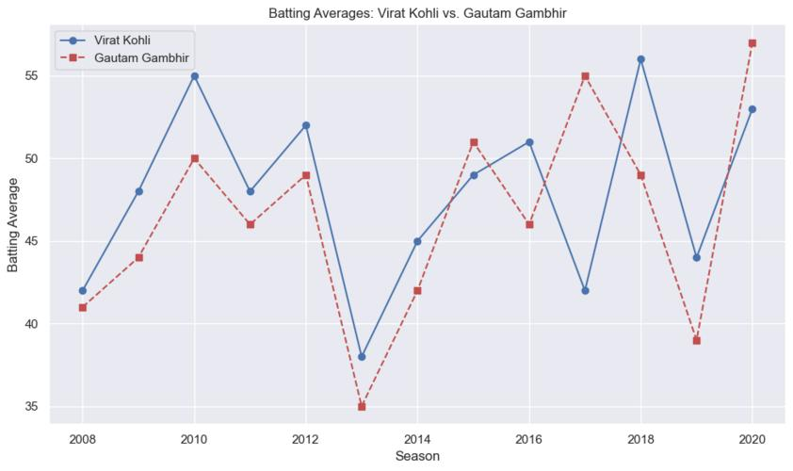

[68]: seasons = [ 2008, 2009, 2010, 2011, 2012, 2013, 2014, 2015, 2016, 2017, 2018,␣
↪
2019, 2020]
kohli_averages = [42, 48, 55, 48, 52, 38, 45, 49, 51, 42, 56, 44, 53]
gambhir_averages = [41, 44, 50, 46, 49, 35, 42, 51, 46, 55, 49, 39, 57]
data = {'Seasons': seasons,'kohli Avg': kohli_averages,'Gambhir Avg':␣
↪
gambhir_averages}
df = pd.DataFrame(data)
print(df)
[46]: import matplotlib.pyplot as plt
import numpy as np
seasons = [2008, 2009, 2010, 2011, 2012, 2013,␣
↪
2014,2015,2016,2017,2018,2019,2020]
kohli_averages = [42, 48, 55, 48, 52, 38, 45, 49, 51, 42, 56, 44, 53]
gambhir_averages = [41, 44, 50, 46, 49, 35, 42, 51, 46, 55, 49, 39, 57]
bar_width = 0.35
x = np.arange(len(seasons))
plt.bar(x - bar_width/2, kohli_averages, bar_width, label='Virat Kohli',␣
↪
color='r', edgecolor='black')
20

Slide 21

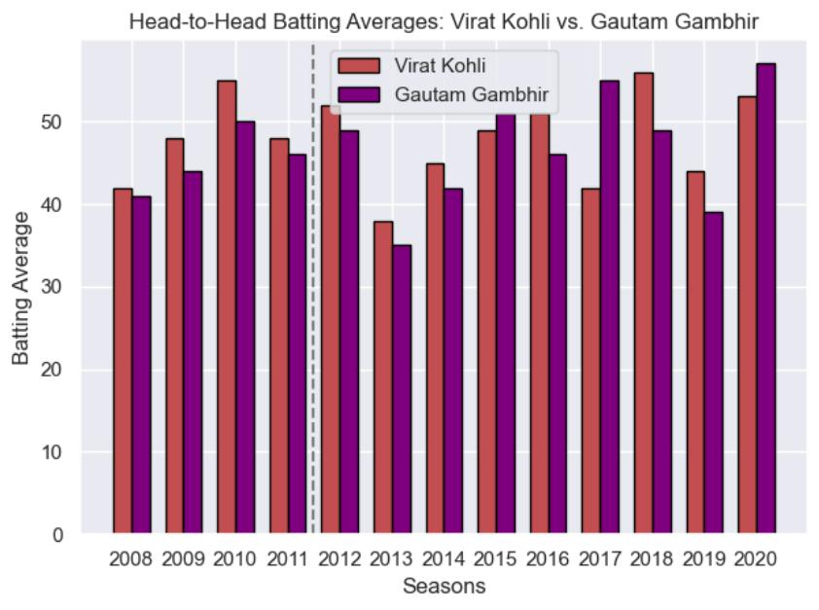
plt.bar(x + bar_width/2, gambhir_averages, bar_width, label='Gautam Gambhir',␣
↪
color='purple', edgecolor='black')
plt.xlabel('Seasons')
plt.ylabel('Batting Average')
plt.title('Head-to-Head Batting Averages: Virat Kohli vs. Gautam Gambhir')
plt.xticks(x, seasons)
plt.legend()
plt.axvline(x=3.5, color='gray', linestyle='--', linewidth=1.5)
plt.tight_layout()
plt.show()
[ ]:
[ ]:
21

Slide 22

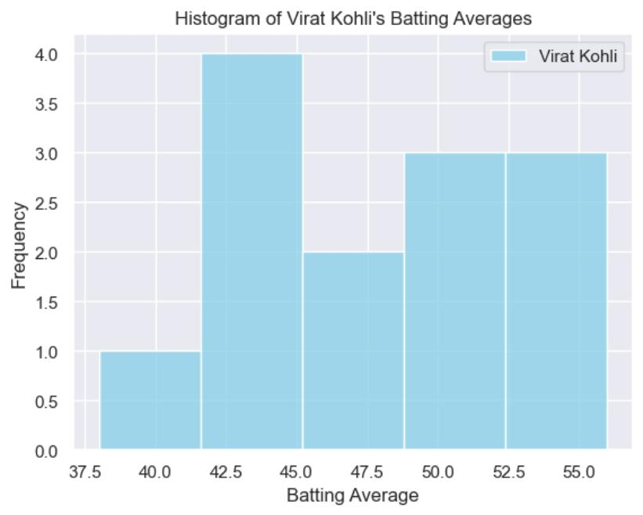

[47]: seasons = [2008, 2009, 2010, 2011, 2012, 2013, 2014, 2015, 2016, 2017, 2018,␣
↪
2019, 2020]
kohli_averages = [42, 48, 55, 48, 52, 38, 45, 49, 51, 42, 56, 44, 53]
gambhir_averages = [41, 44, 50, 46, 49, 35, 42, 51, 46, 55, 49, 39, 57]
# Create a histogram for Virat Kohli's batting averages
sns.histplot(kohli_averages, kde=False, color='skyblue', label='Virat Kohli')
plt.xlabel('Batting Average')
plt.ylabel('Frequency')
plt.title('Histogram of Virat Kohli\'s Batting Averages')
plt.legend()
plt.show()
[48]: sns.histplot(gambhir_averages, kde=False, color='skyblue', label='Gautam␣
↪
Gambhir')
plt.xlabel('Batting Average')
plt.ylabel('Frequency')
plt.title('Histogram of Gautam Gambhir \'s Batting Averages')
plt.legend()
22

Slide 23
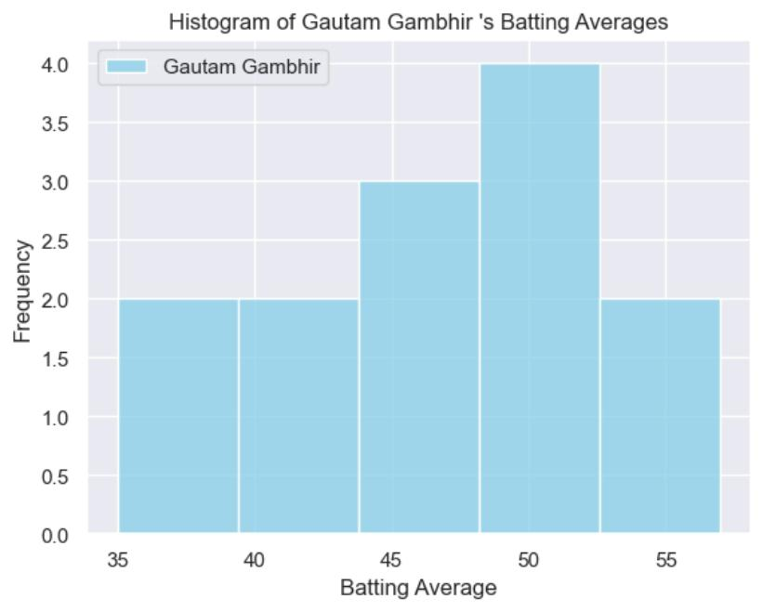
plt.show()
[49]: sns.kdeplot(kohli_averages, color='salmon', fill=True, label='Virat Kohli')
plt.xlabel('Batting Average')
plt.ylabel('Density')
plt.title('Density Plot of Virat kohli\'s Batting Averages')
plt.legend()
plt.show()
23

Slide 24
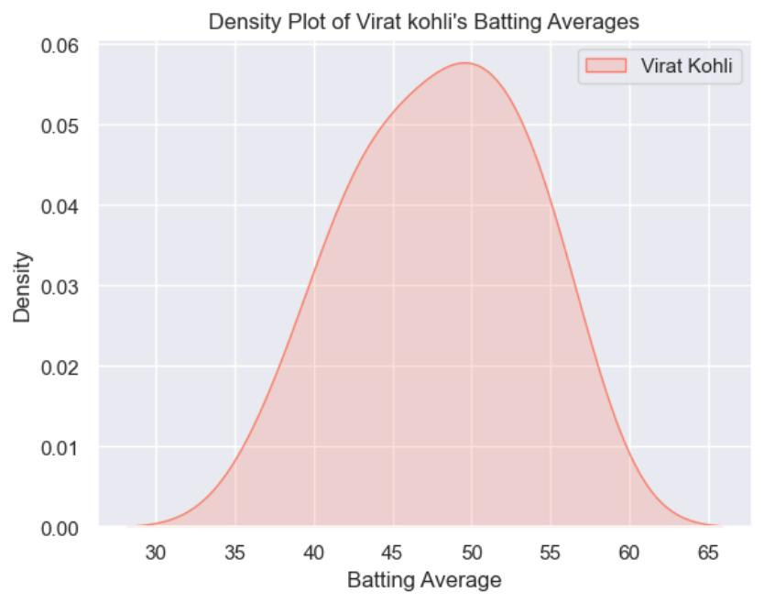

[50]: # Create a density plot (Kernel Density Estimate) for Gautam Gambhir's batting␣
↪
averages
sns.kdeplot(gambhir_averages, color='salmon', fill=True, label='Gautam Gambhir')
plt.xlabel('Batting Average')
plt.ylabel('Density')
plt.title('Density Plot of Gautam Gambhir\'s Batting Averages')
plt.legend()
plt.show()
24

Slide 25
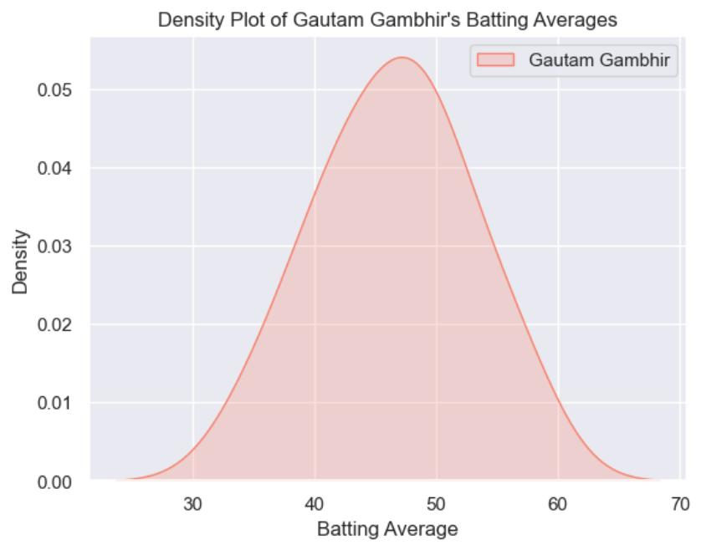
[ ]:
[ ]:
[ ]:
[ ]:
[ ]:
[ ]:
[51]: team_a_wins = match_data['team1']
[52]: team_b_wins = match_data['team2']
match_data.columns
[53]: match_data['winner'].unique()
25

Slide 26

[53]: array(['Kolkata Knight Riders', 'Chennai Super Kings', 'Delhi Daredevils',
'Royal Challengers Bangalore', 'Rajasthan Royals',
'Kings XI Punjab', 'Deccan Chargers', 'Mumbai Indians',
'Pune Warriors', 'Kochi Tuskers Kerala', nan,
'Sunrisers Hyderabad', 'Rising Pune Supergiants', 'Gujarat Lions',
'Rising Pune Supergiant', 'Delhi Capitals'], dtype=object)
[54]: match_data['winner'].value_counts()
[54]: winner
Mumbai Indians
120
106
99
91
88
81
67
66
29
19
13
12
10
6
Chennai Super Kings
Kolkata Knight Riders
Royal Challengers Bangalore
Kings XI Punjab
Rajasthan Royals
Delhi Daredevils
Sunrisers Hyderabad
Deccan Chargers
Delhi Capitals
Gujarat Lions
Pune Warriors
Rising Pune Supergiant
Kochi Tuskers Kerala
Rising Pune Supergiants
Name: count, dtype: int64
5
[55]: import pandas as pd
import matplotlib.pyplot as plt
filtered_data = match_data[['winner']].dropna()
team_wins = filtered_data['winner'].value_counts()
plt.figure(figsize=(10, 6))
plt.bar(team_wins.index, team_wins.values,
color='skyblue', edgecolor='black')
plt.xlabel('Teams')
plt.ylabel('Number of Wins')
plt.title('IPL Team Wins')
plt.xticks(rotation=45, ha='right')
for i, count in enumerate(team_wins.values):
26

Slide 27

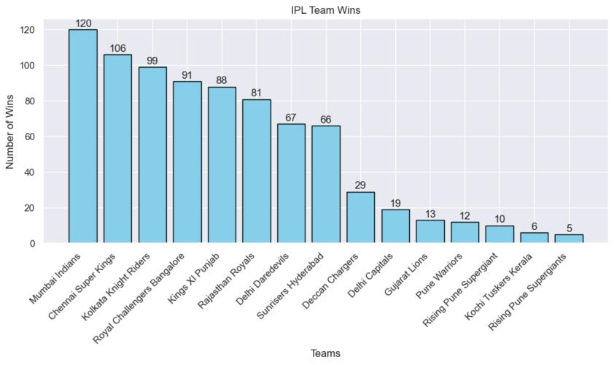

plt.text(i, count + 0.5, str(count), ha='center',
va='bottom')
plt.tight_layout()
plt.show()
[56]: import matplotlib.pyplot as plt
team_wins = {
'Chennai Super Kings': 5,
'Mumbai Indians': 5,
'Kolkata Knight Riders': 3,
'Rajasthan Royals': 1,
'Deccan Chargers': 1,
'Sunrisers Hyderabad': 1,
'Gujarat Titans': 1
}
# Define custom colors for each team
team_colors = {
'Chennai Super Kings': 'yellow',
'Mumbai Indians': 'blue',
'Kolkata Knight Riders': 'purple',
'Rajasthan Royals': 'pink',
'Deccan Chargers': 'grey',
27

Slide 28

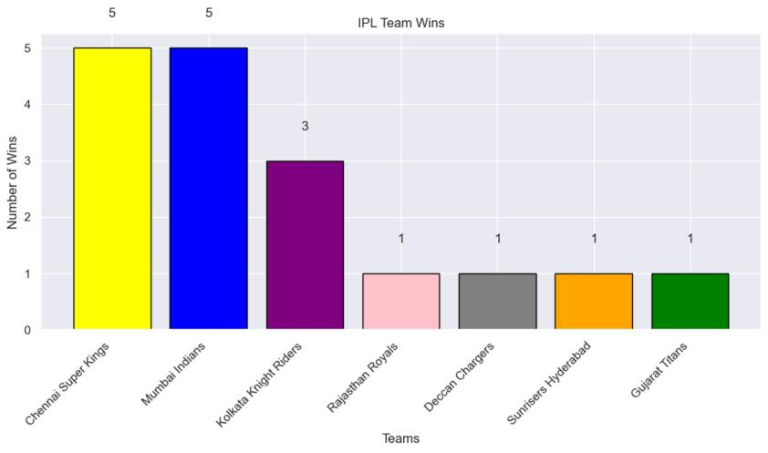
'Sunrisers Hyderabad': 'orange',
'Gujarat Titans': 'green'
}
# Create a bar plot with custom colors
plt.figure(figsize=(10, 6))
plt.bar(team_wins.keys(), team_wins.values(), color=[team_colors[team] for team␣
↪
in team_wins.keys()], edgecolor='black')
plt.xlabel('Teams')
plt.ylabel('Number of Wins')
plt.title('IPL Team Wins')
plt.xticks(rotation=45, ha='right')
# Annotate the bars with win counts
for team, wins in team_wins.items():
plt.text(team, wins + 0.5, str(wins), ha='center', va='bottom')
plt.tight_layout()
plt.show()
[57]: match_data.columns
[57]: Index(['id', 'city', 'date', 'player_of_match', 'venue', 'neutral_venue',
'team1', 'team2', 'toss_winner', 'toss_decision', 'winner', 'result',
'result_margin', 'eliminator', 'method', 'umpire1', 'umpire2'],
28

Slide 29



dtype='object')
[58]: match_data['Season'] = pd.to_datetime(match_data['date']).dt.year ## extract␣
↪
season from "date" feature
[59]: match_data.columns
[59]: Index(['id', 'city', 'date', 'player_of_match', 'venue', 'neutral_venue',
'team1', 'team2', 'toss_winner', 'toss_decision', 'winner', 'result',
'result_margin', 'eliminator', 'method', 'umpire1', 'umpire2',
'Season'],
dtype='object')
[60]: match_data[['team1','team2']]
[60]:
0
team1
Royal Challengers Bangalore
Kings XI Punjab
team2
Kolkata Knight Riders
Chennai Super Kings
Rajasthan Royals
1
2
Delhi Daredevils
3
Mumbai Indians Royal Challengers Bangalore
4
Kolkata Knight Riders
Deccan Chargers
…
Mumbai Indians
Delhi Capitals
Sunrisers Hyderabad
Sunrisers Hyderabad
Mumbai Indians
..
…
811 Royal Challengers Bangalore
812
Mumbai Indians
813 Royal Challengers Bangalore
814
815
Delhi Capitals
Delhi Capitals
[816 rows x 2 columns]
[61]: winners_team ={}
for year in sorted(match_data['Season'].unique()):
current_yr_df = match_data[match_data['Season']==year]
winners_team[year] = current_yr_df['winner'].tail(1).values[0]
[62]: winners_team
[62]: {2008: 'Rajasthan Royals',
2009: 'Deccan Chargers',
2010: 'Chennai Super Kings',
2011: 'Chennai Super Kings',
2012: 'Kolkata Knight Riders',
2013: 'Mumbai Indians',
2014: 'Kolkata Knight Riders',
2015: 'Mumbai Indians',
2016: 'Sunrisers Hyderabad',
29

Slide 30


2017: 'Mumbai Indians',
2018: 'Chennai Super Kings',
2019: 'Mumbai Indians',
2020: 'Mumbai Indians'}
[ ]:
[63]: existing_winners =
{
2008: 'Rajasthan Royals',
2009: 'Deccan Chargers',
2010: 'Chennai Super Kings',
2011: 'Chennai Super Kings',
2012: 'Kolkata Knight Riders',
2013: 'Mumbai Indians',
2014: 'Kolkata Knight Riders',
2015: 'Mumbai Indians',
2016: 'Sunrisers Hyderabad',
2017: 'Mumbai Indians',
2018: 'Chennai Super Kings',
2019: 'Mumbai Indians',
2020: 'Mumbai Indians'}
additional_winners = {
2021: 'Chennai Super Kings',
2022: 'Gujarat Titans',
2023: 'Chennai Super Kings',
2024: 'Kolkata Knight Riders'}
all_winners = {**existing_winners,**additional_winners}
for season in sorted(all_winners.keys()):
winner = all_winners[season]
print(f"season{season}: Winner - {winner}")
season2008: Winner - Rajasthan Royals
season2009: Winner - Deccan Chargers
season2010: Winner - Chennai Super Kings
season2011: Winner - Chennai Super Kings
season2012: Winner - Kolkata Knight Riders
season2013: Winner - Mumbai Indians
season2014: Winner - Kolkata Knight Riders
season2015: Winner - Mumbai Indians
season2016: Winner - Sunrisers Hyderabad
season2017: Winner - Mumbai Indians
season2018: Winner - Chennai Super Kings
season2019: Winner - Mumbai Indians
season2020: Winner - Mumbai Indians
30

Slide 31

season2021: Winner - Chennai Super Kings
season2022: Winner - Gujarat Titans
season2023: Winner - Chennai Super Kings
season2024: Winner - Kolkata Knight Riders
[64]: from collections import Counter
[65]: Counter(all_winners.values())
[65]: Counter({'Chennai Super Kings': 5,
'Mumbai Indians': 5,
'Kolkata Knight Riders': 3,
'Rajasthan Royals': 1,
'Deccan Chargers': 1,
'Sunrisers Hyderabad': 1,
'Gujarat Titans': 1})
[66]: import matplotlib.pyplot as plt
# Data (replace with your actual team wins)
team_wins = {
'Chennai Super Kings': 5,
'Mumbai Indians': 5,
'Kolkata Knight Riders': 3,
'Rajasthan Royals': 1,
'Deccan Chargers': 1,
'Sunrisers Hyderabad': 1,
'Gujarat Titans': 1
}
# Create a bar plot
plt.figure(figsize=(10, 6))
plt.bar(team_wins.keys(), team_wins.values(), color='g', edgecolor='black')
plt.xlabel('Teams')
plt.ylabel('Number of Wins')
plt.title('IPL Team Wins')
plt.xticks(rotation=45, ha='right')
# Annotate the bars with win counts
for team, wins in team_wins.items():
plt.text(team, wins + 0.5, str(wins), ha='center', va='bottom')
plt.tight_layout()
plt.show()
31

Slide 32
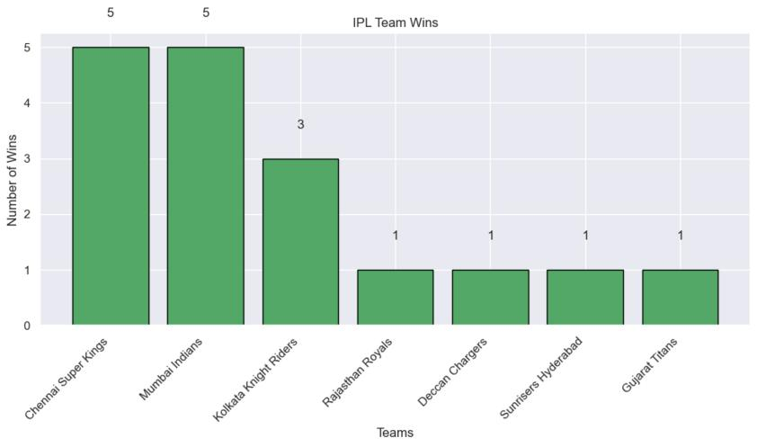
32

