Slide 1
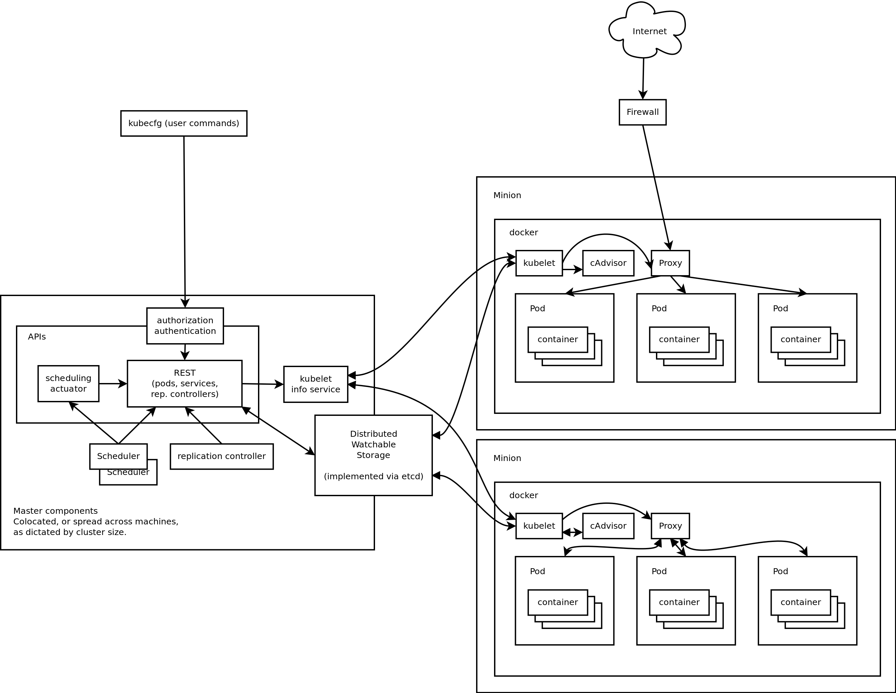
Kubernetes Architecture

Slide 2

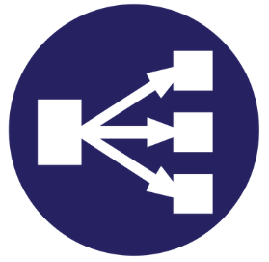



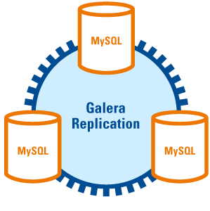
User
Requests
Web Server
K8S Service Loadbalancing
Web Server
Predis
Consistent Hashing
Web Server
Web App Architecture

Slide 3
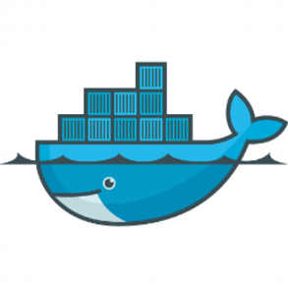

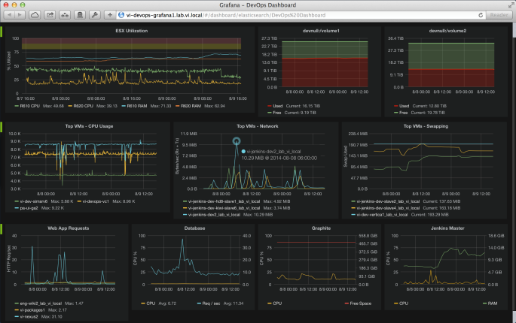

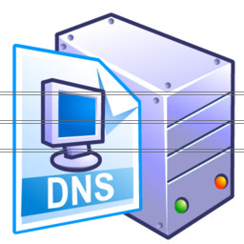
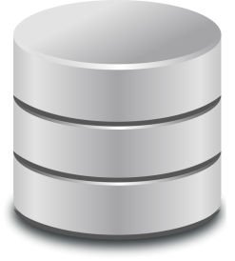

Pods
Pull
metrics
Pods
Pods
Heapster
Grafana
Register hostnames
Store
time-series metrics
Data
visualization
Lookup hostnames
Monitoring Architecture

