Slide 1

MDA 3003 INTRODUCTION TO DATA SCIENCE Semester 1 2022/2023

Slide 2
Lab 3
1. Using Numpy
vectors
matrices
dataset: population
2. Similarities and Dissimilarities Measures

Slide 3
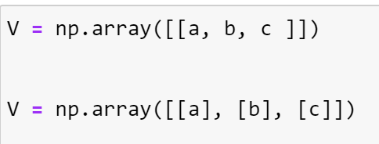

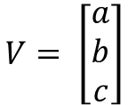

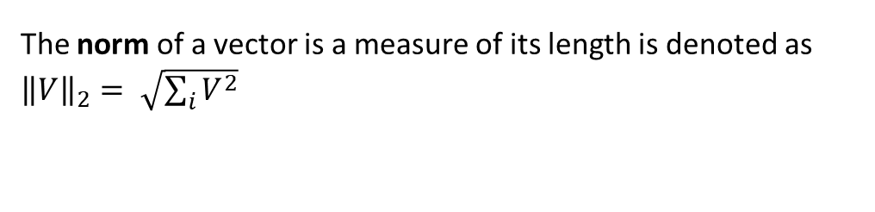

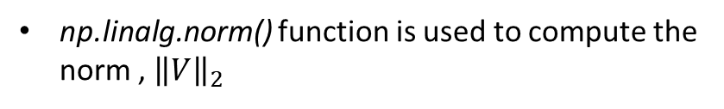


Vectors
The norm of a vector is a measure of its length is denoted as ${\left\|V\right\|}_{2}= \sqrt{\sum_{i}{V^{2}}}$
Type of Vectors
np.linalg.norm() function is used to compute the norm , ${\left\|V\right\|}_{2}$
Row vector
How to execute in python
$$V= \left[\begin{matrix}a & b & c\end{matrix}\right]$$
To determine the angle between 2 vectors
Column vector
${v.w = \left\|v\right\|}_{2}$ ${\left\|w\right\|}_{2}\cos{θ}$
$$V= \left[\begin{matrix}a \\ b \\ c\end{matrix}\right]$$
$\cos{θ}$ = $\frac{v.w}{{\left\|v\right\|}_{2} {\left\|w\right\|}_{2}}$
$$θ= \cos^{−1}\left(\frac{v.w}{{\left\|v\right\|}_{2} {\left\|w\right\|}_{2}}\right)$$
np.dot($v,w$)
.T or transpose() function is used to transpose a vector or matrix. Where it changes the row elements into column elements and the column elements into row elements
np.arccos ()
np.linalg.norm($v$)*np.linalg.norm($w$)
$$∴$$
theta = np.arccos(np.dot($v$, $w$)/(np.linalg.norm($v$)*np.linalg.norm($w$)))

Slide 4
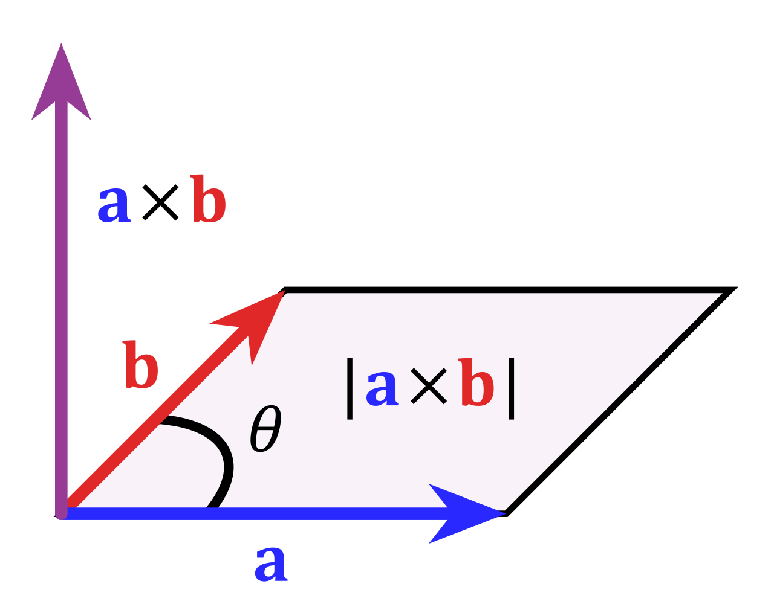

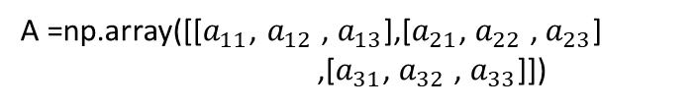
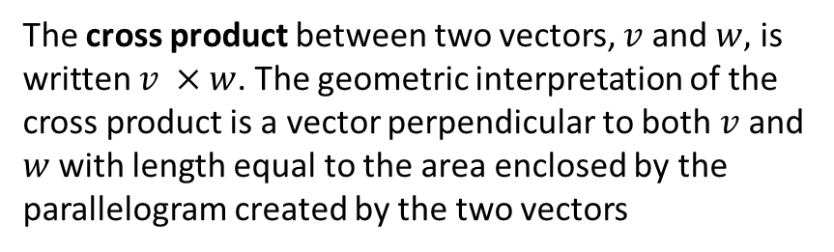




Matrix
The cross product between two vectors, $v$ and $w,$ is written $v ×w$. The geometric interpretation of the cross product is a vector perpendicular to both $v$ and $w$with length equal to the area enclosed by the parallelogram created by the two vectors
$A= \left[\begin{matrix}a_{11} & a_{12} & a_{13} \\ a_{21} & a_{22} & a_{23} \\ a_{31} & a_{32} & a_{33}\end{matrix}\right]$
A =np.array([[$a_{11}$, $a_{12}$ , $a_{13}$],[$a_{21}$, $a_{22}$ , $a_{23}$]
,[$a_{31}$, $a_{32}$ , $a_{33}$]])
$$v ×w$$
The following function is used to find
row x column : matrix.shape
Number of elements : matrix.size
Bytes : matrix.nbytes
Dimension : matrix.ndim
of the matrix
$$w$$
$|v ×w$|
$$v$$
Let $v= \left[\begin{matrix}v_{1} & v_{2} & v_{3}\end{matrix}\right] and w= \left[\begin{matrix}w_{1} & w_{2} & w_{3}\end{matrix}\right]$
Then ,
$v ×w=\left(v_{3}w_{2}−v_{2}w_{3}\right)i −\left(v_{3}w_{1}−v_{1}w_{3}\right)j+\left(v_{2}w_{1}−v_{1}w_{2}\right)k$
Let the array has a dimension of [r x c].
matrix [r] : prints row at r index
matrix[ : , c] : prints column at c index
np.cross(v, w) is used to find the $v ×w$

Slide 5
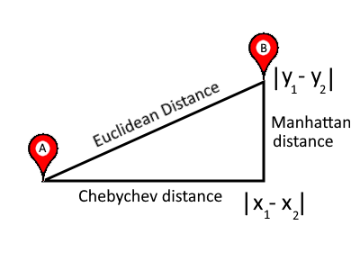
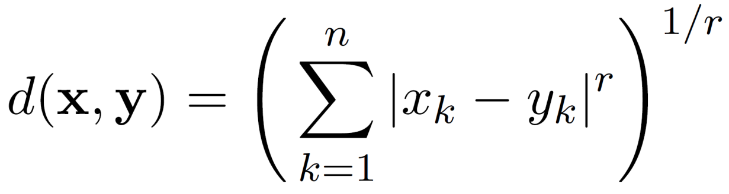
Dissimilarity Measures
Minkowski Distance is a generalization of Euclidean Distance
Where r is a parameter, n is the number of dimensions (attributes) and x_{k} and y_{k} are, respectively, the k^{th} attributes (components) or data objects x and y. x =(x₁, …, x_{n}) and y =(y₁, …, y_{n})
To compute the distance from scipy.spatial import distance library is used
Manhattan
r =1: L₂
distance.minkowski(x, y,r)
r =1: L₁
Manhattan
Euclidean
distance.euclidean(x, y)
distance.pdist(samples, metric= *)
*'cityblock’ ;
'euclidean’ ;
‘chebyshev’
distance.cityblock(x, y)
for binary vectors is the Hamming distance distance.hamming(x, y)
r =1: L∞
Supremum
distance.chebyshev(x, y)

Slide 6
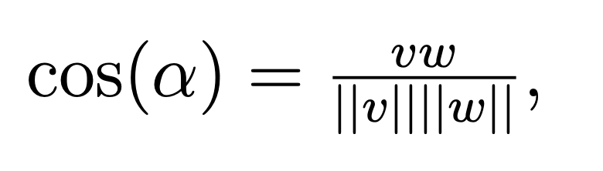
Similarity Measures
Cosine
Jaccard Coefficients
distance.cosine(v,w)
Jaccard- Needham Coefficients
distance.jaccard()
distance.pdist(samples, metric= *) *’Cosine’

Slide 7
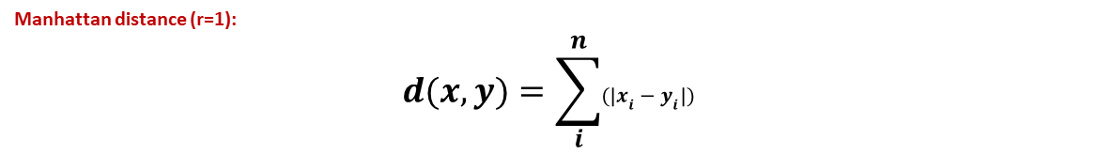
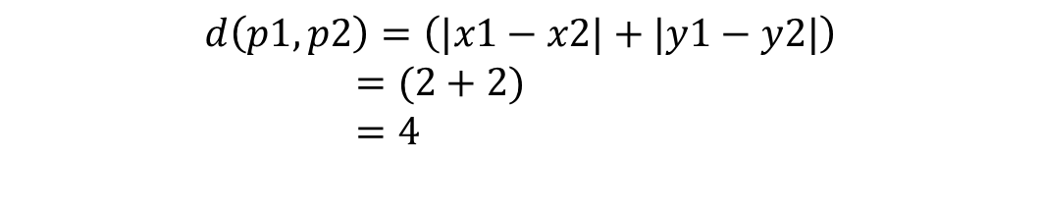
Source: Tan, Steinbach, Karpatne & Kumar., Intro to Data Mining (2021)
Visualization of distance matrix (Manhattan)
Minkowski distance:
Manhattan distance (r=1):
$$d(x,y)=\sum_{i}^{n}{(|x_{i}−y_{i}|)}$$
Manhattan_distance= distance.pdist(samples, metric= ‘cityblock’)
Manhattan Distance matrix:
This function is used to calculate the distance between each data point. And a vector will be resulted
eg
$$d\left(p1,p2\right)=\left(|x1−x2|+|y1−y2|\right)$$ $=(2+2)$ $=4$
Transformation to distance matrix
distance.squareform(Eucledian_distance))

Slide 8
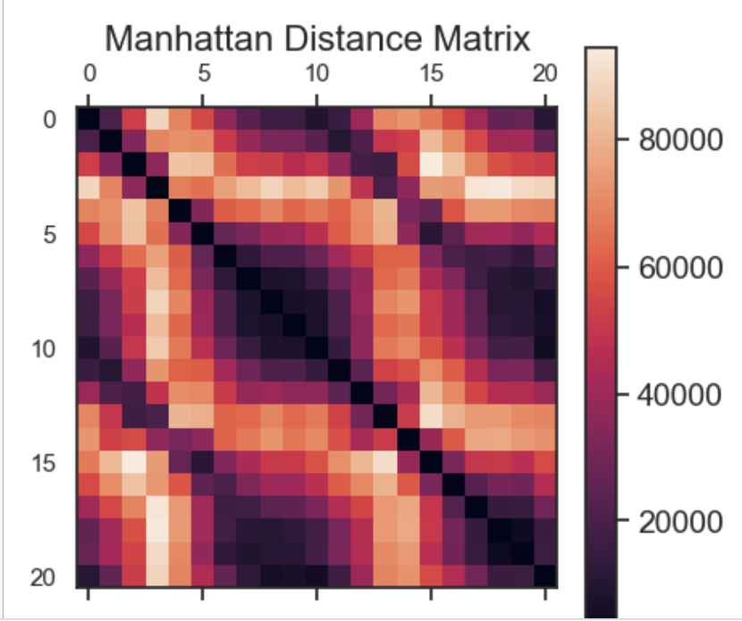
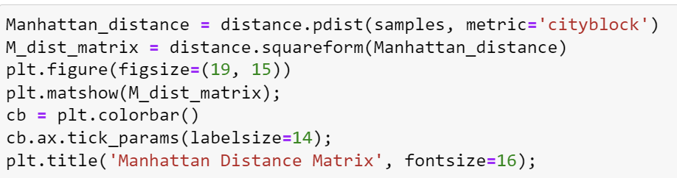
Visualization of distance matrix (Manhattan)
Calculate the distance measure using the function distance.pdist(samples, metric=*)
Transform the calculated distance to distance matrix = distance.squareform()
Visualize the matrix
matshow(array) : Display an array as a matrix in a new figure window
plt.colourbar() : Colorbars are a visualization of the mapping from scalar values to colors

Slide 9
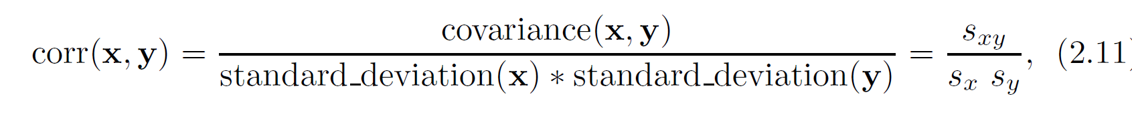
Correlation measures the linear relationship between objects
Pearson’s correlation:
distance.correlation () : function used to find the correlation between 2 vectors
corr() : function used to find the correlation among the columns in the Dataframe using the ‘Pearson’ method.

Slide 10
Seaborn library
Seaborn is a library for making statistical graphics in Python. It builds on top of matplotlib and integrates closely with pandas data structures.
Seaborn helps you explore and understand your data. Its plotting functions operate on dataframes and arrays containing whole datasets and internally perform the necessary semantic mapping and statistical aggregation to produce informative plots. Its dataset-oriented, declarative API lets you focus on what the different elements of your plots mean, rather than on the details of how to draw them.
heatmap = sns.heatmap(df.corr(), annot=True, cmap="Blues", fmt='.1g’)
annot=True (If True, write the data value in each cell. If an array-like with the same shape as data, then use this to annotate the heatmap instead of the data. Note that DataFrames will match on position, not index.)
cmap=“Blues” (matplotlib colormap name or object, or list of colors, optional. In this case Blues is used)
fmt='.1g’ (String formatting code to use when adding annotations. ‘.1g refers to 1 significant figure)
Source: https://seaborn.pydata.org/tutorial/introduction.html
https://seaborn.pydata.org/generated/seaborn.heatmap.html

