Slide 1

MDA 3003 INTRODUCTION TO DATA SCIENCE Semester 1 2022/2023

Slide 2
Lab 2
1. Data retrival
Using Pandas
Use Scikit-Learn data
Download data from internet
Use given data
2. Data Cleaning
Missing value identification
Handling Missing Values
Data Saving: save your data as CSV
3. Data exploration
Simple plot
Descriptive statistics

Slide 3
Data Retrieval
How to load data : Use function datasets.NameofTheDataInSklearn()
*Make sure that it is Bunch data type if not it be able to read the loaded data a dictionary
https://scikit-learn.org/stable/modules/classes.html#module-sklearn.datasets more info is in here
How to access the keys of the dictionary : use keys() function
To access the values of each key() then call the name each key
How to convert the ndarray to DataFrame : pd.DataFrame(data, column = columnName)

Slide 4
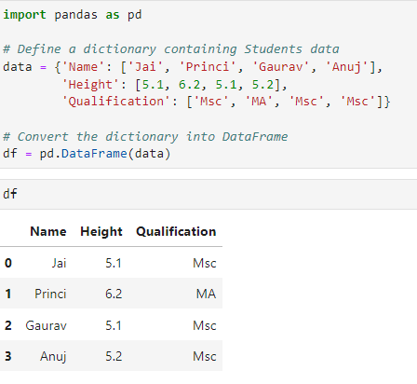
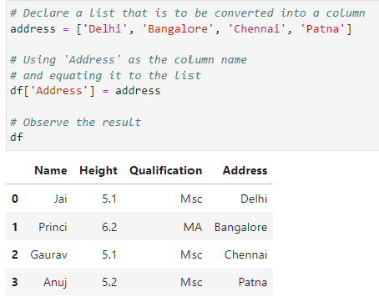
How to add a column to existing data frame
The following coding shows how to add another column with the index name Address
Here there is 3 columns when the index is named as Name; Height and Qualification
Note: if you want to access the second column then use df[“Height”]
Source: https://www.geeksforgeeks.org/adding-new-column-to-existing-dataframe-in-pandas/

Slide 5
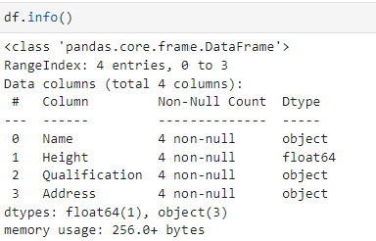
To get information of the data use info() function
From the table it can be deduced that
there is no redundant data
Data type of elements in column 1, 3 and 4 is an object (string)
Data type of the element in column 2 is a number (float)
To get statistics of the data use describe() function
Note that each column in data frame is a series.

Slide 6
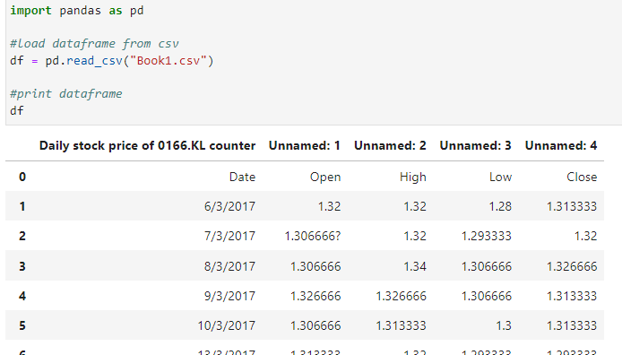
How to manually load a csv data
Note make sure that your file is in csv format. If it is not then convert it to csv format
df.read_csv() : is the function used to read a csv file
*Book1.csv is the file name

Slide 7
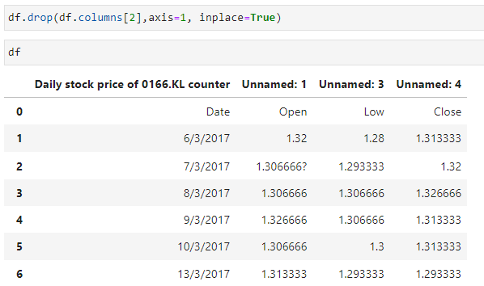
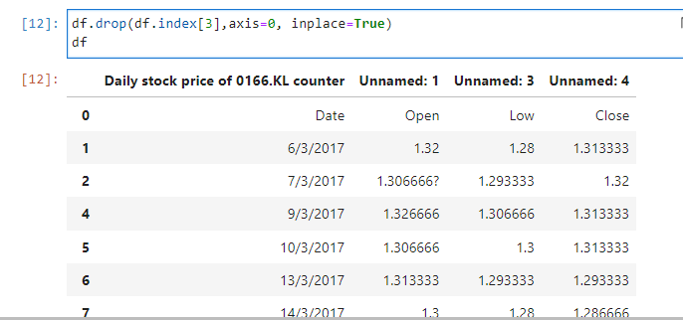
How to drop the columns and row
df.drop() : is the function used to remove/drop the column or row
The following shows how to drop the third column
The following shows how to drop the fourth row

Slide 8
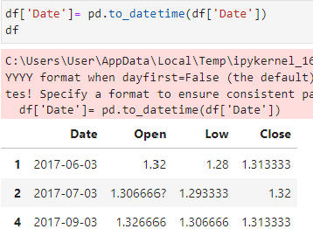
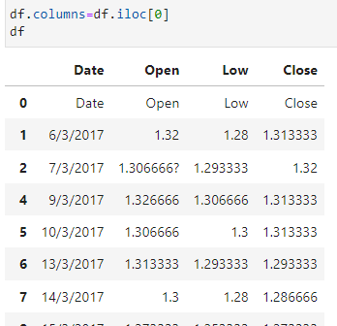
The following shows how to change the features name by replicating the values in first row
The following shows how to change the format of data
df.iloc() : is the function used select a specific row or column from the data set

Slide 9


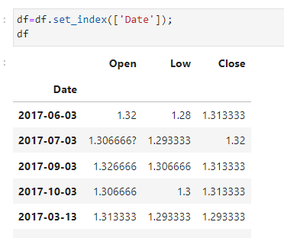
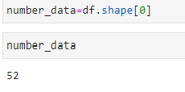
How to set and reset the index of data frame
Function is used to reset index to default
Function is used to set index by the user
The following shows how the Date column is changed to a row index
The following shows how the number of instances in first column is obtained from first column

Slide 10
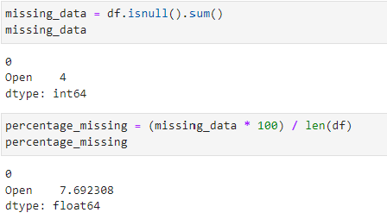
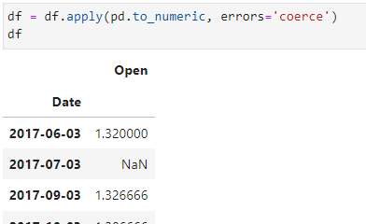
df.apply() : is the function used to iterate through column\row
pd.to_numeric :is the function used to convert the redundant data to numeric data
The following shows how to find the number of missing data and its percentage
The following shows how to convert the noisy data in open column to numeric data type
**The last two columns has been dropped
errors : parameter
If set as
‘raise’ : invalid parsing will raise an exception
‘coerce’ : invalid parsing will set as NaN
‘ignore’ : invalid parsing will return as the input
*parsing can be referred as component

Slide 11
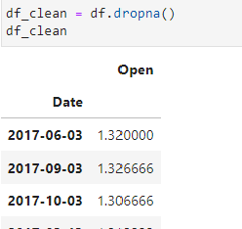
df.dropna() : is the function used drop the rows with NaN
The following show how to drop the NaN and get a clean data

Slide 12
Summary on how to prepare and clean the data
1) Load data
2) Reset the index of the data frame to default setting
3) Assign the names of the attributes/feature/column names
4) Drop unnecessary columns and rows
5) convert the date format
6) Replace the noise or undefined values to NaN (It is done by converting the observations to number data type)
7) To obtain a clean data remove all the NaN

Slide 13
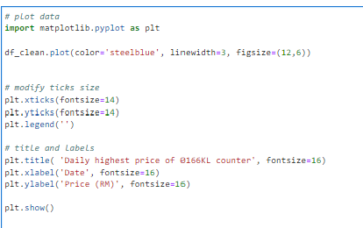
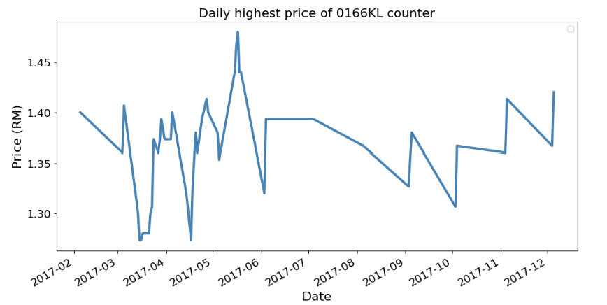
How to plot graph
import matplotlib.pyplot as plt (This function is used to import the module)
For more notes on matplotlib.pyplot refer to
https://matplotlib.org/stable/tutorials/introductory/pyplot.html
https://scipy-lectures.org/intro/matplotlib/index.html

