Slide 1




Home Credit Default Risk
Group 31
Abhay Bharat Rajde
abrajde@iu.edu
Harshit Shiroiya
hshiroiy@iu.edu
Satin Jain
satjain@iu.edu
Govind Babhulgaonkar
gobabh@iu.edu

Slide 2
Project Description
Home credit Uses Data and several methods to predict the repayment abilities of the client.
With the help of \machine learning and statistical methods We are determining the predictions.
in this phase our target is to study HCDR data and perform Exploratory Data Analysis(EDA).
We also aim at preprocessing the data and also build the baseline pipeline after examining the accuracies of explored Data.

Slide 3


Exploratory Data Analysis
We were able to describe the key characteristics of the data set using statistical graphics and other data visualization approaches with the help of exploratory data analysis. We explored the following on the dataset:
The Data types and General Statistics of data.
Number of Missing values (percentage of the missing values.)
Numerical and Categorical Data.
Number of zeros in the columns in the data (Percentage of 0’s).
We also visualized the missing data for each dataset
If some numerical data column can be treated as categorical data?
Correlation of the numerical data with the “Target column”.

Slide 4
Visual Exploratory Data Analysis Visual Exploratory data Analysis performed on Categorical values to understand their significance in data
1. What is the gender breakdown of loan distribution?
2. What is the client's marital status?
3. What percentage of the clients own a car?
4. Type of Education the client have?
5. What are the types of housing does the clients own?
6. What of type of contract is loan the most?

Slide 5
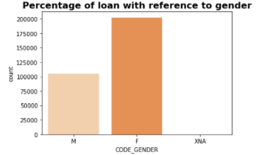
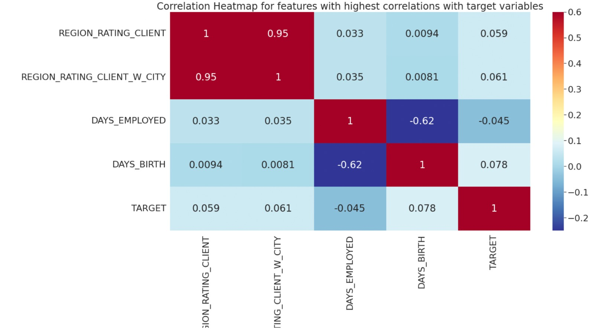
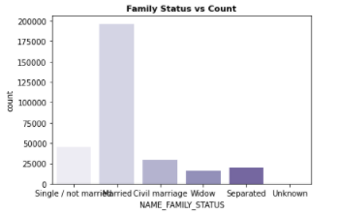
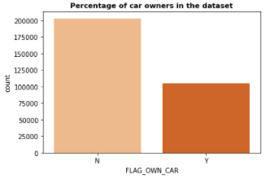
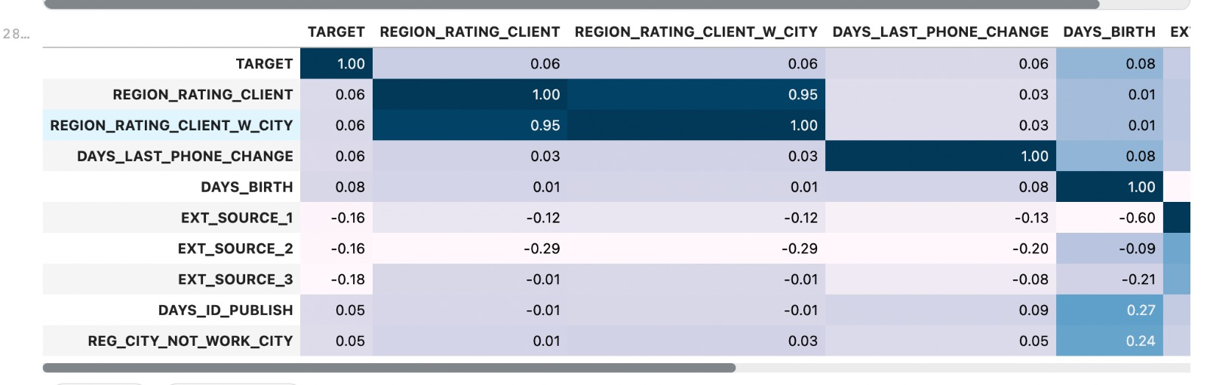
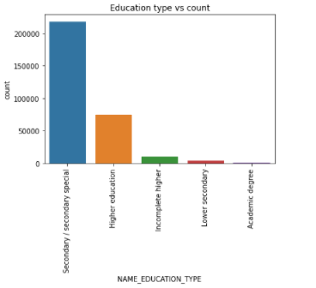
Some Examples

Slide 6
Baseline Pipeline
A collection of final columns is gathered after considering the thresholds for eliminating non-significant columns.
The imputer pipelines were built to deal with numerical and categorical data individually.
We built a data pipeline that handles numerical and categorical data.
We establish a baseline pipeline that normalizes the data and feeds it to Model once the data has been rectified.

Slide 7
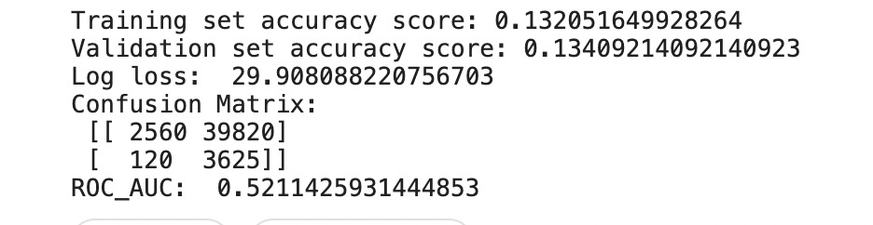
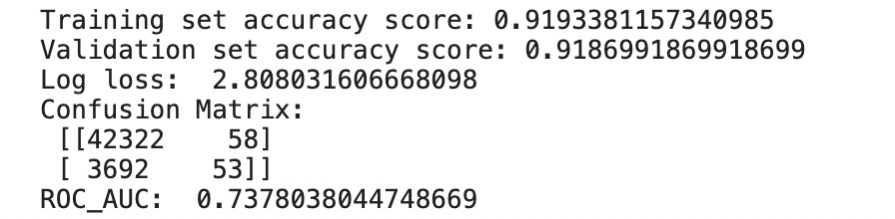
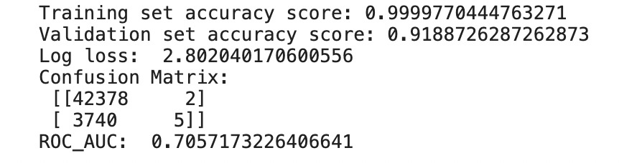
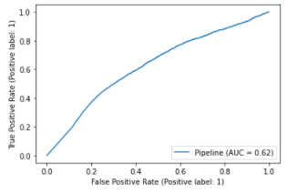
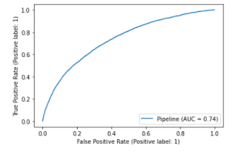
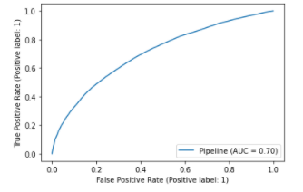
Types of Modeling Pipelines And Comparison
Naïve Bayes
Logistic Regression
Random Forest Classifier

Slide 8
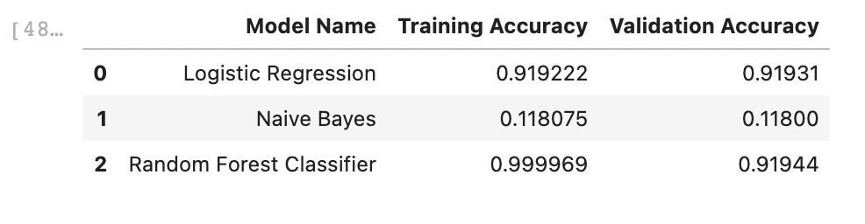
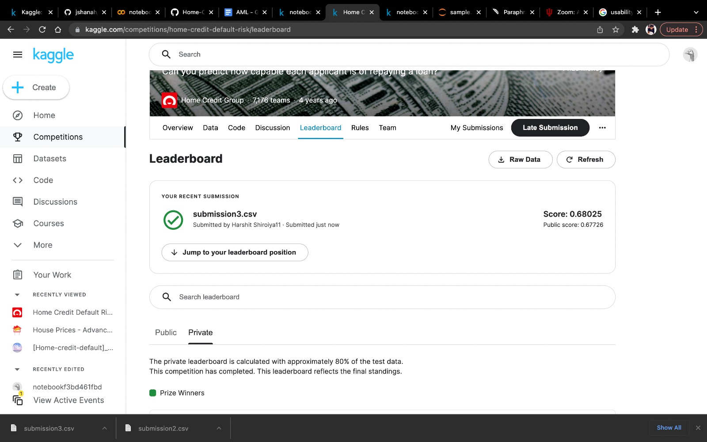

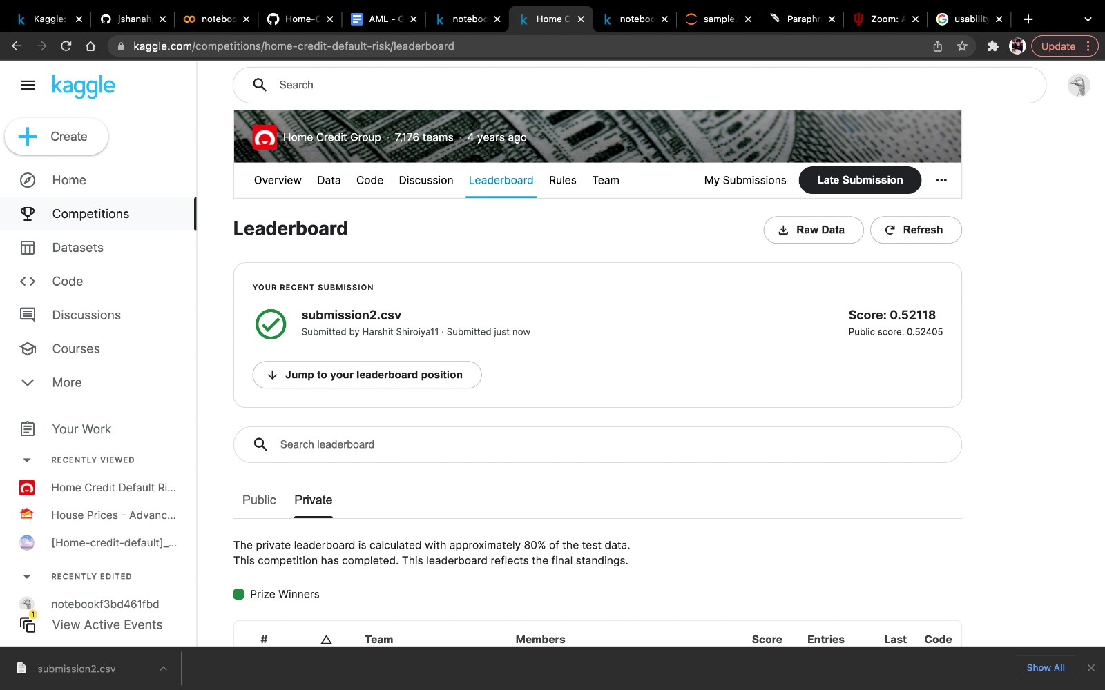
Accuracy in 3 Models

Slide 9
Conclusion and Next Steps
In this phase we cleaned the data and selected just the characteristics that were relevant to the target variable and prediction.
We featured the data performing OHE and applied imputing methods to fix the data before feeding it to the model.
We were able to create the baseline pipeline and could experimentally understand the accuracies of the models like logistic regression, naive bayes and Random forest. Based on the results of the models we saw that there might be underfitting in naive bayes and overfitting in RandomForest.
The best model that we could get for Phase 0 was Logistic Regression which gave a training accuracy of 91.9% and the Kaggle submission accuracy of 73.4%
Further we are planning to improvise the feature engineering, perform hyperparameter tuning for our models alongside using K-Fold cross validation and GridSearchCV, we might also use some advanced gradient boosting models so that we could get as close to the best accuracy as we can.
After the aforementioned step we also plan to apply Deep Learning techniques like developing Artificial Neural Networks for better prediction results.

