Slide 1
Searchest!
CSYE7200 Final Project
Team 1
Presented by
Wenbo Sun
Jianan Wen
Zixuan Xu

Slide 2

AGENDA
Let’s start!
WELCOME
OVERVIEW
TIMELINE
USE CASES
DATA SCOPE
ACCEPTANCE CRITERIA

Slide 3
OUR IDEA
A google search engine-based applications, to achieve a faster and more accurate search.
After entering keyword, using SCALA to process 200 websites address with page content crawling. Classify, analysis these contents and describe our outcomes with five generated topics .

Slide 4
TIMELINE
23th Nov
Connect to Google search engine and return 200 websites.
24th Nov --- Nov30th
Identify websites
Analyze the content
Filtering useless and non-relevant information(URL)
Using Akka

Slide 5
1st Dec---5th Dec
Achieve visualization(UI), using Play framework.
6th Dec--- 10th Dec
Filtering useless and relevant key word(TEXT), improving user experience
11th Dec--- 13th Dec
Debug and Test

Slide 6
Use Cases
A lot of duplicate information
Irrelevant search results
Wanted search results distributed in multiple website
It takes time to classify and select
The second milestone among our project aim to solve this problem. Using scala, akka.
Filtering useless and relevant key word(TEXT), improving user experience

Slide 7
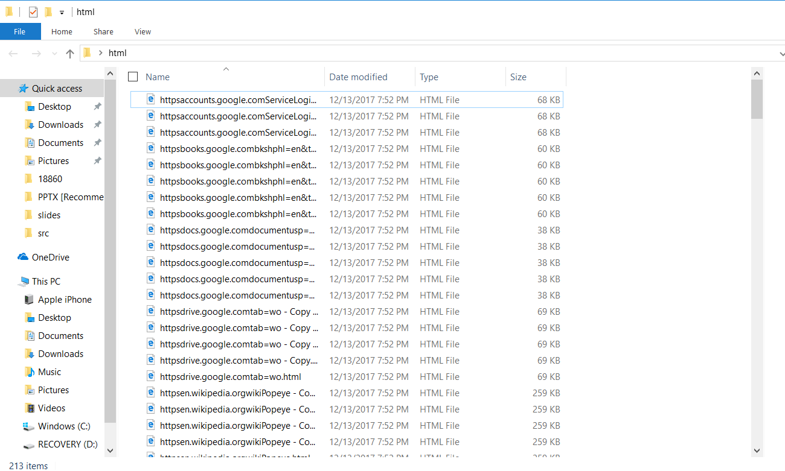
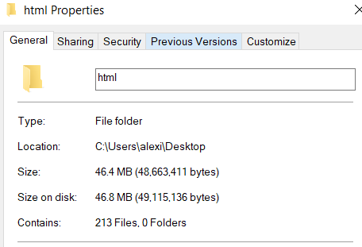
Data Scope
Processing with 213 items, approximately 46 MB data per patch.

Slide 8
ARCHITECTURE
Input key word
Web Crawler
Play Framework
Filter
Result Website
5 Topic
AKKA
HTML FILES
Machine Learning Processor
PRE-PROCESSOR
TXT
Using python for Topic Modeling (Sklearn’s Decomposition and Feature extraction)

Slide 9
Acceptance Criteria 1
After 50 times search test(50 times/per test), 60% of results without duplication and irrelevant.
Set four test cases with the only results, search accuracy will be at least 50%.

Slide 10
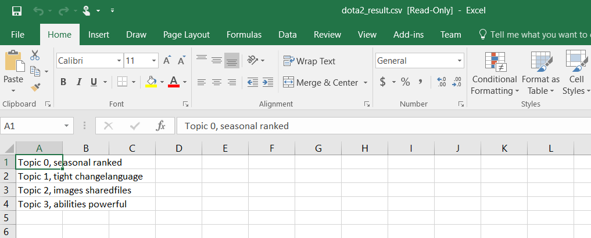
Acceptance Criteria 2
Search: dota2

Slide 11
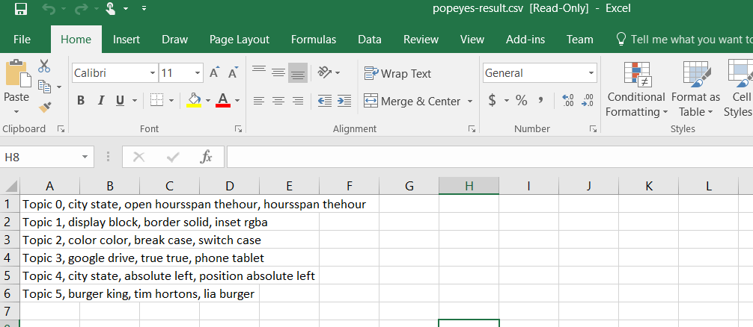
Acceptance Criteria 2
Search: popeyes

Slide 12
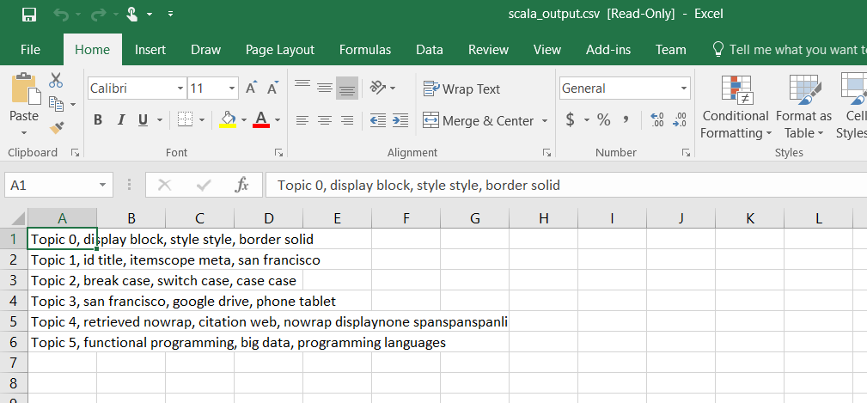
Acceptance Criteria 2
Search: scala

Slide 13
Thank you!
See You Next Time

